Slide 1
About OMICS Group
OMICS Group International is an amalgamation of Open Access publications and worldwide international science conferences and events. Established in the year 2007 with the sole aim of making the information on Sciences and technology ‘Open Access’, OMICS Group publishes 400 online open access scholarly journals in all aspects of Science, Engineering, Management and Technology journals. OMICS Group has been instrumental in taking the knowledge on Science & technology to the doorsteps of ordinary men and women. Research Scholars, Students, Libraries, Educational Institutions, Research centers and the industry are main stakeholders that benefitted greatly from this knowledge dissemination. OMICS Group also organizes 300 International conferences annually across the globe, where knowledge transfer takes place through debates, round table discussions, poster presentations, workshops, symposia and exhibitions.

Slide 2
About OMICS Group Conferences
OMICS Group International is a pioneer and leading science event organizer, which publishes around 400 open access journals and conducts over 300 Medical, Clinical, Engineering, Life Sciences, Phrama scientific conferences all over the globe annually with the support of more than 1000 scientific associations and 30,000 editorial board members and 3.5 million followers to its credit.
OMICS Group has organized 500 conferences, workshops and national symposiums across the major cities including San Francisco, Las Vegas, San Antonio, Omaha, Orlando, Raleigh, Santa Clara, Chicago, Philadelphia, Baltimore, United Kingdom, Valencia, Dubai, Beijing, Hyderabad, Bengaluru and Mumbai.

Slide 3

Design, synthesis and antidiabetic, cardiomyopathy studies of cinnamic acid-amino acid hybrid analogs
By
Dr.S.Samanta
email: samanta_bitmesra@yahoo.co.in
Department of Pharmaceutical Sciences,
Birla Institute of Technology Mesra,Ranchi-835215, India
Med Chem and CADD2013
October 15-17,2013,Las-Vegas,USA

Slide 4

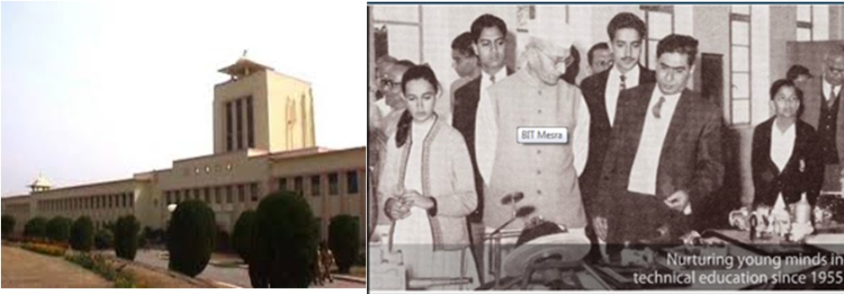
Birla Institute of Technology Mesra, Ranchi…..
Established in 1955 by visionary-industrialist Mr. B.M. Birla, it is today one of the most premier engineering destinations in India.
Main Campus Size - 780 acres
BIT, Mesra is a "Deemed University" under Sec. 3 of the U.G.C. Act 1956.
BIT,Mesra has currently 9 departments with other Research Centers offering various undergraduate and postgraduate courses like B.Tech, B.Pharm,B.Arch., M.Tech.M.Pharm, MBA, M.Sc., , etc. along with research programs leading to MS and PhD.

Slide 5
PRESENTATION OVERVIEW
INTRODUCTION
  DIABETES
  DIABETIC CARDIOMYOPATHY
  CAUSE, COMPLICATION AND MECHANISM
  TREATEMENT
NEED FOR PRESENT INVESTIGATION
OBJECTIVES
EXPERIMENTAL WORK
RESULT AND DISCUSSION
SUMMARY AND CONCLUSION
FUTURE SCOPE OF THE WORK
REFRENCES
APPENDIX

Slide 6
INTRODUCTION
DIABETES¹
DIABETES MELLITUS (DM) is a metabolic disorder characterized by hyperglycemia(fasting plasma glucose level >7.0 mmol l⁻¹ or 126mg dl⁻¹ ) or plasma glucose >10 mmol/lit or 180mg dl ⁻¹ , two hours after a meal) resulting from defects in insulin secretion, insulin action or both. Associated complications include Myocardial infarction, cardiomyopathy, retinopathy, neuropathy, and nephropathy.
It is estimated that there are currently 285 million people with diabetes worldwide and this number is set to increase to 438 million by the year 2030.
The advent of Biotechnology and Molecular biology has made the role of peptides and amino acids more significant to influence virtually all body functions.
TYPES OF DIABETES MELLITUS
Type 1 Diabetes - Diabetes arises when the beta cells in the pancreas fail to produce enough of the hormone insulin.
Type 2 Diabetes - when the body cannot effectively use the insulin produced.

Slide 7
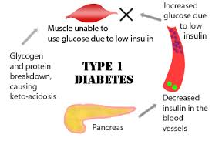
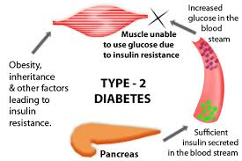
Types of Diabetes
Type 1 Diabetes
Type 2 Diabetes
Ref: http://www.articlesofhealthcare.com/80/types-of-diabetes-mellitus-1-2-gestational

Slide 8
Prevalence of Diabetic Complications
49%
43%
40%
35%
Proportion with complications
Ref: Decision Resourses,Inc.1999 , Accessed on 7th Aug 2013

Slide 9
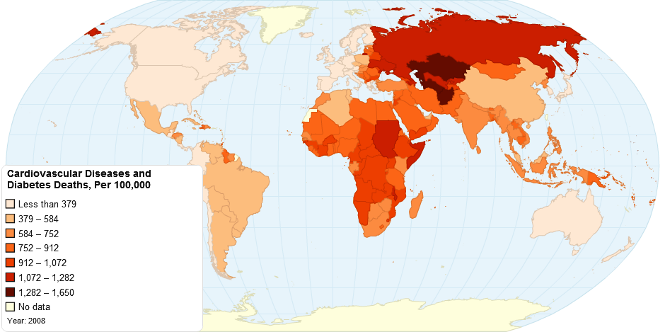
DIABETIC CARDIOMYOPATHY
Diabetic cardiomyopathy refers to a disease process which affects the myocardium in diabetic patients causing a wide range of structural abnormalities eventually leading to LVH [left ventricular (LV) hypertrophy] and diastolic and systolic dysfunction or a combination of these.²
Studies also show that diabetic patients have a signiﬁcantly increased lifetime risk of developing HF, and increased mortality from both Q-wave and non-Q-wave MI (myocardial infarction)
Ref: http://www.intechopen.com/books/ischemic-heart-disease/introduction-to-ischemic-heart-disease , Accessed on 10th Aug 2013
World View of Cardiovascular Disease and Diabetes Deaths, pr 100,000

Slide 10
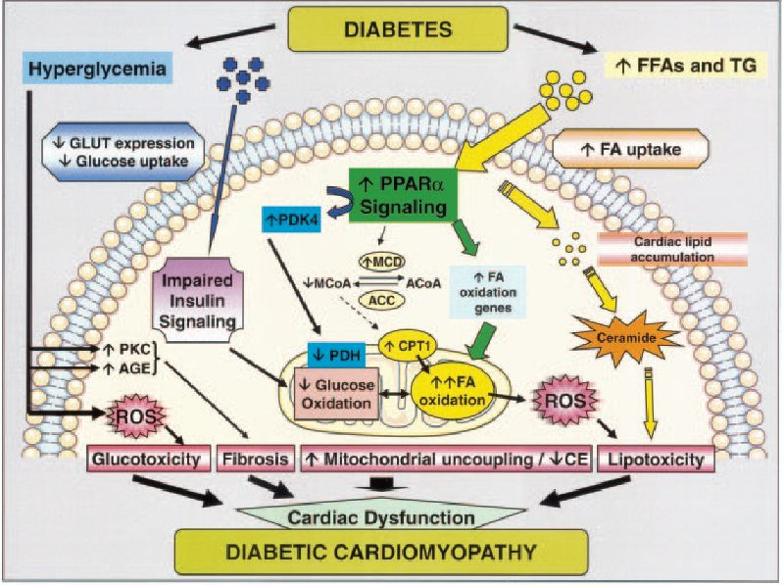
Co-relation between Diabetes and Diabetic Cardiomyopathy
Potential contributors to the development of diabetic cardiomyopathy.
Increased free FA (FFA) activates PPAR-α signaling, leading to the increased transcription of many genes involved in FA oxidation.
Increased FA oxidation leads to the generation of ROS at the level of the electron transport chain. ROS, which also can be generated by extramitochondrial mechanisms such as NADPH oxidase, plays a critical role in several pathways involved in the pathogenesis of diabetic cardiomyopathy, including lipotoxicity, cell death, and tissue damage, as well as mitochondrial uncoupling and reduced cardiac efficiency. TG indicates triglycerides; GLUTs, glucose transporters; PDK4, pyruvate dehydrogenase kinase 4; MCD, malonyl-coenzyme A decarboxylase; MCoA, malonyl-coenzyme A; ACoA, acetyl-coenzyme A; ACC, acetyl coenzyme A carboxylase; CPT1, carnitine palmitoyl-transferase 1; PDH, pyruvate dehydrogenase; CE, cardiac efficiency; PKC, protein kinase C; and AGE, glycation end products.
Ref:
http://www.intechopen.com/books/recent-advances-in-the-pathogenesis-prevention-and-management-of-type-2-diabetes-and-its-complications/diabetic-cardiomyopathy (Accessed on 10th Aug 2013)

Slide 11
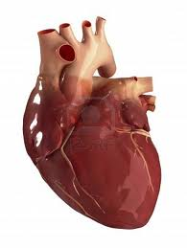
Stages of diabetic cardiomyopathy
MIDDLE STAGE--Slightly increased LV mass,
wall thickness, or size
EARLY STAGE -Normal LV size, wall
thickness, and mass
LATE STAGE--Significantly increased LV size, wall thickness, and
mass

Slide 12
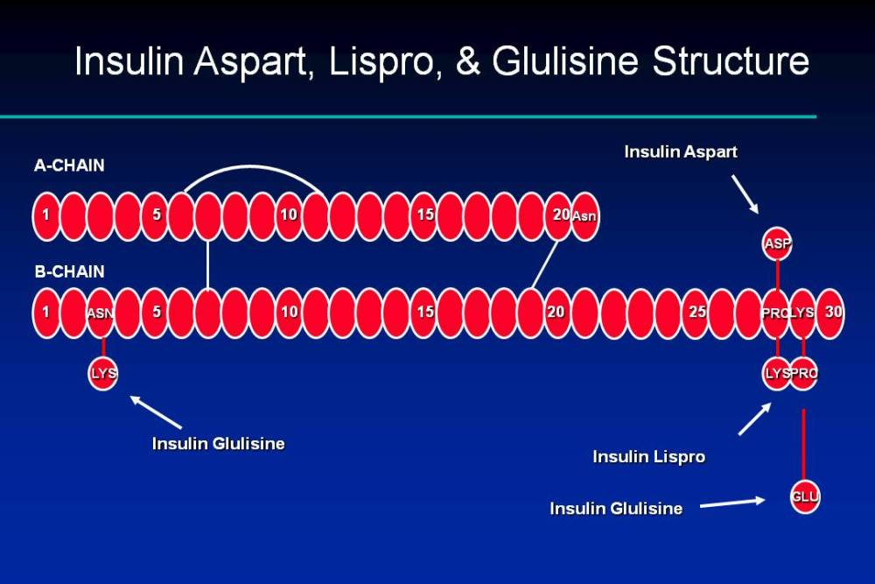
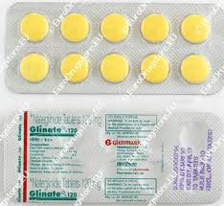
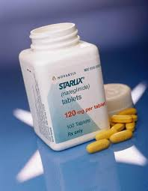
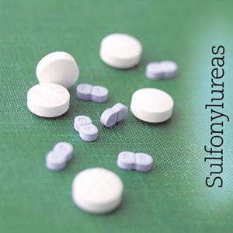
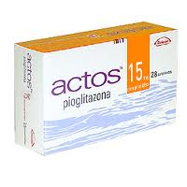
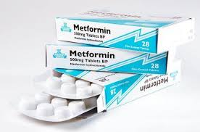
TREATEMENTS ^{3,4}
1.Insulin
2. Short acting Insulin Secretagogues
3.Sulfonylureas
4.Biguanides
5.Thiazolidinediones

Slide 13
NEED FOR PRESENT INVESTIGATION
The modern medicine available for the treatment of Diabetes is either the Insulin injection or other NIDDM based drugs which may produce side effects and inhibiting the proper functioning of many important vital organs.
Therefore there is a need for development of antidiabetic drug to have dual action on hyperglycemia and cardiomyopathy will be beneficial for cardiac function and other vital organs .
A literature survey on Cinnamic acid found that the drug has effect on metabolism as well as it shows the cardioprotective action.
OBJECTIVE OF THE WORK
The objective of the work is to Design and Synthesis Cinnamic acid analogs which will be useful in treatment of Diabetes along with the Diabetic Cardiomyopathy.
Design and validation of Cinnamic acid and its amino acid analogs on PPAR’s and AMPK using CADD software- Glide 5.0
To synthesize Cinnamic acid analogs by adding some Amino acid in Cinnamic acid and characterize by M.Pt, TLC, FT-IR, NMR and Mass spectral analysis.
Pharmacological screening of synthesized compound for Antidiabetic and Cardiomyopathy activity.

Slide 14
PLAN OF WORK
Designing
Designing of some Cinnamic acid based amino acid analogs
Docking of modeled analogs with the receptors(AMPK,PPAR-α,PPAR-γ AND PPAR-δ) by using software- Glide (version: 5.0)
Synthesis
Synthesis of selected Cinnamic acid analogs.
Characterization of the synthesized compounds i)Physicochemical characterization (M.P, R_{f} value ii)Spectral analysis (FT-IR, NMR and Mass).
Biological activity
Pharmacological screening
Antidiabetic activity. ( Alloxan induced Diabetic in Rats)
Diabetic Cardiomyopathy activity. ( Electrocardiogram using Biopac student Lab Pro)

Slide 15
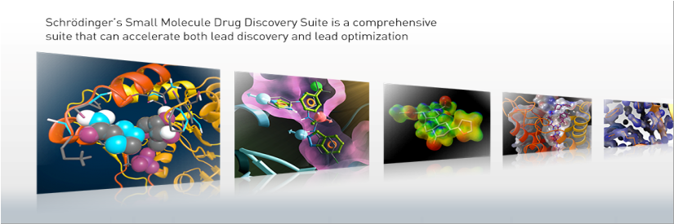
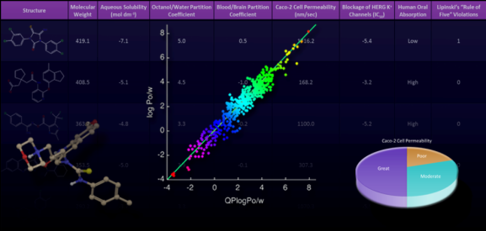
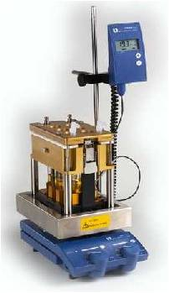
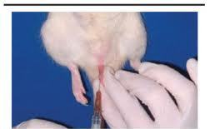
EXPERIMENTAL WORK
Docking Studies by using software Glide 5.0
ADME prediction using software Qikprop version 3.1
Synthesis using solution phase peptide synthesis
Animal Studies a)Antidadbetic Studies
b)DiabeticCardiomyopathic studies

Slide 16
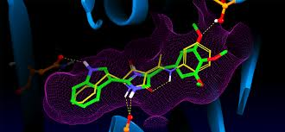
DOCKING STUDIES
GENERAL STEPS INVOVED IN DOCKING
RETRIEVAL OF AMPK 2Y94
AND PPARs RECEPTORS 3ET0, 3ET1, 3ET2 from www.rcsb.org/pdb)
PROTEIN PREPARATION WAS DONE USING THE PROTEIN PREPARATION WIZARD
LIGAND PREPARATIONS using ChemDraw Ultra 10.0 and energy minimization using OPLS 2500
RECEPTOR GRID GENERATION
-The atoms were scaled by Vander Waals radii of 1.0 Ǻ with the partial atomic charge less than 0.25 defaults \
-active site was defined as an enclosing box at the centroid of the workspace ligand as selected in the receptor folder
VALIDATION OF DOCKING PROTOCOL – All the 22 compounds were validated against Cinnamic acid
LIGAND-RECEPTOR DOCKING
All the energy minimised structures were docked with the energy minimised receptors

Slide 17
DOCKING SCORE OF CINNAMIC ACID ANALOGS
LIGAND CODES | Ligand Name | DOCKING SCORE (In AMPK) | PPAR γ ( 3ET0) | PPAR α (3ET1) | PPAR δ (3ET2)
SSPC0 (Cinnamic acid) | Cinnamic acid | -11.67 | -4.79 | -4.45 | -5.12
SSPC1 | Cinn-Ala | -12.40 | -6.35 | -6.128 | -7.23
SSPC2 | Cinn -val | -7.91 | -7.85 | -8.34 | -3.80
SSPC3 | Cinn -Leu | -7.91 | -5.60 | -7.78 | -6.44
SSPC4 | Cinn -Ile | -8.98 | -5.57 | -3.90 | -1.33
SSPC5 | Cinn -Phe | -12.89 | -8.47 | -6.64 | -7.35
SSPC6 | Cinn -Try | -10.13 | -7.83 | -8.25* | -6.44
SSPC7 | Cinn -Met | -10.04 | -6.87 | -8.69 | -7.49
SSPC8 | Cinn -Pro | -6.16 | -10.08 | -8.64 | -4.06
SSPC9 | Cinn -Asp | -11.62 | -6.56 | -3.88 | -6.86

Slide 18
Docking Scores continued…
LIGAND CODES | Ligand Name | DOCKING SCORE (In AMPK) | PPAR γ | PPAR α | PPAR δ
SSPC10 | Cinn -Glu | -11.63 | -6.60 | -4.12 | -1.93
SSPC11 | Cinn –Gly | -12.47 | -6.29 | -5.103 | -4.23
SSPC12 | Cinn -Ser | -10.19 | -6.85 | -7.09 | -6.52
SSPC13 | Cinn -Thr | -9.72 | -6.24 | -6.68 | -5.40
SSPC14 | Cinn -Cys | -8.66 | -8.39 | -7.20 | -7.03
SSPC15 | Cinn -Tyr | -12.37 | -7.09 | -9.97 | -6.53
SSPC16 | Cinn -Asn | -9.65 | -7.96 | -4.27 | -5.00
SSPC17 | Cinn -Gln | -8.04 | -7.05 | -4.43 | -8.30
SSPC18 | Cinn -Lys | -10.34 | -5.95 | -4.55 | -4.56
SSPC19 | Cinn -Arg | -11.10 | -4.77 | -3.90 | -2.94
SSPC20 | Cinn -His | -11.96 | -6.87 | -7.36 | -8.36

Slide 19
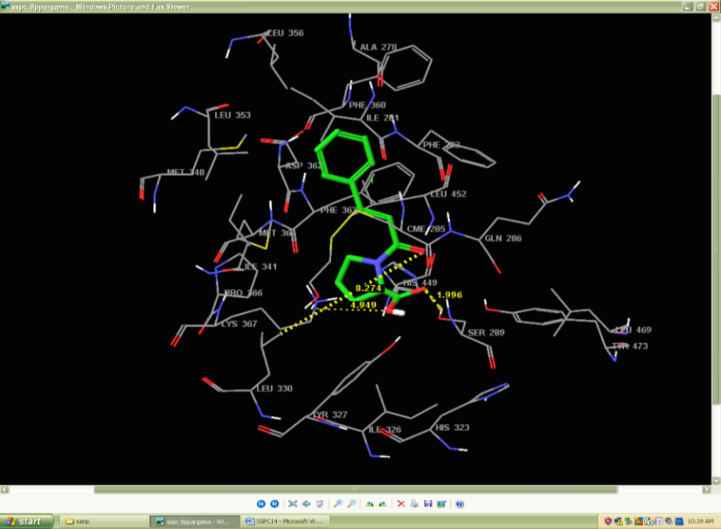
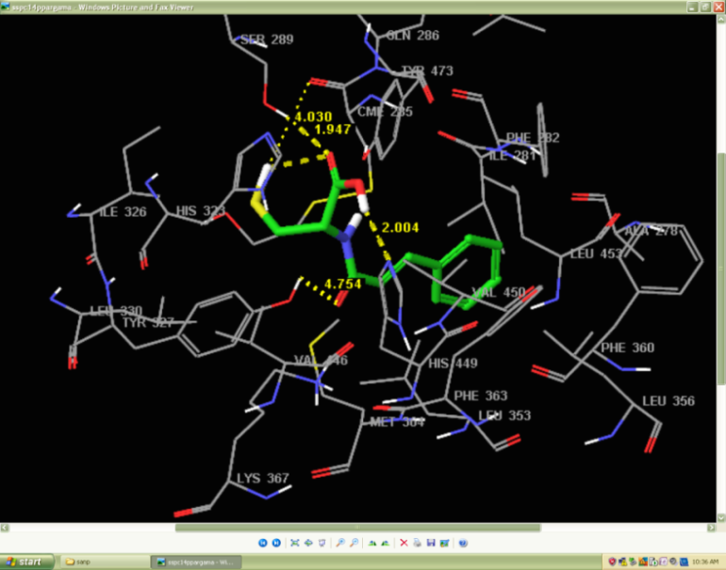
Docking poses
SSPC8 showing h-bonding with PPAR γ
SSPC14 showing h-bonding with PPAR γ
SSPC8 binding in the PPARγ showing important H-bonds with amino-acid residues with SER289,HIS449 and LEU330
SSPC14 binding in the PPARγ showing important H-bonds with amino-aciresidues with SER289,TYR327,HIS449,TYR473
Result: Among the 22 compounds docked using Glide5.0, SSPC5, SSPC8, SSPC11, SSPC14, SSPC15 show good docking score in AMPK (PDB Code:2Y94) and PPARs receptors (PDBCode:3ET0, 3ET1, 3ET2) . SSPC5, SSPC11, SSPC14, SSPC15, showed good docking score of - 12.89, -12.47, -8.66,-12.37 respectively on AMPK. While SSPC5, SSPC11,SSPC14 showed good docking scores of -8.47,-10.08,-8.39 respectively on PPAR γ.
SSPC14 showed moderately good scores with both AMPK and PPAR γ receptors.

Slide 20
2. PREDICTION OF ADME PROPERTIES
QikProp easy-to-use absorption, distribution, metabolism, and excretion (ADME) prediction program designed by Professor William L. Jorgensen
PREDICTED ADME PROPERTIES OF COMPOUNDS
Compound | Molecular weight | QPlogPo/w | QPlogS | Human oral absorption | %Oral absorption
SSPC0 | 148.1 | 1.936 | -0.411 | 2 | 33.39
SSPC1 | 219.2 | 2.063 | -1.429 | 2 | 30.83
SSPC2 | 247.2 | 2.839 | -0.576 | 2 | 33.66
SSPC3 | 277.2 | 3.192 | +0.261 | 1 | 26.03
SSPC4 | 261.3 | 3.198 | -0.280 | 1 | 16.79
SSPC5 | 295.3 | 3.742 | -0.099 | 1 | 22.79
SSPC6 | 311.3 | 4.065 | -0.039 | 2 | 24.21
SSPC7 | 279.3 | 3.214 | -1.536 | 2 | 26.06
SSPC8 | 245.2 | 2.460 | -1.095 | 2 | 35.05

Slide 21
Compound | Molecular weight | QPlogPo/w | QPlogS | Human oral absorption | %Oral absorption
SSPC9 | 263.2 | 1.754 | -1.708 | 2 | 24.95
SSPC10 | 277.2 | 1.912 | +0.299 | 1 | 17.48
SSPC11 | 205.2 | 1.807 | -0.962 | 2 | 30.88
SSPC12 | 235.2 | 1.621 | -1.574 | 2 | 25.66
SSPC13 | 248.2 | 2.083 | -1.520 | 1 | 20.39
SSPC14 | 251.1 | 2.885 | -1.587 | 1 | 54.32
SSPC15 | 311.1 | 2.989 | 0.712 | 2 | 57.52
SSPC16 | 262.2 | 0.299 | -0.292 | 2 | 67.10
SSPC17 | 276.2 | 0.540 | -0.449 | 2 | 56.98
SSPC18 | 276.3 | -0.183 | +0.791 | 2 | 50.05
SSPC19 | 304.3 | 1.477 | -0.428 | 2 | 61.06
SSPC20 | 285.3 | 2.137 | +1.304 | 2 | 44.90

Slide 22
SYNTHETIC STUDIES ^{23,24}
SCHEME FOR CINNAMIC ACID –AMINO ACID HYBRID ANALOUGES
Step1
Step2
Activation
Step 3
Coupling

Slide 23
Materials and methods: All reagents used for synthesis were of Aldrich, RanKem and CDH. All solvents were purified before Synthesis.
SSPC14
The CPE reagent(PCl₅ +C₂H₅OH anhydrous ) was added to Cysteine (1.21g, 0.01mol) and stirred to a clear solution. Then Cinnamic acid(1.48gm, 0.01 mol) was added to the mixture and stirred to a clear solution. To this mixture, triethylamine was added to maintain the pH 7 and the reaction temperature kept below 5ºC. This mixture was then left for 6 hrs. at 0ºC, the product was filtered out and washed with solvent ether and dried. Ethanol was used for recrystallization of final product.
Theoretical Yield : 2.65g
Practical yield : 2.12g
Percent yield : 80.00 %
Melting Point : 146⁰ C
Rf value : 0.73
All other compounds (SSPC5,SSPC8,SSPC11,SSPC15) were synthesized using different amino acids such as Phenylalanine, Proline, Glycine and Tyrosine as discussed above.

Slide 24
CHARACTERIZATION OF THE SYNTHESISED COMPOUNDS
Code | Mol. Wt | Structure | m.pt | Rf value (butanol:acetic acid: water =4:1:1)
SSPC0 | 148 |  | 133°C | 0.61
SSPC5 | 295 |  | 139°C | 0.65
SSPC8 | 245 |  | 129°C | 0.58
SSPC11 | 205 |  | 137°C | 0.41
SSPC14 | 251 |  | 146°C | 0.73
SSPC15 | 311 |  | 147°C | 0.59

Slide 25
CODE | IR Spectra * | NMR Spectra** | Mass Spectra***
SSPC8 | IR spectral data: 3412 cm⁻¹ (N-H str of amide) ,2966.02 cm⁻¹ (C-H str of alkane), 2671.50 cm⁻¹ (O-H str of –COOH), 1925.02 cm⁻¹ (C=O str of –COOH),1613.83 cm-¹ (C=O str of amide) 1475.59 cm-¹ (C-H def ), 1176.02 cm-¹ (C-N str) | ¹HNMR(300Hz,δppm,D2O),7.5(m, 6H) 4.23 (t, J= ,2H) 3.457(d, J =7.2 Hz,1H). | Mass Spectra: The m/.z. shows principal fragment ions at m/z 245 (M), 244(M - H), 229 (M - OH),
SSPC11 | IR spectral data: 3412 cm⁻¹ (N-H str of amide) ,2966.62 cm⁻¹ (C-H str of alkane), 2615.56 cm⁻¹ (O-H str of –COOH), 1925.02 cm⁻¹ (C=O str of –COOH),613.83 cm-¹ (C=O str of amide) | ¹HNMR(300Hz,δppm,D2O) 7.6(m,6H),4.247(s,1H,) 3.92(s,1H) | Mass Spectra: The m/.z. shows principal fragment ions at m/z 205 (M), 204(M - H), 188 (M - OH),
SSPC14 | IR spectral data: 3412 cm⁻¹ (N-H str of amide), 2970.48 cm⁻¹ (C-H str of alkane), 2673.43 cm⁻¹ (O-H str of –COOH), 1925.03 cm⁻¹ (C=O str of –COOH), 1637.02 cm-¹ (C=O str of amide) 1475.59 cm-¹ (C-H def ), 1176.02 cm-¹ (C-N str). | ¹H NMR(300Hz,δppm,D2O) 7.60(m,6H) , 6.46(d,1H), 2.997(d,J= 7.5 ,2H) | Mass Spectra: The m/.z. shows principal fragment ions at m/z 205(M-CH2SH),211(M-COOH)
SSPC15 | IR spectral data: 3450.77 cm⁻¹ (N-H str of amide) ,2966.62 cm⁻¹ (C-H str of alkane), 2675.36 cm⁻¹ (O-H str of –COOH), 1925.02 cm⁻¹ (C=O str of –COOH),1739.85 cm-¹ (C=O str of amide) 1475.59 cm-¹ (C-H def ), 1176.02 cm-¹ (C-N str) | ¹HNMR(300Hz,δppm,D2O)7.242(m,6H),6.937(d,J=6Hz,1H)6.910(d,J=12Hz,1H) | Mass Spectra: The m/.z shows principal fragment ions at m/z 325 (M), 324(M - H), 308(M - OH),

Slide 26
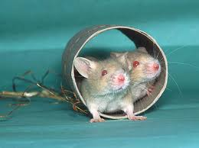
PHARMACOLOGICAL SCREENING
ANTIDIABETIC ACTIVITY ^{25,26}
CARDIOMYOPATHY ACTIVITY
1.ANTIDIABETIC ACTIVITY
The antidiabetic activity of the synthesized test drugs was carried out on Alloxan induced diabetic rats by measuring the decrease in blood glucose level.
ALLOXAN INDUCED DIABETES IN RATS:
Alloxan is used to induce diabetes in laboratory animals because it selectively kills the insulin-producing beta-cells found in the pancreas. This occurs most likely because of selective uptake of the compound due to its structural similarity to glucose as well as the beta-cell's highly efficient uptake mechanism (GLUT2).
MATERIALS AND METHODS:
Male albino rats of Wistar strain weighing about 145-240gm were used. Animals were maintained at 22±2 °C with 12 hr. light: 12 hr. dark cycle. Animals had free access to standard diet and water. Each experimental group was consisting of 4 animals each. Diabetes will be induced in groups III to X rats. Rats were being tested for sufficient levels of hyperglycemia two days after injection and 4 weeks post-injection.

Slide 27
PLASMA GLUCOSE ESTIMATION:
Glucose levels were estimated by commercially available glucose kits based on glucose oxidase method.
Group of animals treated with different test drug
Group | Treatment After Attainment Of Hyperglycemia
I | Received water
II | Received Standard glibenclamide 2mg /kg b.w. Orally.
III | Received Cinnamic acid (50 mg/kg b.w.) Orally.
IV | Received SSPC5 (50 mg/kg b.w.) Orally.
V | Received SSPC8 (50 mg/kg b.w.) Orally.
VI | Received SSPC11 (50 mg/kg b.w.) Orally.
VII | Received SSPC14 (50 mg/kg b.w.) Orally.
VIII | Received SSPC15 (50 mg/kg b.w.) Orally.

Slide 28
CARDIOMYOPATHY ACTIVITY
Electrode Implantation and Recording Procedure:
ELECTRODE IMPLANTATION METHOD
Male wistar rat was taken for all the experiment. All animal was operated in aseptic procedure in operating room. During the surgical process rat was anesthetized by using ketamine with Diazepam and ECG electrode was implanted subcutaneously in left arm (LA), right arm (RA) and left leg (LL). All three electrodes was connected throw a connector near the neck and fixed by dental cement. After the surgery suturing was done and antibiotic treatments were done over the wounded skin.
HOW IT IS CONNECTED WITH INSTRUMENT; RECORDING SETUP
The all the electrode was connected by a three pin connector which is attach through an amplifier. This amplifier transmit electrical signal to digital signal in a recording device which is a computer attached with a monitor.
TIME POINTS OF RECORDING
The ECG recording for normal control and diabetic control group was done in an interval of two hour for two days.
The ECG recording for treatment group was done contentiously six hours after drug treatment and then an interval of six hour up to the 54 hours

Slide 29
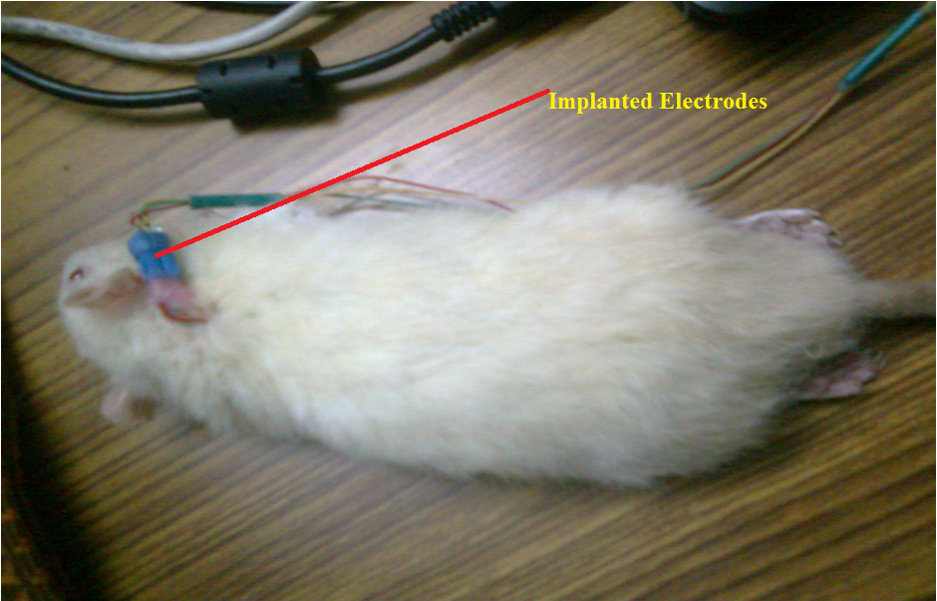
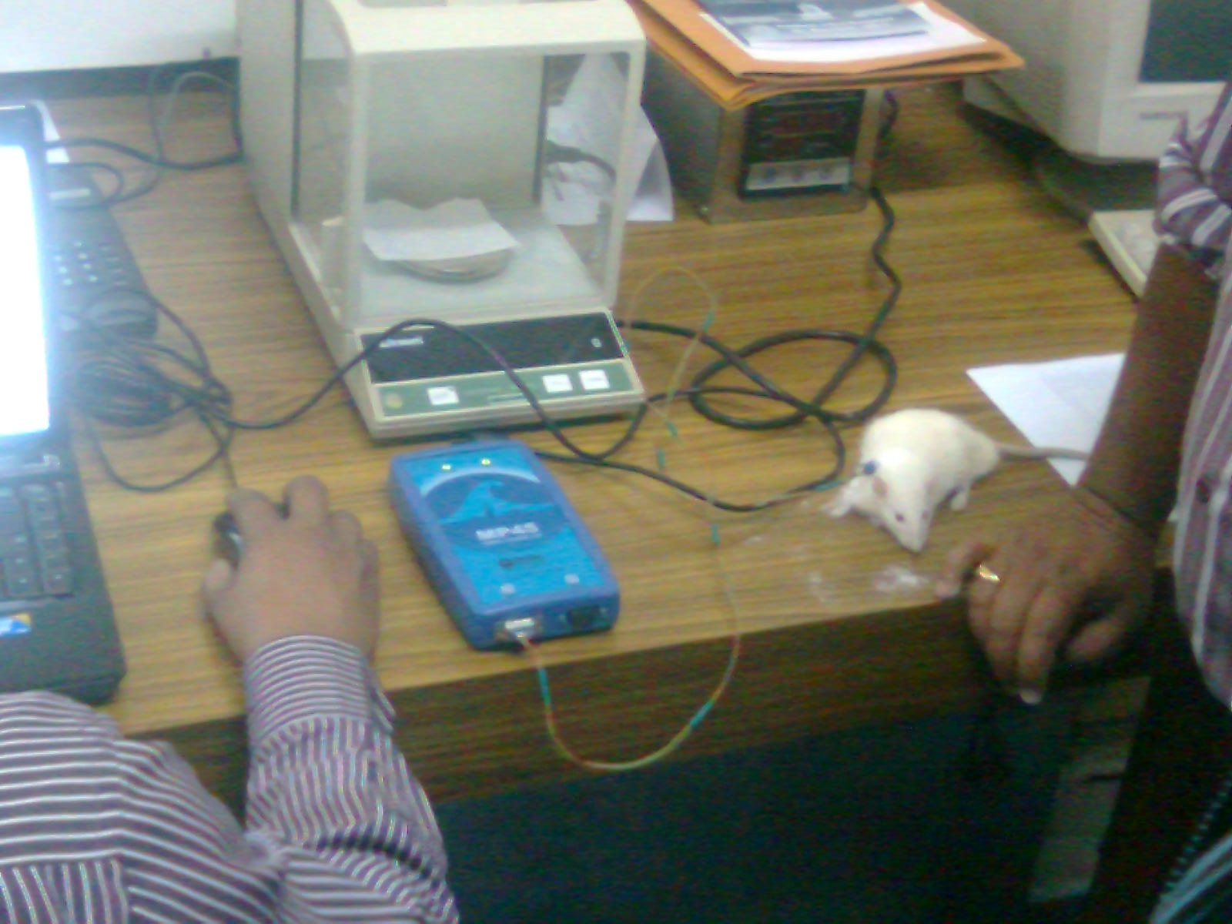
ELECTRODE IMPLANTATION IN RAT
SOFTWARES USED FOR RECORDING OF ECG AND ACTIVE WAVE ANALYSIS
Carrying out the ECG of rats ------ Biopac Student Lab.
2) Analysis and power spectrum analysis------Acknowledge 4.

Slide 30
ANALYSIS
HEART RATE ANALYSIS:
The heart rate analysis was done by manually counting the number of waveform in 30 seconds in at different time intervals.
SEGMENT ANALYSIS
The segment analysis was done by taking active waveforms at different time intervals, and all the digital data was statistically calculated by using Microsoft Excel data sheet.
POWER SPECTRUM ANALYSIS
The power spectrum indicates the power of each frequency component of the source time domain waveform. The power spectrum can be used to analyze a variety of physiological signals. The ECG (rate) and EEG signals are often categorized using spectral analysis.
Although multiple waveforms can be displayed, only one waveform at a time is considered “active.” Most software functions only apply to the active waveform, which is also referred to as the selected channel. Selecting a channel allows highlighting all or part of that waveform, and enables to perform transformations on a given channel.
Instrument: MP45, Biopac Student Lab,
Biopac Systems Incorporation (MS) U.S.A.
Recording: The signals were recorded digitally at the rate of 1000 samples per second

Slide 31
RESULT OF ANIMAL STUDIES
1. ANTIDIABETIC ACTIVITY
The antidiabetic activity of the synthesized test drugs will be carried out on Alloxan induced diabetic rats by measuring the decrease in blood glucose level.
Comparison of Mean Glucose Level after oral administration
Time in hr. | 0 | 2 | 4 | 6 | 12 | 24
Control | 87.25±1.051ª | 90.38±0.8625ª | 88.00±1.071ª | 104.2±0.7984ª | 98.28±0.8625ª | 112.3±1.018ª
Diabetic Control | 232.55±1.041ª | 257.5±1.047ª | 252.1±0.7969ª | 293.1±0.7561ª | 215.3±25.60ª | 257.6±1.085ª
Standard (Gliblenclamide) | 228.4±1.008ª | 168.3±0.8627ª | 116.6±1.258ª | 92.58±0.7846ª | 187.2±1.017ª | 218.2±0.8391ª
SSPC0 (Cinnamic acid) | 277.8±0.9810ª | 212.6±1.031^{b} | 198.1±0.778ª | 180.6±0.9242ª | 154.2±0.2721^{b} | 213.1±1.121ª
SSPC5 | 261.3±1.514ª | 212.6±1.077^{b} | 130.2±0.09013ª | 89.72±0.7217ª | 154.2±0.2721^{b} | 213.1±1.121ª
SSPC8 | 256.8±1.228ª | 178.0±1.006ª | 165.6±0.8330ª | 127.4±1.030ª | 163.0±9.054ª | 232.5±0.9003ª
SSPC11 | 242.2±1.258ª | 194.6±1.512ª | 165.9±0.4761ª | 177.7±1.047ª | 224.4±0.8587ª | 209.9±1.093ª
SSPC14 | 262.5±1.041ª | 237.8±25.93^{ns} | 107.2±1.050ª | 112.5±1.021ª | 166.3±1.328ª | 222.5±1.310ª
SSPC15 | 239.7±1.041ª | 240.1±2.042^{ns} | 187.9±0.9836ª | 160.1±0.08784ª | 213.9±0.8481ª | 234.0±1.374ª
Values are expressed as mean ±S.E.M.; n=4;
Pharmacological data were analyzed by one-way analysis of variance(ANOVA), followed by Dunnett”s Test with equal sample size. ^{ns}: p>0.05;^{c}:p<0.01 ;^{b}:p<0.01 and ª:p<0.001. (
The difference was considered significant when p value < 0.05.

Slide 32
Bar Chart Representing Comparison of Mean % Reduction of Blood Glucose Level after oral administration of Standard Drug Glibenclamide, and Test Drug
BIT,Mesra,Ranchi-835215,India

Slide 33
2. CARDIOMYOPATHY ACTIVITY
The diabetic cardiomyopathy activity of the synthesized test drugs was carried out on Alloxan induced diabetic rats by recording the electrocardiogram of both diabetic and control rat.
EGC INTERPRETATION
SAMPLE ECG OF ‘CONTROL’ RATS
SAMPLE ECG OF DIABETIC RATS

Slide 34
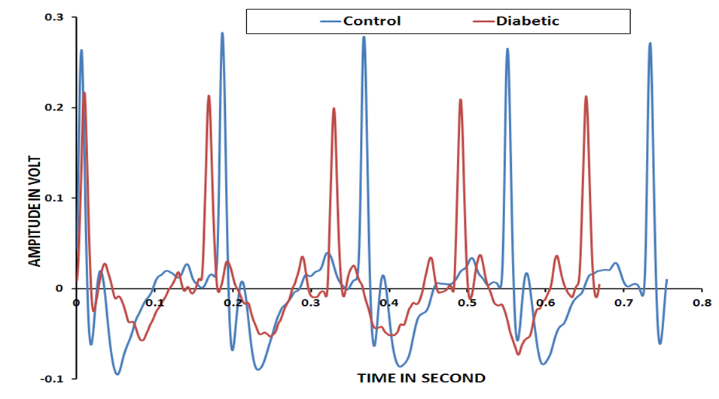
DECREASE IN THE R-R INTERVAL IN THE DIABETIC CONDITION
(HEART RATE IS DECREASING)
SAMPLE ECG OF ‘CONTROL’ AND ‘DIABETIC’ RATS

Slide 35
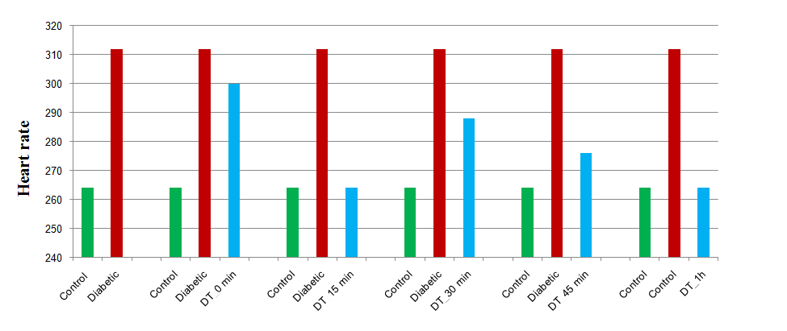
HEART RATE VARIATION IN CONTROL, DIABETIC AND DRUG TREATED ANIMAL
After giving the treatment drug SSPC 14 the animal heart rate appeared to normalize in 15 min and it completely normalized in one hour.
The heart rate is normal up to the 54 hr. after the drug treatment

Slide 36
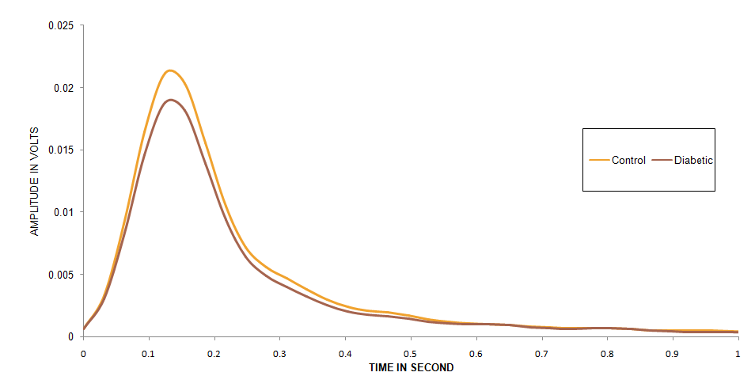
THE HRV ANALYSIS(Heart rate variability Analysis)
The HRV analysis was difficult. HRV spectrum analysis suggests no variation in the sympathetic and parasympathetic systems related to cardiac system.
HRV GRAPH FOR CONTROL AND DIABETIC RAT

Slide 37
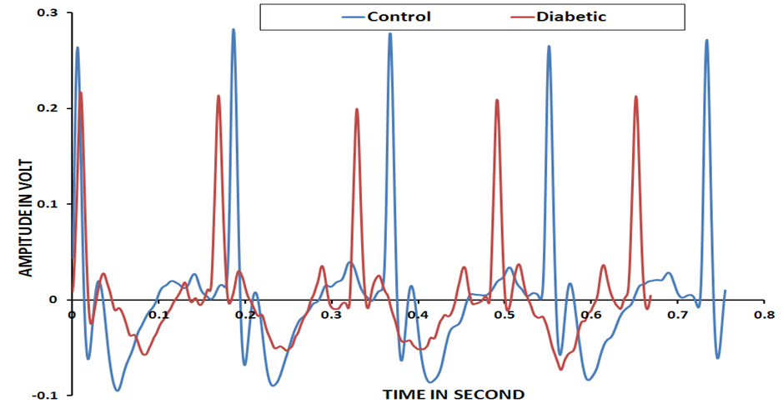
THERE IS ELEVATION IN THE S-T SEGMENT.
The ST segment represents the period when the ventricles are depolarized.
Average S-T prolongation for normal healthy rats is 34.8 sec.
Average S-T prolongation for diabetic rats is 44.6 sec.
Average S-T prolongation for drug treatment rats is 32.6sec after 54 hr.
The ST segment corresponds to a period of ventricle systolic depolarization, when the cardiac muscle is contracted. Subsequent relaxation occurs during the diastolic repolarization phase. The normal course of ST segment reflects a certain sequence of muscular layers undergoing repolarization and certain timing of this activity. When the cardiac muscle is damaged or undergoes a pathological process (e.g. inflammation), its contractile and electrical properties change. Usually, this leads to early repolarization, or premature ending of the systole.

Slide 38
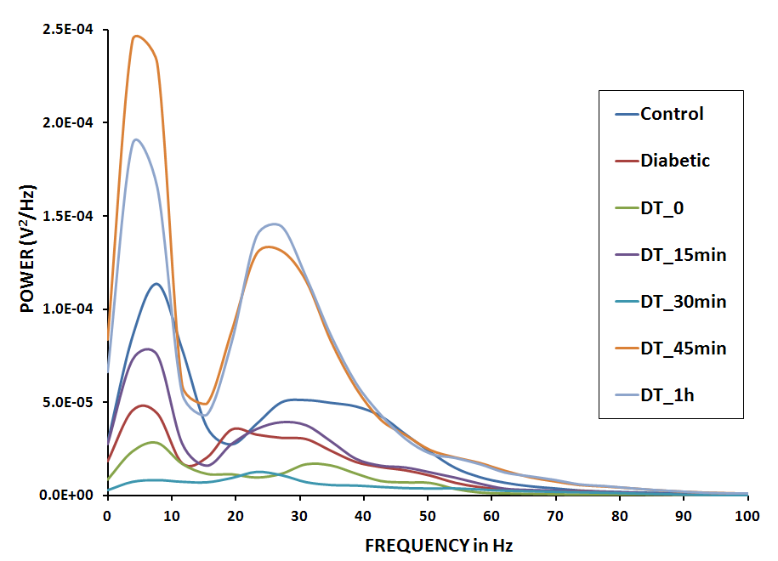
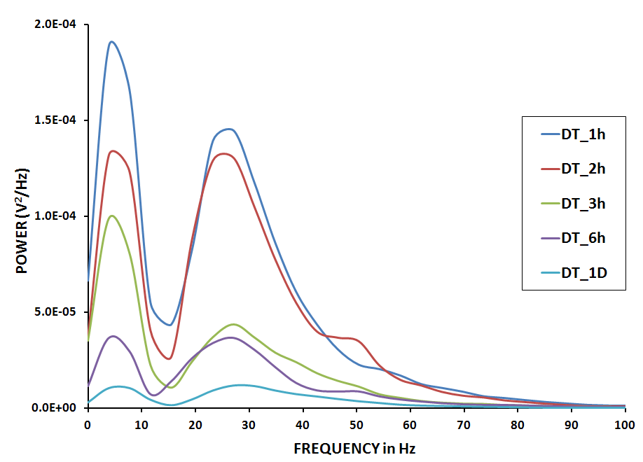
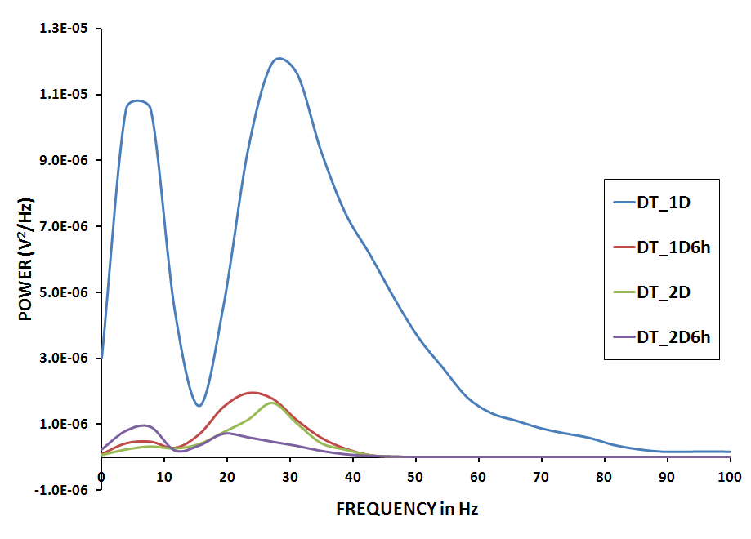
ECG POWER SPECTRUM ANALYSIS
The overall power of ECG frequency spectra was increased just after the oral dose of compound(SSPC14) and it was sustained till 1hour, then started deterioting
ECG POWER SPECTRUM ANALYSIS
(UP TO 1 HOUR OF ORAL DRUG INGESTION)
ECG POWER SPECTRUM ANALYSIS
(1 HOUR TO I DAY OF ORAL DRUG INGESTION)
ECG POWER SPECTRUM ANALYSIS
(1 DAY TO 2DAY 6 HOUR OF ORAL DRUG INGESTION)

Slide 39
QRS INTERVAL ANALYSIS
QRS interval of 5 wave’s l is longer (expanded) that is duration is increased in diabetic rats.
QRS interval for control (normal healthy rats) is 17.6 msec.
QRS interval for control diabetic rat is 25.0 msec.
SAMPLE ECG OF CONTROL RATS SAMPLE EGC OF DIABETIC RATS

Slide 40
ECG of ‘Diabetic treatment’ rats after 0 hr.
ECG of ‘Diabetic treatment’ rats after 15 min.

Slide 41
ECG of ‘Diabetic treatment’ rats after 30 min.
ECG of ‘Diabetic treatment’ rats after 1 hr.

Slide 42
ECG of ‘Diabetic treatment’ rats after 54 hr.
Accordingly the high frequency component of ECG wave was also increased with time, compared to low frequency component with time.

Slide 43
1. CADD APPROACH:
Computer aided drug design using Glide 5.0 a Maestro program.The molecular modeling and docking studies revealed that amongst the compounds SSPC0 to SSPC21, SSPC5, SSPC8, SSPC11, SSPC14, SSPC15 show good docking score in AMPK (PDB Code:2Y94) and PPARs Receptors(PDB Code:3ET0, 3ET1, 3ET2)
2 . SYNTHESIS :
The coupled Cinnamic acid with the amino acids has been synthesized using liquid phase method with chlorophosphate ester as the condensing reagent. The physicochemical properties like melting point, Rf value and Spectral studies like FT-IR,NMR and FAB Mass used for characterization of all synthesized compound.
3. PHARMACOLOGICAL SCREENING:
SSPC5, SSPC8, SSPC11, SSPC14, SSPC15, and SSDM-12 showed significant antidiabetic activity. While Cinnamic acid has a proven antidiabetic activity.
The compound SSPC14 is subjected for the Diabetic cardiomyopathy activity, and it is found to be very effective at the given dose and has a prolong duration of action of the heart. (Up to 54 hrs.)
SUMMARY AND CONCLUSION

Slide 44
FUTURE SCOPE
The new innovative idea to design ,synthesise and screen for the antidiabetic and cardiomyopathic activities of cinnamic acid-amino acid hybrid analouges have given a new direction for the establishment of novel compounds which would be beneficial for diabetes as well for maintaining normal cardiac function .
The use of softwares have helped for rational Receptor based drug designing, justifying the logic for the discovery of new ligands to be effective for NIDDM based diabetes and cardiomyopathy.
The synthetic approach adopted is also unique and innovative.
The use of non-invasive cardiomyopathic animal screening is also a new model :An addition to the conventional pharmacological screening.
This work makes an appeal to the Research scientist in Academy, Industry and other forums who are actively involved for the establishment of novel, patient friendly, economical antidiabetic drugs with broader spectrum of activity.

Slide 45


ACKNOWLEDGEMENT
We deeply acknowledge the Vice-Chancellor, BIT-Mesra and Head of the Department, Pharmaceutical Sciences, Biomedical Instrumentation, and other departments for supporting us with all the available facilities within the Institute. Last but not the least we would like to acknowledge the OMICS Publishing group for accepting and giving us an opportunity to present our research work before this august gathering.

Slide 46
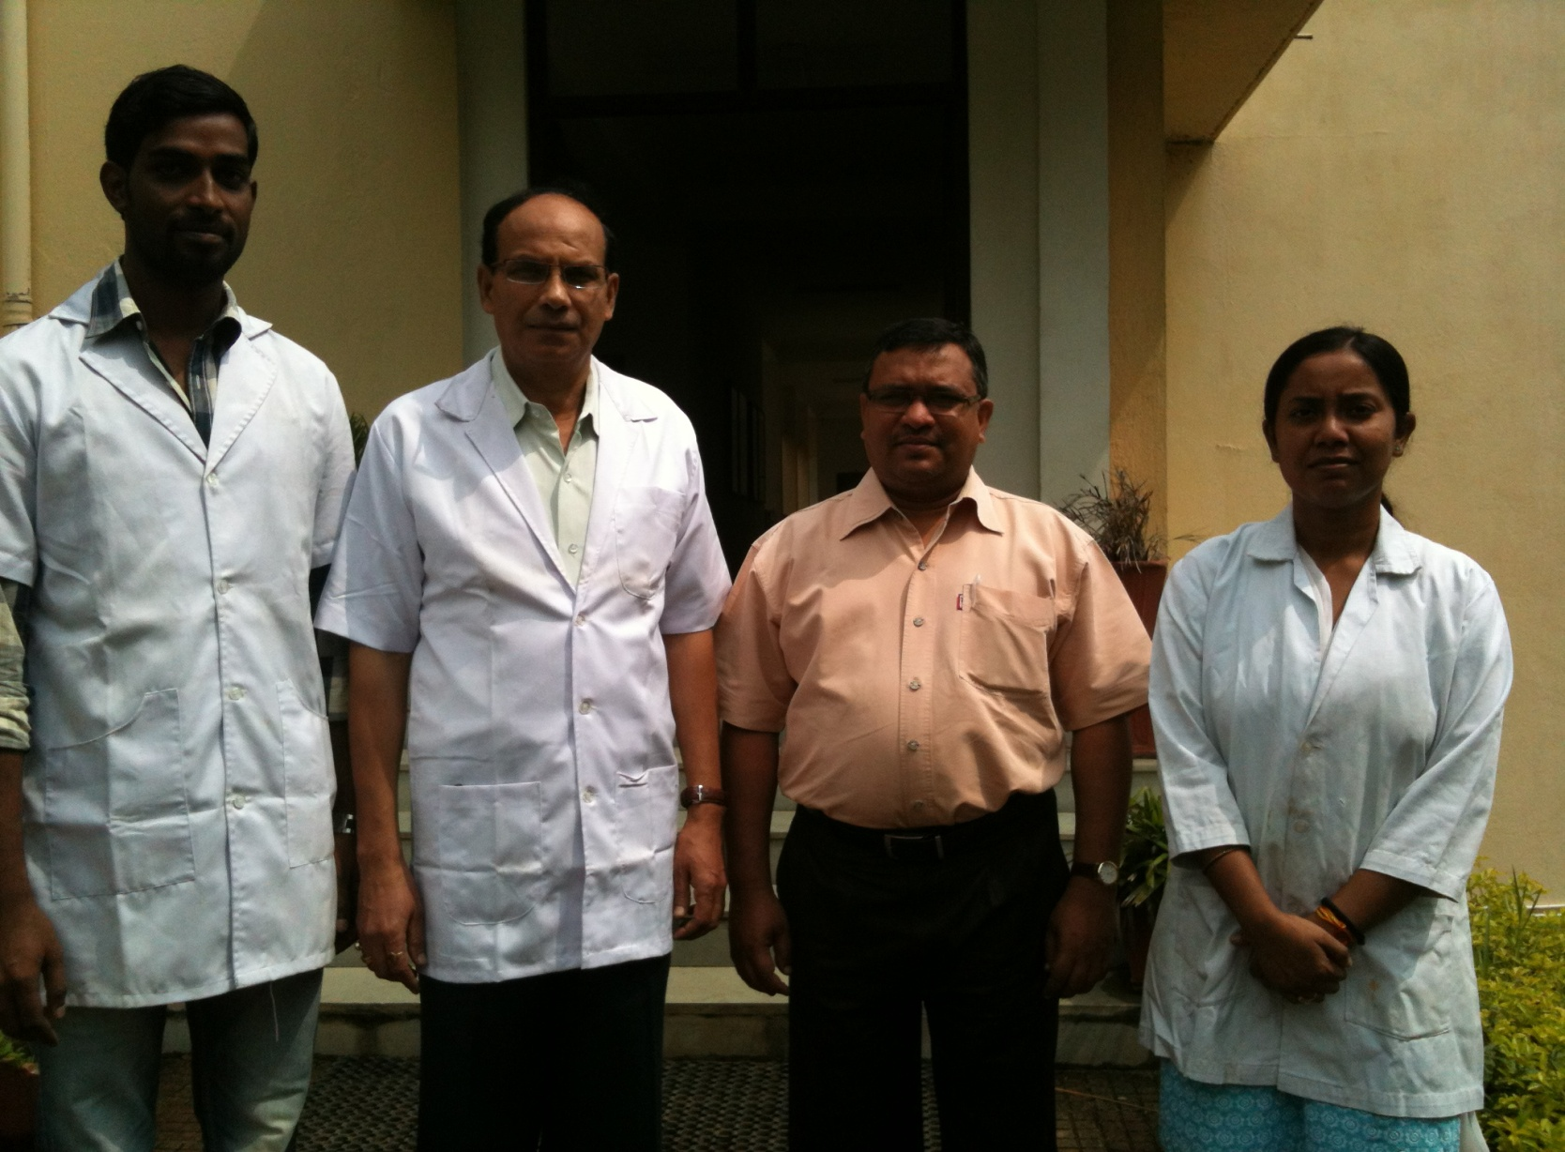
THANK YOU

Slide 47
References
1. Definition and diagnosis of diabetes mellitus and intermediate hyperglycemia, Report of a WHO/IDf Consultation. World Health organization 2006.
Kannel, W. B., Hjortland, M. and Castelli, W. P. Role of diabetes in congestive heart failure: The Framingham Study. Am. J. Cardiol. 1976, 34, 29–341
The Merck manual of Diagnosis and therapy, Beers-Mark., H. New Jersy. 1998, 2, 13,470-487.
Veerapandian, B. Burger’s Medicinal Chemistry and Drug Delivery, Wiley inter science. New York, 1995, 5th ed, Vol.2, 322.
Taft, P.; Zimmet, G.; Bonstein, J.; Seiher, G. Insulin potentiating action of a peptide from human urine. Diabetes 1974, 23, 950-956.
Tanizawa, K.; Okumura, K.; Itoh, K.; Hatanaka, Y.; Kanoka, Y. Synthesis and physico-chemical properties of cyclic peptides. Chem. Pharm. Bull. 1986, 34(10), 4001-111.
Knuhtsen J.A, and Racanhni G. Prolactin control by the tubero-infundibular GABAergic system: role of anterior pituitary GABA receptors. Psycho neuroendocrinology 1987,9: 125–133.
Sheela, C.G.; Kumud, K.; Augusti, K.T. Antidiabetic effects of onion and garlic sulfoxide amino acids in rats. Planta. Med. 1995, 61(4), 356-357.
9. Lee, K.; Ozanne, S.E.; Hales, H.N.; Ashford, M.L.J. Effects of Chemical Modification of Amino and Sulfhydryl Groups on KATP Channel Function and Sulfonylurea Binding in CR1-G1 Insulin Secreting Cells. J. Membrane. Biol. 1994, 139, 167-181

Slide 48
Egan, J.M.; Henderson, T.E.; Bernier, M. Arginine Enhances glycogen synthesis in response to insulin in 3T3-L1 adipocytes. Am. J. Physiol. Endocrinol. Metab. 1995, 269, E61-66.
Klinteberg R.F, and Fuzeasky J.V., The obligatory role of endothelial cells in the relaxation of arterial smooth muscle by acetylcholine. Nature 1996, 288: 373–376.
Bhaver, P.K.; Samanta, S. M.Pharm. Thesis, B.I.T., Mesra, 1999, 45.
Lahkar, V.K.; Samanta, S. M. Pharm. Thesis, B.I.T., Mesra, 2006, 134.
Singh, E.; Samanta, S. M. Pharm. Thesis, B.I.T., Mesra, 2007, 71.
Sivasubramanian,P.;Samanta,S. M. Pharm. Thesis, B.I.T., Mesra, 2009, 65-72,116-117.
SimonA.Hawley,F.A.Ross,C.Chevtzoff,K.A.Green.A.Evans,S.Fogart,M.C.Towler,L.J.Brown,O.A.Ogunbayo,A.M.Evans,d.g.Hardie.Use of Cells Expressing γ Subunit Variants to Identify Diverse Mechanisms of AMPK Activation, Cell Metab. 2010 June 9; 11(6): 554–565
Woo Hyung Lee and Sang Geon Kim, AMPK-Dependent Metabolic Regulation by PPAR Agonists, PPAR Research,Volume 2010, 1-11.Cinnamic acid derivatives: A new chapter of various pharmacological activities, Prateek Sharma, J. Chem. Pharm. Res., 2011, 3(2):403-423.
Eun-Do Kim.; Eunha ,Kim.; Jung-Han, Lee.; Chang-Kee Hyun. Gly-Ala-Gly-Val-Gly-Tyr, a novel synthetic peptide, improves glucose transport and exerts .beneficial lipid metabolic effects in 3T3-L1 adipocytes .European Journal of Pharmacology. 2011,650.487-708.
Kasetti RB,Nabi SA,Swapna S,Apparao C. Cinnamic acid as one of the antidiabetic active principle(s) from the seeds of Syzygium alternifolium. Food Chem Toxicol, 2012, 50(5):1425-1431.

Slide 49
Adisakwattana S, Weerachat S, Sathaporn.M.A,Ngamukote and Sirintorn Y, Cinnamic Acid and Its Derivatives Inhibit Fructose-MediatedProtein Glycation, Int. J. Mol. Sci. 2012, 13, 1778-1789.
Kasetti R.B., Nabi,S.A, Sirasangandla S, Chippada A. Cinnamic acid as one of the antidiabetic active principle(s) from the seeds of Syzygium alternifolium, Food and Chemical Toxicology, 50 (2012) 1425–1431.
22. Eric, E. Cann.; and Tumpf, B.P.K. Outlines of Biochem,., John wiley & sons Asia (Pvt.) Ltd., Singapore, 1972, 3, 69, 464.
23. Nagarajan, K.; and Samanta, S. M.Pharm. Thesis B.I.T., Mesra, 2001, 118.
24. Etuk, E.U. Animals models for studying diabetes mellitus. Biol. J. N. Am. 2010, 1(2), 130-134.
25. Chougale,K.AA.; Panaskar,N.Opimization of Alloxan Dose Essential to Induce Stable Diabetes
for Prolonged Period. Asian Journal of Biochemistry,2007,2(6),402-408.

Slide 50
Let Us Meet Again
We welcome you to join at 4th International Conference on Medicinal Chemistry & Computer Aided Drug Designing
November 02-04 Atlanta, USA
Please Visit:
http://medicinalchemistry.pharmaceuticalconferences.com/
Regards
Adam Benson
medchem@conferenceseries.net

