Slide 1
About OMICS Group
OMICS Group International is an amalgamation of Open Access publications and worldwide international science conferences and events. Established in the year 2007 with the sole aim of making the information on Sciences and technology ‘Open Access’, OMICS Group publishes 400 online open access scholarly journals in all aspects of Science, Engineering, Management and Technology journals. OMICS Group has been instrumental in taking the knowledge on Science & technology to the doorsteps of ordinary men and women. Research Scholars, Students, Libraries, Educational Institutions, Research centers and the industry are main stakeholders that benefitted greatly from this knowledge dissemination. OMICS Group also organizes 300 International conferences annually across the globe, where knowledge transfer takes place through debates, round table discussions, poster presentations, workshops, symposia and exhibitions.

Slide 2
About OMICS Group Conferences
OMICS Group International is a pioneer and leading science event organizer, which publishes around 400 open access journals and conducts over 300 Medical, Clinical, Engineering, Life Sciences, Phrama scientific conferences all over the globe annually with the support of more than 1000 scientific associations and 30,000 editorial board members and 3.5 million followers to its credit.
OMICS Group has organized 500 conferences, workshops and national symposiums across the major cities including San Francisco, Las Vegas, San Antonio, Omaha, Orlando, Raleigh, Santa Clara, Chicago, Philadelphia, Baltimore, United Kingdom, Valencia, Dubai, Beijing, Hyderabad, Bengaluru and Mumbai.

Slide 3

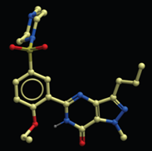
Novel sildenafil analogues
- possible drugs for increased sensitivity to chemotherapeutic agents
Aina Westrheim Ravna, PhD.
Medical Pharmacology and Toxicology
Department of Medical Biology
Faculty of Health Sciences
University of Tromsø – The Arctic University
Norway

Slide 4
Sildenafil (Viagra®)
Sexual stimulation
Nitrergic nerves
Molecular basis for its mechanism of action in erectile tissue
Nitric Oxide (NO)
+
+
Guanylyl cyclase
PKG
cGMP
GTP
PDE5A
Vasodilatation
Inactive product
Penile erection
Notes:
(Erection was an unexpected side effect when Pfizer conducted clinical trials of a drug that was supposed to treat heart problems like angina or chest pain.
Its molecular mechanism of action for this surprising side effect is an inhibition of PDE5 in erectile tissue.
In order to get an erection, you need a ….)
“improve and sustain a man’s penile erection”

Slide 5
Sildenafil (Viagra®)
Sexual stimulation
Nitrergic nerves
Nitric Oxide (NO)
+
+
Guanylyl cyclase
PKG
cGMP
GTP
PDE5A
Vasodilatation
Inactive product
Penile erection

Slide 6
Sildenafil (Viagra®)
Sexual stimulation
Nitrergic nerves
Nitric Oxide (NO)
+
+
Guanylyl cyclase
PKG
cGMP
GTP
PDE5A
Vasodilatation
Penile erection

Slide 7
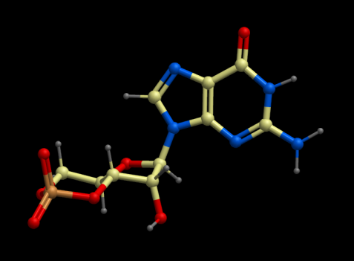

Sildenafil (Viagra®)
We have been characterizing the cGMP efflux of ABCC5 for 15 years biochemically and pharmacologically
Sildenafil inhibits cGMP efflux (Jedlitsky et al. 2000, Sundkvist et al. 2002)
cGMP
Sildenafil

Slide 8
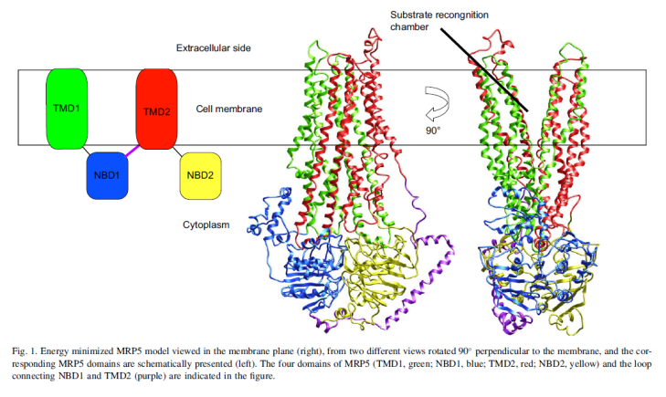
Sildenafil (Viagra®)
Sildenafil inhibition of ABC (ATP-binding cassette) transporters:
  ABCB1
    (P-glycoprotein/MDR1)
  ABCC
    [Multidrug Resistance-Associated Proteins (MRP)]
  ABCG2
    (BCRP / MXR / ABCP)
These are involved in multidrug resistance (MDR)
ABC transporter topology and structure
(Ravna et al. Eur J Med Chem. (2008)43:2557-678)

Slide 9
Multidrug resistance (MDR) in cancer cells
An important contribution factor for MDR:
Overexpression of ABC transporters
Overexpression of ABC transporters
Cytostatics pumped out of the cancer cell
Impaired therapeutic effect

Slide 10
ABC
transporter
cytostatic

Slide 11
ABC
transporter
Cytotoxic

Slide 12
ABC
transporter
cytostatic

Slide 13
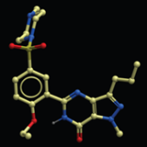
ABC
transporter
cytostatic

Slide 14
ABC
transporter
cytostatic

Slide 15
ABC
transporter
cytostatic

Slide 16
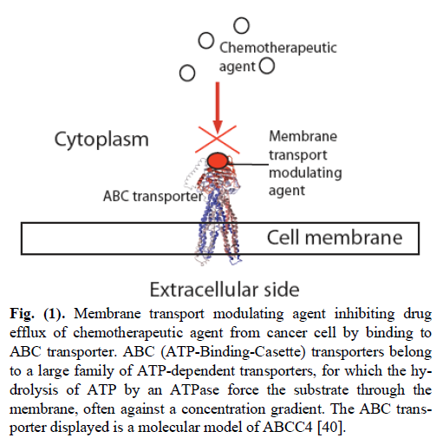
Attempts to develop ABCB1 inhibitors
Attempts to develop ABCB1 inhibitors have been going on for more than 30 years
  3 generations of ABCB1 inhibitors
  Either serious adverse effects or lack of efficacy in clinical trials
There is still a need to develop and test effective and non-toxic ABC transporter inhibitors
(Ravna & Sager, Mini Rev Med Chem. (2009)9:186-93. )

Slide 17
Sildenafil and ABC transporters
Studies have shown that sildenafil
Inhibits a variety of ABC transporters
    ABCB1, ABCC4, ABCC5 and ABCG2
Increases intracellular levels of anticancer agents
  Thereby sensitizing cancer cells to anticancer agents
    Paclitaxel
    5-fluorouracil
    Methotrexate
    Cisplatin
    Oxaliplatin
    Doxorubicin
Chen et al. 2001
Chen et al. 2002
  Das et al. 2010
  Di et al. 2010
  Jedlitsky et al. 2000
Leggas et al. 2004
Norris et al. 2005
  Pratt et al. 2005
  Reid et al. 2003
  Sager et al. 2012
Shi et al. 2011
  Sundkvist et al. 2002
  Ørvoll et al. 2013
  Etc.

Slide 18
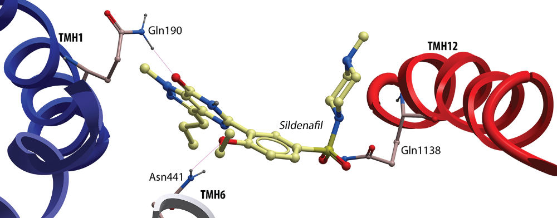
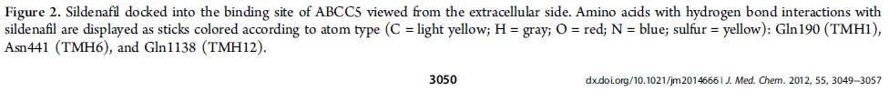
Sildenafil/ABCC5
(Sager et al. J Med Chem. (2012)55:3049-57)

Slide 19
Sildenafil as tumor growth inhibitor
Increased intracellular levels of cGMP may have cytotoxic effects
  PDE5 breaks down cGMP
  ABCC5 transports cGMP out of cells
Several types of tumor cells have increased expression of
  PDE5 (Shi et al. 2011)
  ABCC5 (Eggen et al. 2012)
Inhibition of PDE5/ABCC5 may therefore have antineoplastic effect
Studies have shown that sildenafil can inhibit tumor growth without cytotoxic agents present (Serafini et al. 2006; Tinsley et al. 2009; Piazza et al.)

Slide 20
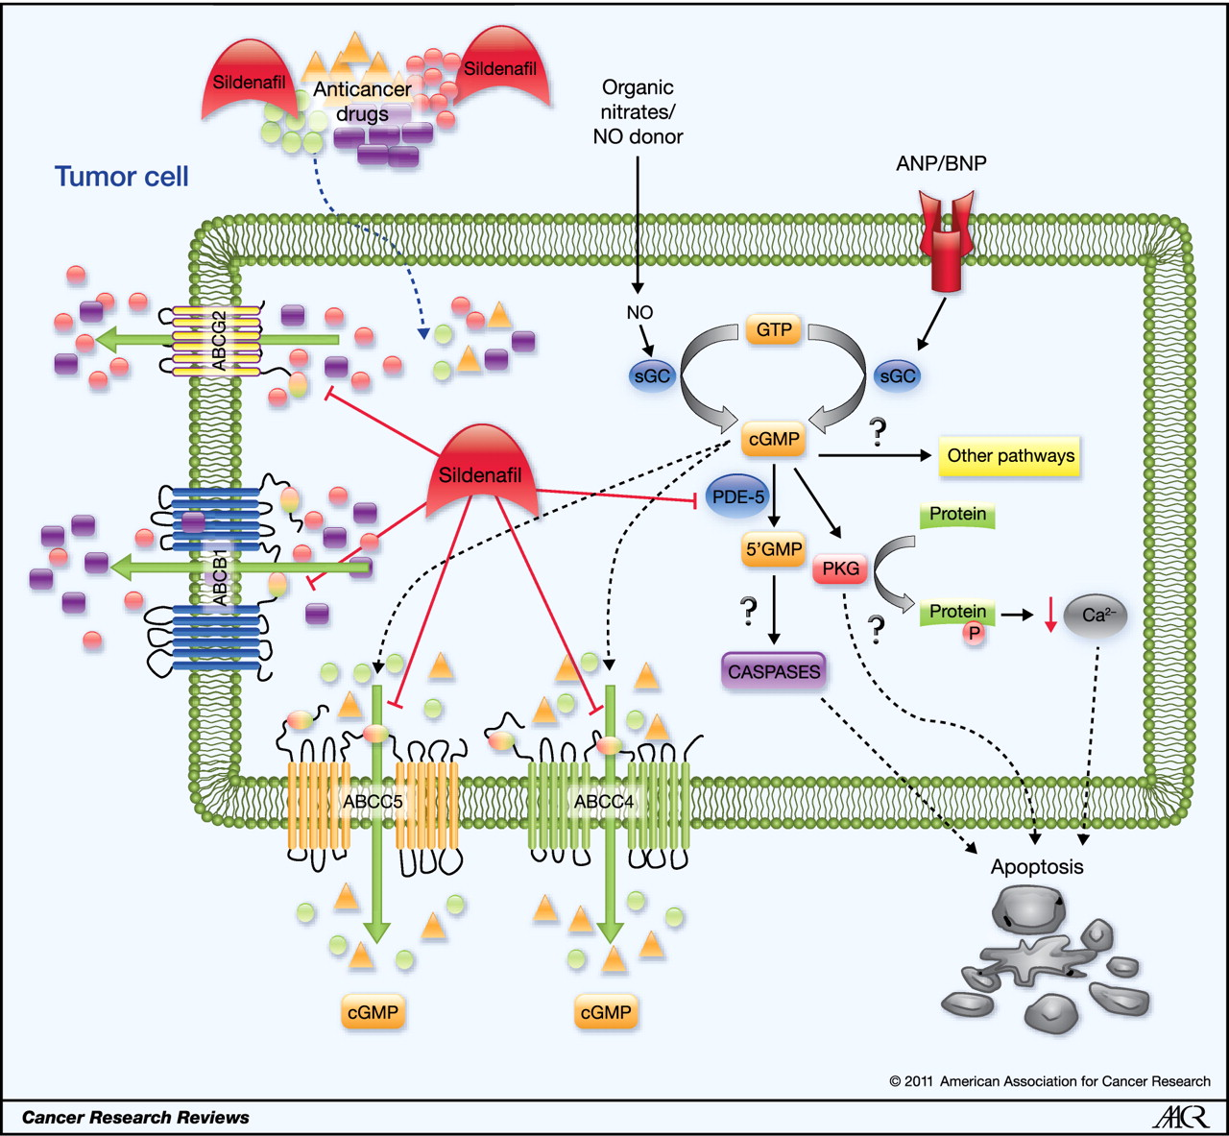

Proposed mechanisms for sildenafil-induced augmentation of the efficacy of antineoplastic drugs, shown in a schematic model.
Shi Z et al. Cancer Res (2011)71:3735-3738
Notes:
Proposed mechanisms for sildenafil-induced augmentation of the efficacy of antineoplastic drugs, shown in a schematic model. Sildenafil may enhance the therapeutic effect of antineoplastic drugs by (1) blocking the substrate efflux function of MDR transporters such as ABCC4/MRP4 (16), ABCC5/MRP5 (15), ABCB1/P-gp, and ABCG2/BCRP (17); and/or (2) increasing cGMP levels by inhibiting PDE5, ABCC4-, and ABCC5-mediated efflux of cGMP. In addition, it has been proposed that in tumor cells, the elevation of cGMP levels by inhibition of PDE5 may activate PKG, leading to growth suppression or apoptosis (26, 27).

Slide 21
Common side effects of sildenafil
Headache, dyspepsia, flushing, nasal congestion, dizziness, blurred vision, color distortion
Maximum plasma concentration (Cmax) of sildenafil after single dose (25 to 200 mg) is 127 to 1,150 ng / mL (0.2 to 2 μmol / L)
  This is lower than the concentration required to inhibit MDR
Fewer side effects by developing sildenafil analogues that are more potent on ABC-transport than the PDE5?
  Dual and balanced effect?

Slide 22
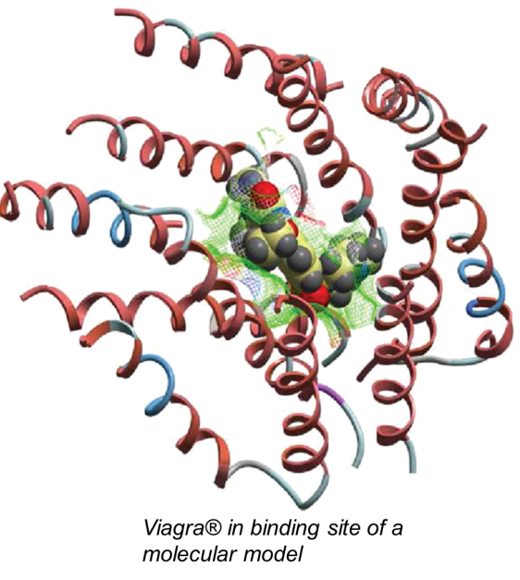
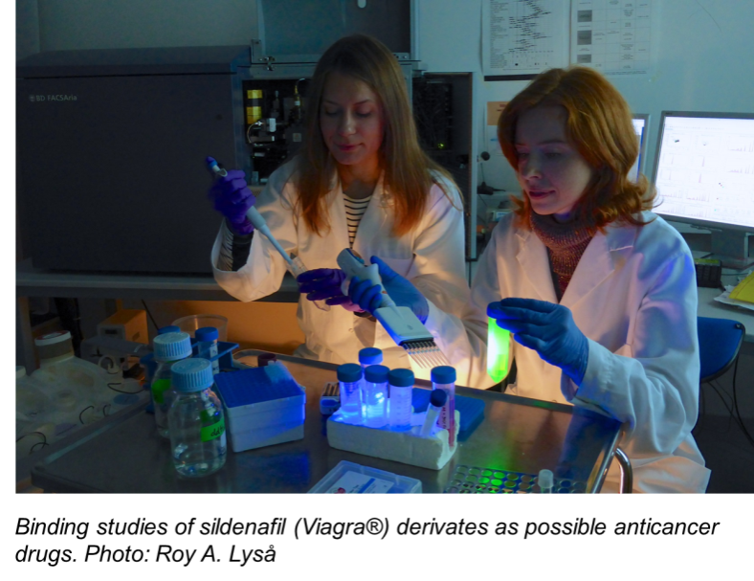
Novel sildenafil analogues
We have identified sildenafil analogues using virtual
ligand screening (VLS) and tested them for ABCC5 transporter efflux using inside-out vesicles (IOV).

Slide 23
Novel sildenafil analogues
Compound
Compound
Compound
Best hits for bioassays
In silico:
  Molecular modeling of ABCC5
  Virtual Ligand Screening (VLS) of sildenafil derivates
In vitro:
  Binding Assays of possible inhibitors to the ABCC5 transporter according to the results from VLS

Slide 24
Novel sildenafil analogues
Results:
7 of 11 compounds predicted by VLS to bind to ABCC5 were more potent than sildenafil
Ki-values of the most potent inhibitors of cGMP transport:
  Sildenafil (reference inhibitor): Ki-value = 1200 ± 170 nM
  Compound 1: Ki-value = 75.3 ± 3.1 nM
  Compound 2: Ki-value = 65.3 ± 6.4 nM

Slide 25
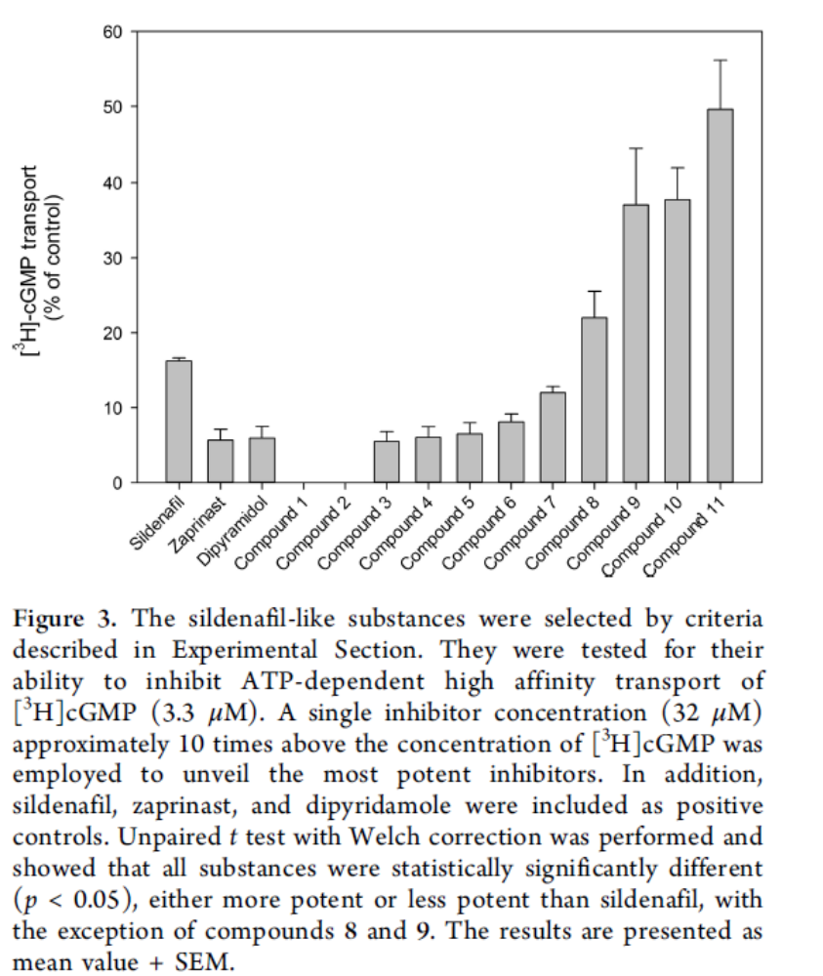
(Sager et al. J Med Chem. (2012)55:3049-57)

Slide 26
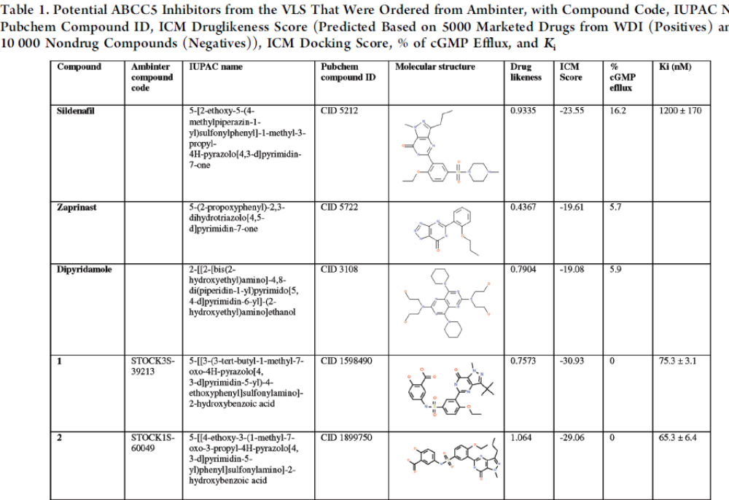
(Sager et al. J Med Chem. (2012)55:3049-57)

Slide 27
Novel sildenafil analogues
The compounds may represent candidates for lead optimization in the search for novel drugs that can be used to reduce MDR
Such drugs may also be used to inhibit cGMP efflux from cancer cells
  Possibly enhancing the body’s own defense mechanism of increasing cGMP levels
Notes:
Det kan være interessant å evaluere effekten av kjemoterapi hos pasienter som som samtidig behandles med sildenafil for andre kliniske indikasjoner

Slide 28
It is still too early to say whether sildenafil can reverse MDR mediated by ABC transport in clinic
Sildenafil and sildenafil analogues may have the potential to enhance the therapeutic effect of chemotherapy

Slide 29
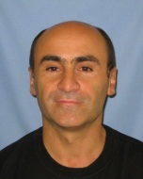
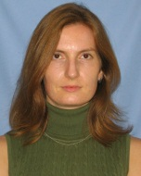
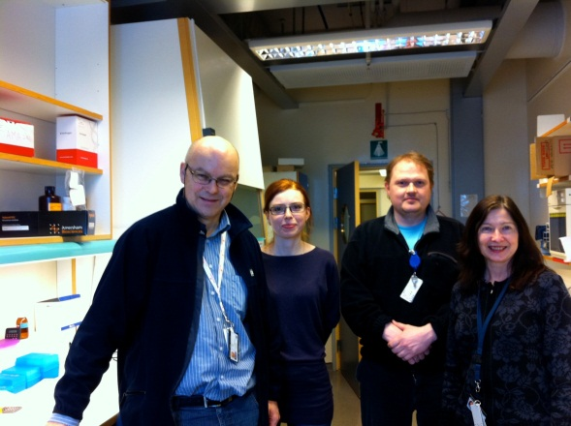



Acknowledgements
Ruben Abagyan Research Group
University of California, San Diego
Skaggs School of Pharmacy & Pharmaceutical Sciences
USA
  Ruben Abagyan & Irina Kufareva
The Experimental and Clinical Pharmacology Group (Tromsoe)
  Georg Sager, Lena Aronsen, Anna Subbotina, Roy Lysaa, Elin Orvoll, Natalia Smaglyukova

Slide 30
Let Us Meet Again
We welcome you to join at 4th International Conference on Medicinal Chemistry & Computer Aided Drug Designing
November 02-04 Atlanta, USA
Please Visit:
http://medicinalchemistry.pharmaceuticalconferences.com/
Regards
Adam Benson
medchem@conferenceseries.net

