Slide 1
About OMICS Group
OMICS Group International is an amalgamation of Open Access publications and worldwide international science conferences and events. Established in the year 2007 with the sole aim of making the information on Sciences and technology ‘Open Access’, OMICS Group publishes 400 online open access scholarly journals in all aspects of Science, Engineering, Management and Technology journals. OMICS Group has been instrumental in taking the knowledge on Science & technology to the doorsteps of ordinary men and women. Research Scholars, Students, Libraries, Educational Institutions, Research centers and the industry are main stakeholders that benefitted greatly from this knowledge dissemination. OMICS Group also organizes 300 International conferences annually across the globe, where knowledge transfer takes place through debates, round table discussions, poster presentations, workshops, symposia and exhibitions.

Slide 2
About OMICS Group Conferences
OMICS Group International is a pioneer and leading science event organizer, which publishes around 400 open access journals and conducts over 300 Medical, Clinical, Engineering, Life Sciences, Phrama scientific conferences all over the globe annually with the support of more than 1000 scientific associations and 30,000 editorial board members and 3.5 million followers to its credit.
OMICS Group has organized 500 conferences, workshops and national symposiums across the major cities including San Francisco, Las Vegas, San Antonio, Omaha, Orlando, Raleigh, Santa Clara, Chicago, Philadelphia, Baltimore, United Kingdom, Valencia, Dubai, Beijing, Hyderabad, Bengaluru and Mumbai.

Slide 3

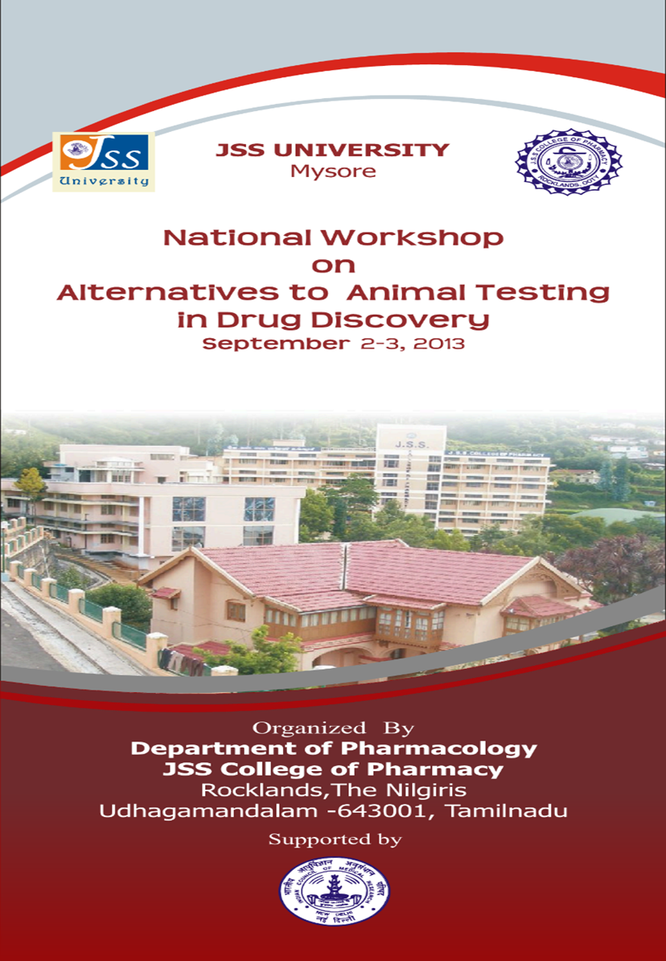
Newer approaches to the discovery of glitazones
Dr. Praveen T.K., M.Pharm., Ph.D.,
Assistant Professor
Dept. of Pharmacology
J.S.S. College of Pharmacy
Ootacamund 643 001
The Nilgiris, Tamilnadu, India.
Email: praveentk7812@gmail.com

Slide 4
Introduction
Diabetes mellitus (DM) is a chronic metabolic disorder characterized by hyperglycemia resulting from impaired insulin secretion and/or action.
IDF estimated that around 285 million adults were affected with DM in 2010, and it is estimated to affect 439 million adults by 2030.
The Type 2 Diabetes Mellitus (T2DM) is multifactorial and complex disease accounting for 90% of total diabetes cases.

Slide 5
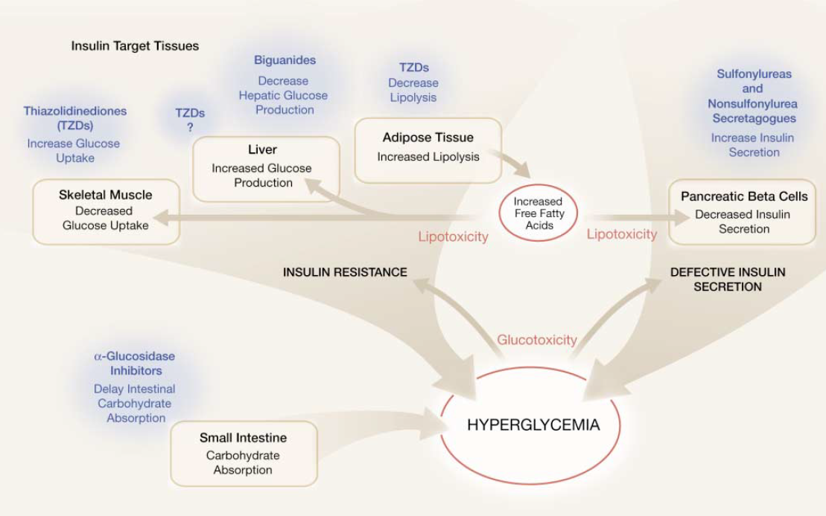
Pharmacotherapy of type 2 diabetes mellitus

Slide 6
Glitazones/Thiazolidinediones
Thiazolidinediones (TZDs) or glitazones are one of the important classes of insulin sensitizers used in the management of type 2 diabetes mellitus (T2DM).
TZDs are reported to reverse insulin resistance without stimulating the release of insulin from β-cells.
They reduce hepatic glucose production and increase peripheral utilization of glucose thus reducing both preload and after load on β-cells.
In addition, unlike sulphonylureas these agents are devoid of mechanism based hypoglycaemic side effects. There is, thus, an excellent rationale for the use of TZDs in the management of T2DM.

Slide 7
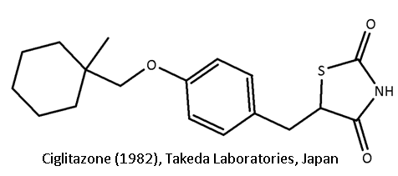
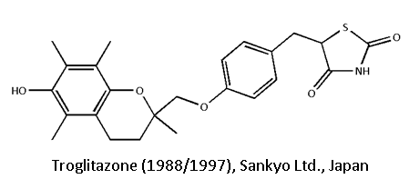
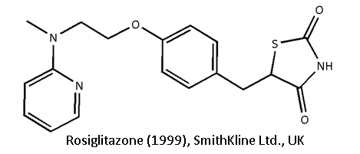
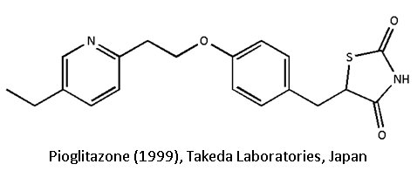
History of glitazones

Slide 8
Mechanism of action of glitazones
Glitazones act by binding to Peroxisome proliferator activated receptors (PPARs).
PPARs are nuclear receptors which function as transcription factors
These receptors are reported to act by coordinating the activities of multiple pathways involved in the glucose and lipid metabolism instead of acting through one major target.

Slide 9
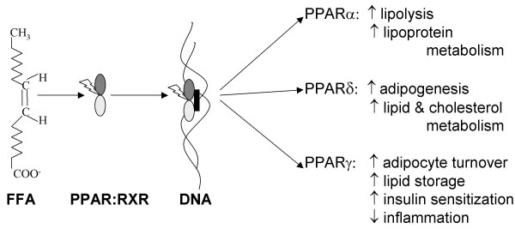

Slide 10
The primary target for the glitazones is PPAR-γ receptors
Glitazones are reported to exert their insulin sensitizing actions either directly (the fatty acid steal hypothesis) or indirectly by means of altered adipokine release.

Slide 11
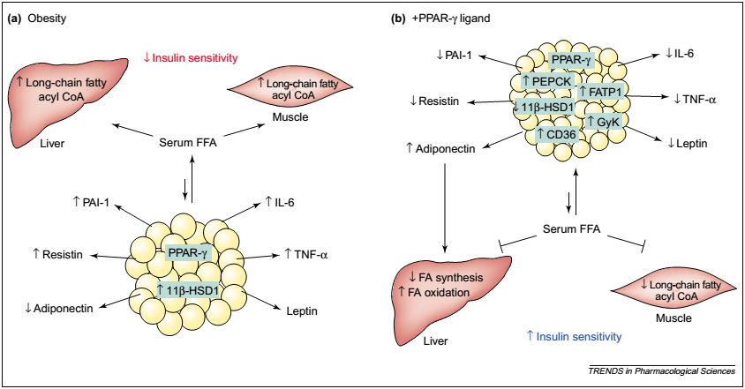

Slide 12
Unfortunately, the clinically used TZDs suffered with some serious side effects like;
  Idiosyncratic hepatotoxicity,
  Fluid retention and edema
  congestive heart failure
  Weight gain,
  Bone fracture
  Bladder cancer, etc.,

Slide 13
Glitazones- Hepatotoxicity
Troglitazone was withdrawn from the market due to serious idiosyncratic hepatotoxicity.
At least 43 cases of acute hepatic failure have been reported with 28 reported deaths.
However, mechanism of troglitazone hepatoxicity is unknown, relevance to other TDZs unclear
Rosiglitazone, pioglitazone have shown no clear evidence of hepatotoxicity

Slide 14
Glitazones-Weight gain

Slide 15
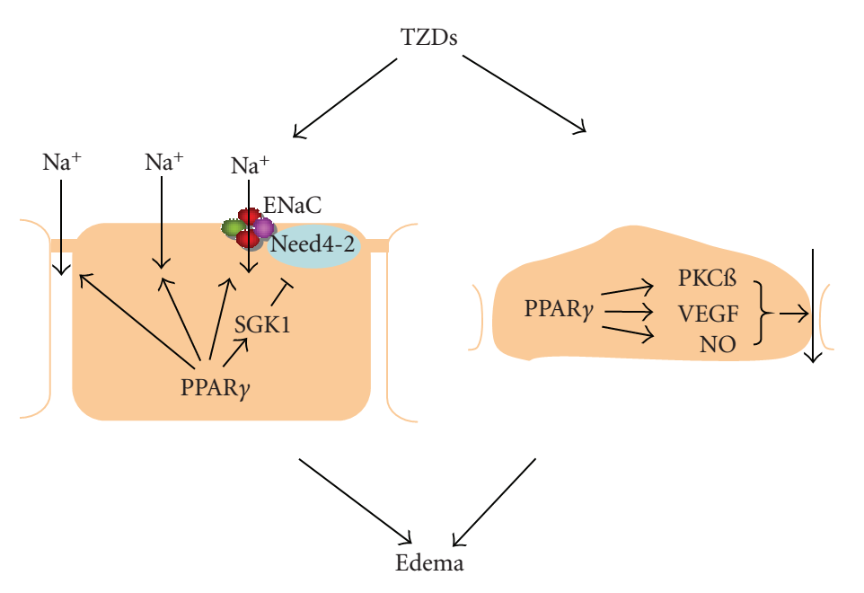
Glitazones- Fluid retention and edema
PPAR Research Volume 2008

Slide 16
Glitazones were also reported to cause osteoporosis, risk of cancer, macular edema, etc.
As a result of above discussed adverse effects troglitazone was banned, rosiglitazone was restricted and the pioglitazone label was updated for the risk of bladder cancer.

Slide 17
What could be the reasons for their failure?
The TZDs that were withdrawn from the clinical use were developed at the time when enough scientific data were not available on the structure and the transcriptional mechanisms of peroxisome proliferator activated receptors (PPARs).
In the year 1990, Issemann and Green identified these nuclear receptors in mouse.
Clinically used glitazones were PPAR-γ selective full agonists
Recent advances in understanding the structure and function of PPARs, however, has led to more rationalized approaches to develop these agents.

Slide 18
Newer Approaches…
PPAR-α/γ dual agonists (glitazars)
PPAR-δ/γ dual agonists
PPAR-pan (α/γ/δ) agonists
Selective Peroxisome ProliferatorActivated Receptor Modulators (SPPARMs)

Slide 19
1. PPAR-α/γ dual agonists (glitazars)
In general, type 2 diabetic patients suffer from both hyperglycemia and dyslipidemia.
The major cause of mortality in these patients is atherosclerotic macrovascular diseases.
Activation of different PPAR subtypes leads to a broad spectrum of metabolic effects that may be complementary.
PPAR-γ activation improves insulin sensitivity
PPAR-α activation stimulate lipid oxidation and reduce adiposity.
PPARα/γdual agonists, therefore, have been postulated to improve insulin resistance, hyperglycemia and alleviate atherogenic dyslipidemia.

Slide 20
In addition, PPAR-α agonists stimulate lipid oxidation and decrease adiposity and thus, counter the PPAR-γ mediated weight gain through its adipogenic affects.
One strategy for designing PPAR-α/γ dual agonists is to merge the chemical structures of the fibrates and TZDs into a single chemical entity
Another strategy is based on incorporation of the 2-aryloxy-2-methylpropionic acid substructure derived from fenofibric acid into o-arylmandelic acid-based PPAR agonists

Slide 21
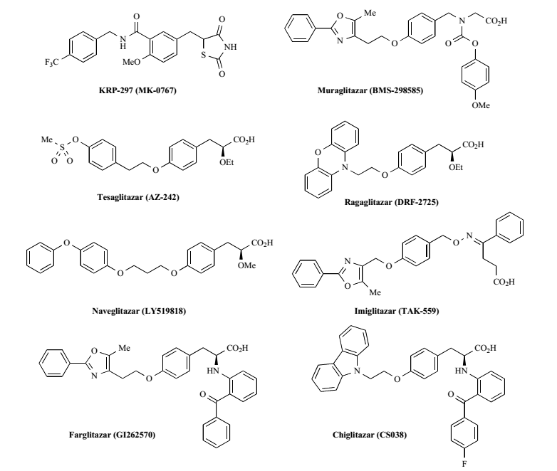

Slide 22
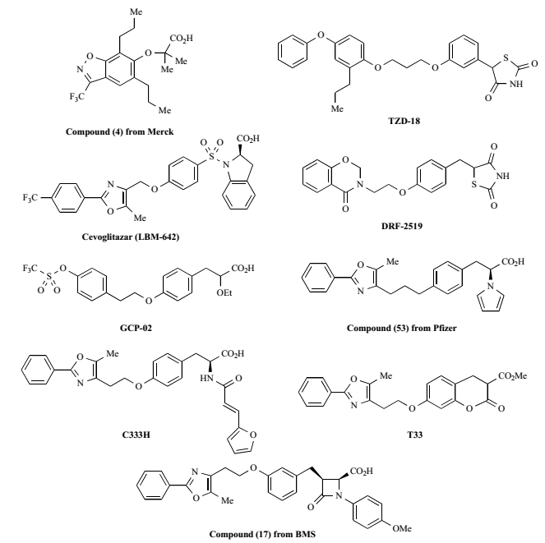

Slide 23
Most of the terminated PPAR ligands shared some undesirable adverse events but the reason for discontinuation was, in many cases, claimed to be compound specific.

Slide 24
2. PPAR-δ/γ dual agonists
The rationale for developing PPAR-δ/γ dual agonists is improvement of insulin sensitivity mainly through PPAR-γ activation with simultaneous alleviation of dyslipidemia and weight gain through PPAR-δ activation.
Similar to PPARα/γ dual agonists, PPAR-δ/γ dual agonists have also been postulated to improve insulin resistance, hyperglycemia and alleviate atherogenic dyslipidemia
Development of PPAR-δ/γ dual agonists is currently ongoing and reports have been limited.

Slide 25
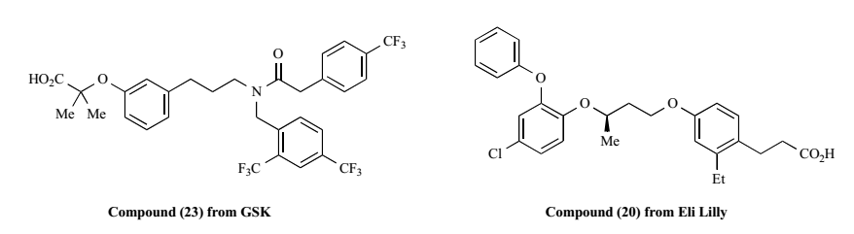

Slide 26
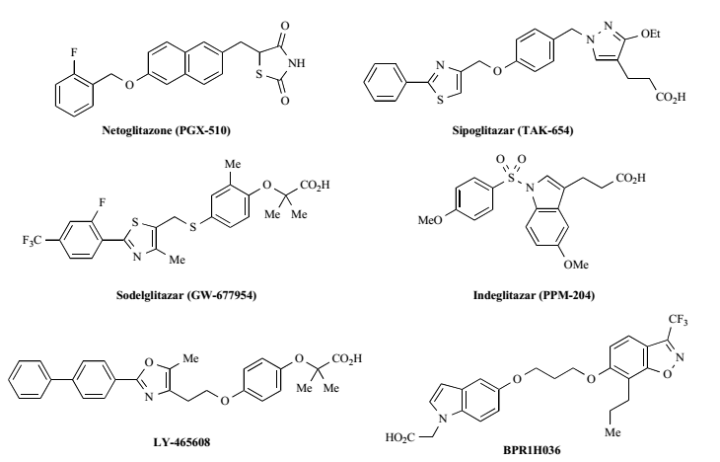
3. PPAR-pan (α/γ/δ) agonists
PPAR pan agonists due to their wide spectrum of metabolic effects could potentially treat an entire spectrum of metabolic disorders by ameliorating insulin resistance, dyslipidemia, obesity, and hypertension.

Slide 27
4. Selective Peroxisome Proliferator-Activated Receptor Modulators (SPPARMS)
Recent progress in the understanding of the LBD structure of PPAR-γ and important ligand protein interactions has lead to the development of selective PPAR-γ modulators (SPPARγM)
Selective modulation is a pharmacological approach that is based on selective receptor–cofactor interactions and target-gene regulation.
Diverse PPAR-γ ligands, depending on their chemical structures, bind in distinct manners to the LBD of PPAR-γ and induce different levels of activation and distinct conformational changes of the receptor, leading to differential interactions with coactivators and corepressors.
This approach, therefore, may lead to development of compounds with potent insulin-sensitization without the PPAR-γ-mediated adverse effects

Slide 28
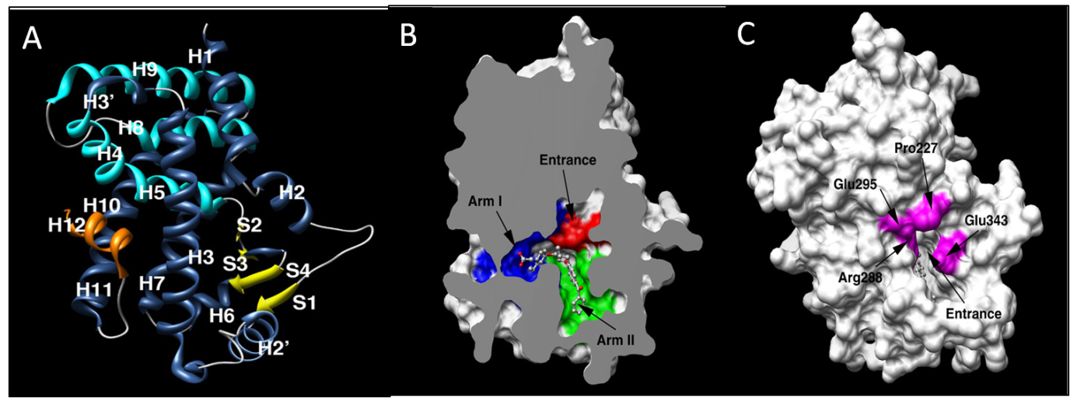
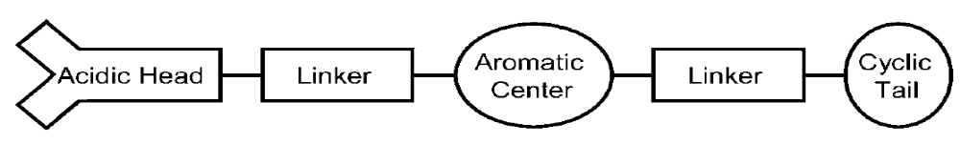

Slide 29
Hydrogen bonding interactions 10a-k with LBD of PPAR-γ
 | Arm-I |  |  |  |  | Arm-II
 | Ser 289 | His 323 | His 449 | Tyr 473 | Gln 286
10 a | √ | √ | √ | √ | √ | Tail
10 b | √ | √ | √ | √ | √ | Tail
10c | √ | √ | √ | √ | √ | Tail
10d | √ | √ | √ | √ | √ | Tail
10e | √ | √ | √ | √ | √ | Tail
10f | √ | √ | √ | X | √ | Tail
10g | √ | √ | √ | X | √ | Tail
10h | √ | √ | √ | √ | √ | Tail
10i | √ | √ | √ | X | √ | Tail
10j | √ | √ | √ | √ | √ | Tail
10k | √ | √ | √ | X | √ | Tail
Rosiglitazone | √ | √ | √ | √ | √ | Tail
Aleglitazar | √ | √ | X | √ | X | Tail

Slide 30
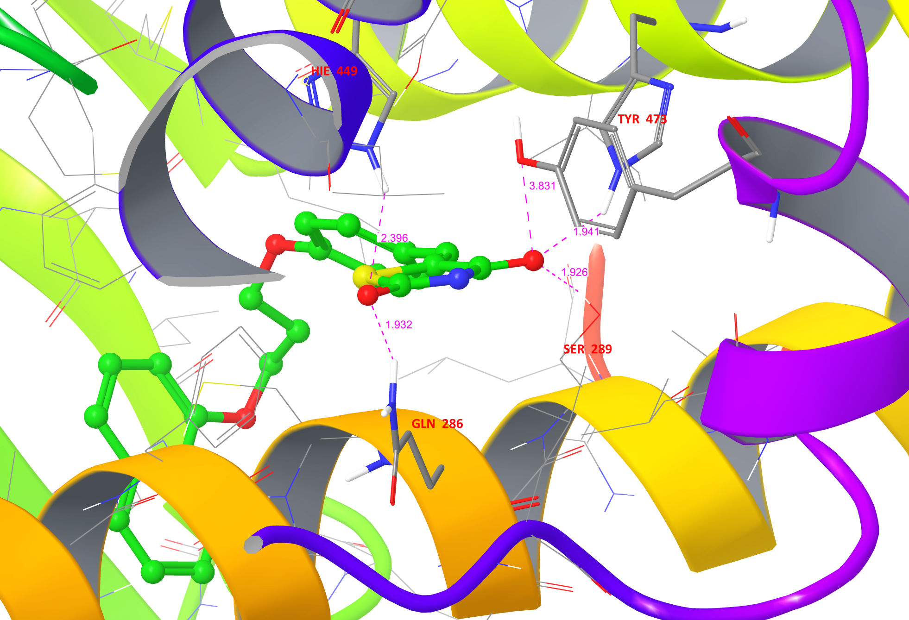
Hydrogen bonding interactions of 10b with LBD of PPAR-γ

Slide 31
Conclusion
The withdrawal of glitazones from the clinical use has created a vacuum in the insulin sensitizer class of antidiabetic agents.
The recent understanding of structure and function of PPARs has resulted in a rationalized the drug discovery process in this therapeutic area.
This new knowledge has led research into developing dual and Pan PPAR agonists, and selective PPAR modulators.
The new research direction has, therefore, created possibilities of developing novel TZDs that are devoid of or show minimal unwanted side effects.

Slide 32
Thank you

Slide 33
Let Us Meet Again
We welcome you to join at 4th International Conference on Medicinal Chemistry & Computer Aided Drug Designing
November 02-04 Atlanta, USA
Please Visit:
http://medicinalchemistry.pharmaceuticalconferences.com/
Regards
Adam Benson
medchem@conferenceseries.net

