Slide 1
About Omics Group
OMICS Group International through its Open Access Initiative is committed to make genuine and reliable contributions to the scientific community. OMICS Group hosts over 400 leading-edge peer reviewed Open Access Journals and organize over 300 International Conferences annually all over the world. OMICS Publishing Group journals have over 3 million readers and the fame and success of the same can be attributed to the strong editorial board which contains over 30000 eminent personalities that ensure a rapid, quality and quick review process.

Slide 2
About Omics Group conferences
OMICS Group signed an agreement with more than 1000 International Societies to make healthcare information Open Access. OMICS Group Conferences make the perfect platform for global networking as it brings together renowned speakers and scientists across the globe to a most exciting and memorable scientific event filled with much enlightening interactive sessions, world class exhibitions and poster presentations
Omics group has organised 500 conferences, workshops and national symposium across the major cities including SanFrancisco,Omaha,Orlado,Rayleigh,SantaClara,Chicago,Philadelphia,Unitedkingdom,Baltimore,SanAntanio,Dubai,Hyderabad,Bangaluru and Mumbai.

Slide 3
Ultrafast dynamics explaining pH probe mechanism in borondipyrromethene benzimidazole compound
Gökhan Sevinç, Betül Küçüköz, Halil Yılmaz, Gökhan Şirikçi, H. Gul Yaglioglu, Mustafa Hayvalı, Ayhan Elmali
http://www.omag.ankara.edu.tr/

Slide 4
Outline
Motivation
Optical Chemical Sensors
Investigated Material
Synthesis
Experiments
Results and Discussion

Slide 5
Motivation
PH Sensors Applications
  Chemical Processing
  Pulp and Paper
  Food and Beverage
  Pharmaceutical
  Biomedical
  Industrial
Requirements for Biomedical and Industrial Applications
real time measurement
continuous monitoring
A perfect solution
Optical Chemical pH Sensors¹
¹ Anal. Chem. 2014, 86, 15−29

Slide 6
Optical chemical sensors senses of electronics¹ eyes and ears capable of seeing and hearing beyond the human perception¹
Optical sensors are based on reagents that change their optical properties on interaction with the analyte of interest.²
The most commonly measured optical properties
Absorption,
Fluorescence intensity
Decay time
Reflectance
Refractive index
Light scattering
Light polarization
Fluorescent pH indicators offer better selectivity and sensitivity than absorption-based pH indicators.²
¹Orellana, G. In Optical Chemical Sensors. Proceedings of the NATO Advanced Study Institute on Optical Chemical Sensors; Baldini, F., Chester, A. N., Homola, J., Martellucci, S., Eds.; Springer: Netherlands, 2006; pp 99−116.
²Dorota Wencel, Tobias Abel, and Colette McDonag, Anal. Chem. 2014, 86, 15−29

Slide 7
Material
Properties of Borondipyrromethene (BODIPY) dyes
  High fluorescence quantum yield¹
  High extinction coefficient
  Narrow absorption and emission bands²
  Fine-tuned spectroscopic and physical properties
  Applications
    Optical engineering
    Fluorescence imaging
    Fluorescent chemo sensors (such as pH probe)³⁻⁵
    …..
BODIPY scaffold
    ¹L. Gai, et al, Sens. Actuators B 182 (2013) 1–6.
²F.L.P. Arbeloa, et al, Int. Rev. Phys. Chem. 24 (2005) 339–374.
³Y. Ando, et al, Sens. Actuators B 121 (2007) 74–82.
⁴W. Qin, et al, ChemPhysChem 6 (2005) 2343–2351.
⁵T.Werner, et al, Fresenius J. Anal. Chem. 359 (1997) 150–154.

Slide 8
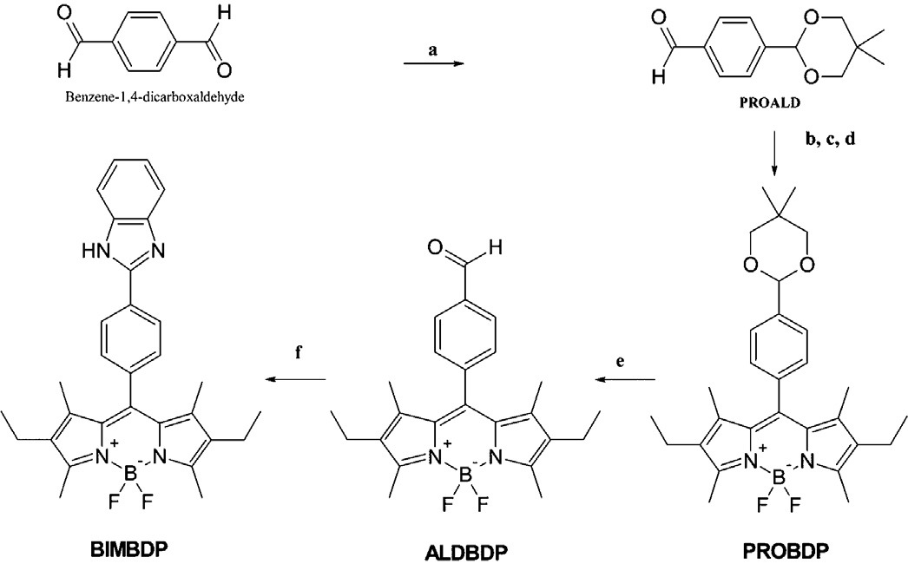
Material
Properties of Benzimidazole compound
A heterocyclic aromatic organic compound
Consists of a fusion of benzene and imidazole
Usually used as ligand for transition metal complexes
Protonation property due to presence of pyridinic
nitrogen atom in benzimidazole
Benzimidazole
Notes:
Benzimidazole, a heterocyclic aromatic organic compound consisting of a fusion of benzene and imidazole, in an extension of the well-elaborated imidazole system, has been used as a carbon skeleton for N-heterocyclic carbenes, usually used as ligand for transition metal complexes.
In chemistry, protonation is the addition of a proton (H+) to an atom, molecule, or ion, forming the conjugate acid.

Slide 9
Synthesis
a: 2,2-dimethylpropane-1,3-diol, p-toluen sulfonic acid, toluen, Ar, refluks, 24h, %50;
b: 2,4-dimethyl-3-ethylpyrrole, trifluoroacetic acid, CH₂Cl₂, rt, 24 h.;
c: 2,3-dichloride-5,6-dicyano-1,4-benzoquinone (DDQ), 45min.;
d: Diisopropylethylamine (DIPEA, 5min) BF₃.OEt₂, 2h.(%20);
e: CH₂Cl₂:H₂O, trifluoroacetic acid, rt, 6h.(%90);
f: o-phenylenediamine, p-TsOH, DMF, 3h. Reflux (%60)
Notes:
Benzimidazole is an organic compound that is composed of a benzene ring fused to an imidazole ring at the 4,5-positions. Benzimidazole is slightly basic. The basic properties of benzimidazole result from the imidazole nitrogen being able to accept a proton. However, when compared to imidazole, benzimidazole is slightly weaker base. The benzene ring acts as an electron withdrawing species and is able to tie up electrons of the imidazole nitrogen through a variety of resonance conformations.
It is expected that the designed BODIPY compound can be used as a pH probe due to the presence of the pyridinic nitrogen atom in benzimidazole moiety [28,29] accepting a proton.
Benzimidazole is an amphiprotic molecule that can both accept and donate a proton or H+ with weak basic and weak acidic character.

Slide 10
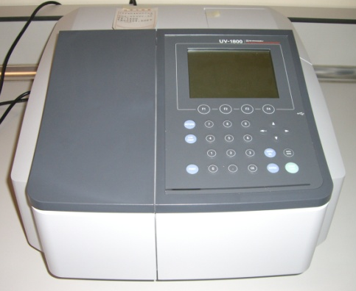

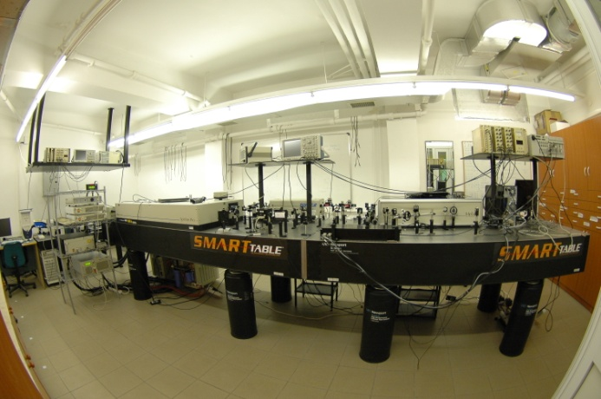
Experimental Techniques
Linear absorption spectroscopy
Emission spectroscopy
Femtosecond transient absorption spectroscopy

Slide 11

Experimental results
1)
1) S0 → S1
2) out of plane vibrations of the aromatic skeleton
2)
3)
3) S0 → S2
(a) Absorption spectra of PROBDP in different solvents. (b) Emission spectra of PROBDP. (c) Absorption spectra of ALDBDP. (d) Emission spectra of BIMBDP. (e) Absorption spectra of BIMBDP. (f) Emission spectra of BIMBDP.
Notes:
There are three main absorption bands: (a) a strong S0 → S1 tran-sition with a maximum appearing at 523 ± 5 nm, (b) a shoulder at 492 nm which is attributed to out of plane vibrations of the aromatic skeleton, and (c) a weaker and broader absorption band at 375 nm, corresponding to the S0 → S2 transition with a high energy level [30]. When the solvent is changed from DMF to hexane the absorption maxima are slightly red shifted which is consistent with the general behavior of meso-substituted BODIPY dyes. This small shift reflects the polarizability of the solvent and has also been observed for all synthesized dyes. On the other hand, the broad absorption band which has been attributed to the S0 → S2 transition is barely affected by solvent polarity.
The Compounds showed characteristic emission features of the BODIPY dyes that fluorescence quantum yields decreased from apolar hexane to polar DMF solvent.

Slide 12
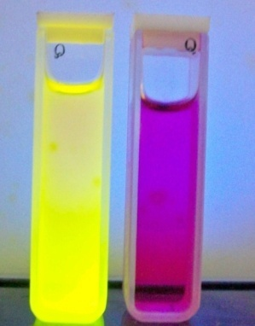
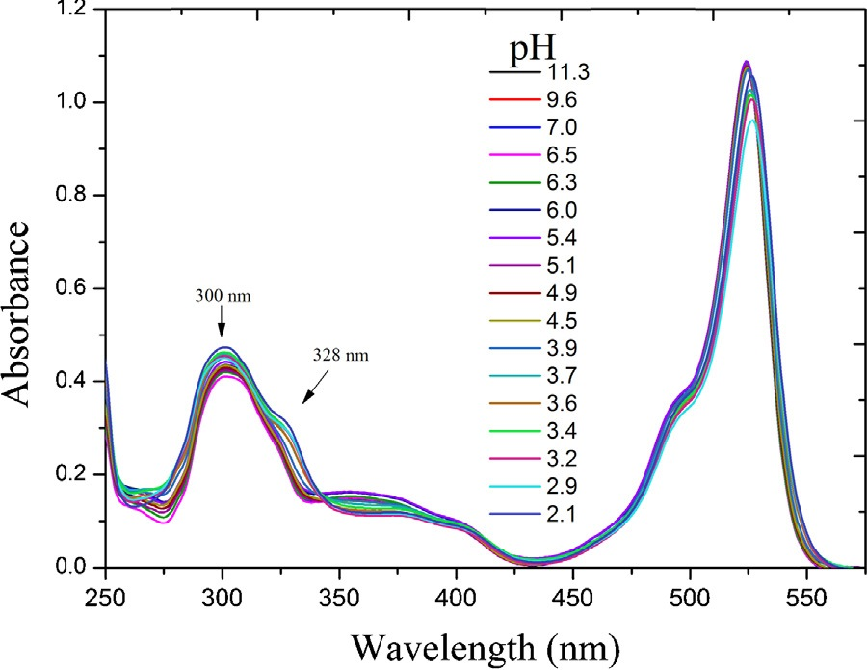
Experimental results
Absorption and emission spectra of BIMBDP in various pH intervals
(dye concentration was 2x10⁻⁵ molar in 5:1 methanol-water mixture at excitation wavelength of 525 nm).
Notes:
It is known that both absorption and emission spectra can be used to determine pH sensing properties of molecules. The pH level of the corresponding solution was adjusted using 0.1 M of HCl or NaOH (sodium hyroxide). Therefore, pH dependent absorption and fluorescence spectra were taken for PROBDP, ALDBDP and BIMBDP. The absorption and emission spec-tra showed no alteration for PROBDP and ALDBDP upon addition of acid and base in various solutions, whereas a significant change was observed in BIMBDP. This can be explained on the basis that the ALDBDP and PROBDP compounds do not have binding sites for the hydrogen ion (Fig. 3) whereas the benzimidazole moiety in Fig. 3 changes of absorbance for BIMBDP compound by pH (dye concentration was 2 × 10−5 mol in 5:1 MeOH:H2 O). BIMBDP has a pyridinic nitrogen atom that can be protonated in acidic environments.
The 2-phenylbenzimidazole has a broad absorption band around 260–320 nm [31] with a maximum at 300 nm. The same band was seen in the absorption spectrum of BIMBDP attributed to the binding of the benzimidazole moiety to the BODIPY core. This absorption band was not observed for the PROBDP and ALDBDP compounds (Fig. 2a). The absorption spectra of BIMBDP in neutral media clearly show the main absorption band of BODIPY moiety at 525 nm and a weak and broad absorption band at a lower energy level (between 350 and 425 nm) ascribed to the S0 → S2 transition. In addition, there is a small overlap between the 350–425 nm band of BODIPY and the main absorption band of the benzimidazole moiety. Absorption intensity is higher within 350–425 nm for BIMBDP with respect to the PROBDP and ALDBDP compounds (Fig. 2e).
Absorption studies revealed the substitution of benzimidazole moiety to the meso position of the BODIPY to cause no elec- tronic perturbation between the two groups in neutral media. However, upon protonation of BIMBDP the absorption band at 300 nm bathochromically shifted and a shoulder was observed at 328nm while the absorbance at 525nm due to the BODIPY sub- unit remained nearly unchanged. These findings show that the absorption spectra of the neutral benzimidazole and the posi- tively charged benzimidazole moieties overlap (260–375 nm) with increasing H+ concentration. The fluorescence properties were examined in the same media under different pH values. BIMBDP is a highly fluorescent molecule in neutral media contrary to aniline substituted BODIPY compounds [21]. Note that, the photophysics of BIMBDP is analogous to pyridine substituted BODIPY [32,33]. The absorption spectrum of borondipyrromethene group remained unchanged upon the addition of acid, however fluorescence intensity quenched significantly at a maximum fluorescence wavelength at 549nm (Fig. 4). Reversibility of the protonated BIMBDP was evaluated with both thin layer chromatography and fluorescence measurements. No degradation of the compound was seen with thin layer chromatography upon addition of pyridine. Also, fluores-cence measurement revealed the addition of pyridine to the acidic solution of BIMBDP resulted in the same fluorescence intensity as observed in the neutral solution of BIMBDP.
In an attempt to check the acidic properties of the pyrrolic nitrogen and its effect on the photophysical properties of BIMBDP, we added base to the solution. Although the fluorescence of BIMBDP was quenched below pH 3, no changes were observed with increasing alkaline concentration. The absorption and emission wavelengths as well as intensities remained unchanged through- out. These findings show that the hydrogen on the pyrrolic nitrogen was not ionized.
These results indicate that the decreasing emission intensity seems to be related to the photoinduced electron transfer (PET) mechanism between the benzimidazole and BODIPY groups. In order to support this idea, ultrafast pump probe spectroscopy experiments with white light continuum were performed for the BIMBDP compound in neutral and acidic media.

Slide 13
Femtosecond transient absorption spectroscopy experiment
Pump pulse
spectrometer
Intensity (au)
Intensity (au)
350
700
Wavelength (nm)
350
700
Wavelength (nm)
Nonlinear absorption
Probe pump pulse comes after pump
Intensity (au)
sample
Linear absorption
350
700
Wavelength (nm)
Intensity (au)
350
700
Wavelength (nm)

Slide 14
Femtosecond transient absorption spectroscopy experiment
Pump pulse
spectrometer
Intensity (au)
500Hz
350
700
Wavelength (nm)
sample
beam
dump
Probe pulse
Intensity (au)
1000Hz
350
700
Wavelength (nm)

Slide 15
Intensity(au)
Pump pulse
Intensity (au)
spectrometer
500Hz
350
700
Wavelength (nm)
350
700
Wavelength (nm)
Intensity(au)
350
700
Wavelength (nm)
sample
beam
dump
Intensity(au)
Intensity (au)
Probe pulse comes after the pump pulse
1000Hz
350
700
Wavelength (nm)
350
700
Wavelength (nm)

Slide 16
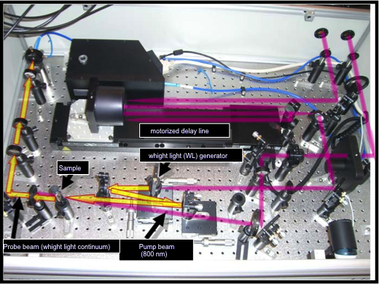
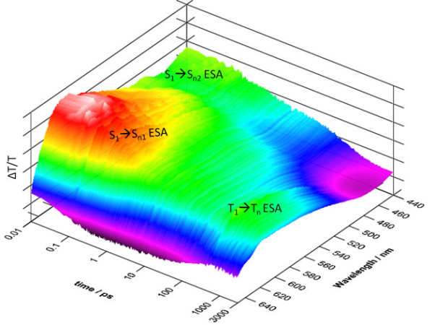
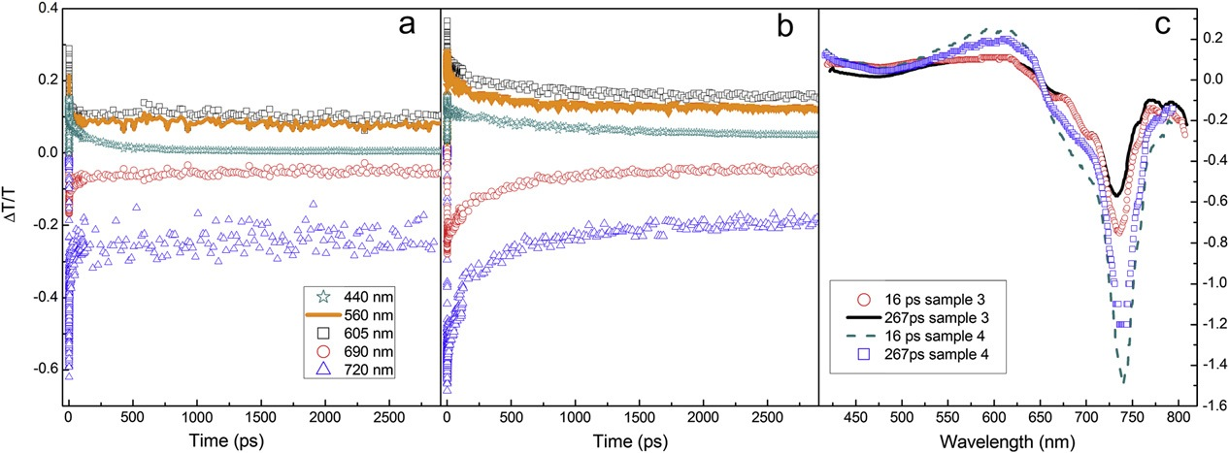
Femtosecond transient absorption spectroscopy experiment
Example Transient Absorption Data
SA
SA
ESA
ESA
SA
SA

Slide 17

Experimental results
Femtosecond transient absorption spectra as a function of time for
unprotonated and
protonated compound of BIMBDP
Notes:
The white light continuum was used as a probe beam for ultra- fast pump probe spectroscopy experiments. The linear absorption maxima of the protonated and unprotonated BIMBDP compound (520 nm) was used as the pump beam for the experiment. Fig. 5a and b indicates transient absorption spectra as a function of time for the unprotonated and protonated compounds, respectively. The spectra for the unprotonated compound (Fig. 5a) shows strong bleach signal around 528 nm. This signal can be attributed to the ground state bleach and stimulated emission of the BODIPY moiety in the BIMBDP compound [32]. In the case of the protonated com- pound, the bleach signal decreases considerably and another bleach signal appears at a lower energy level (around 675 nm).

Slide 18
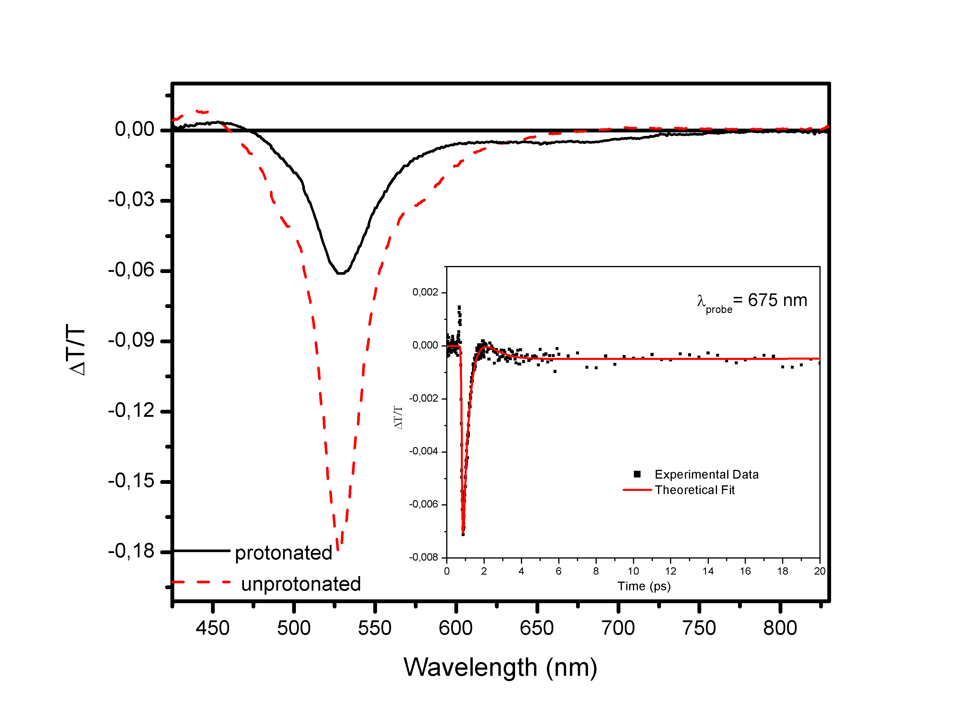
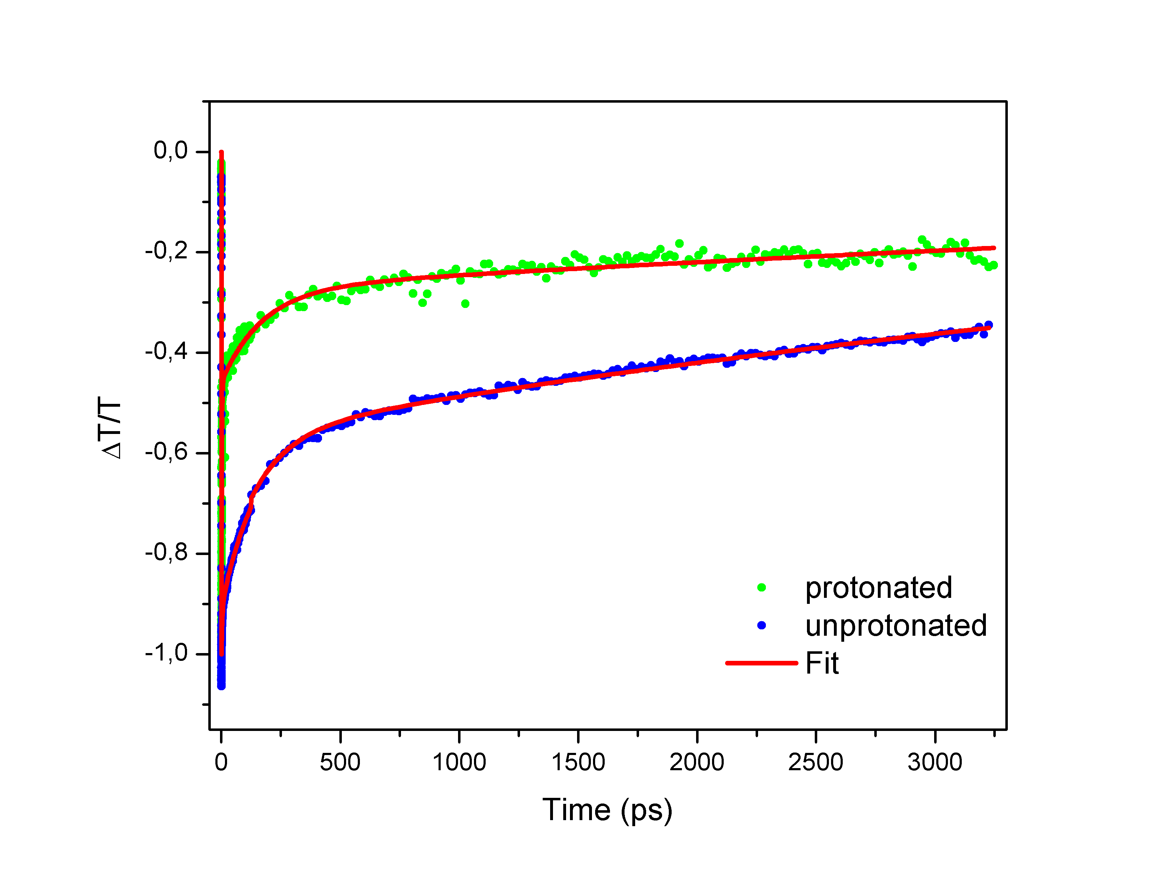
Experimental results
532 nm probe wavelength
Femtosecond transient absorption spectra of BIMBDP compound in (5:1 MeOH-H₂O) with different pH value. The Fig. inset indicates fast decay of transient band corresponding to LUMO energy level of benzimidazole.
Notes:
Fig. 6 shows femtosecond transient absorption spectra of the unprotonated (pH=7.0) and protonated (pH=2.1) BIMBDP compound. Bleach signals for protonated and unprotonated compounds were fitted to the multi-exponential decay functions. Signal for the unproto- nated compound showed three decay components (a couple of ps, around hundred ps and very long component). Although the signal for the protonated compound has similar decay components, it has an additional ultrafast component (about 600 fs) as seen in the inset of Fig. 6. In addition, the lifetime of the bleach signal of BIMBDP around 528 nm decreases with protonation (Fig. 7). Due to the ultra- fast component, this signal may be attributed to weakly stimulated emission from a charge transfer state that may exist at an energy level below the LUMO level of the BODIPY moiety in BIMBDP. This lower energy level could be attributed to the LUMO energy level of benzimidazole moiety in BIMBDP compound. Because of the short lifetime of this lower energy level, the electron population of the LUMO level of BODIPY moiety in BIMBDP (bleach at 528 nm) decreases through this lower energy level (Fig. 7). Therefore, fluo- rescence from the LUMO level of the BODIPY moiety in BIMBDP is quenched when protonated. In an attempt to make sure that the LUMO level of benzimidazole moiety in BIMBDP decreases during protonation we performed DFT calculation.

Slide 19
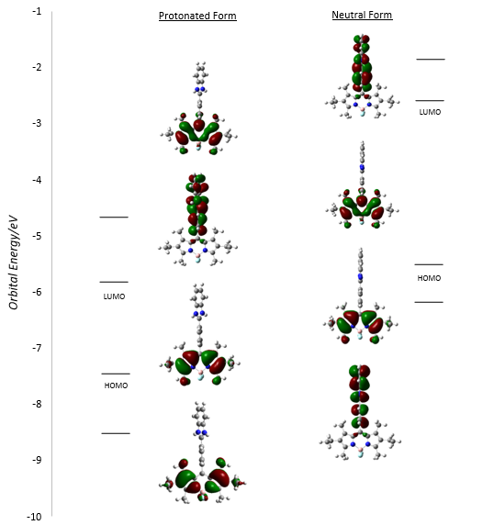
Density Functional theory calculation
Energy levels and frontier molecular orbital distributions of the novel BODIPY compound in protonated and neutral states respectively
Notes:
Density functional theory is a quantum chemistry calculation approach, which could be very helpful to the explanations of var- ious phenomena in chemical systems. The photoinduced electron transfer (PET) mechanism can be enlightened using this powerful tool [34]. This mechanism depends on the change of energy lev- els of the frontier molecular orbitals of a specific compound due to different environments. In our case, a molecular modeling study was performed based on our novel BODIPY compound using DFT. Computational details can be found in the Supporting Informa- tion section. As can be seen from Fig. 8, our calculations revealed that the HOMO and LUMO energy levels of BODIPY are located between HOMO−1 and LUMO+1 energy levels of benzimidazole moiety in the neutral state. However, protonation of benzimida- zole moiety dramatically changes the energy levels and the LUMO energy (−5.84 eV) of benzimidazole moiety drops under the LUMO energy of the BODIPY moiety (−4.66 eV) showed in Fig. 8. This find- ing explains the nature of the electronic transfer from the BODIPY moiety to the benzimidazole moiety upon protonation and reflects complete agreement with the results of a similar study.

Slide 20
Proposed mechanism
Proposed mechanism for fluorescence quenching of BIMBDP in acidic media attributed by d-PET
fluorescence mechanism
quenching mechanism
Notes:
Based on our experimental and theoretical results discussed above we suggest donor-PET mechanism depicted schematically in Fig. 9 for this study. According to the mechanism, the energy levels of BODIPY stand between that of the benzimidazole group. Therefore, the fluorescence signal comes from the LUMO level of BODIPY moiety of BIMBDP compound in neutral state. Upon pro- tonation, the HOMO and LUMO energy levels of benzimidazole moiety decrease resulting in a decrease of the LUMO level of benz- imidazolium moiety becoming lower than that of BOIDPY moiety.
When the borondipyrromethene group is excited in acidic media, electron transfer occurs from the LUMO energy level of the BODIPY subunit to that of the benzimidazole group causing fluores- cence quenching as observed in the fluorescence and pump probe experiments. This charge transfer is known as donor type photoin- duced electron transfer (d-PET). No drastic wavelength shifts were observed similar to other fluorescent probes operating based on the d-PET mechanism.

Slide 21
Result and Discussion
We have designed and synthesized new BODIPY compounds
Absorption and emission properties were investigated as a function of H⁺ concentration
Drastic fluorescence quenching was observed upon protonation
Photo-induced electron transfer was proposed as an underlying mechanism
Underlying mechanism was proved by DFT calculation and ultrafast transient absorption experiments

Slide 22

Thank you for your patience

Slide 23
Let Us Meet Again
We welcome all to our future group conferences of Omics group international
Please visit:
www.omicsgroup.com
www.Conferenceseries.com
http://optics.conferenceseries.com/

