Slide 1
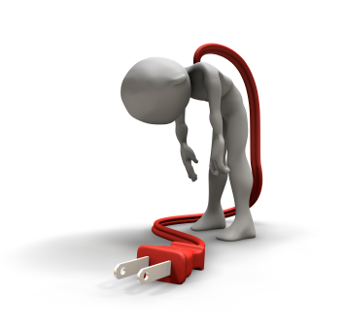
The effect of tDCS on fatigue of multiple sclerosis patients
(review of randomized control clinical trials)
Atefe Ashrafi
MSc Student of Physical Therapy, USWR, Tehran, Iran

Slide 2
Introduction
Multiple sclerosis characteristics
Multiple sclerosis fatigue
Conventional treatments of fatigue of multiple sclerosis
Trans cranial direct current stimulation (tDCS)
tDCS in MS fatigue

Slide 3
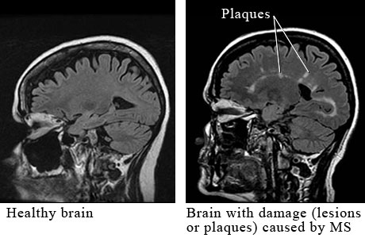
Immune-mediated inflammation
CNS neurodegeneration
Demyelination
MS Characteristics

Slide 4

Multiple sclerosis has a variable and unpredictable course, with symptoms that can include:
Weakness
Visual loss
Bowel and bladder incontinence
Fatigue
Cognitive impairment
Mood symptoms

Slide 5
Cycle of MS Symptoms: Related and Interdependent
↑ Fatigue
Depression
↓ Cognitive function
↑Sexualiy issues
↓ Sleep
↑ Spasticity
Constipation
↑ Bladder
& Bowel problems

Slide 6

MS constitutes the second most common cause of handicap in young adults
A significant percentage of individuals affected by multiple sclerosis (MS) report fatigue as their most disabling symptom(%75)

Slide 7
Multiple sclerosis fatigue
Fatigue is defined as
A “subjective lack of physical and/or mental energy that is perceived by the individual or caregiver to interfere with usual and desired activities” (MS Council, 1998) and is often considered by the patients as their most disabling symptom.

Slide 8
Fatigue
Central
Secondary
Peripheral
Primary

Slide 9
The pathophysiology of fatigue
Some studies suggest an involvement of
Proinflammatory cytokines
Cerebral lesions
Cortical atrophy
Endocrine dysfunction
Axonal damage.

Slide 10
Fatigue severity
The anatomical landmarks of fatigue in MS
Functional and structural alterations in the frontal cortex
Fatigue
scores
White matter lesions in the left frontal cortex as well as with atrophy of the left superior frontal gyrus and left precentral gyrus

Slide 11
MS fatigue has multifactorial nature
Structural or functional brain abnormalities
Neurochemical imbalance
Neuroendocrine dysfunction
Neuroimmune dysregulation

Slide 12
The multimodal approaches able to ameliorate fatigue acording to the International guidelines:
Fatigue management
Physical activity
Diet features
Energy effectiveness strategies
Nevertheless, none of these approaches applies in a systematic manner

Slide 13
Fatigue management
The two most common being progressive resistive training and fatigue management programs is:
Exercise
Behavior change interventions
Drug therapies
There is none specifically indicated for this symptom

Slide 14
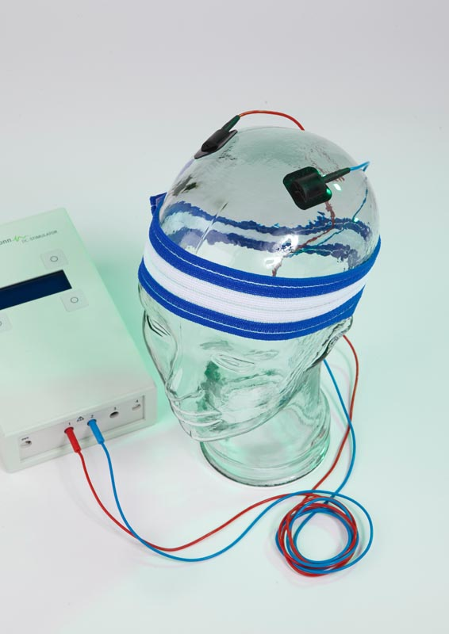
Transcranial direct current stimulation (tDCS)
Non-invasive
painless brain stimulation
A constant, low intensity direct current

Slide 15
tDCS has two types of stimulation
Anodal stimulation
acts to excite neuronal activity
Cathodal stimulation
inhibits or reduces neuronal activity

Slide 16
Advantages AND Side effects
Advantages:
Cheap
Non-invasive
Painless
Safe
Easy to administer
The equipment is easily portable
The most common side effect of tDCS is a slight itching or tingling on the scalp.

Slide 17
How long do effects from tDCS last?
The immediate effects
from 5 to 90 minutes after the end of the stimulation session
With repetitive stimulation
educe longer lasting, and more “ingrained” effects

Slide 18

The aim of this research
To review the articles that considered the effect of tDCS on fatigue of MS patients

Slide 19
Record represented in Pub Med, science direct, google scholar, scopus, elsevier and manual search. date base searching (n=44)
Duplicated articles excluded (n= 9)
Flowchart of included studies
Potential relevant articles after duplicates removed (n=35)
Articles excluded based on title and abstract screening (n=12)
Full text articles assessed for eligibility (n=23)
Articles excluded based on full-text screening (n=12)
Articles included in this study (n=11)

Slide 20
Summarized details of the studies in the effect of tDCS on fatigue of multiple sclerosis
No. | Author/ Year | Purpose | Subjects | Intervention | Duration of Treatment | Outcome Measures | Conclusion
1 | Chalah et al.2017 | Effects of left DLPFC versus right PPC tDCS on multiple sclerosis fatigue | 10 patients with multiple sclerosis fatigue | three anodal tDCS blocks: active stimulation over the left dorsolateral prefrontal cortex (DLPFC), active stimulation over the right posterior parietal cortex (PPC), and sham stimulation over either cortical site | five consecutive daily sessions and were held apart by a washout interval of three weeks. | active left DLPFC stimulation significantly ameliorated fatigue and Mood improvement was exclusively obtained following active right PPC stimulation | After three blocks interventions only anodal tDCS over the left prefrontal in treatingMS fatigue
2 | Cancelli at al.2017 | The effect of bilateral whole-body somatosensory cortex stimulation to relieve fatigue in multiple sclerosis | 10 patients with multiple sclerosis fatigue | stimulation targeted the bilateral whole-body primary somatosensory cortex (S1)with an occipital cathode | 15 minutes a day for five consecutive days | The amelioration of fatigue symptoms after Real stimulation was significantly larger than after Sham stimulation and Anodal whole body S1 induced a significant fatigue reduction in mildly disabled MS patients | neuromodulation Interventions such as tDCS might be a suitable non-pharmacological treatment for MS fatigue

Slide 21
No. | Author/ Year | Purpose | Subjects | Intervention | Duration of Treatment | Outcome Measures | Conclusion
3 | Ferrucci et al.2014 | The effect of anodal tDCS applied over the motor cortex in MS patients with fatigue | 25 patients with MS fatigue | They delivered anodal and sham tDCS over the motor cortex | They delivered anodal and sham tDCS in random order in two separate experimental sessions at least 1 month apart 15 minutes once a day for 5 consecutive days | The fatigue score significantly decreased after anodal tDCS in 65% of the patients | anodal tDCS applied over the motor cortex, could improve fatigue in most patients with MS
4 | Saiote et al,2014 | to assess whether fatigue symptoms can be reduced by excitability-enhancing anodal tDCS | Fourteen patients with MS fatigue | tDCS was applied over the left prefrontal cortex of MS patients with fatigue | They received tDCS stimulation for five consecutive days and Symptoms were tracked for 1 month via questionnaires | the scores of the fatigue scales were not altered by tDCS | They did not find a robust effect of anodal tDCS on MS fatigue
5 | Ayache et al.2016 | To evaluate the tDCS effects over the left dorsolateralprefrontalcortex(DLPFC) on pain, attention,fatigue,andmood in MS patients | Sixteen MS patients with chronic neuropathic pain and fatigue | tDCS was applied over the left dorsolateralprefrontal cortex(DLPFC) | They Received two anodal tDCS blocks (active or sham), for three consecutive daily tDCS sessions and held apart by 3 weeks | There were no effects of any block on fatigue | They did not find a ameliorating effect of anodal tDCS on MS fatigue

Slide 22
6 | Tecchio et al. (2015) | to assess the tDCS interventions can changes in the excitability of sensorimotor cortical areas in MS fatigue | 13 patients with MS fatigue | tDCS was applied over the whole body S1 personalized of MS patients with fatigue | They received tDCS stimulation for 15 min at 5 days | Fatigue reduced after active but not sham tDCS at the end of the intervention | The tDCS treatment was more effective against MS fatigue when the electrode was focused on the bilateral whole body somatosensory area
7 | Katrin Hanken et al.2016 | to investigate whether anodal transcranial direct current stimulation (tDCS) over the right parietal or frontal cortex counteracts fatigue-as-sociated vigilance decrement and subjective fatigue | 52 healthy participants | tDCS was delivered to the right parietal cortex or the right frontal cortex | Healthy participants received tDCS during the first 20 min of a 40-min lasting visual vigilance task | right parietal stimulation, but not right frontal stimulation, counteracts the increase in RT associated with vigilance decrement | Anodal tDCS over the right parietal cortex can counteract the increase in RTs during vigilance performance, but not the increase in subjective fatigue
8 | Katrin Hanken et al.2016 | to investigate whether anodal transcranial direct current stimulation (tDCS) over the right parietal or frontal cortex counteracts fatigue-as-sociated vigilance decrement and subjective fatigue | 46 MS patients experiencing cognitive fatigue | anodal tDCS over the right parietal cortex | MS patients received 20 min tDCS before patients performed a 20-min lasting visual vigilance task | tDCS had a significant effect on vigilance decrement in mildly to moderately cognitively fatigued MS patients | This finding is compatible with our model of fatigue in MS, suggesting a dissociation between the feeling and the behavioral characteristics of fatigue
No. | Author/ Year | Purpose | Subjects | Intervention | Duration of Treatment | Outcome Measures | Conclusion

Slide 23
No. | Author/ Year | Purpose | Subjects | Intervention | Duration of Treatment | Outcome Measures | Conclusion
9 | Tecchio et al. 2014 | To assess the effect of bilateral somatosensory cortex neuromodulation in MS fatigue | Ten fatigued multiple sclerosis patients | anodal bilateral primary somatosensory areas transcranial direct current stimulation | two blocks of 5-day, for 15min | The real neuromodulation OF primary somatosensory cortex reduce fatigue in all patients | Anodal tDCS over bilateral somatosensory areas was able to relief fatigue in mildly disabled MS patients
10 | E Charvet et al.2017 | To assess the effect of tDCS in MS fatigue | 26participant in active tDCS group and 20 participant in control group | Anodal over the left Dorsolateral prefrontal cortex | for openlabel tDCS received 10 sessions of 20 minute × 1.5 mA stimulation and for Control participants were done cognitive training games for 10 sessions × 20 minutes | fatigue reduced in the active group | tDCS is a potential treatment for MS-related fatigue
11 | E Charvet et al.2017 | To assess the effect of tDCS in MS fatigue | 17participant in active tDCS group and 14 participant in sham tDCS group | Anodal over the left Dorsolateral prefrontal cortex | Participants completed 20 sessions of active tDCS or sham tDCS, each session lasting 20 minutes | there was statistically significant reduction for the active group | tDCS is a potential treatment for MS-related fatigue

Slide 24
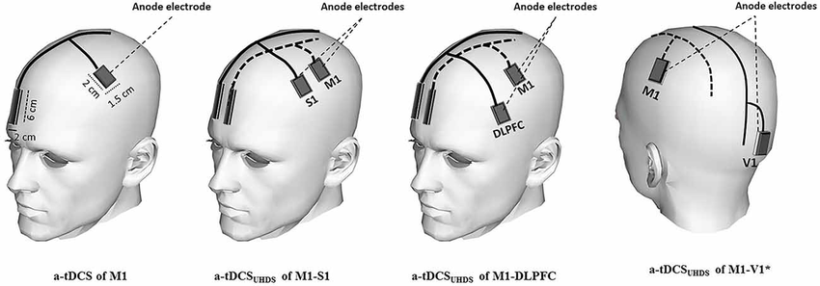
Electrode placement of some variant protocols

Slide 25
Disccusion:
To sum up what has been recap regarding to the contradictory results among different studies it seems difficult to conclude that tDCS is an effective approach in the treatment of fatigue in patients with MS however further research is necessary

Slide 26
Conclusion:
In conclusion because this is a new method in treatment of fatique in MS patients, and the number of studies are rare and also their methodology are varied, but many of these articles have reported positive effects of TDCS in treatment of fatigue. As this treatment has less adverse effects , we need to consider more studies with specific method and greater sample sizes for achieve reliable results and a specific protocol for the treatment of fatigue in MS patients.

Slide 27

Thanks for your attention

