Slide 1


Family Presence During Resuscitation:
To Be or Not To Be
Shirley Strachan-Jackman RN(EC), MN, ENC(C)
Nurse Practitioner Emergency Medicine
Toronto Western Hospital- University Health Network
Euro Nursing 2015- July 29, 2015

Slide 2
Outline
This presentation will discuss the findings of our phenomenological study that was undertaken to describe “the lived experiences of families who were present during cardiopulmonary resuscitation (CPR)” in the emergency department setting.

Slide 3
Significance
A better understanding of family presence during resuscitation, will inform how care can best support the needs of individuals who wish to be at their family members bedside

Slide 4
Question?
Recommend family presence during resuscitation
Recommend against family presence during resuscitation

Slide 5
Background
Family presence during resuscitation (FPDR) has gained increasing attention over the past few decades
Routinely family members were not invited to be present
Unit Council- families should be given the opportunity to be in the room during a resuscitation
Research Challenge

Slide 6
Research Question
What is the structural description of family presence during resuscitation in the emergency department?
The purpose is to describe family members lived experiences when present during CPR of a loved one.
Giorgi’s Phenomenological Analysis

Slide 7
Process
Family members were given a choice
Facilitator assigned to family
Given a package outlining the study before leaving the department
Called to see if they would participate- consent
Interview

Slide 8
Family Facilitators
Ensure that relatives understand that they can choose whether or not to be present during resuscitations
Explain that someone will be designated to care for them, regardless of their choice
Discuss the patients’ illness or injuries and what the relatives will see when the enter the room
Ensure relatives understand that they can leave and return at any time
Explain resuscitation procedures in simple terms as the occur

Slide 9
Interviews
Six participants consented & interviewed by two study team members
Interview location determined by participant
Audio Recorded
Family member was asked one question-
    “Describe your experience of being present during the resuscitation of your loved one.”
Participants were emotional & able to talk about their experience in great depth

Slide 10
Analysis
2 study team members & 2 research experts in phenomenological analysis & telephone consultation with Giorgi
Interviews were transcribed verbatim
Over the course of 5 meetings:
  Each analysis team member:
    Read & re-read each transcripts
    Identified meaning units for each transcript
Together, discussed meaning units & identified focal meaning(s) for each transcript
Focal meanings were discussed & transformed into language that best expressed the participants experience of witnessing resuscitation

Slide 11
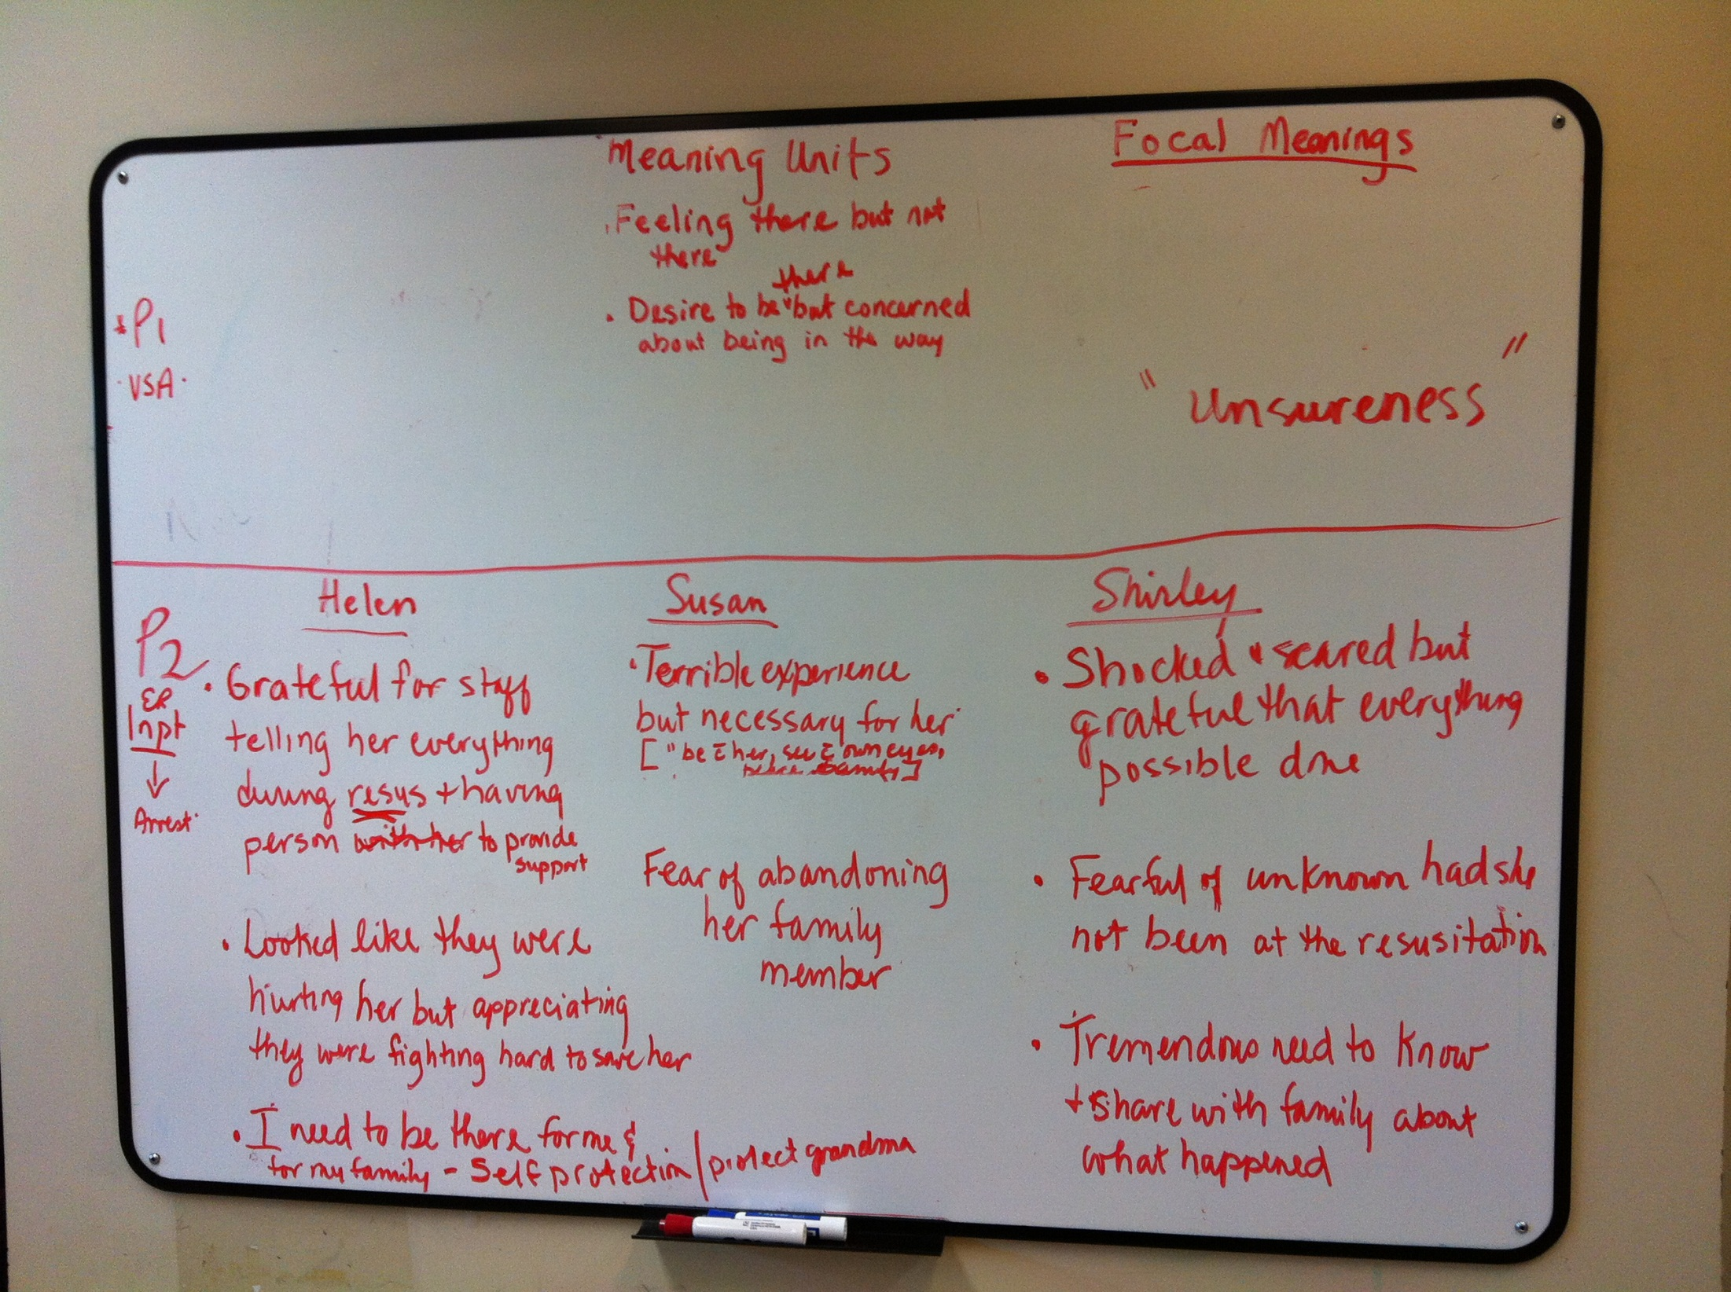

Slide 12
Meaning Units
Feeling there but not there
Desire to be there but concerned about being in the way
Hard, difficult experience but necessary to see with their own eyes
Grateful for staff telling her everything/ support
Shocked and scared but grateful everything possible was done
Looked like the staff was hurting the patient at times but appreciated that they were fighting to save the patient

Slide 13
Meaning Units
Fear of abandoning her family unit
Fearful of the unknown if they had not been present
Need to know and be able to share with family members what happened
Wanting to be close to loved ones
Being reassured by seeing everything possible was done
Confusion, disbelief, denial

Slide 14
Meaning Units
“Like a movie”...there but not there
Memories were haunting, remembering what she saw
Afraid for their loved one
Hoping and praying she would come back to life
Emotional rollercoaster, relief when resuscitated
Important role for English speaking family members to be able to explain what happened

Slide 15
Focal Meaning
Push/ pull- striking a balance
Need to be guided in this foreign land/ foreign language by the facilitator
Hard and difficult experience- intense and profound- but wanted to be there
Expectations weigh heavily on the family member who is present, but was necessary in order to fulfill the family expectations
Spiritual connections
Vacillating emotions

Slide 16
Study Finding:
General Structural Description
The essence of witnessed resuscitation is: A profound emotional experience where the onus on the witnesser demands in the moment, shifting of how to be within their role as conduit INTERMEDIARY between health care team and family during this critical incident in the patient’s and family‘s life journey

Slide 17
Recommendations
  Recognize that care is an opportunity to strengthen individuals during a critical time in a person/family’s life journey, and positively impact on family’s health
Nurse Coach:
  Focus on the Witnesser
  Appreciate individual as family
  Help them to negotiate how to be
  Address emotional issues as needed
  Provide information/interpret what is happening

Slide 18
Recommendations
Health Care Team –
Recognize importance of witnesser who can provide information about the patient in the moment
Information valuable to support care and decisions

Slide 19
Limitations
6 participants
older with chronic illness
2 successfully resuscitated but died within 3 months
all female
all non English speaking ( TWH Catchments )

Slide 20
Summary
“Resuscitation teams often take for granted that they will be the last people to be in the presence of dying patients. But being present in these last moments is a privilege, and sharing this privilege may be the greatest comfort that healthcare professionals can offer grieving relatives” (Boucher, 2010)

Slide 21
Acknowledgements
Participants
Funders – Nursing Research Challenge & Krembil Funding
Study Team
  Shirley Strachan-Jackman; Sheila Foggie; Sharon Foskett; Licinia Simoes; Tim Stewart; Helen Kelly
Consultants: Dr. Debra Bournes, Nadine Cross, Dr. Sue Bishop; Dr. Amadeo Giorgi,
TWH – ER Staff

Slide 22

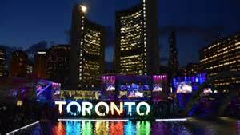

Toronto- Pan/ ParaPan Games

Slide 23

Thoughts? Questions?

