Slide 1

Health-related Quality of Life (SRS-22r) of Adolescents with Idiopathic Scoliosis in Korea
Choi, Jihea, PhD, RN, CPNP
Department of Nursing, Wonju College of Medicine
Yonsei University, South Korea

Slide 2
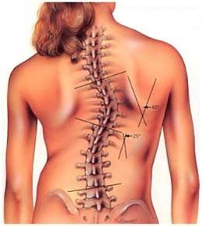
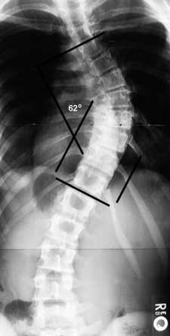
Introduction
Scoliosis
A complex spine deformity involving three-dimensional deviation of the spinal axis by deformation with thoracic lordosis, lateral curvature, and vertebral rotation.
(Trobish et al., 2010)
Diagnosis
By exceeding 10° of spinal curvature on an anterior-posterior X-ray image.
(Trobish et al., 2010)

Slide 3
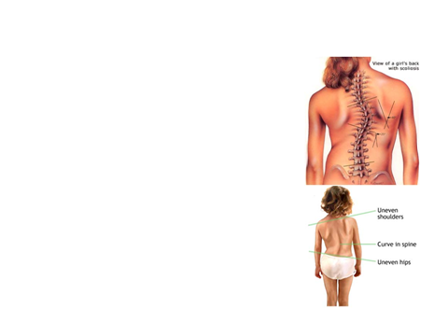
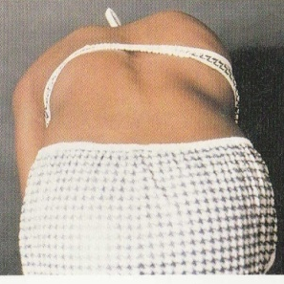
Introduction
Adolescent idiopathic scoliosis (AIS)
One of the most common musculoskeletal problems in adolescents, and the prevalence rate of AIS is more than 80% of scoliosis cases.
Causes are unknown.
Age of onset 10 years of age to skeletal maturity.
Predominant in females, about 3~5times.
(Wick et al., 2009)

Slide 4




Introduction
Prevalence of AIS in Korea
0.35% (1998)
1.35% (2002) Rapidly Increasing
6.17% (2008)
Prevalence of AIS in U.S.A
2~4% (2009)
(National Scoliosis Foundation and Depuy Spine, 2009)
Prevalence of AIS in Japan
0.87% (2011)
(Suh et al., 20011)
(Ueno et al., 2011)
1st Question:
What are the specific characters of AIS prevalence among Korean adolescents?
Increasing Pattern of AIS Prevalence Rate in Korea
Notes:
In Korea, the prevalence rate of AIS from 10 to 16 years old has rapidly increased about 4.5 times in just 6 years from 1.3% in 2002 to 6.2% in 2008 (3).
Korea has a high prevalence rate compared to other countries such as 2-4% in the United States and 0.87% in Japan (4, 5).

Slide 5
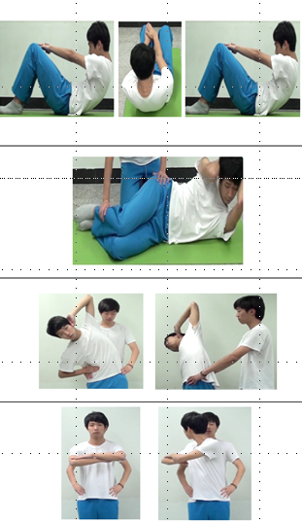
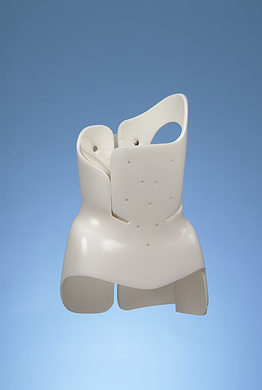
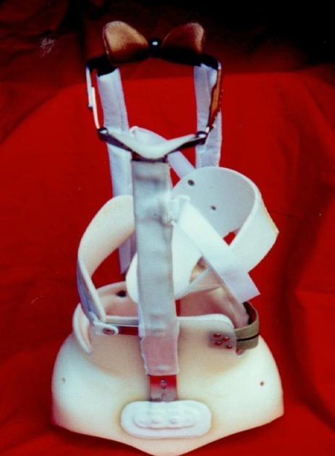
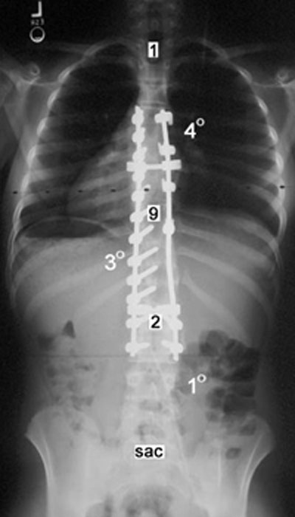
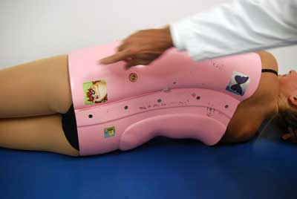
Introduction
Medical Treatments for AIS by Disease Severity
Cobb’s angle | Diagnosis | Treatment
10°~25° | Mild Scoliosis | Observation
25°~45° | Moderate Scoliosis | Exercise Good Posture Electronic stimulation Brace
>45° | Severe Scoliosis | Operation
Notes:
Treatment of mild scoliosis (Cobb’s angle less than 25°) should be followed up in periodic outpatient visits (every 4 to 6 months) for evaluation of spinal curvature progression, or physiotherapy can be started for mild scoliosis.
Brace treatment is recommended for moderate scoliosis (Cobb’s angle more than 25° and less than 40°) before termination of bone growth and for Cobb’s angle progression more than 5° in 6 months.
Surgical correction and spine stabilization is considered for severe scoliosis (Cobb’s angle exceeding 45°), especially when the Cobb’s angle or symptoms of scoliosis are expected to worsen (1).

Slide 6
Introduction
Effects of AIS to Adolescents
Physical
Limited physical activity cause of asymmetry of shoulder height, scapular, flank shape, hip height, & etc.
Decreased body function, Muscular-skeletal pain
Psychological
Decreased body-image
Social
Impairment of interpersonal relationship, especially with peer
Maladjustment at school
Self-abasement, Depression
Decreased QoL
(Burns et al., 2009; Lee, 2008)
(Choi et al., 2011; Sapountzi et al., 2001)
(Kim, 2010; Park, 2009)
Notes:
Without adequate treatment, AIS can lead to increasing physical, psychological, and social problems, including limited physical activities, musculoskeletal pain, low body image, self-depreciation, maladjustment at school, and difficulty in peer relationships (6, 7).
All of these factors can affect the quality of life of adolescents with idiopathic scoliosis (8).

Slide 7

Introduction
HRQoL
Assessments of health related quality of life have focused more on physicians and researchers because this allows assessment of a patient’s perception of adolescents with idiopathic scoliosis condition and medical treatment effects (Asher et al., 2006).
Scoliosis Patient Questionnaire :Version 30
SRS 24 Patient Questionnaire(Haher et al., 1999)
SRS 22 Patient Questionnaire (Asher et al., 2000)
SRS 22-revision Patient Questionnaire(Asher et al., 2006)
Notes:
Interest in quality of life (QoL) in adolescents with idiopathic scoliosis has increased recently.
Assessments of health related quality of life (HRQoL) have focused more on physicians and researchers because this allows assessment of a patient’s perception of their condition and medical treatment effects (9, 10).
Haher et al. developed a simple and practical HRQoL questionnaire to assess the QoL of patients with scoliosis as a disease specific outcome measurement (11).
The SRS-22r (Scoliosis Research Society 22 revision) is widely used in English-speaking countries and has been recently translated and cross-culturally adapted for various languages including Korean (12, 13).

Slide 8
Introduction
Function/
Activity
A better understanding of the HRQoL of idiopathic scoliosis adolescents is needed to identify patient perceptions of their condition and treatment effects by severity of disease, which will contribute to improved care.
Pain
HRQoL
SRS-22r
Image/
Appearance
Mental
Health
Satisfaction
with management
2nd Question:
How is different the HRQoL by severity of IS?
Notes:
A better understanding of the HRQoL of idiopathic scoliosis adolescents is needed to identify patient perceptions of their condition and treatment effects, which will contribute to improved care.
However, there are no studies that identify differences in the HRQoL by AIS severity in Korea.

Slide 9
Purpose
1
  To characterize disease severity in adolescents with idiopathic scoliosis (AIS) in Korea.
2
To characterize health related quality of life (HRQoL) by disease severity in adolescents with idiopathic scoliosis (AIS) in Korea.
Notes:
Thus, authors had some research questions on the adolescents’ HRQoL by severity of idiopathic scoliosis.
There are two research purposes
The first, To characterize disease severity in adolescents with idiopathic scoliosis (AIS) in Korea.
The second,To characterize health related quality of life (HRQoL) by disease severity in adolescents with idiopathic scoliosis (AIS) in Korea.

Slide 10
Methods
Descriptive study design
Study participants: 110 adolescents with idiopathic scoliosis
Study location: an outpatient orthopedic clinic and a rehabilitation clinic in two (K, S) tertiary hospitals located in Seoul, Korea
Data collection: From November 2010 to August 2012
To recruit study participants, research assistants explained the purpose and intention of this study and asked for agreement to participate from adolescents and their legal guardians
(IRB #: K hospital 3-2010-0172, S hospital 4-2011-0682
Notes:
This was a descriptive study designed to identify HRQoL according to severity of idiopathic scoliosis in Korean adolescents.
One hundred and ten adolescents with idiopathic scoliosis participated.
Participants were recruited from an outpatient orthopedic clinic and a rehabilitation clinic in two tertiary hospitals located in Seoul, Korea.
Data were collected for one year from November 2010 to August 2012.
To recruit study participants, research assistants explained the purpose and intention of this study and asked for agreement to participate from adolescents and their legal guardians.

Slide 11
Study Participants
Inclusion criteria:
  primary diagnosis of AIS determined by expert clinicians
  Cobb’s angle over 10°
  age of 10-19 years old
  participants and their legal guardians agreed to participate
Exclusion criteria:
  any diagnosable musculoskeletal disease except scoliosis
  cognitive impairment causing inability to read and understand the questionnaires
Notes:
The inclusion criteria for study participants were that adolescents had to have a primary diagnosis of AIS determined by expert clinicians, Cobb’s angle over 10°, and age of 10-19 years old, In addition, the participants and their legal guardians agreed to participate.
The exclusion criteria were any diagnosable musculoskeletal disease except scoliosis and cognitive impairment causing inability to read and understand the questionnaires.

Slide 12
Materials
Cobb’s angle & Type of treatment
  Collected from the medical records with the permission
HRQoL
  Used SRS-22r
  Consists of 22 questions
    function/activity (5 items), pain (5 items), self-image/appearance (5 items), mental health (5 items), and satisfaction with management (2 items)
    Each item allowed 5 response levels from worst to best (scored 1-5)
    Higher mean score indicates higher quality of life
    Cronbach’s α of the measurement was 0.84 in this study
Notes:
The Cobb’s angle and type of treatment were collected from the medical records with the permission of participants and their legal guardians.
From previous studies, personal characteristic study variables that are significantly related to the HRQoL of adolescents with idiopathic scoliosis were selected: gender, age, and type of treatment (7, 8).
HRQoL was assessed using the revised Scoliosis Research Society-22r (SRS-22r) (9). Authors carried out translation and adaptation processes following published guidelines for the cross-cultural adaptation of self-report measures (15).
SRS-22r includes five domains of function/activity, pain, self-image/appearance, mental health, and satisfaction with management. It consists of 22 questions: function/activity (5 items), pain (5 items), self-image/appearance (5 items), mental health (5 items), and satisfaction with management (2 items). Each item allowed 5 response levels from worst to best (scored 1-5).
Results are expressed as the mean score of each domain or a total mean score of the measurement. Higher mean score indicates higher quality of life. Cronbach’s α of the measurement was 0.84 in this study.

Slide 13
Data Analysis
  To assess differences in HRQoL (SRS-22r) according to severity of AIS, data were analyzed using PASW Window version 20.0
  Descriptive statistics
  Kruskal-Wallis tests
  Mann-Whitney U tests
  ANOVA P values < .05 were considered statistically significant
Notes:
Collected data were analyzed using descriptive statistics, Kruskal-Wallis tests, Mann-Whitney U tests, and ANOVA to assess differences in HRQoL (SRS-22r) according to severity of AIS using PASW Window version 20.0 (PASW, Chicago, IL, USA). P values < 0.05 were considered statistically significant.

Slide 14
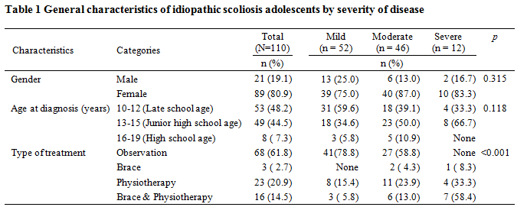
Results (1)
47.3%
41.8%
10.9%
The mean age of participants was 14.2 years (SD 2.17)
The mean age of AIS diagnosis was 12.5 years (SD 1.82)
Notes:
Among 110 participants, 52 adolescents (47.3%) were categorized as having mild AIS with 10° < Cobb’s angle ≤ 25°, 46 adolescents (41.8%) were categorized as having moderate AIS with 25° < Cobb’s angle ≤ 40°, and 12 adolescents (10.9%) were categorized as having severe AIS with Cobb’s angle > 40°. The mean age of participants was 14.2 years (SD 2.17), and mean age of AIS diagnosis was 12.5 years (SD 1.82).
Table 1 summarizes the personal characteristics of study participants. Among participants, female adolescents were the majority (80.9%). However, the three severity levels of IS groups do not show significant differences by gender. Most adolescents were diagnosed with IS during their late elementary school age (48.2%) and junior high school age (44.5%). However, there were no significant differences among the severity groups by diagnosed age. All participants were treated conservatively with observation, braces, and physiotherapy. Observation of spinal curvature changes was performed in 61.8% of cases, with 78.8% of the mild IS group and 58.8% of the moderate IS group. Treatment with braces and physiotherapy were mainly provided for the severe IS group.

Slide 15
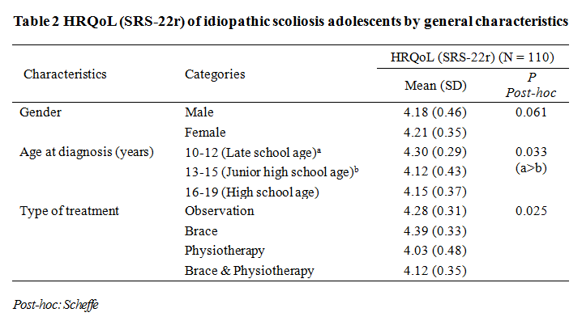
Results (2)
Notes:
Differences in SRS-22r according to general characteristics are summarized in Table 2.
The total mean score of SRS-22r was not significantly different by gender.
However, adolescents diagnosed with AIS in late elementary school age showed a significantly higher SRS-22r score compared to adolescents diagnosed with AIS in junior high school age (p = 0.033). Also, SRS-22r significantly differed with type of treatment (p = 0.025). The lowest SRS-22r score occurred in the physiotherapy only group.

Slide 16
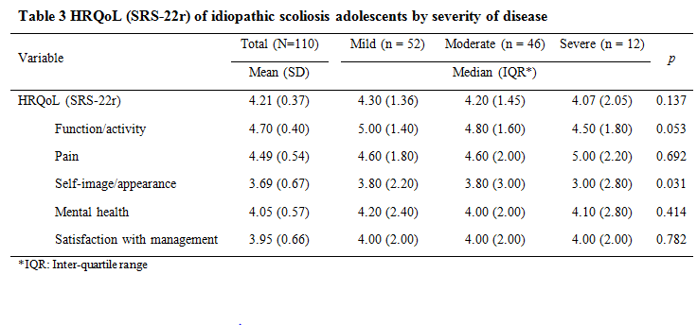
Results (3)
Notes:
Table 3 shows the HRQoL of study participants using SRS-22r scores. The total mean SRS-22r score was 4.21 out of 5.
Among sub-domains, the self-image/appearance domain had the lowest score among all participants.
The median SRS-22r score of the mild IS group was 4.30, that of the moderate IS group was 4.20, and that of the severe IS group was 4.07. Median SRS-22r scores did not significantly differ by severity (p = 0.137).
However, the median score of the self-image/appearance sub-domain significantly differed with IS severity (p = 0.031).
The score of the severe group was lower than the scores of the mild and moderate groups.

Slide 17
Discussion (1)
The age of AIS diagnosis is high during late school age (10-12 year-old, 48.2%) and junior high school age (13-15 year-old,44.5%).
However, in Korea, school screening regulations do not include scoliosis detection.
Results suspicious for IS are occasionally reported to physicians from chest x-ray results of pulmonary tuberculosis school screening examinations.
A chest x-ray for tuberculosis screening is recommended at ages 13 and 16 years for all adolescents in Korea. Therefore, many adolescents are initially diagnosed with AIS around 13 years old.
Needed any of early detect or health promote regulation

Slide 18
Discussion (1) – Cont.
In general, the American Academy of Pediatrics has recommended scoliosis screening at ages 10, 12, 14, and 16 years, and the Scoliosis Research Society has recommended annual scoliosis screening of all children age 10–14 years.
The authors suggest that an effective school scoliosis screening program should be implemented in the Korea school screening regulations, and the specific time of scoliosis screening examination should be determined according to age specific characteristics of IS by gender difference.

Slide 19
Discussion (2)
The self-image/appearance domain score was significantly different with different severity groups.
Among SRS-22r sub-domains….
The function/activity domain scored the highest value (4.7 out of 5).
The self-image/appearance domain scored the lowest value (3.7 out of 5).
The severe IS group had significantly lower scores than the mild and moderate IS groups.
Study participants were mainly female adolescents interested in their body image as a developmental factor.
We should be aware of how IS adolescents perceive their self-image/appearance by the severity of their spinal curvature.

Slide 20
Discussion (3)
The overall mean SRS-22r score was 4.2 out of 5 among study participants receiving conservative treatments.
The mean SRS-22r score did not differ with IS severity in this study even though the mean score gradually decreased with increasing spinal curvature severity.
May Causes
  The sample size was relatively small and the number of patients in each severity group was uneven
  All participants were conservatively treated
Larger and even sample sizes in each severity group could uncover a greater range of HRQoL characteristics in Korean IS adolescents.

Slide 21
Conclusion
Korean adolescents with idiopathic scoliosis tend to be diagnosed at an early pubertal period (late elementary school age). This indicates that the prevalent age for AIS is slightly earlier than 13 years old in Korean adolescents, demonstrating the need for early AIS screening examination.
Total score of HRQoL (SRS-22r) was not influenced by disease severity, but self-image/appearance was significantly different with differing severity.

Slide 22
Conclusion – Cont.
Medical staff should be aware of the characteristics of Korean AIS and variation in the HRQoL characteristics of adolescents with idiopathic scoliosis based upon severity of AIS.
To enhance the HRQoL of idiopathic scoliosis adolescents, medical staff should consider developing strategies tailored to individuals based on disease severity.

Slide 23
References
Asher MA, Lai SM, Glattes RC, Burton DC, Alanay A, Bago J. Refinement of the SRS-22 Health-Related Quality of Life questionnaire Function domain. Spine (Phila Pa 1976). 2006;31(5):593-7.
Lee, M. S. (2008). Effects of an exercise program including promotion of self-efficacy on the physical and psychological functions of middle school students with minimal scoliosis. The Journal of Korean Academic Society of Nursing Education, 14(2), 282e293.
Choi JH, Oh EG, Lee HJ. Comparisons of Postural Habits, Body Image, and Peer Attachment for Adolescents with Idiopathic Scoliosis and Healthy Adolescents. Journal of Korean Academy of Child Health Nursing. 2011;17(3):167-73.
Trobisch P, Suess O, Schwab F. Idiopathic scoliosis. Dtsch Arztebl Int. 2010;107(49):875-83; quiz 84.
Wick JM, Konze J, Alexander K, Sweeney C. Infantile and juvenile scoliosis: the crooked path to diagnosis and treatment. AORN J. 2009;90(3):347-76.
Suh SW, Modi HN, Yang JH, Hong JY. Idiopathic scoliosis in Korean schoolchildren: a prospective screening study of over 1 million children. European spine journal : official publication of the European Spine Society, the European Spinal Deformity Society, and the European Section of the Cervical Spine Research Society. 2011;20(7):1087-94.
Lee, M. S. (2008). Effects of an exercise program including promotion of self-efficacy on the physical and psychological functions of middle school students with minimal scoliosis. The Journal of Korean Academic Society of Nursing Education, 14(2), 282e293.
National Scoliosis Foundation and DePuy Spine I. Scoliosis media and community giude 2009. Available from: http://www.srs.org/professionals/advocacy_and_public_policy/scolimediaguide.pdf.

Slide 24





Thanks a lot!

