Slide 1

6th Global Summit and Expo on
Food and Beverages
Florida, USA
PERTH
NUTRITIONAL THERAPY ACTIVATES THE ANTI-AGING
PROCESS TO REVERSE ACCELERATED GLOBAL DISEASES
Dr Ian Martins
*Centre of Excellence for Alzheimer's Disease Research and Care,
EDITH COWAN UNIVERSITY
School of Psychiatry and Clinical Neurosciences, University of Western Australia,
Sir James McCusker Alzheimer's Disease Research Foundation, Hollywood Private Hospital, Perth, WA, Australia.

Slide 2
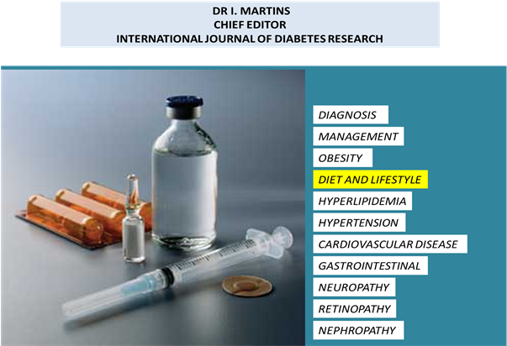
DIET AND LIFESTYLE TO MAINTAIN ORGAN SURVIVAL

Slide 3
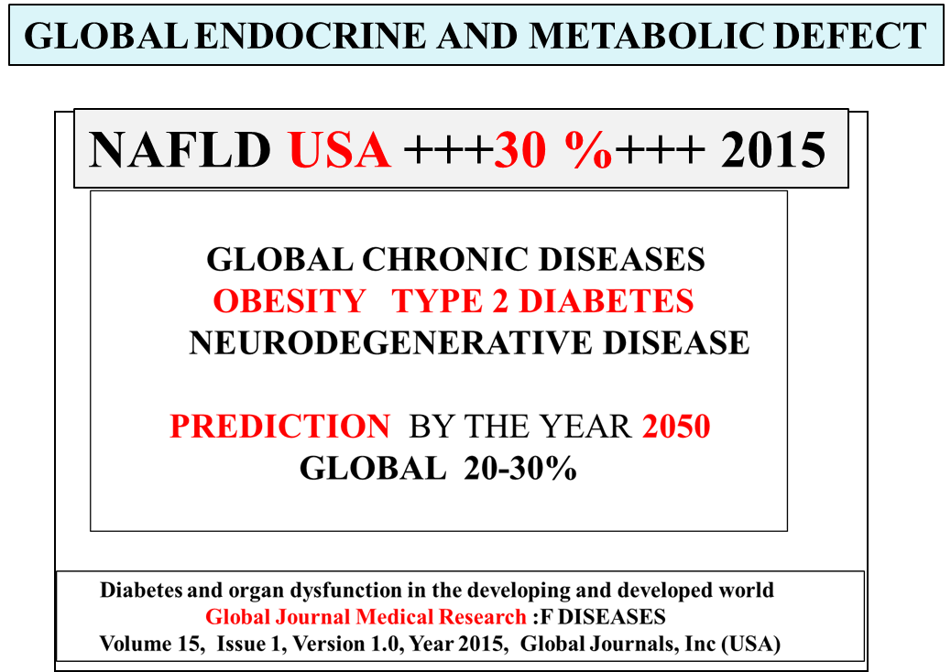

Slide 4
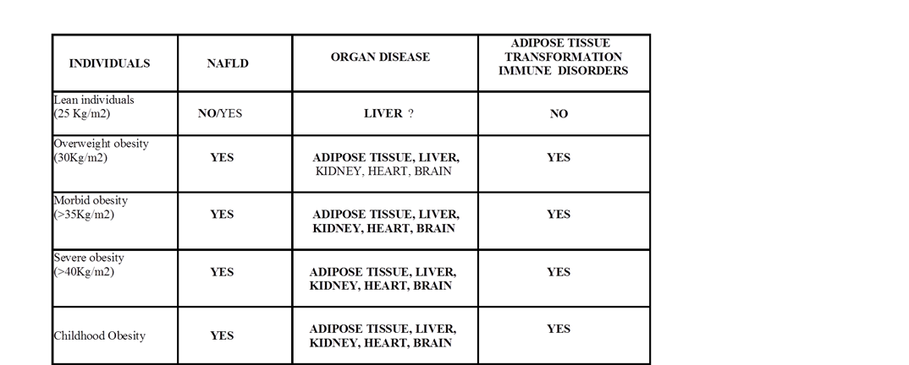
ADIPOSE TISSUE TRANSFORMATION
ENDOCRINE METABOLIC DEFECT
Unhealthy Nutrigenomic diets accelerate NAFLD and Adiposity in Global Communites.
2015. J. Mol. Genet. Med. 9: 1.

Slide 5
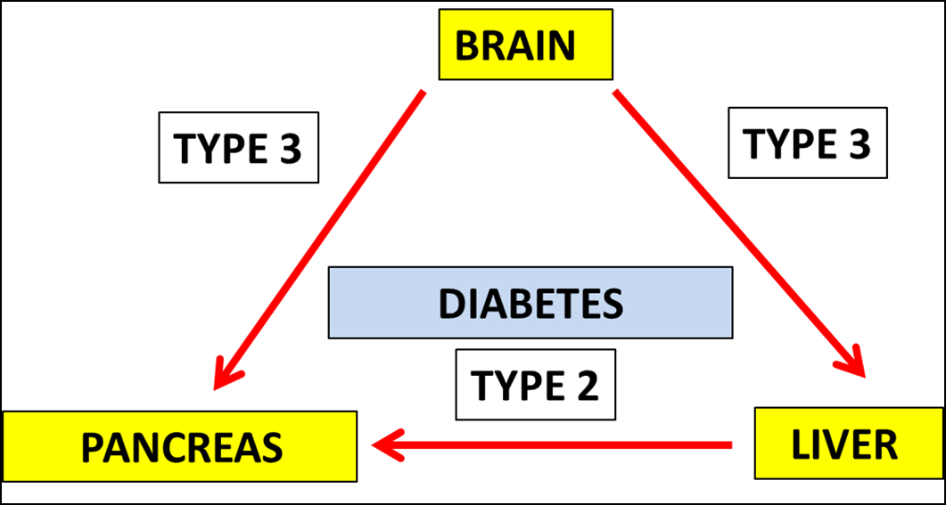
NUTRITIONAL INTERVENTION TO PREVENT
BRAIN AND LIVER DISEASE
Diabetes and Cholesterol dyshomeostasis involve abnormal α-synuclein and
amyloid beta transport in neurodegenerative diseases. Austin Alzheimer’s and Parkinson’s disease. 2015; 2 (1):1020

Slide 6
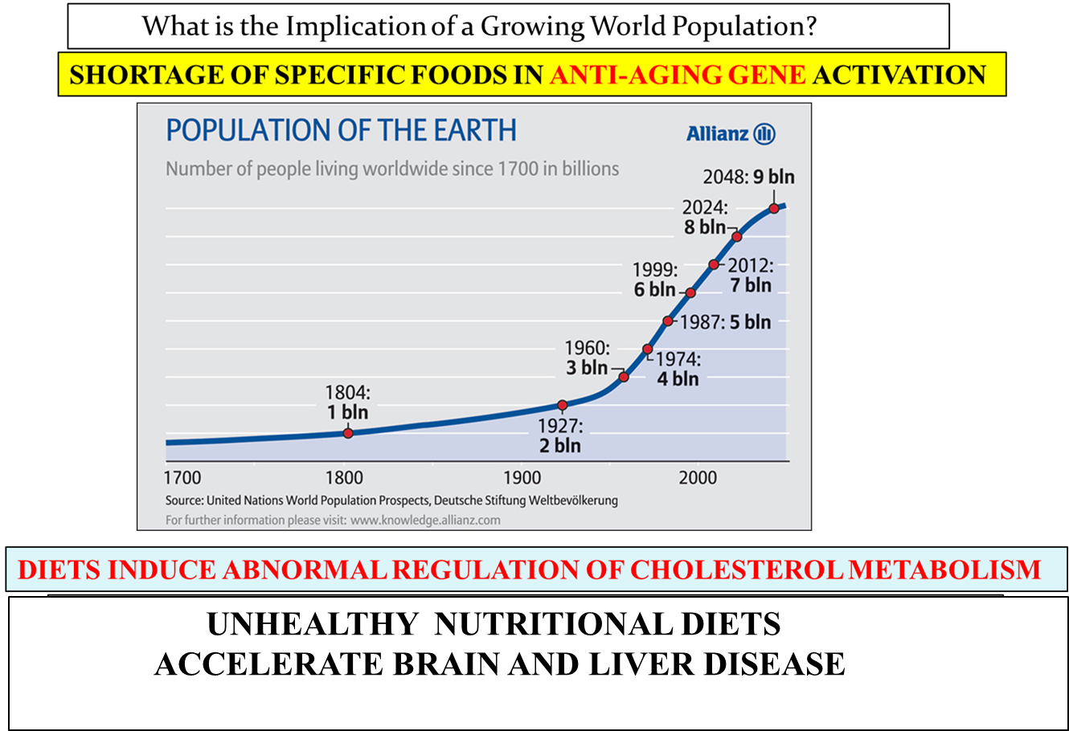

Slide 7
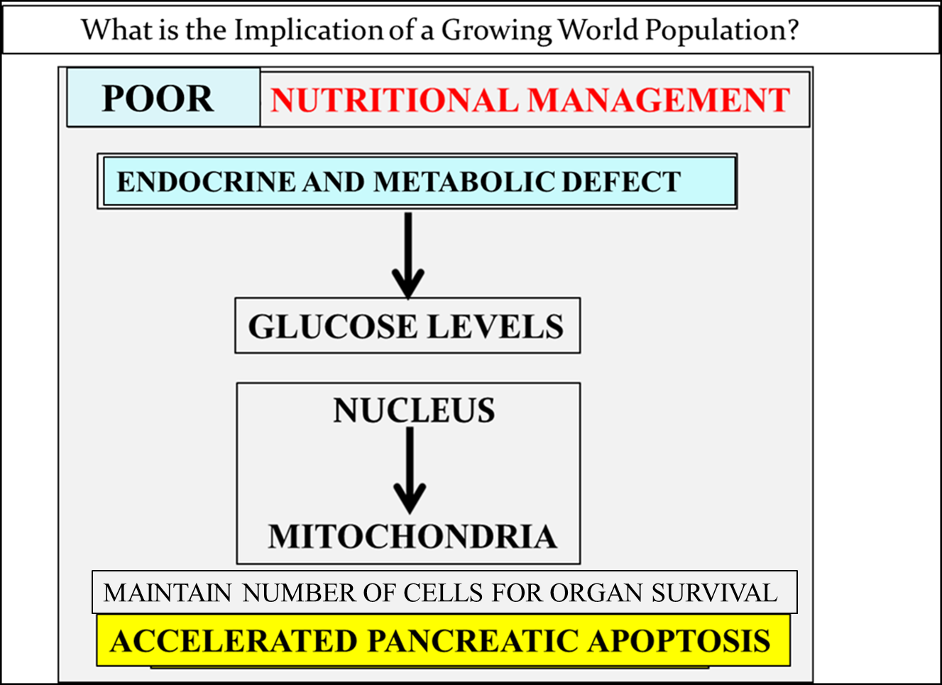

Slide 8

MAINTAIN NUMBER OF CELLS FOR ORGAN SURVIVAL

Slide 9
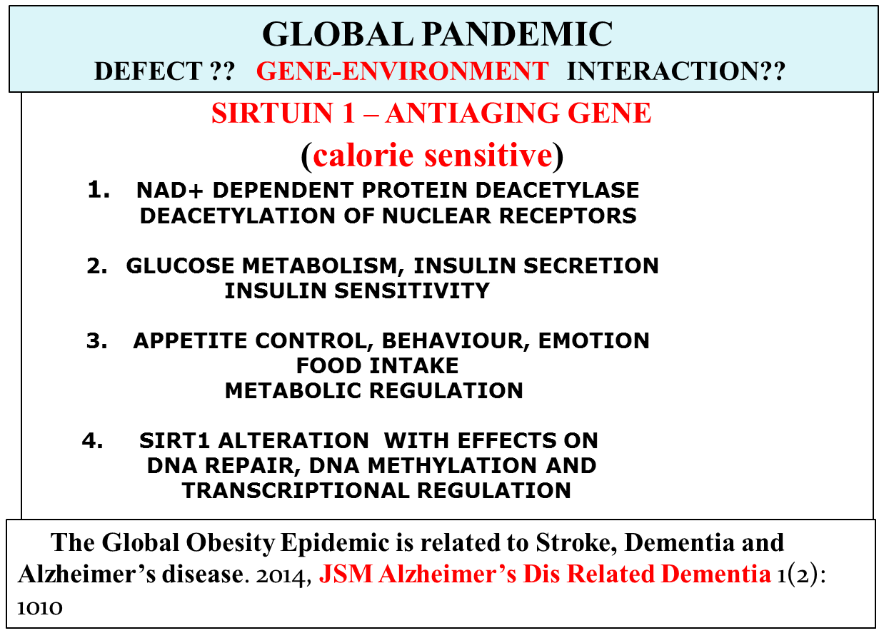
TRACK 10- NUTRITIONAL MANAGEMENT
ZINC

Slide 10
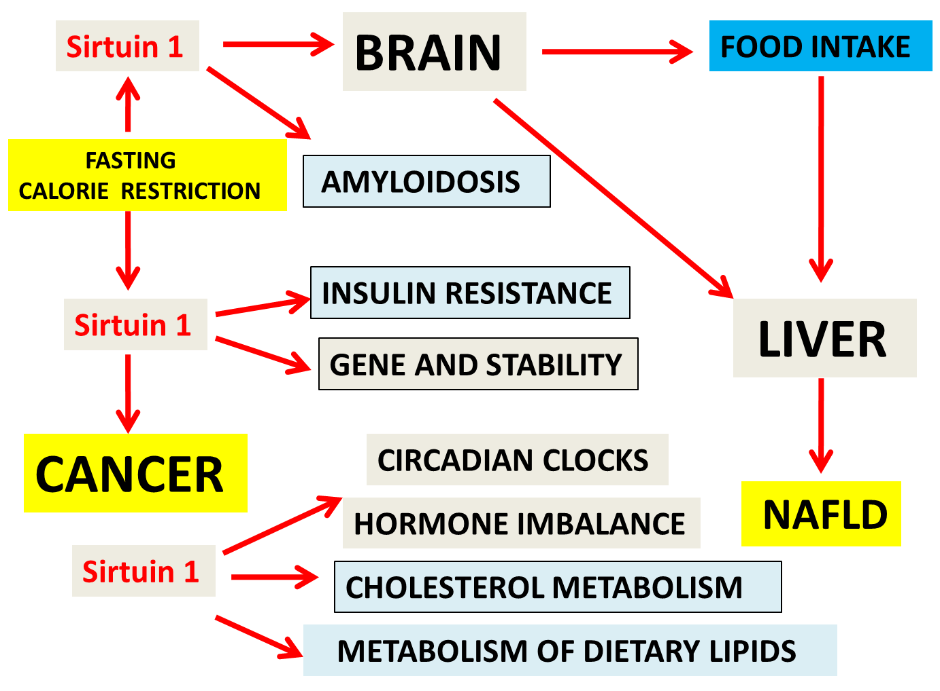
TRACK 10- NUTRITIONAL MANAGEMENT
Frontiers in Clinical Drug Research-CNS & Neuro Vol.3, 2015
CHAPTER Nutritional and Genotoxic Stress Contributes to Diabetes and Neurodegenerative Diseases such as Parkinson's and Alzheimer's Diseases

Slide 11
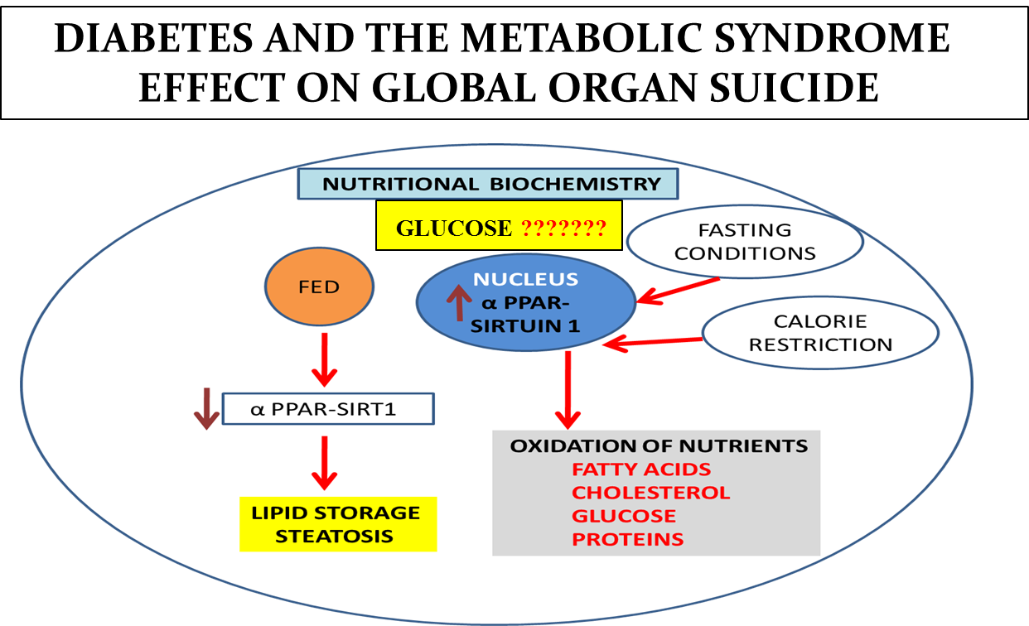
MITOCHONDRIAL APOPTOSIS

Slide 12
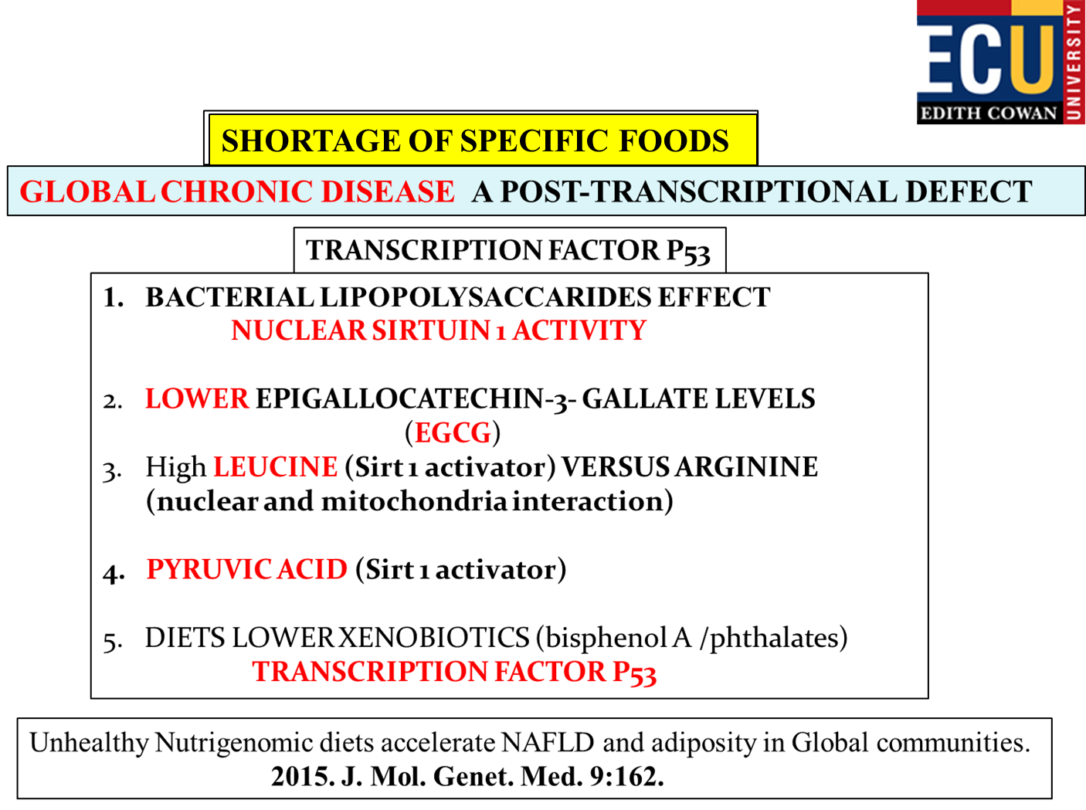

Slide 13

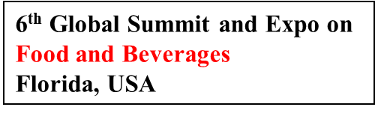
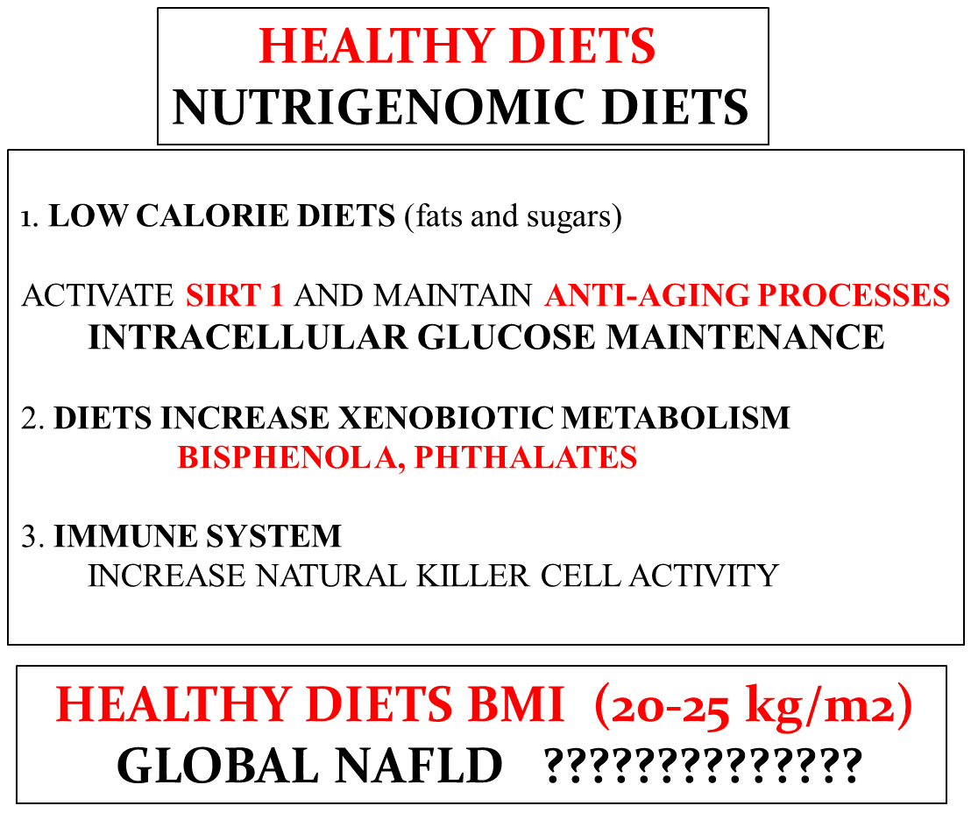
NUTRITIONAL MANAGEMENT
HEALTHY NUTRIGENOMIC DIETS
A. Links between Insulin resistance, Lipoprotein metabolism and Amyloidosis in Alzheimer’s disease.
2014. Health. 6; 1549-1579. B. Induction of NAFLD with Increased Risk of Obesity and Chronic Diseases
in Developed Countries. 2014. Open Journal of Endocrine and Metabolic Diseases. 4; 90-110.

Slide 14
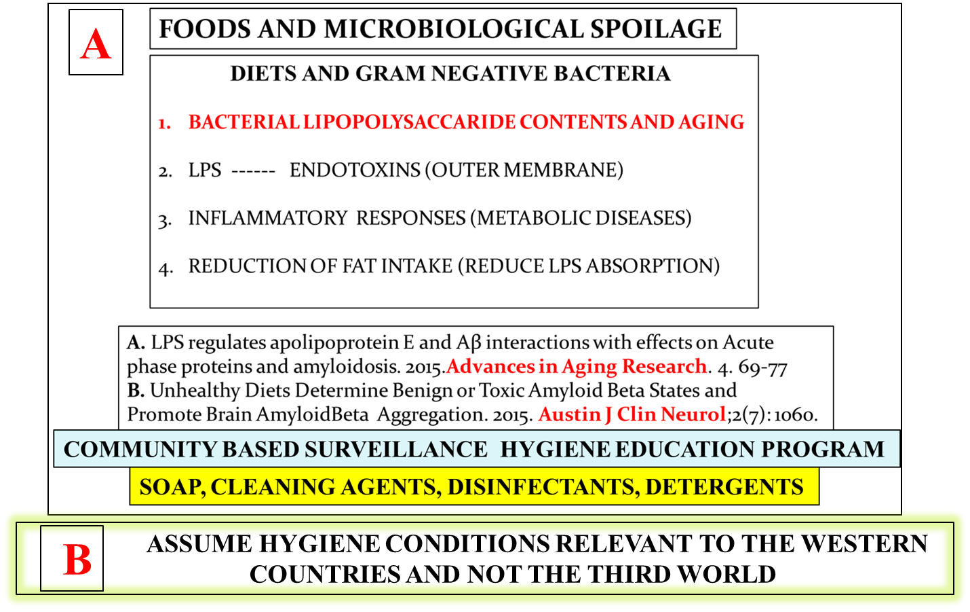
WESTERN COUNTRIES AND REVERSAL OF GLOBAL DISEASES

Slide 15
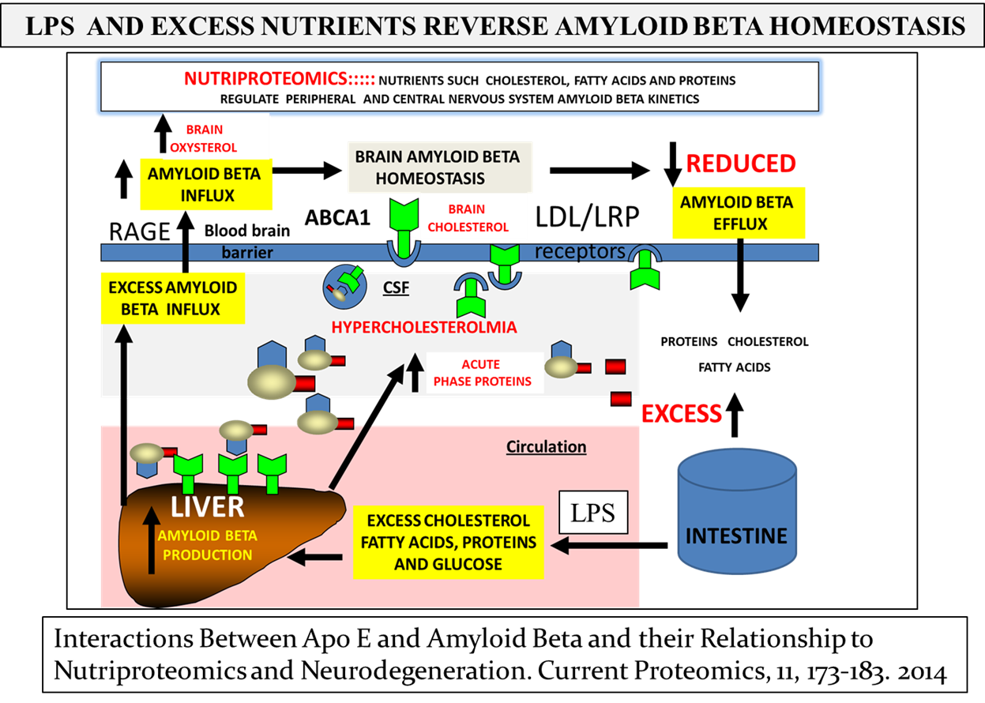

Slide 16
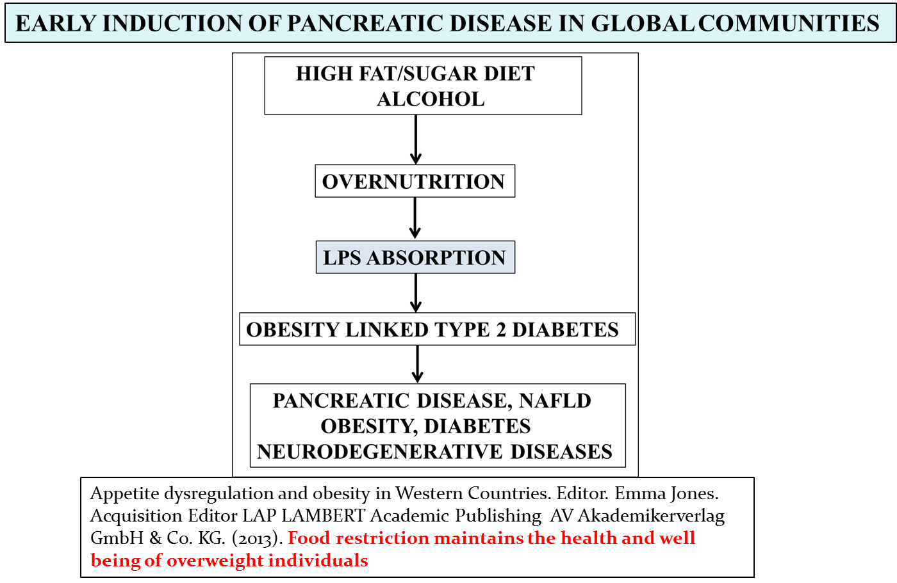
TRACK 10- NUTRITIONAL MANAGEMENT

Slide 17
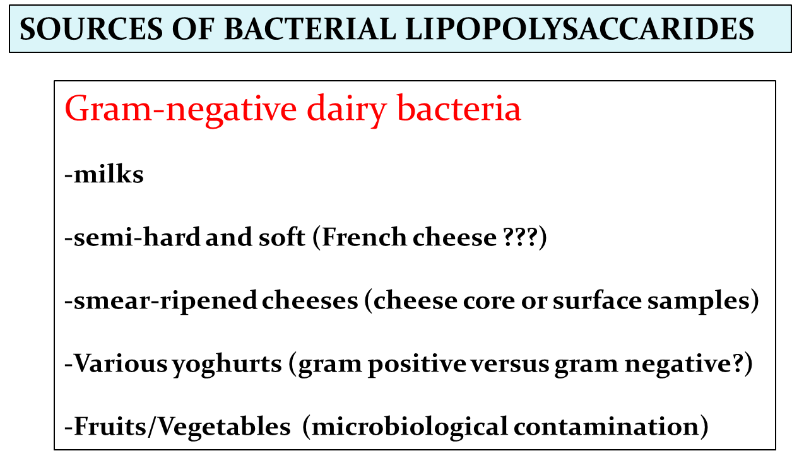
TRACK 10- NUTRITIONAL MANAGEMENT

Slide 18
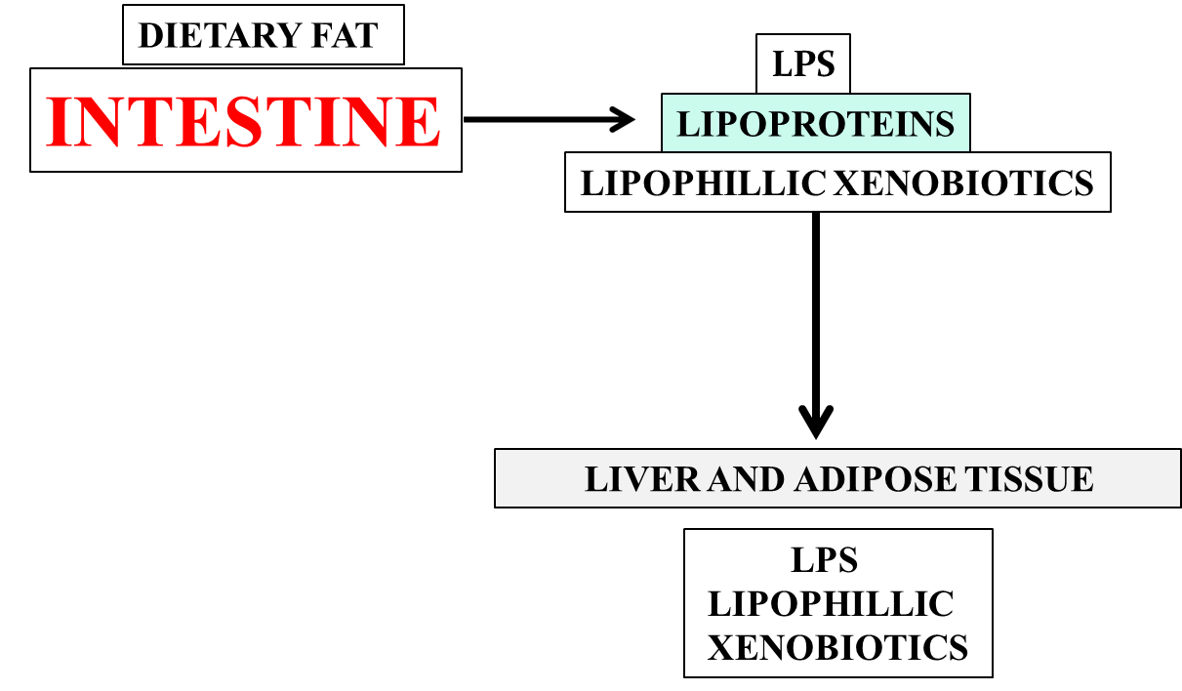
INCREASED DIETARY FAT
REDUCED CLEARANCE OF LIVER LPS AND XENOBIOTIC METABOLISM
DIETARY FAT
ANTI-AGING GENES
XENOBIOTIC INTESTINAL ABSORPTION SHARE
SAME PATHWAYS AS LPS AND NUTRIENT ABSORPTION

Slide 19
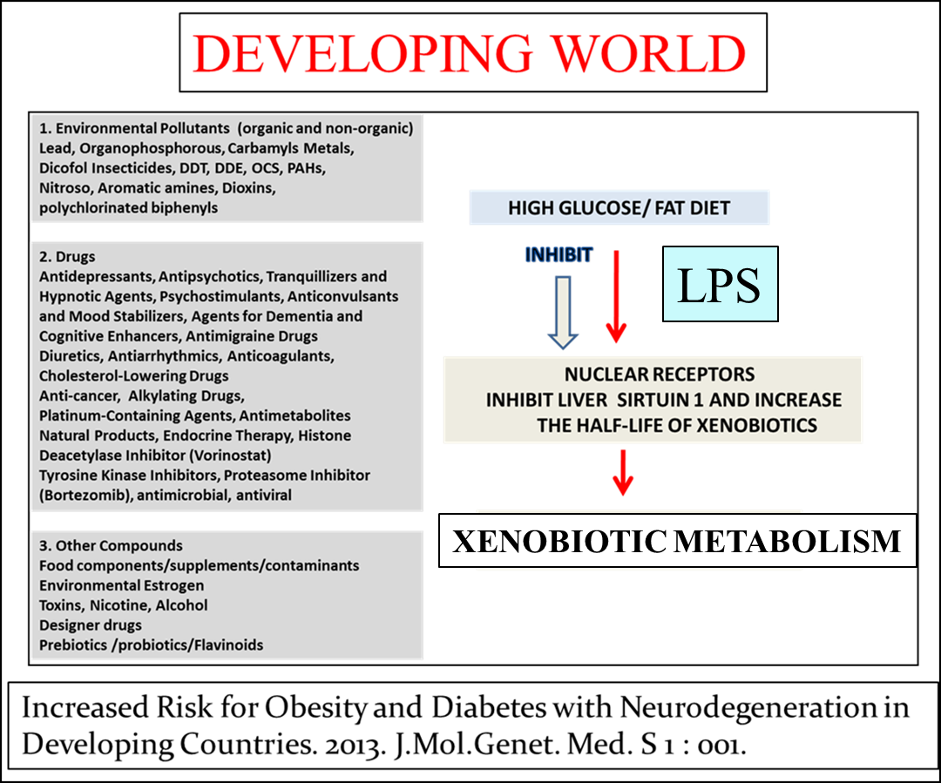

Slide 20
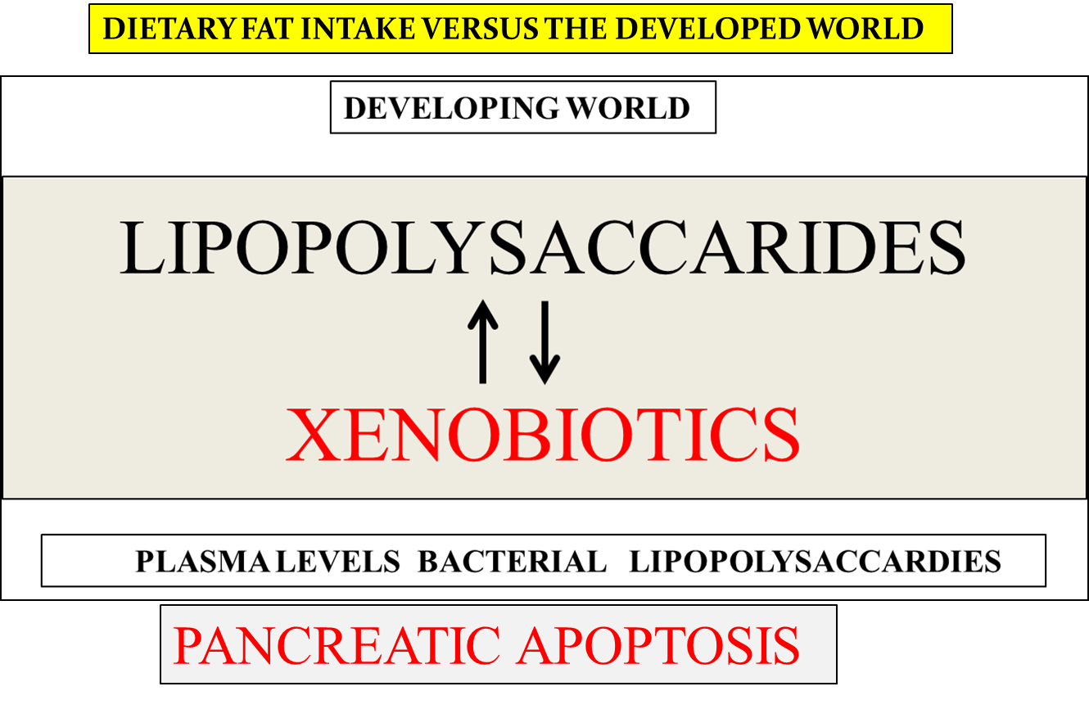
MITOCHONDRIAL APOPTOSIS

Slide 21
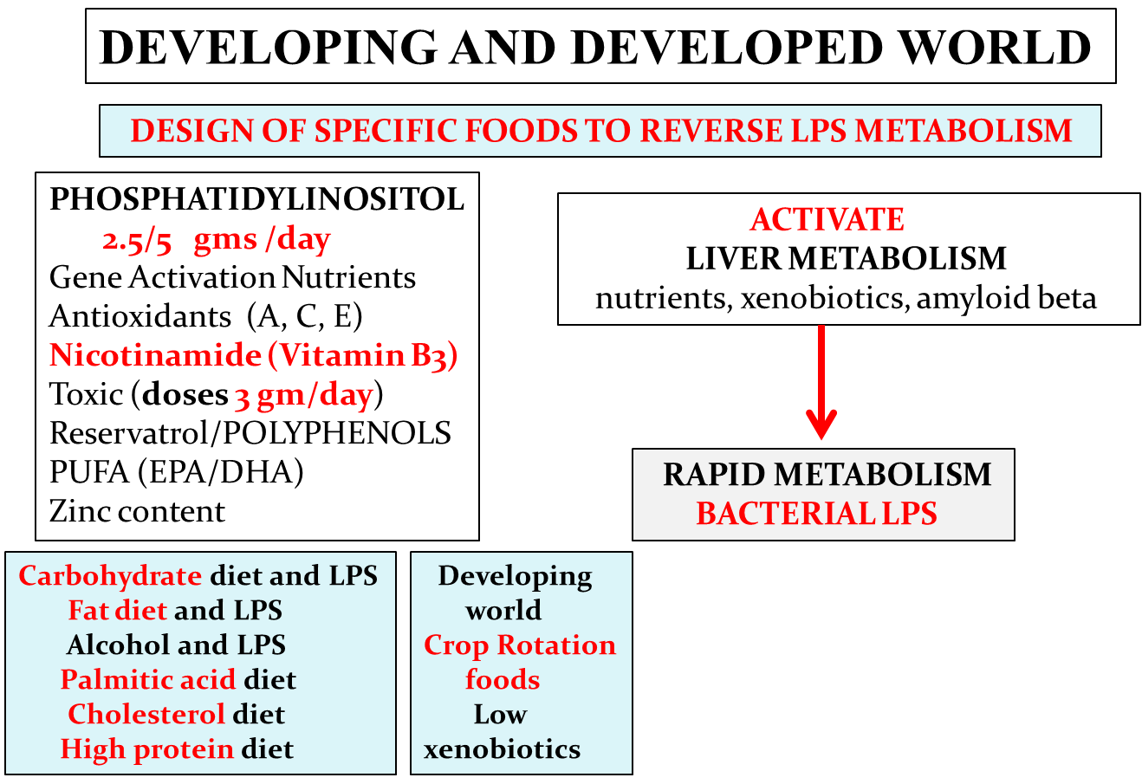
SIRTUIN 1 GENE ACTIVATION LEADS TO RAPID LPS METABOLISM
FAT DIET AND LPS
PALMITIC ACID DIET
CHOLESTEROL DIET
ALCOHOL AND LPS
CARBOHYDRATE DIET and LPS
HIGH PROTEIN DIET
CROP ROTATION
XENOBIOTIC FREE FOODS
DEVELOPING WORLD

Slide 22
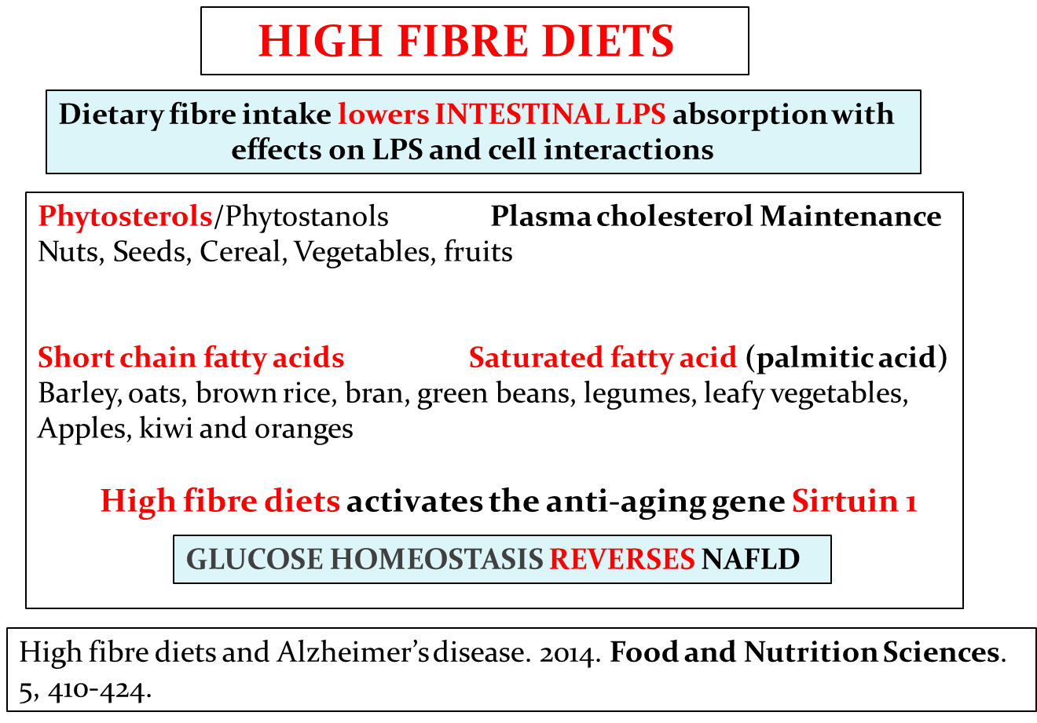
TRACK 10- NUTRITIONAL MANAGEMENT

Slide 23
TRACK 10- NUTRITIONAL MANAGEMENT
CONSUMPTION OF NITRIC OXIDE FOODS
Foods associated with NO production
Fruits, nuts, vegetables, spices, fish and meats
Food restriction (nitric oxide content) maintains the expression
and activity of the anti-aging Sirt 1 central to nutritional intervention and involve NITRIC OXIDE HOMEOSTASIS connected to pancreas function and diabetes.
Nutritional diets accelerate amyloid beta metabolism and prevent the induction of chronic diseases and Alzheimer’s disease
Chapter · July 2015 In book: Photon eBooks, Edition: First, Chapter:
First, Publisher: Photon, pp.1-48

Slide 24
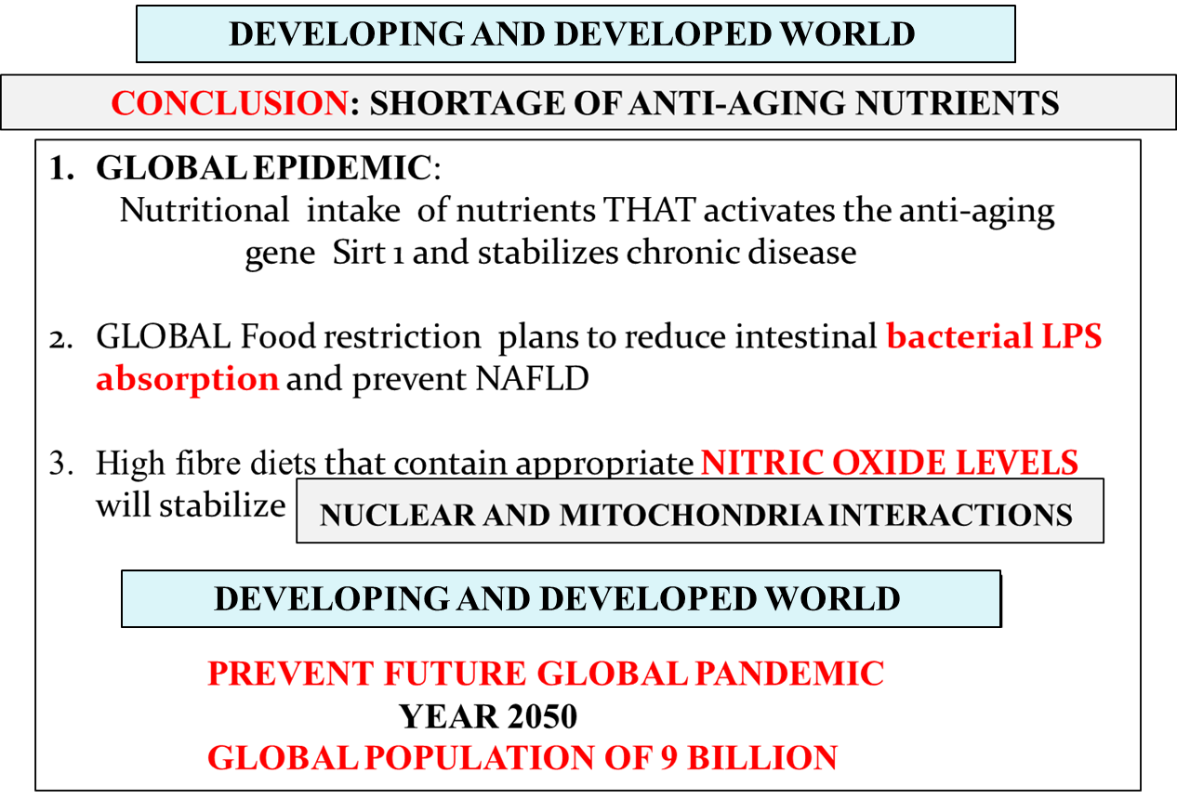

Slide 25

A GROUP
Edith Cowan University
UNIVERSITY OF WA
Prof. R.Martins
Dr W Fernando
Dr F Lim
Prof S Laws
Dr V Gupta
Ms R Creegan
A/Prof G Verdile
Dr K Bates
Mr Kevin Taddei
Dr S Fuller
Dr E Hone
Dr M Sharman
Mr M Morici
Prof. T.Redgrave
GLOBAL JOURNAL OF MEDICAL RESEARCH
SCIENTIFIC AND ACADEMIC PUBLISHING
B. GROUP
DR. A. Fernandis University of Singapore
Dr J Dumin Pfizer Global, USA
Prof. M Wenk University of Singapore
Prof. SE Gandy New York School of Medicine USA
GRANTS:
NATIONAL HEALTH MEDICAL RESEARCH COUNCIL AUSTRALIA
NATIONAL INSTITUTE OF HEALTH (UNITED STATES OF AMERICA)
EDITH COWAN UNIVERSITY
HOLLYWOOD HOSPITAL RESEARCH FOUNDATION

