Slide 1

Prevalence & Incidence of Leprosy, New cases more than the Prevalence
Stable ANCD rates at National level since nearly a DECADE
NLEP - Prevalence Rate & ANCDR
(per ten thousand per year)

Slide 2
Pockets of High Endemicity
(As on 31.03.2014)
198 Districts out of 657 Districts (30%) and 2139 Blocks out of 6391 (34%) have prevalence rate of more than 1 per 10,000

Slide 3
Current NLEP based on only giving MDT to patients
Drugs do not invigorate immune response. Even a former treated patient can become lepromatous on re-exposure

Slide 4
An Immuno-therapeutic vaccine
Developed for Multi bacillary Leprosy based on Heterologous Approach
(14 papers in Golden Jubilee issue of Leprosy In India Oct. 1978)
Strategy adopted : Search for an immunologically cross-reactive mycobacteria eliciting immune response from not only TT but also LL patients; in-vitro followed by in-vivo investigations

Slide 5
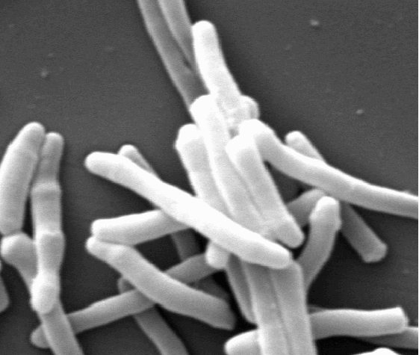

Slide 6
Mw vaccine
Combined Immunotherapy with Chemotherapy
BENEFITS
Faster bacterial clearance
Shortens recovery time
Clears granulomas
Reactions (number and severity) reduced
Lepromin conversion to positivity
Effective in “slow responders”

Slide 7
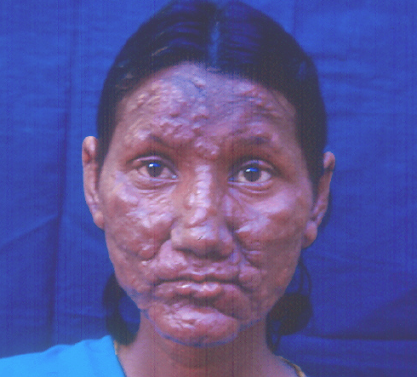
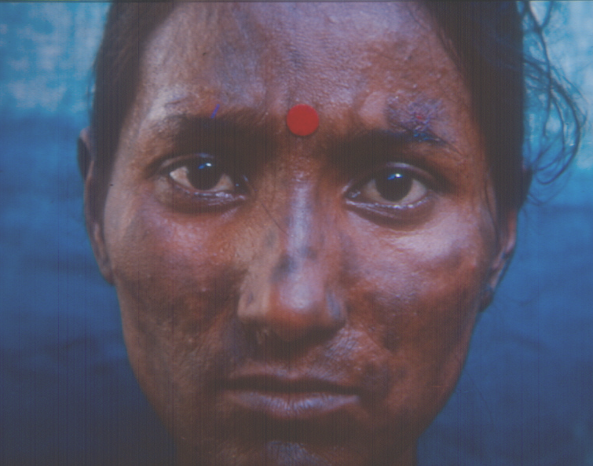
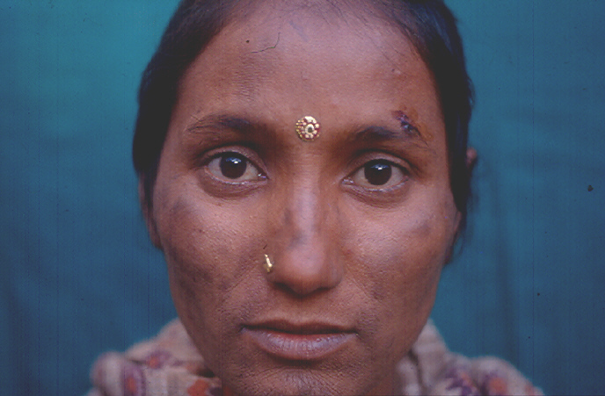
Patient code: MD
Initial
After 4 doses
There after 1year

Slide 8
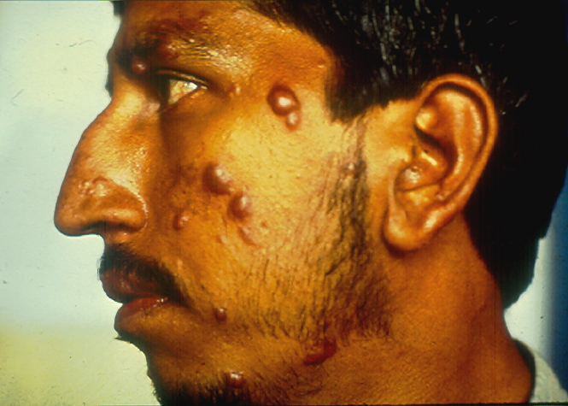
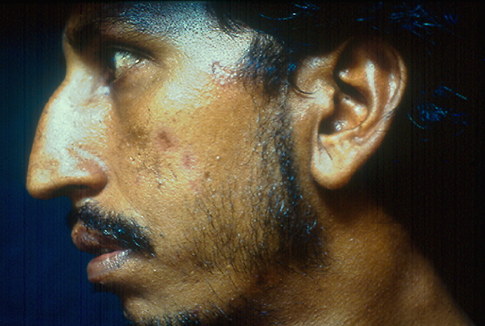
Patient code: CR
Initial
After 5 doses

Slide 9
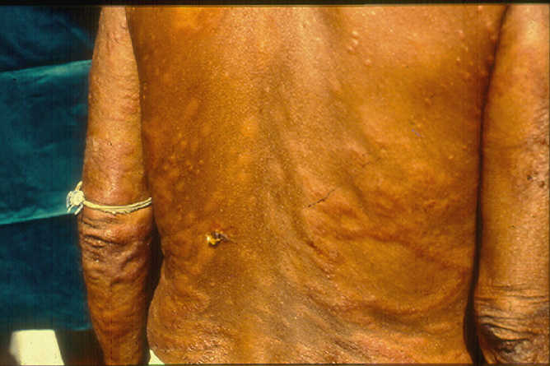
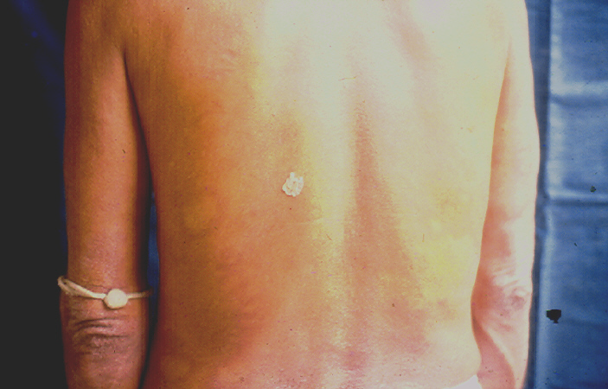
Patient code: RPS
Initial
After 2 doses

Slide 10
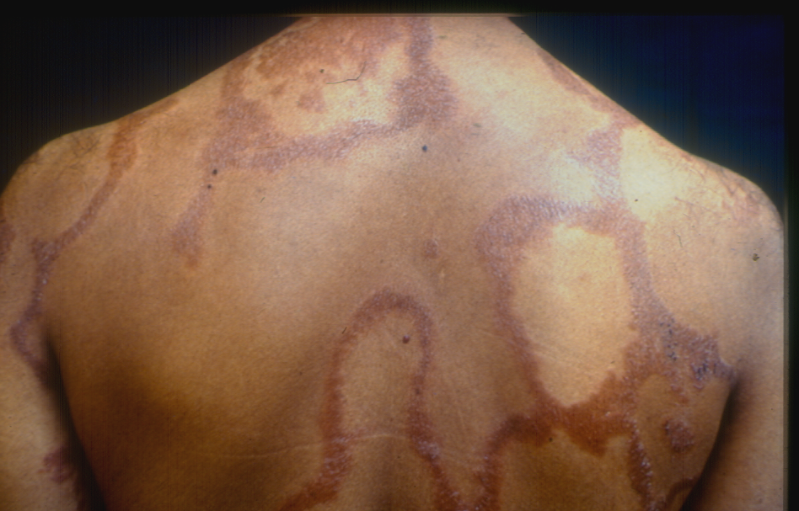
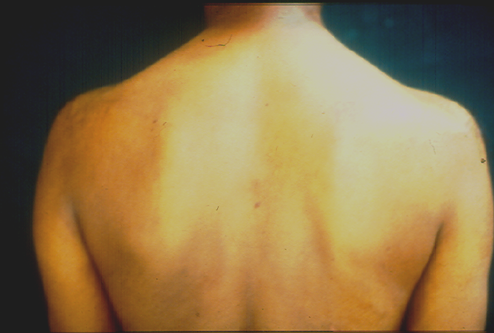
Patient code: BWS
Initial
After 4 doses

Slide 11
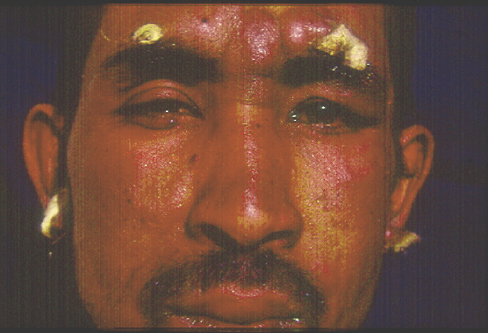
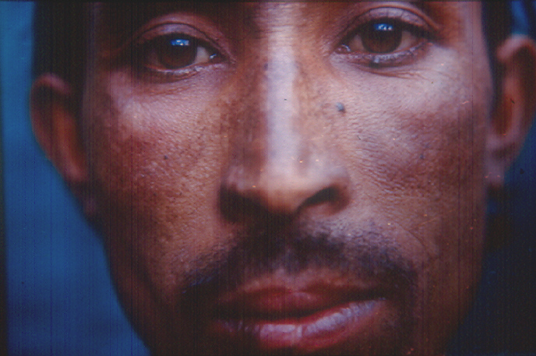
Patient code: CHB
Initial
After 1 Year

Slide 12
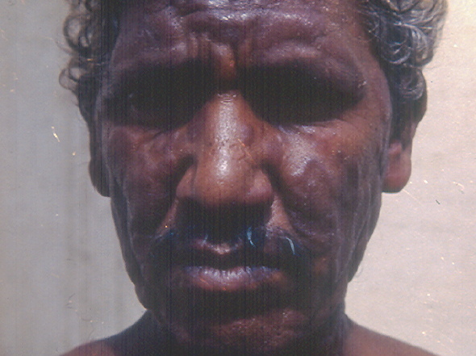
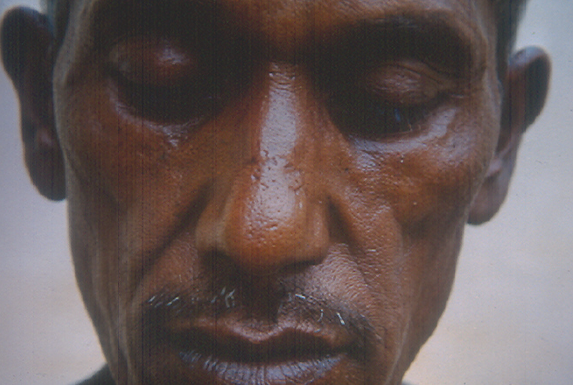
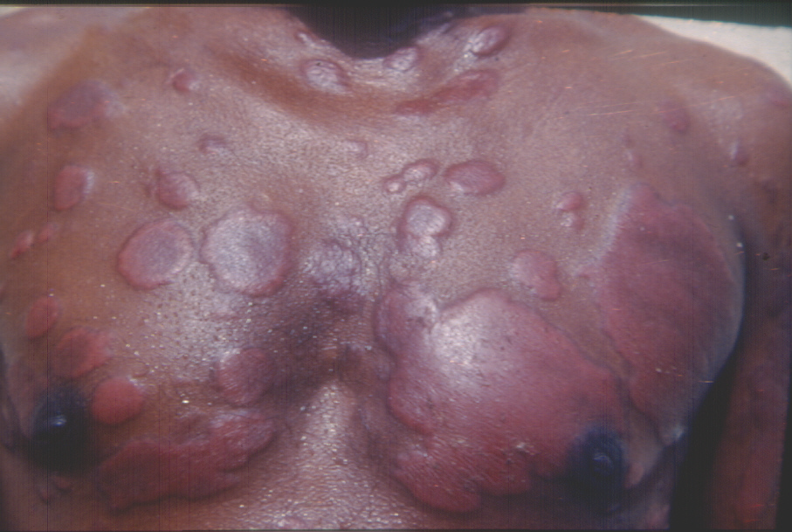
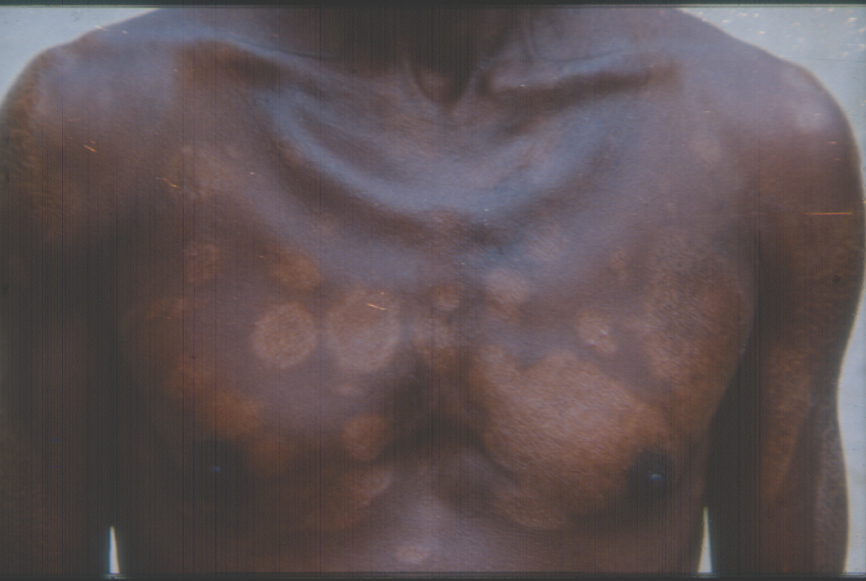
Patient code: RAB
Initial
After 4 doses

Slide 13
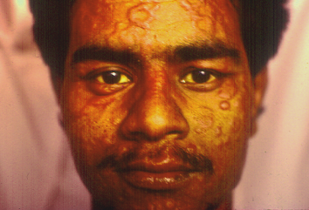
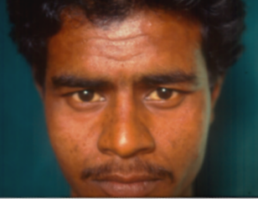
Patient code: SNC
Initial
After 2 doses (six months)

Slide 14
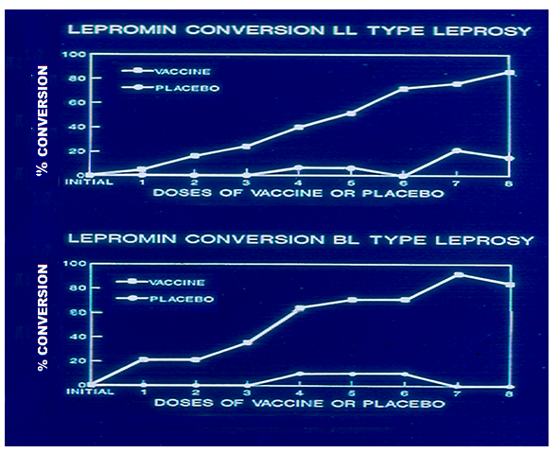
It converts lepromin negative to lepromin positivity status

Slide 15
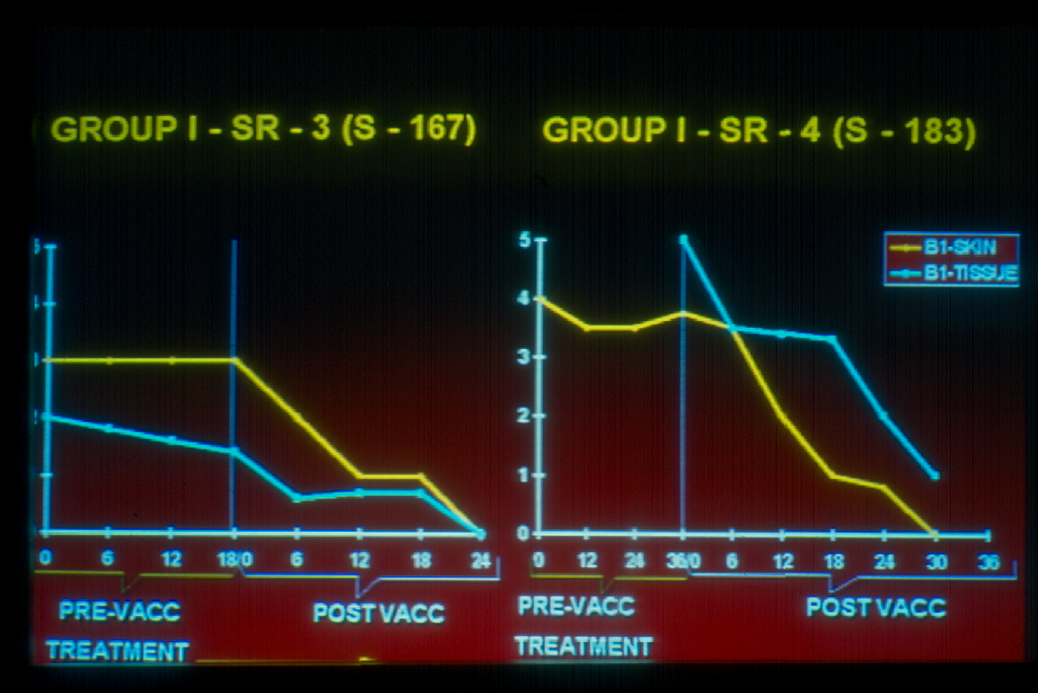
GROUP I- SR-3 (S-167) GROUP I- SR- 4 (S-183)
5
B1-Skin
B1-Tissue
4
3
2
1
0

Slide 16
Persister Studies
Group | Type | Initial BI | Final BI | Initial H/P | Final H/P | Nerve*BI
Vaccine | LL | 4 | 0 | LL | NSI | 0
 | BL | 3 | 0 | BL | NSI | 0
 | LL | 5 | 0 | LL | BL | 0
 | BL | 2.33 | 0 | BL | NSI | 0
Control | LL | 4.33 | 0 | LL | LL | 2
 | BL | 3.16 | 0 | BL | BL | 1
 | LL | 2.16 | 0 | LL | LL | 0
* All nerve biopsies were done on sural nerve

Slide 17
Genomic analysis of M.w. done by a National consortium of Professors S. Hasnain, Akhlesh Tyagi and Anil Tyagi - laboratories

Slide 18
MIP ancestor of M. tuberculosis, M. leprae and M. avium intracellular complex (MAIC)
PloS ONE (2007), 10/e968, 1 – 8
M.w. named as Mycobacterium indicus pranii (MIP)
Infect. Genet. Evol (2008), 8, 100-101

Slide 19
Launching of a Pilot Project in 4 Districts of high endemicity
Dang, Gujarat
Shahjahanpur, Uttar Pradesh
Saran, Bihar
Sonepur, Orissa

Slide 20
Each index case of Leprosy will receive not only MDT but also MIP at 3-6 months interval
All family members and contacts will receive MIP

Slide 21
Protection test of M.w in tuberculosis
(a)
(b)
(c)
(d)
Spleen
Lungs
(a) & (b) Guinea pigs challenged with M.tuberculosis H ₃₇R_{v}
(c) & (d) Immunized with M.w.

Slide 22
OUTCOME OF THERAPY
(CAT II Tuberculosis)
CURED
Mw + MDT 48/49* 97.96%
MDT alone 21/27** 77.77%
P=0.007
* Defaulter for 6 doses, sputum negative after intensive phase
** 2 –2+ No effect of therapy
4 –1+ No effect of therapy

Slide 23
Relapse Rate in Category II after completion of therapy

Slide 24
Mw
Singh IG, Mukherjee R & Talwar GP. Vaccine, 9, 10 – 14, 1991

Slide 25
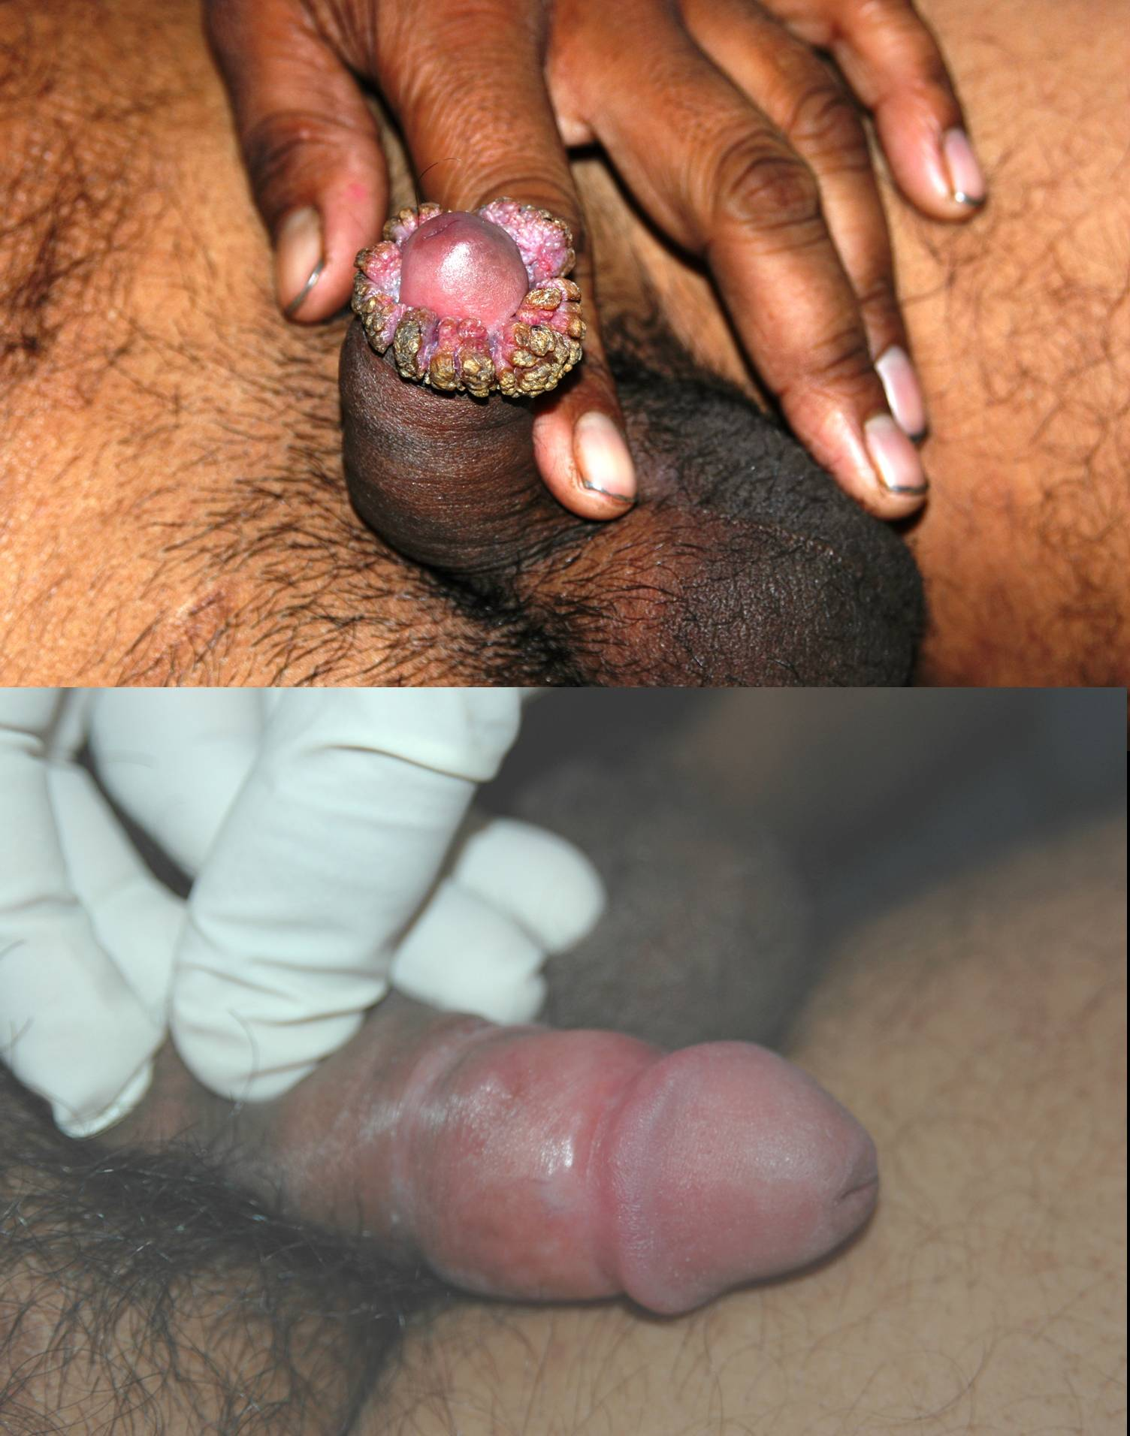

Slide 26
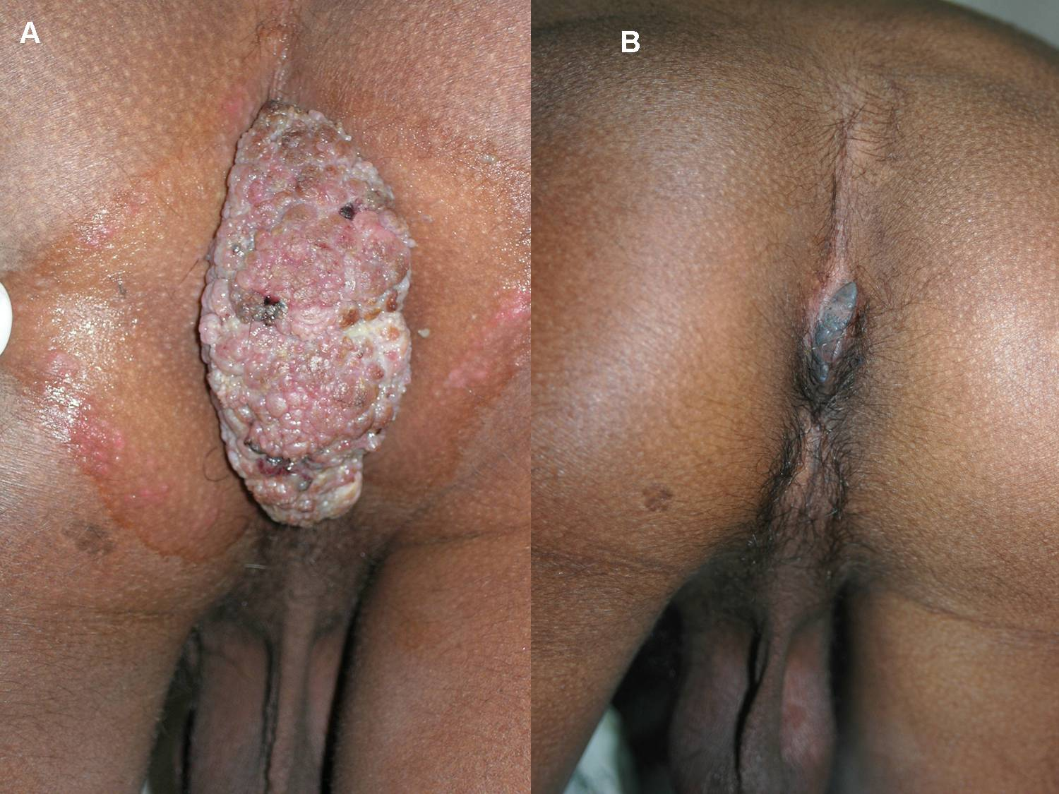

Slide 27
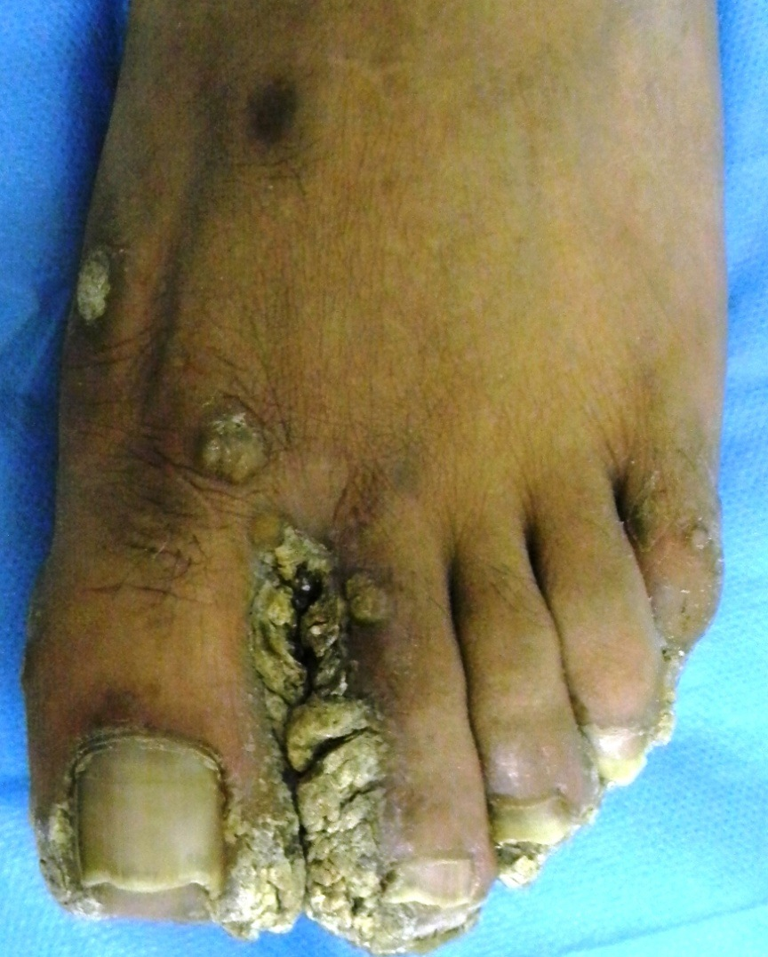
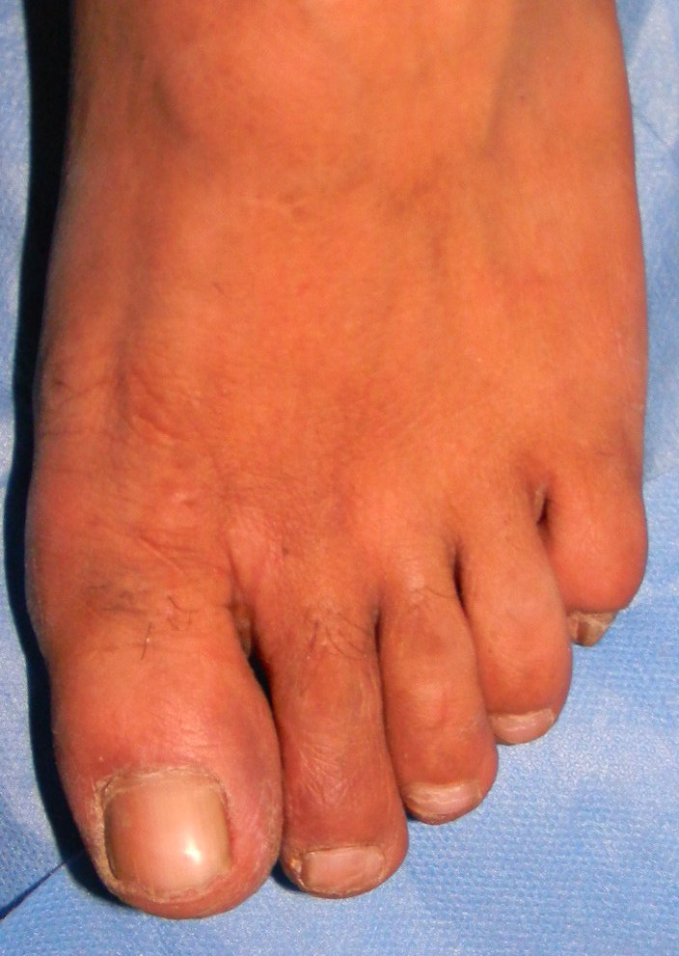
At 5 months

Slide 28
Comparison between prophylactic and therapeutic mode of MIP treatment
Day 0, Sp2/0 Myeloma cells (~10 × 10⁶⁾ subcutaneously inoculated into BALB/c mice
*
**
1 2 3 4 5
PBS (+3D)
Day -1,+3 or +6, mice intradermally injected with heat-killed MIP, PBS was injected on day 3
MIP (-1D)
MIP (+3D)
Measurement of tumor volume and mice sacrificed by ~day 15
MIP (+6D)

Slide 29
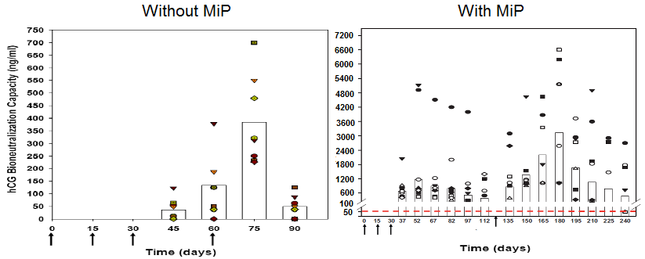
Potent Adjuvant to Birth Control Vaccine
MiP enhances anti-hCG response in BALB/c mice
immunized with hCG-beta-LTB vaccine
Purswani and Talwar, 2011, Vaccine 29: 2341-2348

Slide 30
SUMMARY
A marvellous vaccine developed based on a non-pathogenic cultivable mycobacteria
Its gene sequence determined, named as Mycobacterium indicus pranii
It expedites bacterial clearance, clearance of granulomas, upgrades CMI responses of BL-LL patients

Slide 31
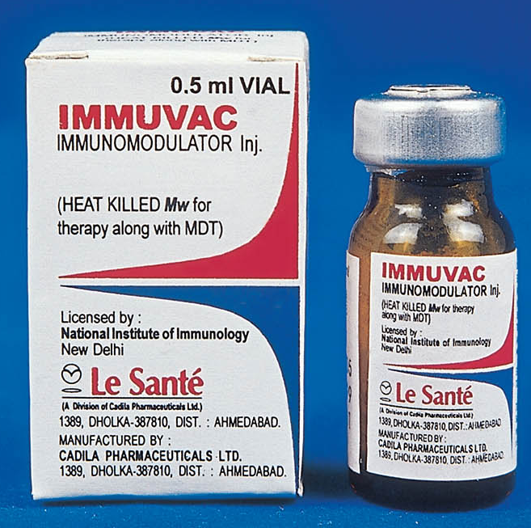
MIP is approved by Drugs Controller General of India & USFDA
Licensed to Cadilla Pharma

Slide 32
Additional Unexpected Properties & Benefits of MIP
Heals ugly ano-genital warts
Prevents and cures Sp2/o Myelomas
Potent adjuvant to a unique Birth Control Vaccine hCGβ-LTB

Slide 33
CREDITS
G.P.Talwar, A.D.Krishnan, Vijay Lakshmi Mehra, A.S.Mustafa, Arun Fotedar, H.K.Prasad, S.A.Zaheer, R.S.Misra, H.K.Kar, Ashok Mukherjee, R.Walia, Pankaj Sharma, Kiran Katoch, Vishwa Mohan Katoch, Rama Mukherjee, P.Prabhakar Reddy, Rajni Rani S. Hasnain, Nyaz Ahmed, Akhlesh Tyagi, Anil Tyagi, Somesh Gupta, Dipankar Nandi

