Slide 1
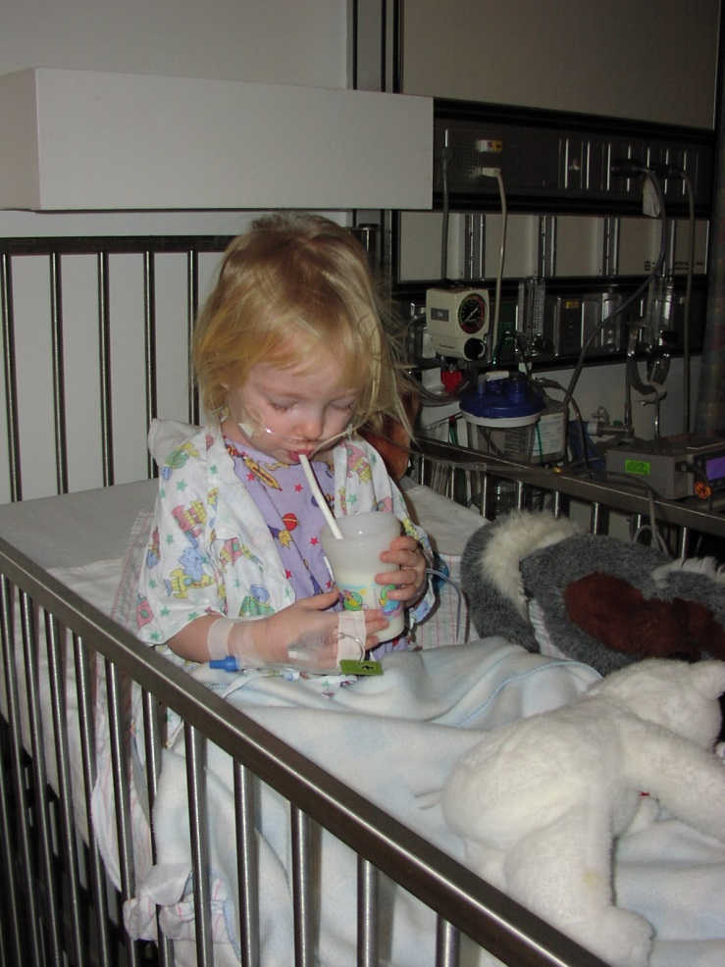
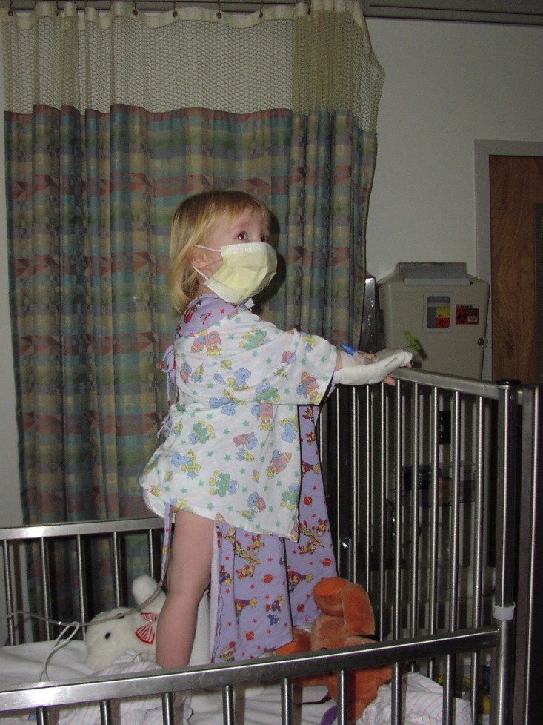
5th Asia Pacific Global Summit on Vaccines
Development of a passive RSV vaccine for
infants as an alternative to maternal vaccination

Slide 2
Agenda
1
RSV Epidemiology
2
MEDI8897 non-clinical characteristics
3
MEDI8897 clinical update
4
Development approach for seasonal dosing
5
Birth dosing for expanded global access

Slide 3
Respiratory Syncytial Virus
RSV is ubiquitous and circulates globally
  50% of infants infected by 12 months of age
  90-100% infected by 24 months of age (Glezen)
Multiple infections are common throughout life (Hall 2001)
Primary infection associated with Lower Respiratory Illness and hospitalization (Glezen 1986)
  90% of all childhood bronchiolitis (Hall 2006)
  40% of all pediatric pneumonias (Hall 2006)
Emerging linkage between severe RSV infection and later wheezing
Neutralizing antibody to Fusion Protein known to prevent disease and hospitalization (palivizumab)

Slide 4
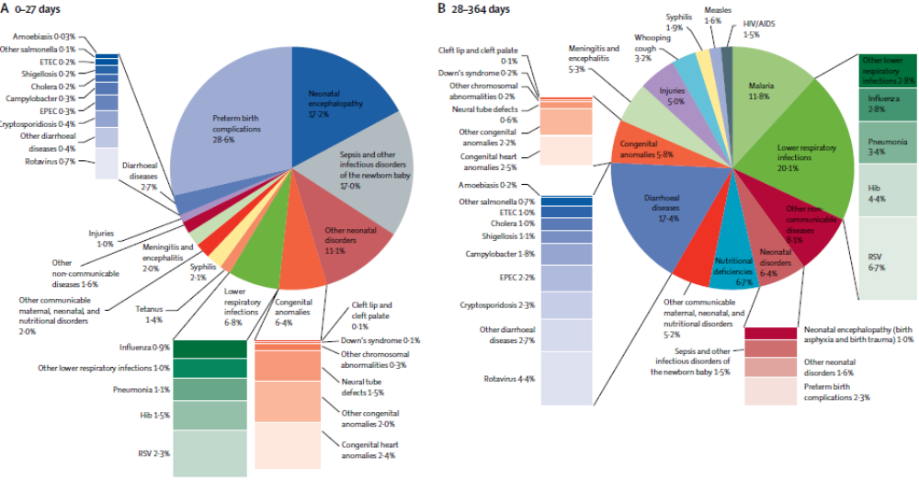
RSV is the most significant cause of ALRI-death in 1st year of life
Lozano et al. Lancet 2012; 380 2095-128

Slide 5
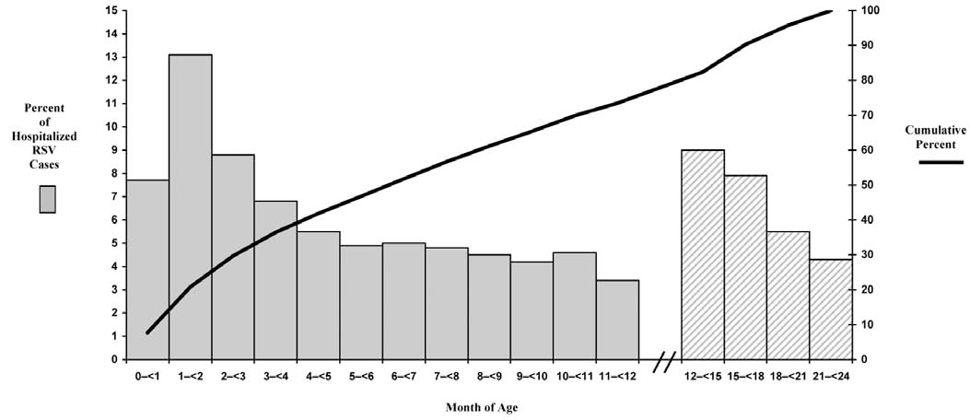
High neonatal disease burden reduces feasibility of active immunization in infants
Maternal immunization is leading approach
Passive vaccination is an alternative approach
Hall Infect Disord Drug Target 2012

Slide 6
Overview for MEDI8897 Passive RSV Vaccine
Technology
  High potency mAb derived from human B-cells
  YTE half-life extension technology
  High efficiency fermentation and purification
Potential Advantages
  Once per season dosing
  Fixed IM dose (not weight based)
  Vaccine-like pricing
Clinical endpoint
  Prevention of lower respiratory tract illness attributed to RSV
  Prevention of severe RSV illness
Indicated population
  Term infants entering first RSV season
  Pre-term infants entering first RSV season
  Children with CLD/CHD entering first and second RSV season
Project Status
  Phase 1a adult FTiH dosing complete (N=136)
  Phase 1b/2a in 32-35 week GA preterm infants dosing ongoing (N=90)

Slide 7
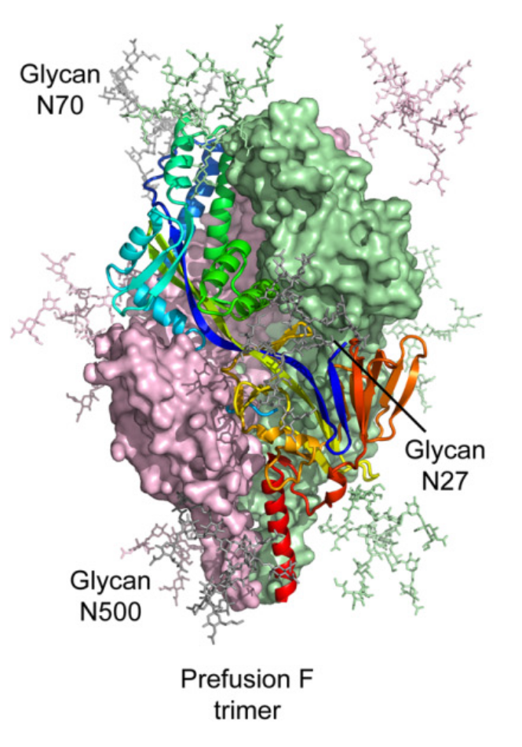
MEDI8897 blocks RSV F mediated fusion
MEDI8897
palivizumab
  Fully human IgG1 mAb derived from human B-cells
  Targets a unique antigenic site on pre-fusion RSV F (distinct from palivizumab)
7

Slide 8
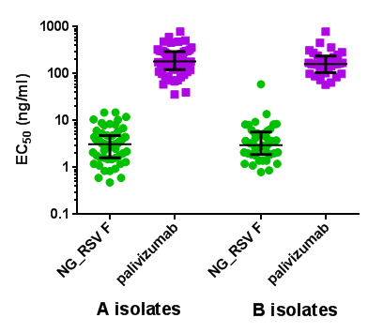
MEDI8897 demonstrates >150 fold increase in in vitro potency compared to palivizumab
RSV Clinical Isolates (N=99)
MEDI8897
MEDI8897
RSV A
RSV B
Neutralizes all RSV A and RSV B isolates tested

Slide 9
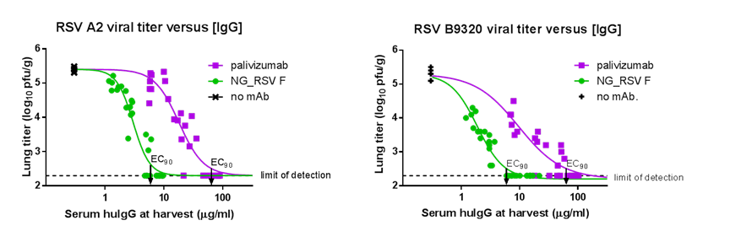
MEDI8897 has 9-fold increase in in vivo potency compared to palivizumab
MEDI8897
MEDI8897
EC90 identified as target concentration

Slide 10










Half-life extended with YTE modification in Fc region
Blood (physiological pH)
FcRn
IgG dissociates
at physiological pH
Recycling
endosome
Endocytic
vesicle
Acidified
endosome
YTE increases
binding to FcRn
at acidic pH
FcRn-IgG
complexes are
recycled
Non-receptor bound IgG
are degraded in lysosome
Endothelial Cell
Lysosome

Slide 11
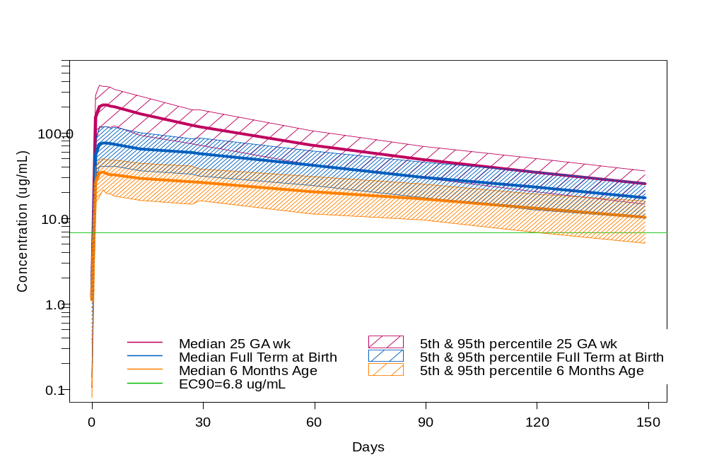
Enhanced Potency and Extended Half-life Enables
Once Per Season Dosing with fixed IM dose
EC90
11

Slide 12
MEDI8897 Clinical development overview
Phase 1a First-Time in Human study in healthy adults
Double-blind (3:1) placebo controlled study (N = 136)
Evaluated multiple IV and IM dose levels
Subjects followed for 1 year
Safety
  Adverse Events balanced
  1 SAE of trauma, No AESI or NOCD
Pharmacokinetics
  Bioavailability 85%
  Half-life extended to 69-77 days
Anti-drug antibody
  Placebo and vaccine group with similar ADA titers, no impact on PK observed
12

Slide 13
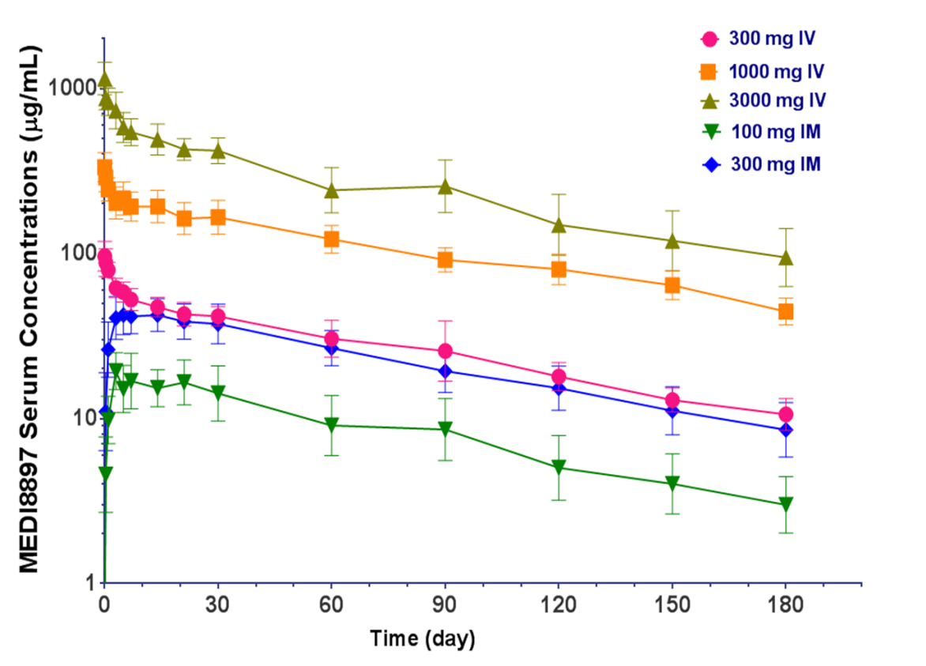
MEDI8897 Phase 1a PK in Healthy Adults

Slide 14
MEDI8897 Clinical development overview
Phase 1a First-Time in Human study in healthy adults
Double-blind (3:1) placebo controlled study (N = 136)
Evaluated multiple IV and IM dose levels
Subjects followed for 1 year
Safety
  Adverse Events balanced
  1 SAE of trauma, No AESI or NOCD
Pharmacokinetics
  Bioavailability 81%
  Half-life extended to 69-77 days
Anti-drug antibody
  Placebo and vaccine group with similar ADA titers, no impact on PK observed
Phase 1b/2a safety, PK and exploratory efficacy in 32-35 week GA infants
Double-blind (4:1) placebo controlled study in USA, SA, Chile (N=90)
Three IM dose levels evaluated
Subjects followed for 1 year
Safety evaluation
  AE, SAE, AESI and NOCD
Pharmacokinetic evaluation
  PK, ADA, microneutralization
Exploratory efficacy
  Incidence of Medically-Attended Lower Respiratory Tract Illness
14

Slide 15
MEDI8897 target attributes
Seasonal Administration
Indication: Passive immunization of all infants entering their first RSV season and children with CLD/CHD entering their first and second RSV season for the prevention LRI caused by RSV
Dose: Single 0.5ml dose delivered by IM injection at beginning of RSV season; larger dose for children in second season
Duration: through temperate climate winter viral season (~ 6mo)

Slide 16
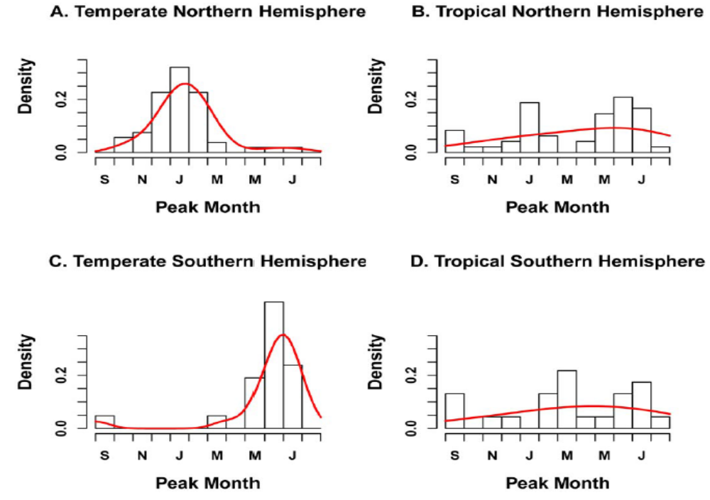
Distribution of RSV peak month by geographic zone, n=96
Bloom-Fesbach et al. PLOSOne 2013; e54445 1-12

Slide 17
Alternative MEDI8897 dosing strategy
Deliver MEDI8897 as birth dose in term infants
  Provides protection through first half-year of life where risk of serious RSV disease is greatest
  Eliminates need for RSV surveillance to identify timing of seasonal dosing
  Takes advantage of pre-existing medical contacts eliminating need to establish seasonal vaccination campaigns
Pursue parallel clinical development as birth-dose in tropical regions with irregular RSV transmission
  Massive unmet medical need and mortality in developing countries
  Accelerate availability in developing countries
  Seek label indication for use as birth-dose
  Generate relevant safety & efficacy data to facilitate deployment in individual countries

Slide 18
Data supporting efficacy of passive RSV vaccination in term infants and when administered as a birth dose
Passive vaccination with motavizumab effective in term infants¹
  Randomized 2:1 Native American term infants to 5 monthly doses (N=2,127)
  Mean age at dosing approximately 2 months of age (SD± 1.9 months)
  RSV Hospitalization: 8.3% placebo vs 1.4% motavizumab; 83% relative reduction
  RSV Outpatient LRI: 9.5% placebo vs 2.8% motavizumab; 71% relative reduction
1: Chandran et al. Presented at PAS May 4 2008

Slide 19
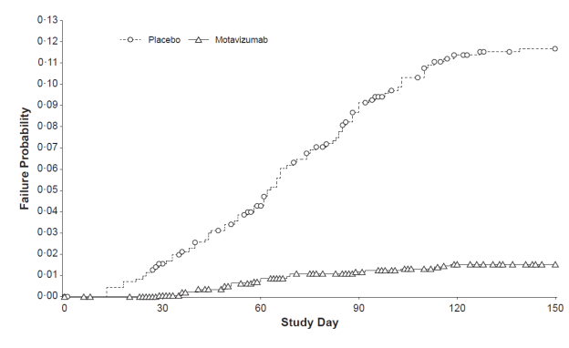
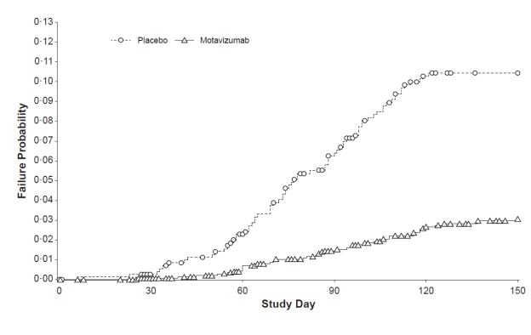
Motavizumab was effective in preventing RSV hospitalizations and outpatient MA-LRIs in healthy term infants
RSV Hospitalization
RSV Outpatient MA-LRI

Slide 20
Data supporting efficacy of passive RSV vaccination in term infants and when administered as a birth dose
Passive vaccination with motavizumab effective in term infants¹
  Randomized 2:1 Native American term infants to 5 monthly doses (N=2,127)
  Mean age at dosing approximately 2 months of age (SD± 1.9 months)
  RSV Hospitalization: 8.3% placebo vs 1.4% motavizumab; 83% relative reduction
  RSV Outpatient LRI: 9.5% placebo vs 2.8% motavizumab; 71% relative reduction
Passive vaccination with palivizumab effective as birth doses in tropics²
  Taiwan has a blend of year-round and twice-yearly RSV epidemics
  6 monthly doses initiated at hospital discharge irrespective of season (N=127)
  Compared to historical rates of RSV hospitalization
  Median age at dosing approximately 3 months (IQR 1-6 mo)
  RSV Hospitalization within 6 months 86% (95% CI: 36-97)
  RSV Hospitalization within 12 months 78% (95% CI: 40-92)
1: Chandran et al. Presented at PAS May 4 2008
2: Chi et al PLoS One June 2014

Slide 21
MEDI8897 target attributes
Seasonal Administration
Birth-dose Administration
Indication: Passive immunization of all infants entering their first RSV season and children with CLD/CHD entering their first and second RSV season for the prevention LRI caused by RSV
Dose: Single 0.5ml dose delivered by IM injection at beginning of RSV season; larger dose for children in second season
Duration: through temperate climate winter viral season (~ 6mo)
Indication: Passive immunization of all infants in the first year of life for the prevention of (severe) lower respiratory tract illness caused by RSV
Dose: Single 0.5ml dose delivered by IM injection as a birth-dose
Duration: approximately through the first 6-8 months of life

Slide 22
MEDI8897: Passive RSV Vaccine
Validated target & approach to address unmet medical need
Modern monoclonal antibody technology
  Passive vaccination for general population
  Once per season dosing
  Tiered vaccine-like pricing
Opportunity to execute a parallel developed/ developing world strategy to facilitate availability in LICs/LMICs
  Passive vaccination approach supported by IVR/WHO
  Discussions on developing WHO pre-qualification pathway have been initiated
  FDA fast-track granted and clinical endpoint tacitly approved

Slide 23
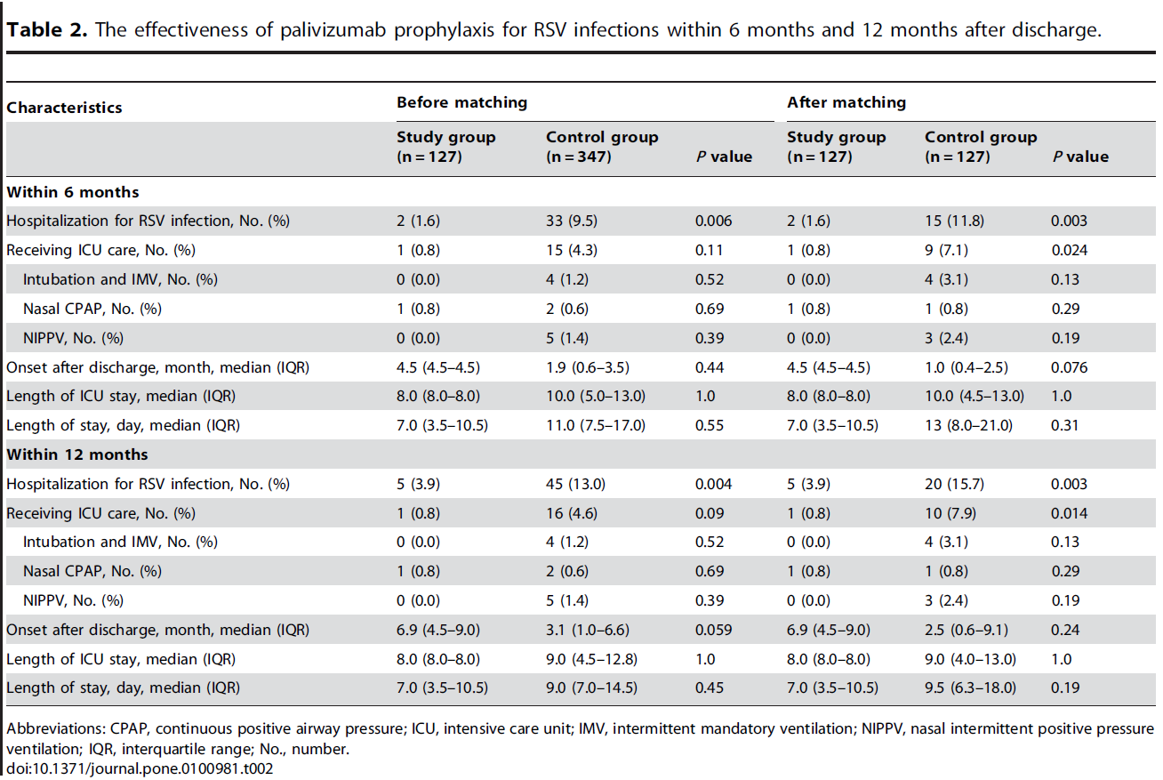
Palivizumab effective as a Birth Dose Year Round
Chi et. al. 2014 PLOS One 9(6): e100981, 1-10

Slide 24
Proposed objective based RSV LRI definition requires one criteria from each column
Specificity | Sensitivity | Medical Significance
RSV Confirmed: Positive RT-PCR | Documented PE findings localizing to lower respiratory track: Rhonchi Rales Crackles Wheeze | Objective measures of clinical severity: Increased respiratory rate ≥ 60 for < 2 mo ≥ 50 for 2-6 mo ≥ 40 for 6-24 mo Hypoxemia O₂ saturation < 95% in room air Clinical signs of severe respiratory disease New onset apnea Nasal flaring Retractions Grunting Acute hypoxic or ventilatory failure requiring assisted ventilation Dehydration due respiratory distress requiring IV hydration Prescription medications (only for children with underlying lung disease)

