Slide 1

THE EFFECT OF MUSİC
ON THE COMFORT AND ANXIETY
OF THE ELDERLY LIVING NURSING HOME
Research Asst. Eda Yaşar
Manisa Celal Bayar University
Dept. of Fundamentals of Nursing
Asst.Prof. Şebnem Çınar Yücel
Ege University
Dept. of Fundamentals of Nursing

Slide 2

The importance of music therapy and
its effects on patients’ recovery was emphasized
by Florence Nightingale in the 19th century,
and recognized as a nursing approach
which reduces
pain and anxiety
and increases a patient’s comfort.
*Khorshıd L. Akın E. (2007). Mekanik Ventilatöre Bağlı
Hastalarda Anksiyete Yönetiminde
Müzikle tedavinin Yeri.
Yoğun Bakım Hemşireliği Dergisi; 11(2):83-88.

Slide 3
Comfort,
which includes relief,
achieving tranquility and the ability to overcome problems, is a subjective concept.
One way of making this concept
as objective as possible is the ability to measure it.
Bekiroğlu, T. (2011). Klasik Türk Müziğinin Hipertansiyon
Hastalarının Kan Basınçlarına Ve Anksiyete Düzeylerine Etkisi,
Gaziantep Ü. Sağlık Bilimleri Enstitüsü, Yükseklisans Tezi, Gaziantep.

Slide 4

According to Kolcaba’s Comfort Theory, nurses identify the comfort needs of individuals in a stressful health care environment, and implement nursing approaches to increase comfort concerning unmet needs, evaluating the extent to which they achieve the result of eliminating anxiety or reducing it to a minimum.
*Karabacak, Ü. (2004). Meme Kanserli hastalarda
Konforu Destekleyici
Hemşirelik Bakımının Ve Eğitiminin
Radyoterapi Uygulaması ile
Etkileşimi, İ. Ü. Sağlık Bilimleri Enstitüsü, Doktora Tezi, İstanbul.

Slide 5

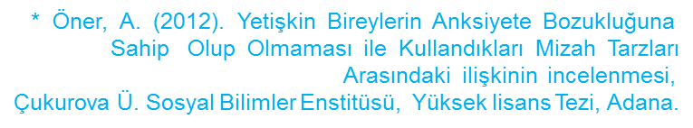
Anxiety
can be seen as
one of the basic human emotions.

Slide 6
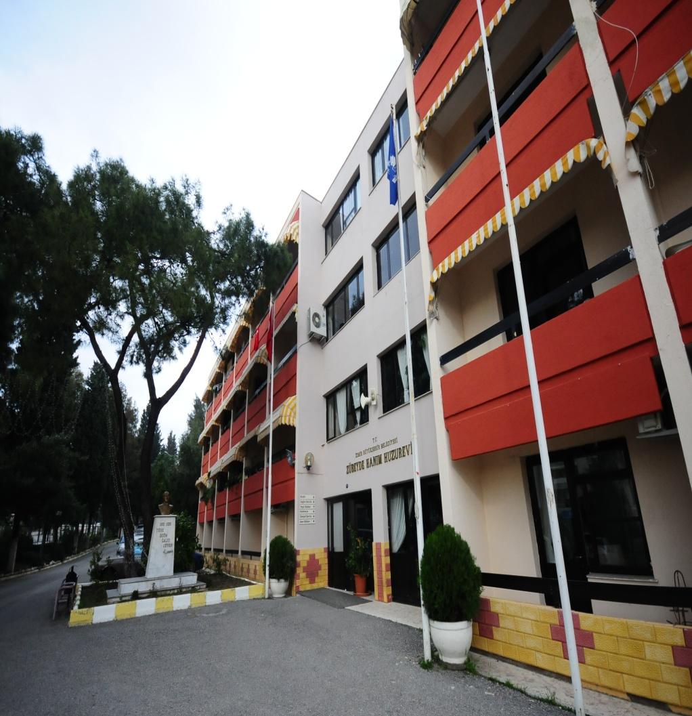
Nurses,
who are in constant contact with the residents of old people’s homes, will naturally act as guides to the old people in reducing anxiety levels and increasing comfort.

Slide 7

Examining the literature:
We found studies of the use of music with patients
in intensive care units and various clinics in the hospital environment, but we came across no studies examining
the effects of music on comfort and anxiety specifically on the residents of the elderly living nursing home.

Slide 8

AIM
To examine
the effect of music on the residents of the elderly living nursing home.

Slide 9
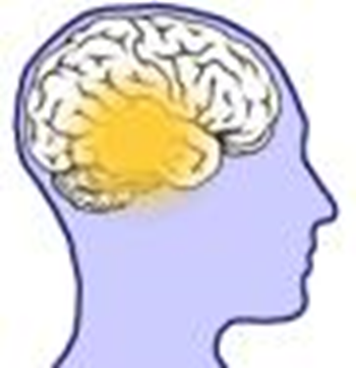
MATERIALS & METHODS
TYPE OF RESEARCH
This was a randomized controlled experimental study, with pre-test, post-test and a control group

Slide 10

LOCATION AND DATE
The study was conducted at an Izmir Municipality old people’s home between
15 December 2013 and 15 May 2014.

Slide 11



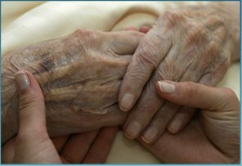
POPULATION AND SAMPLE

Slide 12



Inclusion criteria were:
Being over the age of 60
Literate
Turkish-speaking

Slide 13

Having normal cognitive functions (Standardized Mini-Mental Test – SMMT):
0-12: severe
13-22: medium
23-24: slight
25-30: no cognitive disorder

Slide 14

Not having been exposed to
environmental factors
(three or more people living in one room,
heat, light, noise)
thought to affect
the comfort of old people

Slide 15

Not having recently suffered
an attack
of a chronic illness

Slide 16

Not having suffered
an acute illness such as flu
in the past three days

Slide 17

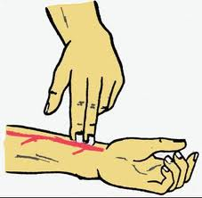

Showing normal vital signs

Slide 18


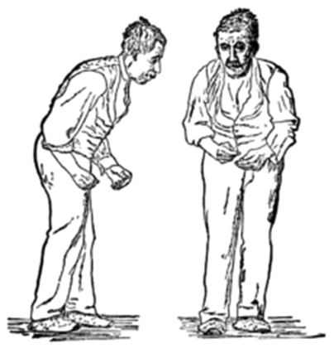
Not having a diagnosis of
Parkinson’s,
Alzheimer’s,
dementia or
major depression.

Slide 19

RANDOMIZATION

Slide 20
OLD PEOPLE FITTING THE STUDY CRITERIA
FEMALE
AGE
60-74
AGE
75-89
MALE
AGE
60-74
AGE
75-89

Slide 21
Not wanting to take part in the study (n=5)
Withdrawing from the study because of problems with record-keeping during the application (n=8)
Exposed to negative environmental factors (more than three in a room, heat, light, noise) (n=180)
Recently experiencing an attack of a chronic illness (n=2)
Having a hearing problem (n=3)
Not having normal cognitive functions according to the Standardized Mini-Mental Test (n=5)
Diagnosed with Parkinson’s, Alzheimer’s, dementia or major depression (n=5)
A total of 208 old people were excluded from the study.

Slide 22
Of the 264 residents of the old people’s home:
56 people
were included in the study and formed the research sample –
28 in the experimental group and 28 in the control group.

Slide 23

DATA COLLECTION
«An Old People’s Identification Form»
with seven questions
to collect characterization information on the residents of the home
(age, gender, marital status, education level, known illnesses, regularly-used medications, length of stay in the home)

Slide 24


Anxiety levels were measured
with the 21-item
Beck Anxiety Scale developed by Beck et al. (1988) and tested for validity and reliability in Turkey by Ulusoy et al. (1988).
A higher total score shows higher anxiety levels.

Slide 25
The old people’s comfort levels
were measured using a
General Comfort Scale
(with 48 items,
24 containing positive statements and
24 with negative statements),
developed by Kolcaba in 1992 and tested for validity and reliability by Kuğuoğlu & Karabacak (2004).

Slide 26

DATA COLLECTION
The old people were monitored for 22 days
*Lai, H.L., Good, M. (2005). Music İmproves sleep quality in older alduts. Journal of ADVENCED Nursing, 49(3):234-244.

Slide 27

The control group received
no intervention.
On the first day the
identification form was applied.
On days 1, 8, 15 and 22, the Beck Anxiety Scale and the General Comfort Scale were applied.

Slide 28

In the experimental group
On the first day,
the identification form, the Beck Anxiety Scale and the General Comfort Scale were applied before the application of music.

Slide 29
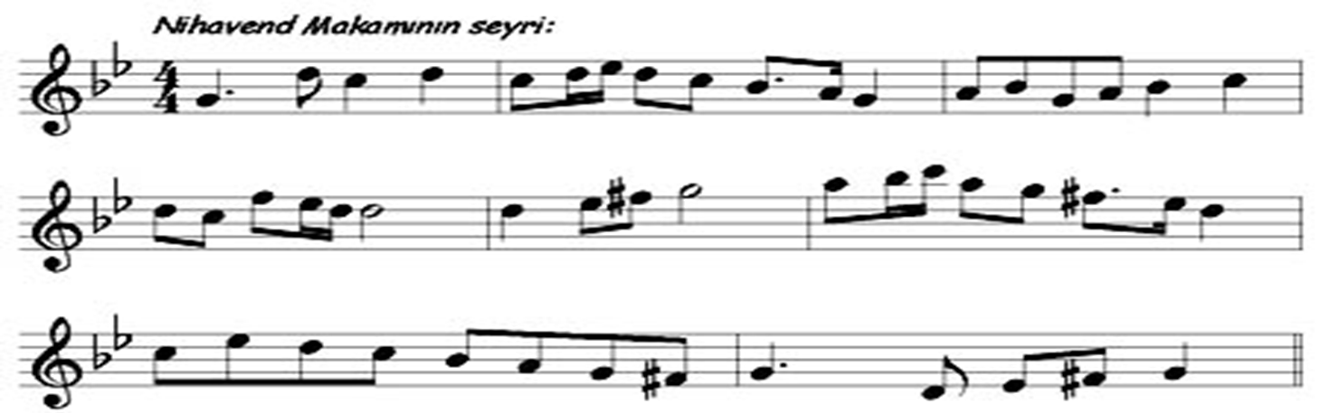
An expert music teacher was consulted to determine music which would be restful for the old people,
and a piece of
Turkish classical music (Nihavend makamı)
was chosen for its relaxing effect.

Slide 30

30 minutes of music was played to
the experimental group
between 20:00 to 22:00
for 22 days.
On days 8, 15 and 22,
the General Comfort Scale and the Beck Anxiety Scale were applied.

Slide 31

Examining the relevant literature,
it was seen that music had been played to this age group for
periods of 25-30 minutes.

Slide 32
In the literature,
music had been played to old people between 20:00 and 22:00, as the most suitable time, after they had completed activities such as shopping or eating supper.

Slide 33
In order to provide motivation and to make the experience more memorable, daily plans were used with the old people
 | Day 1 | Day 2 | Day 3 | Day 4 | Day 5 | Day 6 | Day 7
Week 1 | I listened to music | I listened to music | I listened to music | I listened to music | I listened to music | I listened to music | I listened to music
Week 2 | I listened to music | I listened to music | I listened to music | I listened to music | I listened to music | I listened to music | I listened to music
Week 3 | I listened to music | I listened to music | I listened to music | I listened to music | I listened to music | I listened to music | I listened to music

Slide 34

Dependent and Independent Variables
Dependent variables:
The old people’s total mean scores on the Beck and Comfort Scales
Independent variables:
The old people’s age, gender, marital status, education level and
chronic illness; environmental factors and music.

Slide 35

EVALUATION OF STUDY DATA
The difference between groups by week was examined with
the Mann-Whitney test,
and the difference between total mean scores between weeks was examined with Least Significant Difference (LSD) analysis.

Slide 36

ETHICS
The study was performed in accordance with ethical principles
Written permission was obtained from the Nursing Faculty Scientific Ethics Committee
and informed consent was obtained from all participants

Slide 37

FINDINGS

Slide 38
Total Mean Score Distribution of
Experimental and Control Groups on General Comfort Scale by Weeks
A statistically significant difference was found between
total mean scores on the General Comfort Scale
of old people
in the experimental group by weeks
(χ2=30.558, p=0.000).
WEEKS | Experimental Group X ±Ss
Week 1 | 3.19±0.38
Week 2 | 3.23±0.32
Week 3 | 3.40±0.27
Week 4 | 3.58±0.25
 | χ²=30.558, p=0.000

Slide 39
Total Mean Score Distribution of
Experimental and Control Groups on
General Comfort Scale by Weeks
No statistically significant difference was found between
total mean scores on the General Comfort Scale
of old people in the control group by weeks
(χ²=5.033, p=0.169).
WEEKS | Control Group X ±Ss
Week 1 | 2.97±0.30
Week 2 | 3.01±0.33
Week 3 | 3.08±0.32
Week 4 | 3.09±0.43
 | χ²=5.033, p=0.169

Slide 40
The differences between weeks of the mean total Comfort Scale score of the experimental group were examined.
No significant difference was found in Weeks 1 and 2,
but a significant difference was found between Weeks 3 and 4 (p<0.05).
There was a significant difference between Week 2 and Weeks 3 and 4 (p<0.05),
and a statistically significant difference was also found between Weeks 3 and 4 (p<0.05).

Slide 41
In the control group:
No significant difference was found between Week 1 and Weeks 2, 3 and 4 (p>0.05),
no significant difference was found between Week 2 and Weeks 3 and 4 (p>0.05),
and no significant difference was found between Weeks 3 and 4 (p>0.05).

Slide 42

Distribution of Total Mean Scores on the Beck Anxiety Scale of the Old People in the Experimental and Control Groups by Weeks
WEEKS | Experimental Group X ±Ss | Control Group X ±Ss
Week 1 | 14.60±12.23 | 13.67±8.91
Week 2 | 11.42±9.98 | 12.64±7.84
Week 3 | 6.78±5.19 | 13.32±9.53
Week 4 | 3.57±4.59 | 11.32±8.13
 | χ²=42.416, p=0.000 | χ²=4.601, p=0.203

Slide 43
Distribution Of Differences Between Weeks Of
Total Mean Scores On The Beck Anxiety Scale
Of Old People In The Experimental And Control Groups
WEEKS |  | Experimental Group BAÖ X ±Ss | p | Control Group BAÖ X ±Ss | p
Week | 2. Week | -2.863 | 0.004 | -1.084 | 0.278
 | 3. Week | -3.578 | 0.000 | -0.293 | 0.770
 | 4. Week | -4.200 | 0.000 | -1.531 | 0.126
2. Week | 3. Week | -2.649 | 0.008 | -0.527 | 0.598
 | 4. Week | -4.115 | 0.000 | -1.309 | 0.191
3. Week | 4. Week | -3.612 | 0.000 | -1.861 | 0.063

Slide 44
DIFFERENCES BETWEEN WEEKS
IN THE TOTAL MEAN BECK SCALE SCORE
IN THE EXPERIMENTAL GROUP
A significant difference was found between Week 1 and Weeks 2, 3 and 4 (p<0.05),
a significant difference was also found between Week 2 and Weeks 3 and 4 (p<0.05),
and a statistically significant difference was found between Week 3 and Week 4 (p<0.05).

Slide 45
In The Old People In The Control Group
No significant difference was found between Week 1 and Weeks 2, 3 and 4 (p>0.05),
No significant difference was found between Week 2 and Weeks 3 and 4 (p>0.05),
And no significant difference was found between Week 3 and Week 4 (p>0.05).

Slide 46
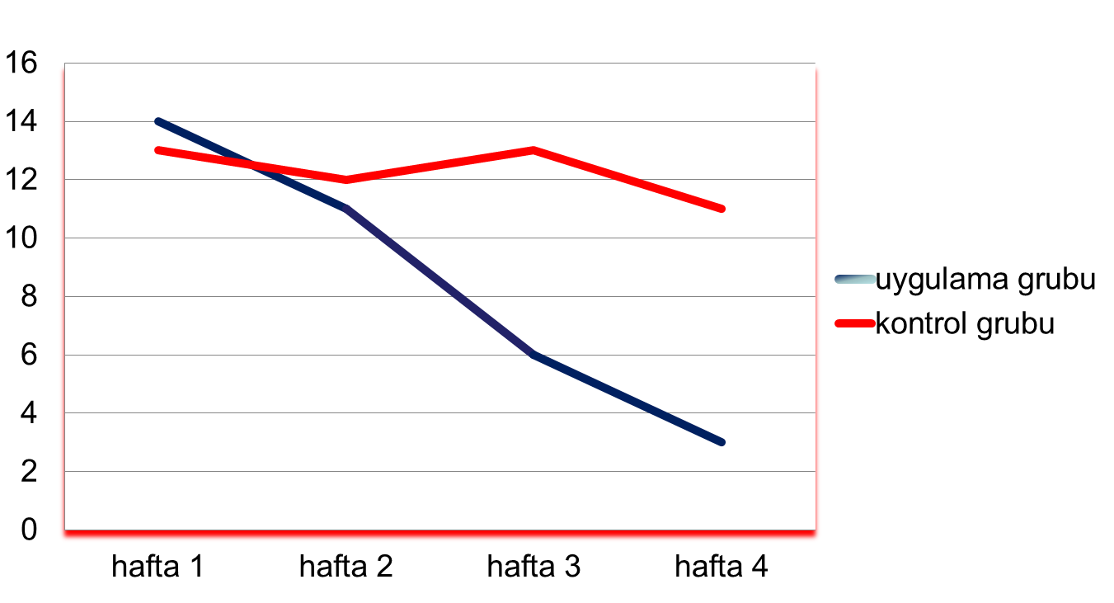
Total Mean Scores
On The Beck Anxiety Scale
Of The Experimental And Control Groups By Weeks

Slide 47

RESULTS

Slide 48


ACCORDING TO THE FINDINGS OF THE STUDY:
Music
increased comfort and decreased anxiety levels
in the old people in the experimental group

Slide 49

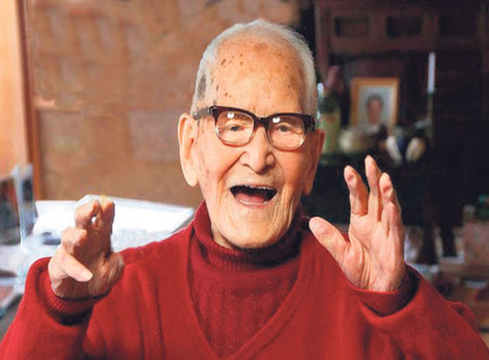
But
no significant change was seen in comfort or anxiety levels among old people
in the control group (p>0.05).

Slide 50
In studies on music therapy
it has been found that music has the effect of reducing the anxiety levels*
and increasing the comfort levels**
felt by patients.
*Davis, C., Cunningham, S. G. (1985). The physiologic responses of patients in the coronary care unit to selected music. Heart and Lung .14(6):291-92.
Hatem, T. P., Lira, P. I., Mattos, S. S. (2006). The therapeutic effects of music in children following cardiac surgery. J Pediatr (RioJ);82(3):186-92.
Lee, O. K., Chung, Y. F., Chan, M. F., Chan, W. M. (2005). Music and its effect on the physiological responses and anxiety levels of patients
receiving mechanical ventilation: a pilot study. J Clin Nurs; 14:609-20.
Ovayolu, N., Ucan, O., Pehlivan, S. (2006). Turkish classical music decreases patients’ anxiety, pain, dissatisfaction and dose of and analgesic drugs
during colonoscopy: A prospective randomized controlled trial. World J Gastroenterol; 14;12(46):7532-6.
Wong, H. L., Lopez-Nahas, V., Molassiotis, A. (2001). Effects Of music therapy on anxiety in ventilatordependent patients. Heart Lung; 30: 376-387.
Vizeli, M. (2010). Koroner Anjiyografi Uygulanacak Hastalarda Müzik Terapisinin Anksiyete Düzeyine Etkisi,
Haliç Üniversitesi Sağlık Bilimleri Enstitüsü ,Yüksek Lisans Tezi, İstanbul
Yıldırım, S., Gürkan, A. (2007). Müziğin, Kemoterapi Yan Etkilerine Ve Kaygı Düzeyine Etkisi, Anadolu Psikiyatri Dergisi ; 8:37-45.
**Besel, J. M. (2006). The Effects Music Therapy On Comfort In The Mechanıcally Ventılated Patıent In The Intensıve Care Unıt. A Thesis Submitted İn Partial Fulfillment of the Requirements For The Degree of Master of Nursing, Montana State Universty, Montana.
Bekiroğlu, T. (2011). Klasik Türk Müziğinin Hipertansiyon Hastalarının Kan Basınçlarına Ve Anksiyete Düzeylerine Etkisi,
Gaziantep Ü. Sağlık Bilimleri Enstitüsü, Yükseklisans Tezi, Gaziantep.
Çiftçi, H. (2011). Müziğin Yoğun Bakım Ünitesinde Serebro Vasküler Olay Tanısıyla Yatan Hastalarda Konfor, Anksiyete Ve Ağrıya Etkisinin İncelenmesi, Çukurova Ü., Sağlık Bilimleri Enstitüsü, Yüksek Lisans Tezi, Adana.
Elliott, D. (1994). The effects of music and muscle relaxation on patient anxiety in a coronary care unit. Heart Lung. 23(1):27-35.
Tsay, S. L., Wang, J. C., Lin, K.C., Chung, U. L. (2005). Effects of acupressure therapy for patients having prolonged mechanical ventilation support. J Adv Nurs; 52:142-50.

Slide 51
However, a scan of the literature shows that
other studies on music therapy have generally been conducted in intensive care units and on hospitalized patients*
* Yıldırım, S., Gürkan, A. (2007). Müziğin, Kemoterapi Yan Etkilerine Ve Kaygı Düzeyine Etkisi, Anadolu Psikiyatri Dergisi ; 8:37-45.
Wong, H. L., Lopez-Nahas, V., Molassiotis, A. (2001). Effects Of music therapy on anxiety in ventilatordependent patients. Heart Lung; 30: 376-387.
Vizeli, M. (2010). Koroner Anjiyografi Uygulanacak Hastalarda Müzik Terapisinin Anksiyete Düzeyine Etkisi,
Haliç Üniversitesi Sağlık Bilimleri Enstitüsü ,Yüksek Lisans Tezi, İstanbul.
Ovayolu, N., Ucan, O., Pehlivan, S. (2006). Turkish classical music decreases patients’ anxiety, pain, dissatisfaction and dose of and analgesic drugs during colonoscopy: A prospective randomized controlled trial. World J Gastroenterol; 14;12(46):7532-6.
Lee, O. K., Chung, Y. F., Chan, M. F., Chan, W. M. (2005). Music and its effect on the physiological responses and anxiety levels of patients
receiving mechanical ventilation: a pilot study. J Clin Nurs; 14:609-20.
Tsay, S. L., Wang, J. C., Lin, K.C., Chung, U. L. (2005). Effects of acupressure therapy for patients having prolonged mechanical ventilation support.
J Adv Nurs; 52:142-50.
Khorshıd L. Akın E. (2007). Mekanik Ventilatöre Bağlı Hastalarda Anksiyete Yönetiminde Müzikle tedavinin Yeri.Yoğun Bakım Hemşireliği Dergisi; 11(2):83-88.

Slide 52
Previous studies*
(despite differences in sampling and methods)
support the findings of our study.
*Davis, C., Cunningham, S. G. (1985). The physiologic responses of patients in the coronary care unit to selected music. Heart and Lung .14(6):291-92.
Hatem, T. P., Lira, P. I., Mattos, S. S. (2006). The therapeutic effects of music in children following cardiac surgery. J Pediatr (RioJ);82(3):186-92.
Lee, O. K., Chung, Y. F., Chan, M. F., Chan, W. M. (2005). Music and its effect on the physiological responses and anxiety levels of patients
receiving mechanical ventilation: a pilot study. J Clin Nurs; 14:609-20.
Ovayolu, N., Ucan, O., Pehlivan, S. (2006). Turkish classical music decreases patients’ anxiety, pain, dissatisfaction and dose of and analgesic drugs
during colonoscopy: A prospective randomized controlled trial. World J Gastroenterol; 14;12(46):7532-6.
Wong, H. L., Lopez-Nahas, V., Molassiotis, A. (2001). Effects Of music therapy on anxiety in ventilatordependent patients. Heart Lung; 30: 376-387.
Vizeli, M. (2010). Koroner Anjiyografi Uygulanacak Hastalarda Müzik Terapisinin Anksiyete Düzeyine Etkisi,
Haliç Üniversitesi Sağlık Bilimleri Enstitüsü ,Yüksek Lisans Tezi, İstanbul
Yıldırım, S., Gürkan, A. (2007). Müziğin, Kemoterapi Yan Etkilerine Ve Kaygı Düzeyine Etkisi, Anadolu Psikiyatri Dergisi ; 8:37-45.
Besel, J. M. (2006). The Effects Music Therapy On Comfort In The Mechanıcally Ventılated Patıent In The Intensıve Care Unıt. A Thesis Submitted İn Partial Fulfillment of the Requirements For The Degree of Master of Nursing, Montana State Universty, Montana.
Bekiroğlu, T. (2011). Klasik Türk Müziğinin Hipertansiyon Hastalarının Kan Basınçlarına Ve Anksiyete Düzeylerine Etkisi,
Gaziantep Ü. Sağlık Bilimleri Enstitüsü, Yükseklisans Tezi, Gaziantep.
Çiftçi, H. (2011). Müziğin Yoğun Bakım Ünitesinde Serebro Vasküler Olay Tanısıyla Yatan Hastalarda Konfor, Anksiyete Ve Ağrıya Etkisinin İncelenmesi, Çukurova Ü., Sağlık Bilimleri Enstitüsü, Yüksek Lisans Tezi, Adana.
Elliott, D. (1994). The effects of music and muscle relaxation on patient anxiety in a coronary care unit. Heart Lung. 23(1):27-35.
Tsay, S. L., Wang, J. C., Lin, K.C., Chung, U. L. (2005). Effects of acupressure therapy for patients having prolonged mechanical ventilation support. J Adv Nurs; 52:142-50.

Slide 53
RECOMMENDATIONS
Turkish classical music can be played to old people to help to reduce their anxiety levels and increase their comfort.
Nurses working in old people’s homes can make use of this effect and include it in their nursing practice.

Slide 54
Questions, suggestions and contributions to:
edayasar35@hotmail.com
sebnemcinar@gmail.com

Slide 55

THANK YOU

