Slide 1

MODERN TRENDS IN THE TREATMENT OF DEMENTIA
Cheryl Atherley-Todd, MD, CMD
Family Physician/Geriatrician
Assistant Professor FM/Ger
Email:ca765@nova.edu

Slide 2
Definition
According to DSM-5, released in 2013, the criteria for dementia (now called major neurocognitive disorder) include the following
  Evidence from the history and clinical assessment that indicates significant cognitive impairment in at least one of the following cognitive domains:
  Learning and memory
  Language
  Executive function
  Complex attention
  Perceptual-motor function
  Social cognition
Must be acquired and represent a significant decline from previous level of functioning.
Must interfere with independence in everyday activities.

Slide 3

Agnosia

Slide 4
Statistics
Starting at age 65, the risk of developing dementia doubles every five years.
By age 85 years and older, between 25 and 50 percent of people will exhibit signs of Alzheimer disease.
Up to 5.3 million Americans currently have Alzheimer’s disease.
By 2050, the number is expected to more than double due to the aging of the population.
Alzheimer disease is the sixth leading cause of death in the United States and is the fifth leading cause among persons age 65 and older.

Slide 5
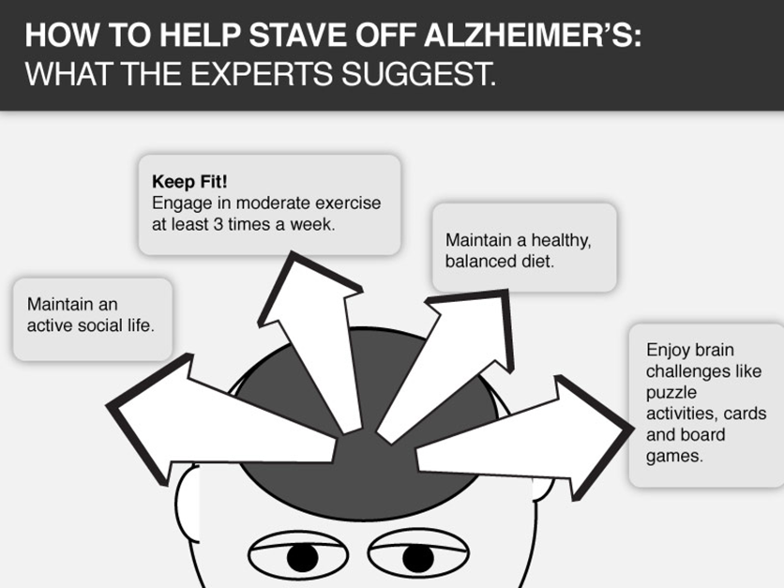

Slide 6
Prevention
Numerous observational studies on
  Use of dietary supplements
  Diet
  Physical activity
  Socioeconomic factors
  Co-morbidities
  Environmental exposures
  Cognitive engagement
No proof that modification of these factors reduces the risk of dementia.

Slide 7
Types of Dementia
Alzheimer disease (AD) accounts for the majority of cases- 60-80%.
Vascular dementia
Lewy body dementia
Parkinson-related dementia
Alcoholic dementia
Fronto-temporal dementia

Slide 8
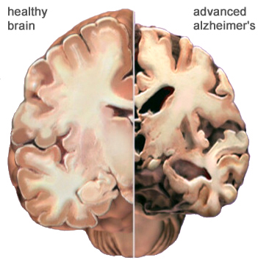
Brain changes in advanced AD

Slide 9
Clinical course and prognosis
Dementia is a terminal illness
Stages of dementia
  Mild or early stage
  Moderate
  Moderately severe
  Severe

Slide 10
Tools Used To Assess Progression of Dementia
Folstein’s Mini-mental Assessment Scale
  Mild to moderate
  Scores 25-30 normal. Less than 10 severe dementia
Functional Assessment Staging
  Moderate to severe
  Scores 1: normal, 7c hospice eligible.
Karnofsky Performance Scale
  Performance progress through any terminal illness
  Scores 100% : normal, decrease by multiples of 10 down to a score of 10% when patient is moribund.
Global Deterioration Scale
  Stage 1: normal, Stages 4-7 severe dementia

Slide 11
Family meeting
Discussion with patient and caregiver on disease progression:
Early in illness so patient can participate.
Many matters to be discussed including
  Medical
  Social
  Psychological
  Ethical
  Spiritual

Slide 12
Treatment of Dementia
Main focus
  Enhance quality of life
  Maximize functional performance
  Improve cognition, mood and behavior.
Types of treatment
  Pharmacological
  Non-pharmacological

Slide 13
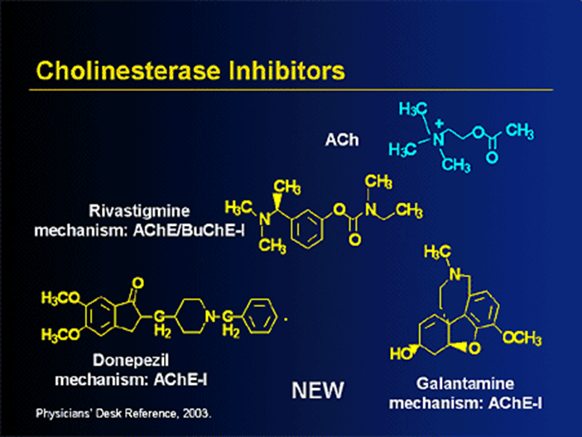
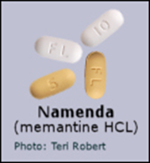
Current pharmacological treatment

Slide 14
Pharmacological treatment
Cognitive enhancers
Acetylcholinesterase inhibitors
  Donepezil
  Rivastigmine
  Galantamine
NMDA receptor antagonists
  Memantine

Slide 15
Pharmacological treatment
Behavioral problems are among the main reasons why dementia patients are placed in long term care facilities.
Agitation with non-acute psychosis
  Risperidone (FDA warning about cerebrovascular events)
  Olanzapine (Use with caution in diabetics)
  Quetiapine (Useful for patients with Parkinsonian symptoms)
  Ariprazole
Acute agitation
  Haloperidol
Sleep disturbances
  Melatonin, Trazodone, non-benzodiazepine hypnotics.
Avoid antipsychotics in patients with Lewy body dementia.

Slide 16
Pharmacological treatment
Agitation with anxiety and irritability
  Trazodone
  Buspirone
Agitation with depression
  Citalopram
Agitation with significant aggression (second line treatment)
  Divalproex
Sexual aggression, impulse control in men
  Atypical antipsychotics
  Divalproex
  Second line treatment: Estrogen, medroxyprogesterone

Slide 17
Other agents
Conflicting evidence about the benefits of
  Selegiline (a MAO type B inhibitor with minimal anticholinergic effects)
  Testosterone
  Ginkgo biloba (neuroprotective agent, anti-oxidant and free radical scavenger)
No evidence supporting the beneficial effects
  Vitamin E
  Estrogen
  NSAIDs
  Statins
  Insulin sensitizers
  Lecithin
  Acetyl-L-carntine

Slide 18
Monitoring therapy
Alzheimer’s Disease Assessment Scale of cognition (ADAS-Cog) and the Clinician Interview-Based Impression of Change Scale plus Caregiver Input(CIBICS-CI) are the most commonly used instruments to establish effectiveness of AD medications in clinical trials.
Lengthy and cumbersome.
MMSE: familiar to most physicians but non specific.
No subspecialty group guidelines give concrete recommendations regarding how monitoring should be done or which tools should be used.
The Alzheimer’s Association suggests post-diagnostic monitoring every 6 months or any time there is a behavioral change or sudden decline in function.

Slide 19
When should medications be discontinued?
Patient does not adhere to treatment.
Deterioration continues.
Patient develops serious co-morbid disease or is terminally ill.
Patient or caregiver chooses to discontinue treatment.
A brief medication free trial may be used to assess whether a medication is still providing a benefit.

Slide 20
Non pharmacological treatment
Familiar surroundings
Daily routines
Environmental modifications
  Clocks
  Calendars
  To do lists
  Pictures of a toilet on the bathroom door
  Pictures of food on the dining room door
  Stop signs on the entrance doors
Environmental safety

Slide 21
Non pharmacological treatment
Cognitive rehabilitation
  Reality orientation
  Memory retraining
  Cognitive training
Problem: inability to learn new skills
Solution: provide support to accommodate lost skills.

Slide 22
Non pharmacological treatment
Stimulation oriented treatment
  Art
  Music
  Dance
  Pet therapy
Emotion oriented psychotherapy
  Pleasant events
  Reminiscent therapy
Emotional connection with partner: expressions of feelings, closeness, touch, massage and cuddling.
These are especially useful for patients with behavioral problems.

Slide 23
Special care units
Only about 13% of all long term facilities have dementia special care units.
Patients with similar needs are placed together.
Staff is specially trained to deal with dementia patients and are thus more able to give quality supportive care to the patient.
Goals of a successful dementia unit include
  Maximize safety and support
  Facilitate social opportunities
  Support of functional abilities
  Provide opportunity for control and privacy
  Adjust the amount of stimulation
  Maintain self identity
  Maximize awareness and orientation

Slide 24
Dementia Village
Weesp,The Netherlands
In 2009, Hogeweyk, a neighborhood for dementia patients in the Dutch town of Weesp, near Amsterdam, Holland.
Wandering is one of the symptoms of dementia. Residents can move around freely in the village but they cannot leave.
This sort of village environment allows patients with dementia to live with dignity in safe environs.
Observational studies indicate that patients are more active and require less medication.
Another dementia village is in the planning stages in Wiedlisbach, canton Bern, Switzerland.
Will we have one in USA any time soon?

Slide 25

Supermarket,Dementia village, Weesp

Slide 26
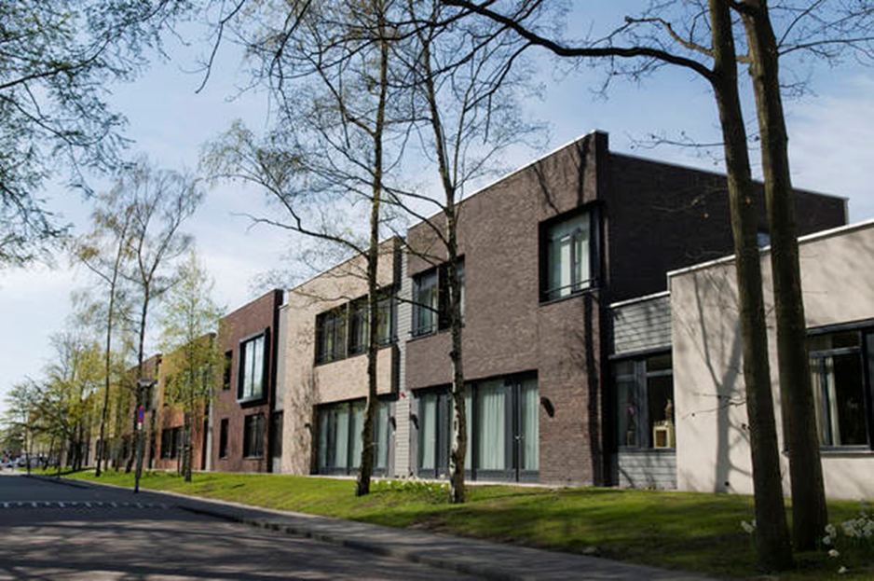
Housing: Dementia Village, Weesp

Slide 27


Slide 28
Caregiver Support
Caregiver stress.
Isolation.
Anticipatory grief.
Respite care and support groups.
Local agency on aging.
Alzheimer’s Association.
Physician’s role.

Slide 29
New modalities
No new drug has been approved for the treatment of AD for more than 10 years.
Old drugs aimed at treating dementia signs and symptoms.
New modalities aim at treating the root cause of dementia in the brain cells.

Slide 30
Beta-amyloid
Chief component of plaques
  A hallmark of AD
  Clipped off from parent compound amyloid precursor protein (APP) by 2 enzymes
    Beta-secretase
    Gamma-secretase
  Two humanized monoclonal antibodies, bapineuzumab and solanezumab, directed against the N terminus and mid-region of Beta-amyloid, respectively are being tested in phase III trials in patients with mild to moderate AD. Aim: To confirm beneficial cognitive effects shown in previous studies.

Slide 31
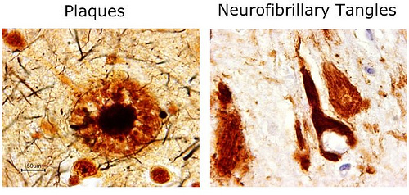
Beta-amyloid plaques &
Tau tangles

Slide 32
Immunotherapy
Both active and passive vaccinations with beta-amyloid have been tested in clinical trials.
Tau based therapies have so far only been tested in mice.
Beta-amyloid immunotherapy may delay the onset of dementia.
Phosphorylated tau immunotherapy might delay the progression of AD.

Slide 33
Inflammation
Excess pro-inflammatory mediators, some of which may cross the blood-brain barrier may trigger neurodegeneration.
In a recent study in mice with AD, a heptapeptide isolated from the Ph.D-C7 library by phage display significantly improved the spatial memory and reduced the amyloid plaque burden.

Slide 34
Insulin Resistance
Insulin receptors are distributed throughout the brain.
Modulates neurotransmitter channel activity, cholesterol sysnthesis, mitochondrial function and phosphorylation of tau protein.
Disruption of insulin action in the brain leads to impairment of neuronal function and synaptogenesis.
Thus, alteration in insulin action can contribute to the development of neurodegenerative diseases like AD.

Slide 35
Caprylidene (Axona)
Medical food marketed since 2009 to assist with the dietary management of AD.
Main ingredient caprylic triglyceride – fractionated coconut oil, a medium chain triglyceride.
MOA:
  Caprylic acid is broken down to ketones when digested.
  Alternative energy source for the brain.
  In AD the brain’s ability to utilize it’s normal energy source (glucose) is impaired.
Caprylidene is not approved as a drug to treat AD by FDA.
No evidence to substantiate it’s efficacy to treat AD.
Accera Inc. the manufacturer of Axona has paid for and conducted the only clinical trial published in an open access journal.

Slide 36
In the pipeline
Electroconvulsive therapy (ECT).
  Venue: Mclean Hospital in Belmont, Massachusetts, USA
  Aim: To find out whether patients receiving ECT or standard care differ in reduction of agitation/aggression severity and changes in cognition pre- and post-treatment.
Far infrared Radiation
  Venue: The Centre for Incurable Diseases Toronto, Canada
  Aim: To determine the therapeutic effects ofinfrared radiation on dementia.
Tolcapone
  Venue: Columbia University, NY, USA
  Aim: To test the effects of Tolcapone (This increases the amount of dopamine in the brain.) in patients with fronto-temporal dementia.

Slide 37
Yarumal, Columbia
Earlier I mentioned Weesp, the Dutch AD village.
That one was artificially created.
In Yarumal, Antioquia region of Columbia over 5000 members of 25 families have a mutation in the presenilin gene-1 on chromosome 14
  “Piasa variation” of AD= Autosomal-Dominant AD (ADAD) = La bobera = “The stupidity”
  Inbred communities, all descendants of a single Basque who settled in the area in the 18th century
  Develop AD much earlier – in the 5th decade
  Identical brain lesions to that seen in mainstream AD
Alzheimer’s Prevention Initiative (API), an international public-private consortium has been established to conduct research on these families.
  First clinical studies being done with anti-amyloid therapies.
  Target: Family members who are known to have the ADAD gene but have not yet experienced symptoms.
  Aim: To delay or prevent AD in these members.

Slide 38
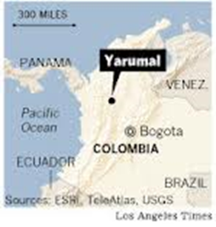
Yarumal

Slide 39

Yarumal

Slide 40
Summary
Dementia is a very stressful illness for the patient, the caregiver, and caring family members so continuing research needs to be done on prevention, treatment and a possible cure.
Modern trends in treatment include
  Dementia villages
  Vaccines
  Research on ECT, infrared radiation
  Food supplement: Axona
  Drugs that modify the disease process
It is important to do advanced care planning while the patient still has decision making capacity.
The multidisciplinary hospice team can help to make the end of life issues for these patients and their caregivers much more bearable but hospice is underutilized and often utilized too late.
Caregivers should be encouraged to use support groups and try to maintain a life outside of caring for the dying patient.
The physician has a pivotal role not just in the medical management of dementia patients but we must also be cognizant of the other domains: functional, psychological, ethical, and spiritual.

Slide 41
Questions?

