Slide 1
Rotator Cuff Injuries
Partial Thickness Rotator Cuff Tears: Treatment and Repair Techniques
OMICS March 24th, 2015
Sports Medicine and Fitness
Alex Martusiewicz
Coukos, J., Gomberawalla, M., Douros, D., Terry, M.

Slide 2
Overview
Anatomy
Classification
History
Examination
Imaging
Treatment

Slide 3
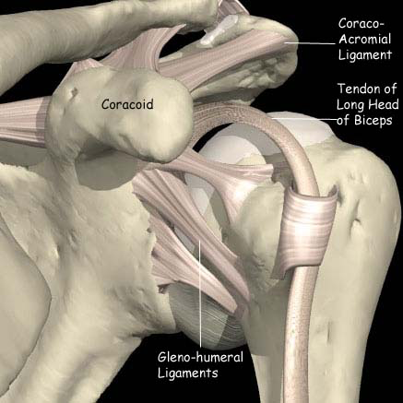
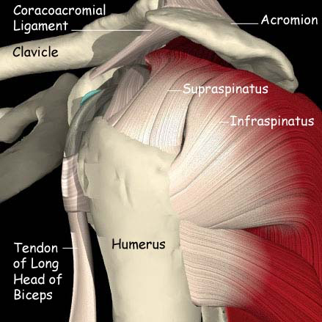
Anatomy

Slide 4
Classification
Partial
-Bursal vs Articular
< 50% thickness
> 50% thickness
Complete
Organize by size
Number of muscles involved

Slide 5
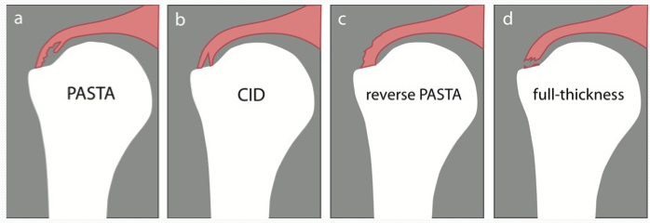
Classification
PASTA:
Partial Articular Supraspinatus Tendon Avulsion

Slide 6
History
Pain on the lateral aspect of the shoulder
  may radiate to deltoid insertion
  anterior acromion with impingement
    +/- biceps tendonitis
Stiffness, especially IR
Cannot lie on that side
Weakness, instability, crepitus
Partial tears more sore and stiffer
Acute tear may have inciting event

Slide 7
Physical Exam
Inspection: atrophy, symmetry
Palpation: AC, cuff tenderness
Range of motion: active, passive
Strength: ER and elevation power, lag
Provocative: impingement sign, arc of pain

Slide 8
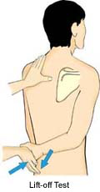
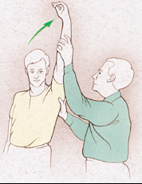
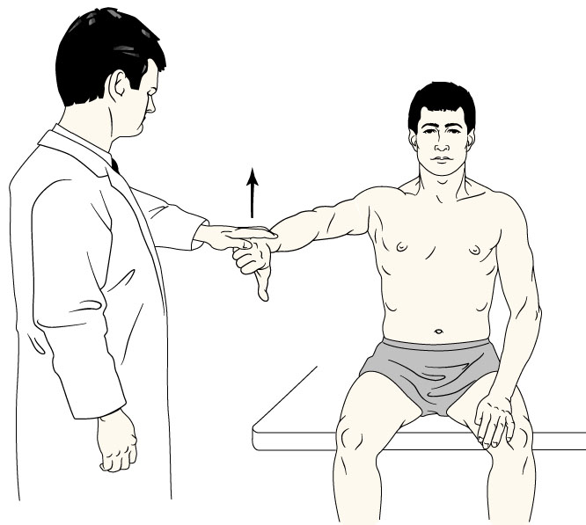
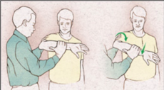
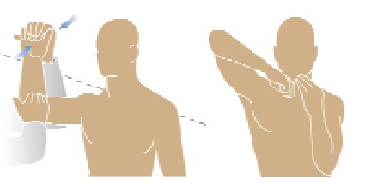
Physical Exam
Specialized Tests
Jobe (Empty Can) - Supraspinatus
Neer – Impingement
Lift Off – Subscapularis
Hawkins – Impingement
Hornblower – Teres Minor

Slide 9
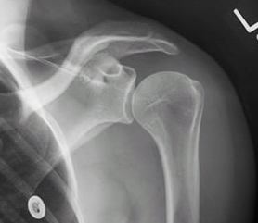
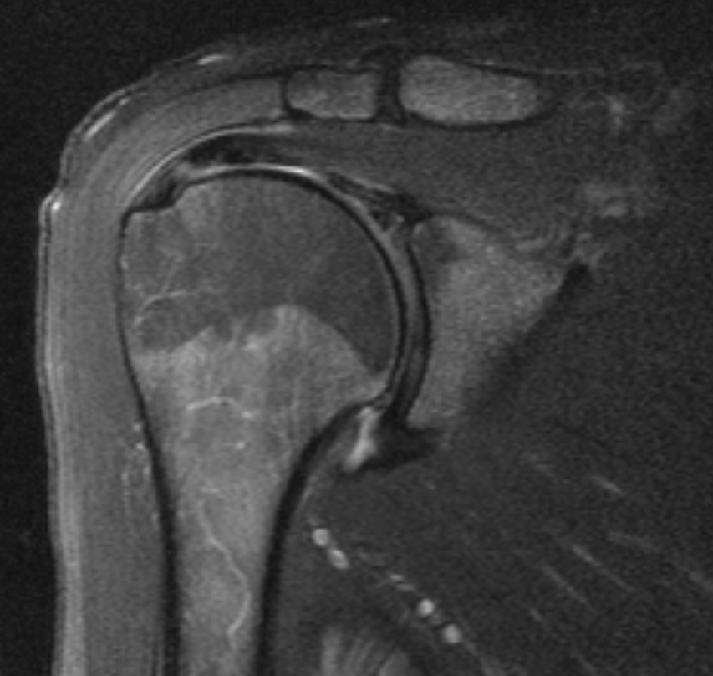
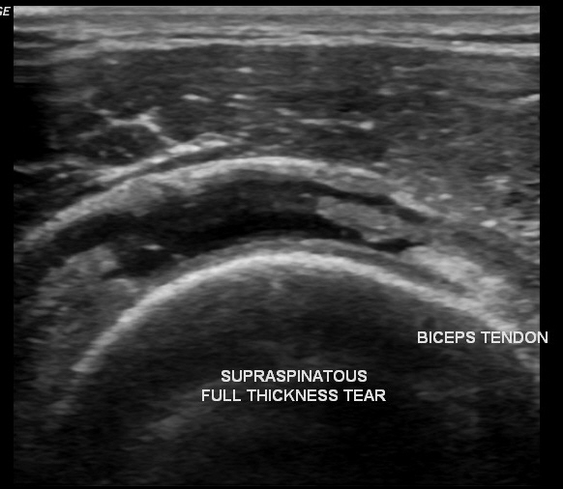
Imaging
X-ray
Ultrasound
MRI

Slide 10
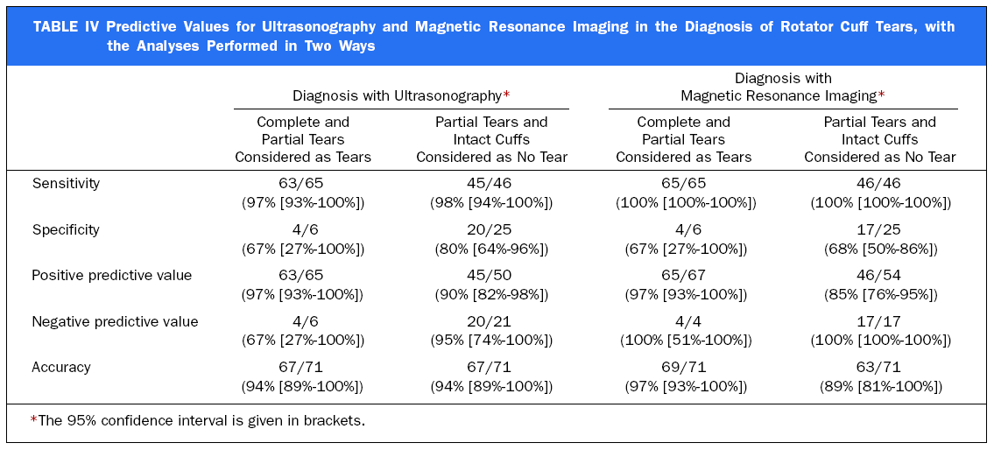
MRI vs Ultrasound
Detection and quantification of rotator cuff tears. Teefey et al. JBJS 2004
  71 patients with shoulder pain had imaging with
  U/S and MRI then underwent arthroscopy
    46 full thickness tears
    19 partial thickness tears
    6 had no tear
  U/S and MRI had comparable accuracy for identifying and measuring size of partial and full thickness tears
  MRI slightly more sensitive

Slide 11
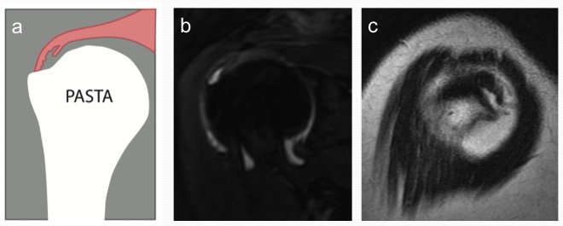
Imaging

Slide 12
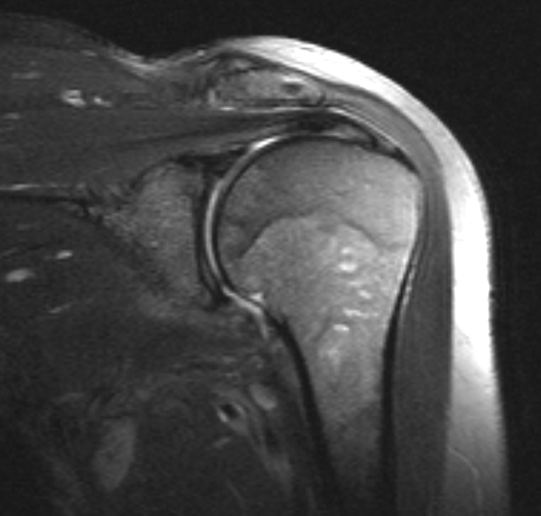
Imaging

Slide 13
Treatment
Mainstay is conservative
Surgery reserved for significantly symptomatic patients who have failed conservative management > 6 -12 months
Younger patient (<60) with acute tear
  Cuff repair within 6 weeks

Slide 14
Treatment
Conservative Treatment Candidates
  Partial thickness tears
  Older patients with chronic large tears and extensive cuff muscle atrophy
NSAIDs
  Symptom control ± ↓ inflammation
Physical Therapy
  Rotator cuff strengthening
  Pain free ROM
  Strengthening shoulder girdle
  Improving biomechanics and proprioception
Corticosteroid Injections
  Subacromial injection if impingement thought to be primary cause of symptoms

Slide 15
Indications for Surgery
Failed conservative management
  3 to 12 month course of NSAIDs, therapy, corticosteroid injections, activity modification
Significant or progressive weakness, esp. acute
  Early repair if <50 y.o. and full-thickness tear
Differential diagnosis confirms weakness is from rotator cuff tear (i.e. MRI findings correlate with exam, rule out other causes)

Slide 16
Contraindications to Surgery
Asymptomatic tear
Chronic “massive” irreparable tears
  Tendon retraction past glenoid rim
  Fatty degeneration of muscle
  Increased width of subtrapezial fat pad
Frozen shoulder
  Need ROM pre-op
Unwilling or unable to participate in post-op therapy

Slide 17
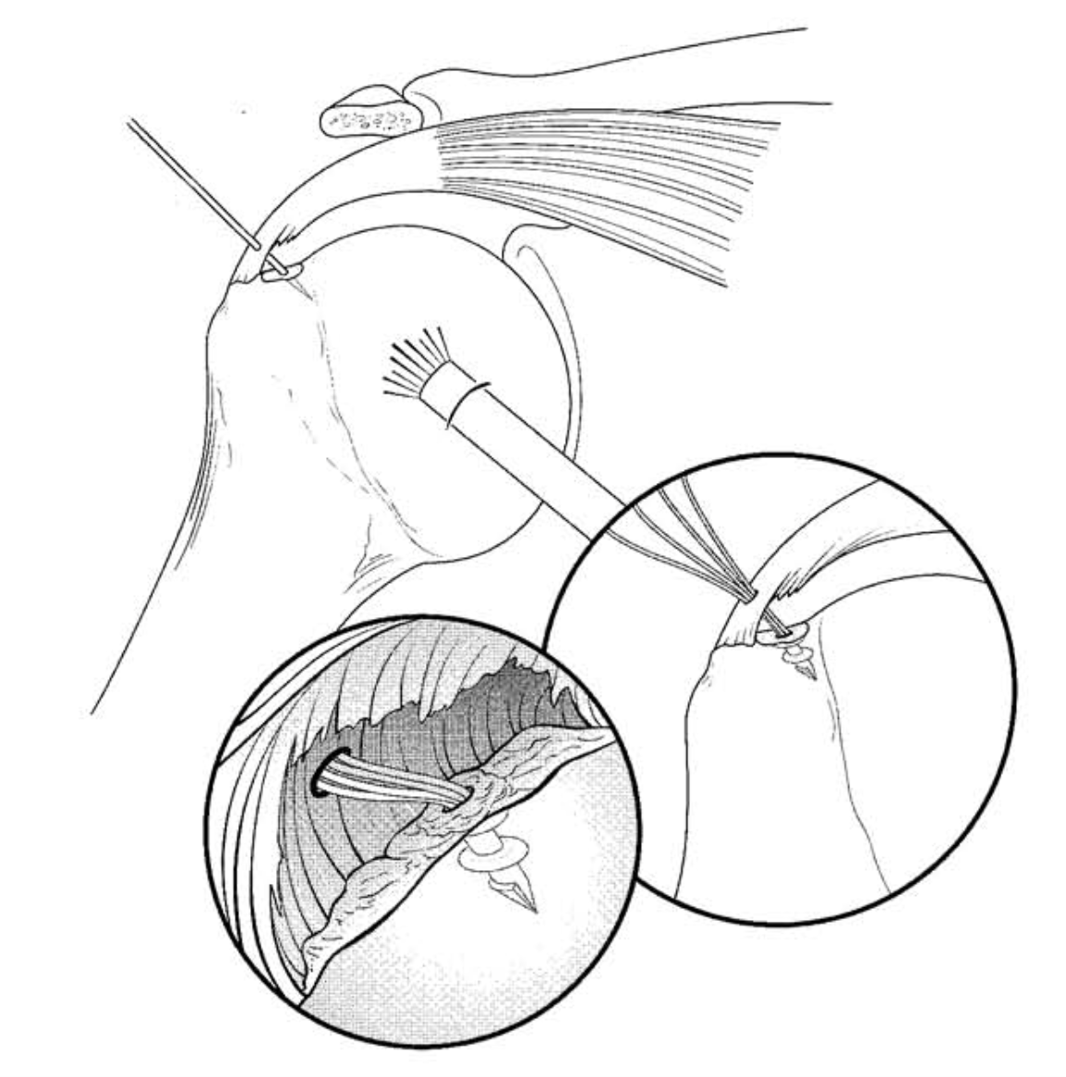
Surgical Techniques
Debridement
Decompression and acromioplasty
Repair
  “Complete the tear”
  Trans-osseous
  Trans-tendon

Slide 18
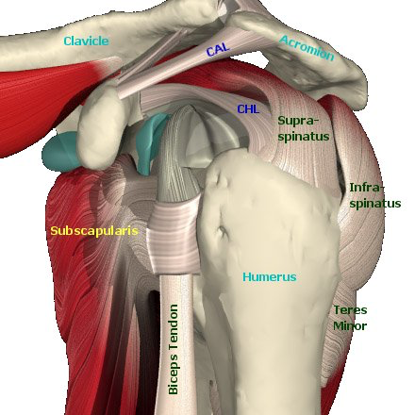
Surgical Techniques
-Trans-interval rotator cuff repair
Rotator Interval:
capsule, SGHL, and the coracohumeral ligament that bridge the gap between the supraspinatus and the subscapularis

Slide 19
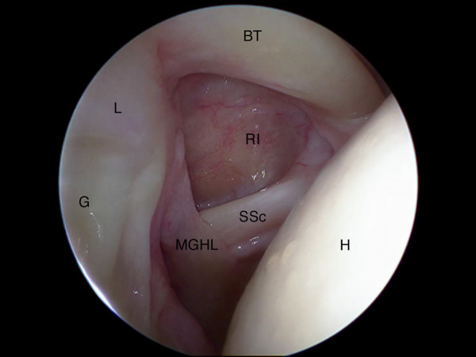
Surgical Techniques
-Trans-interval rotator cuff repair
Rotator Interval:
capsule, SGHL, and the coracohumeral ligament that bridge the gap between the supraspinatus and the subscapularis

Slide 20
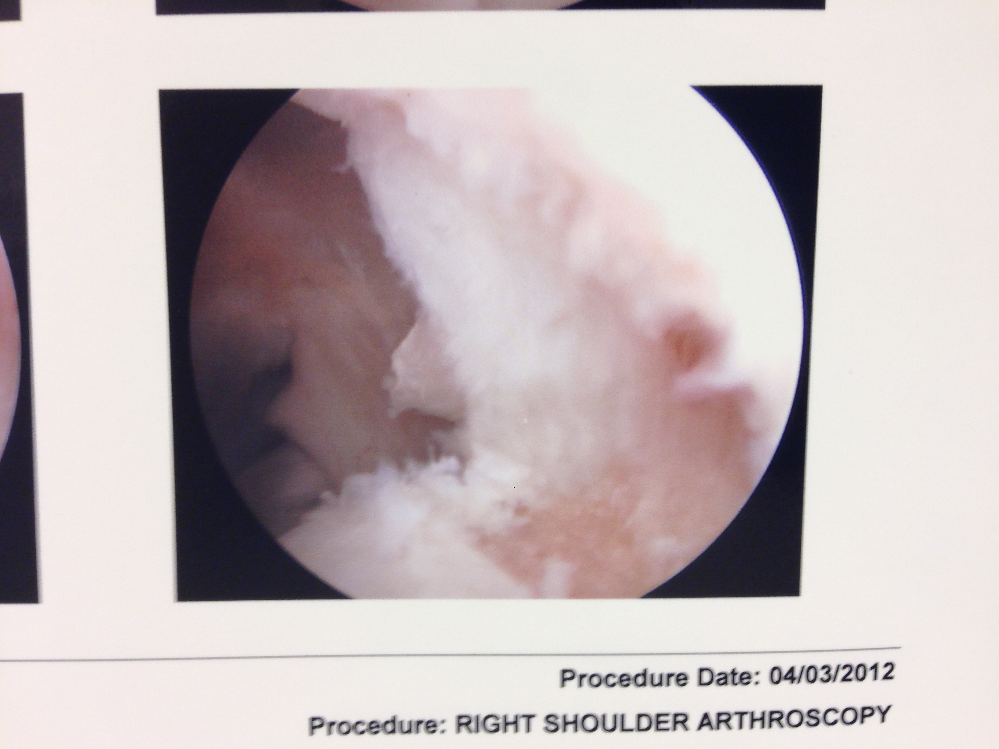
Surgical Techniques
-Trans-interval rotator cuff repair
Identify tear
Prepare footprint

Slide 21
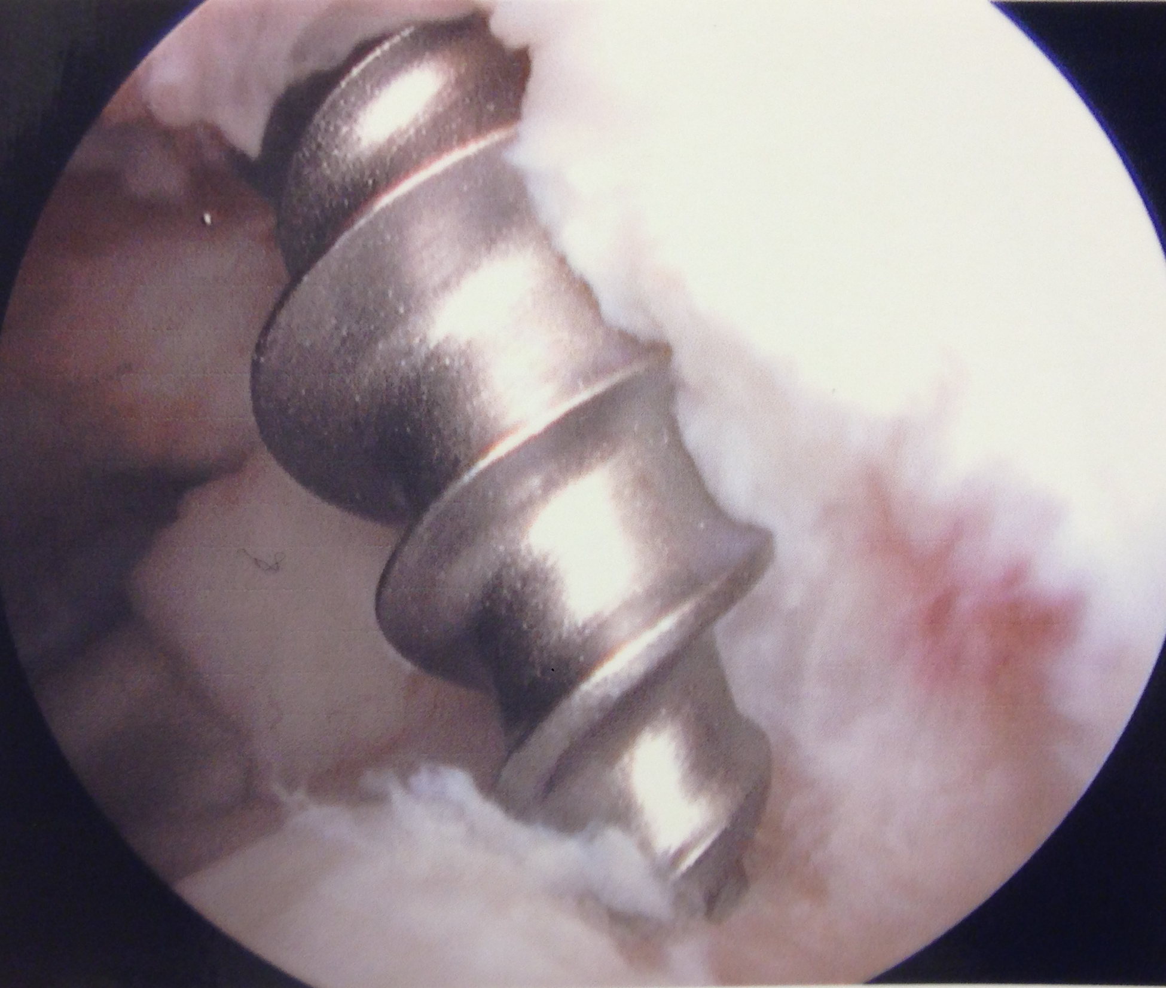
Surgical Techniques
-Trans-interval rotator cuff repair
Insert anchor through the rotator interval
  - 5 mm double loaded titanium anchor

Slide 22
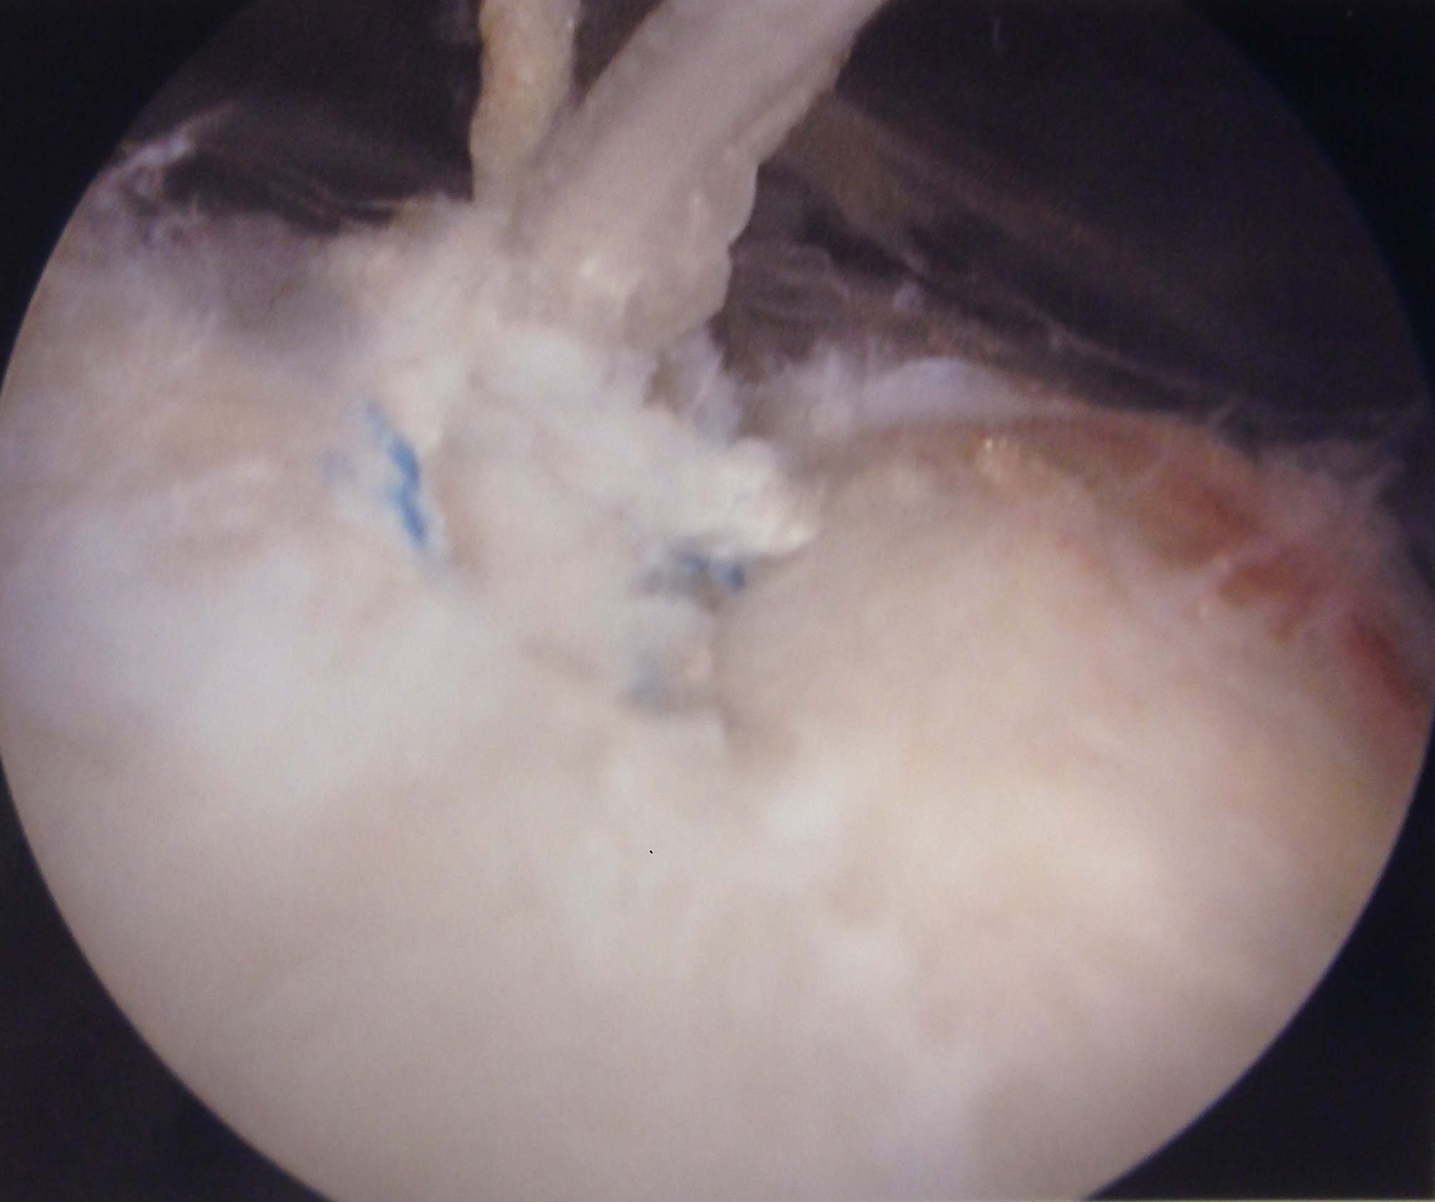
Surgical Techniques
-Trans-interval rotator cuff repair
Create subacromial portal
Pass two suture limbs through rotator cuff with suture lasso
Tie in subacromial space

Slide 23
Surgical Techniques
-Trans-interval rotator cuff repair
Respects intact tendon and supraspinatus footprint
Avoids creating a breach close to the rotator cuff insertion

Slide 24
Surgical Techniques
-Trans-interval rotator cuff repair
14 patients retrospectively identified with a PASTA tear who met criteria (< 50% tear, refractory to conservative treatment)
- 10 Males, 4 Females
- Dominant arm in 11/14 patients
- Average age: 56
- Mean clinical follow up: 28 months

Slide 25
Surgical Techniques
-Trans-interval rotator cuff repair
ASES Shoulder Score used as an outcome measure
- 95.8 out of 100 (95% CI: 91.8- 99.8)
11/14 Patients had complete resolution of pain
92% of patients stated that they would repeat the procedure again

Slide 26
Conclusions
Thorough examination and appropriate imaging are important for diagnosing rotator cuff pathology
Important to distinguish between partial and complete tears
Conservative management should be attempted for partial tears
Trans-interval repair provides reliable pain relief while respecting the intact tendon and supraspinatus footprint

Slide 27
References
"We Provide Medical Images." Silkfactory. Web. Feb 3. 2015. <http://www.silkfactory.com/2015/02/13/we-provide-medical-images/>
Fox, J.A., Romeo A.A., PASTA Lesion-Trans-Tendon Technique for Repair. Operative Techniques in Orthopaedics, Vol 12, No 3, 2002 pg. 191-196.
Penello, D. Rotator Cuff Tears. Upper Extremity Rounds. Feb 22, 2006.
"Rotator Cuff Tear." Rotator Cuff Tear. Web. 20 Mar. 2015. <http://www.londonortho.co.uk/private/RCT.htm>.
"Rotator Cuff Tears." Rotator Cuff Tears. Web. 21 Mar. 2015. <http://www.shoulderdoc.co.uk/articletile.asp?article=61§ion=22&tile=4>.
Teefey et al. Detection and quantification of rotator cuff tears. JBJS 2004, Apr;86-A(4):708-16.

Slide 28
Thank You
John Coukos
Dr. Mustafa Gomberawalla
Dr. Michael Terry

