Slide 1

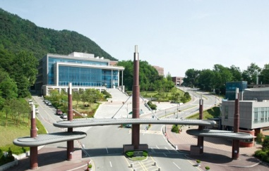

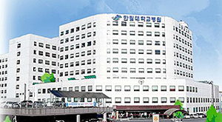
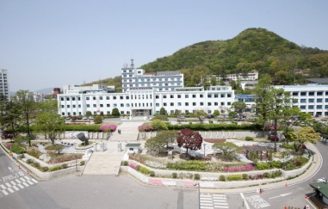
Cross-Talk between Human Mast Cells and Epithelial Cells by IgE-mediated Periostin Production in Eosinophilic Nasal Polyps
Dong-Kyu Kim, MD, PhD
Department of Otorhinolaryngology-Head and Neck Surgery, Chuncheon Sacred Heart Hospital, Hallym University College of Medicine, Chuncheon, Korea

Slide 2
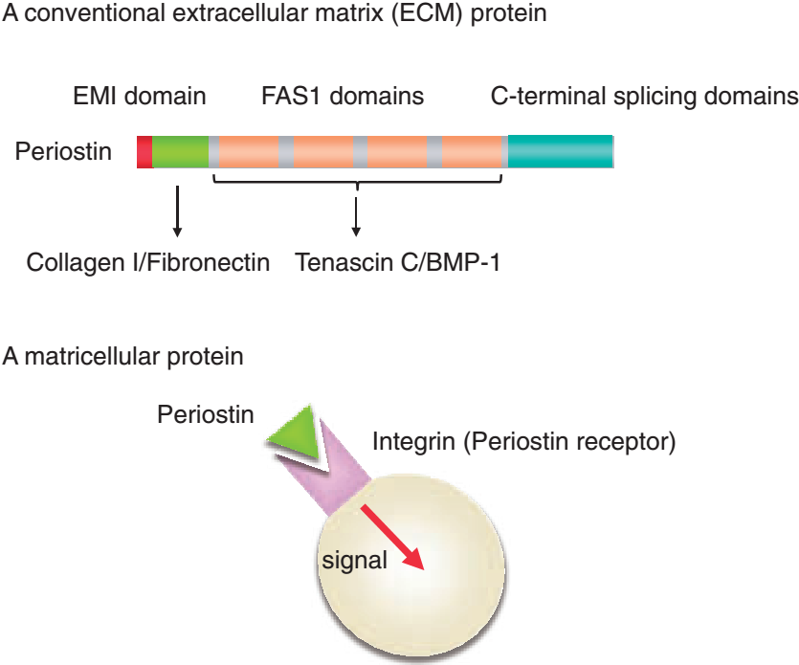
Introduction
Periostin, an extracellular protein, has emerged as a novel mediator of allergic diseases and plays an important role in tissue remodeling.

Slide 3
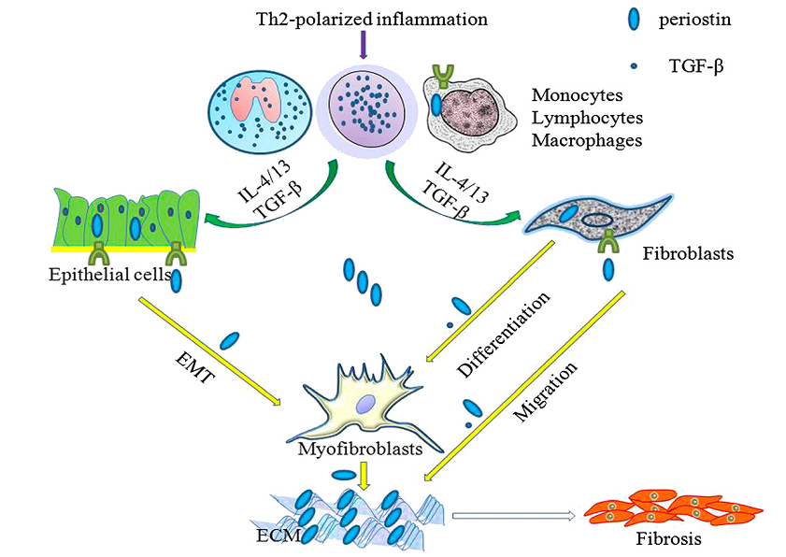
Role of periostin in the pathogenic process of subepithelial fibrosis

Slide 4
Introduction
Serum periostin, as a biomarker, is elevated in severe eosinophilic asthma and aspirin-exacerbated respiratory disease and levels can predict the development of airflow limitation in asthmatic patients on an inhaled corticosteroid as well as responsiveness to omalizumab or lebrikizumab in uncontrolled severe allergic asthma.

Slide 5
Introduction
However, despite its clinical significance, the mechanism by which periostin regulates inflammation remains poorly understood in the pathogenesis of airway inflammatory diseases.

Slide 6
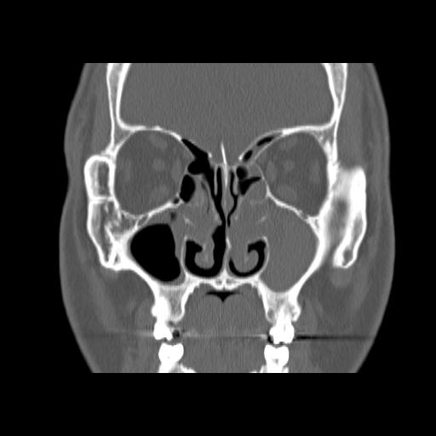
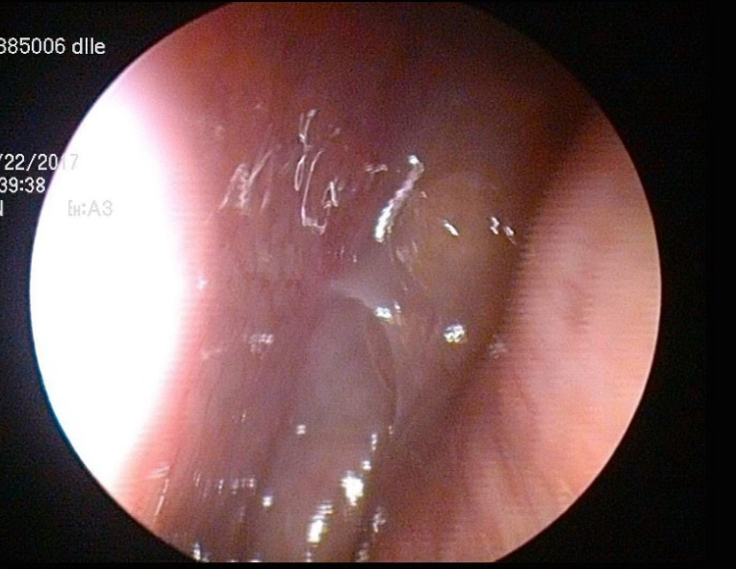
Introduction
Chronic rhinosinusitis (CRS) is one of the most common chronic rhinologic diseases and can significantly reduce the quality of life of affected subjects. Increased periostin production in sinonasal tissues occurs in subjects with CRS, particularly those with nasal polyps (NP) and allergic fungal sinusitis.

Slide 7
Introduction
Periostin expression is also associated with CRS tissue eosinophil and disease severity. However, it is still unclear how periostin contributes to the pathophysiology of CRS with nasal polyps (CRSwNP).
Therefore, the expression, cellular origin and function of periostin in NP tissues were investigated according to various subtypes of CRSwNP.

Slide 8
Method
Group
  Control- Uncinate process (UP) : 22
  CRS without NP (CRSsNP)-Uncinate process (UP) : 62
  CRS with NP (CRSwNP)-Uncinate process (UP) : 68
  Nasal polyp (NP) : 34
IHC, double IHC, qRT-PCR, ELISA, Confocal analysis
In vitro assay
  Mast cell culture, hBronchial epithelial cell culture

Slide 9
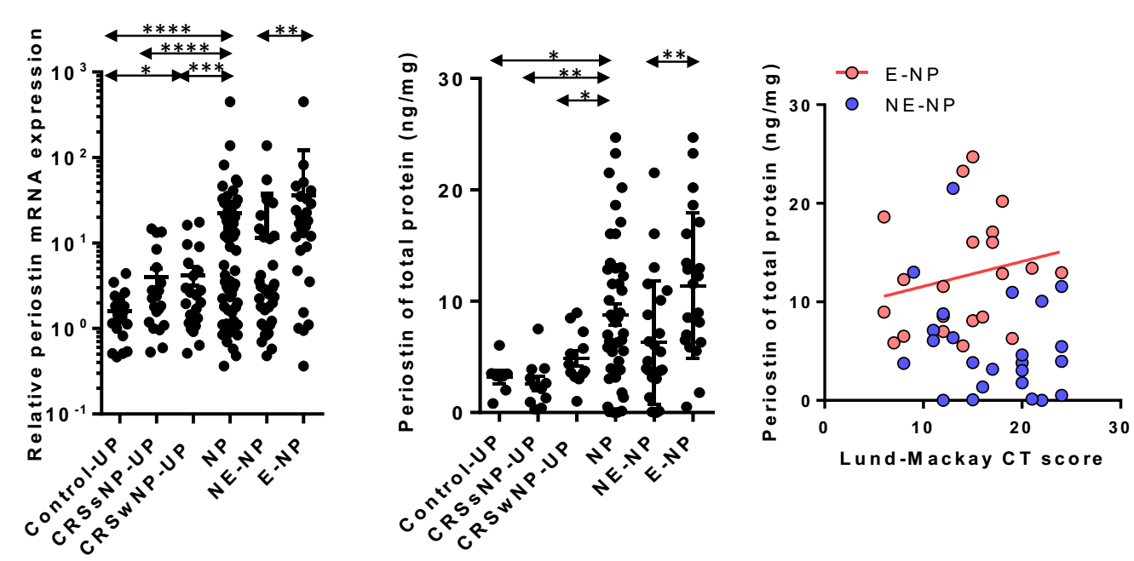
Expression of periostin
Result

Slide 10
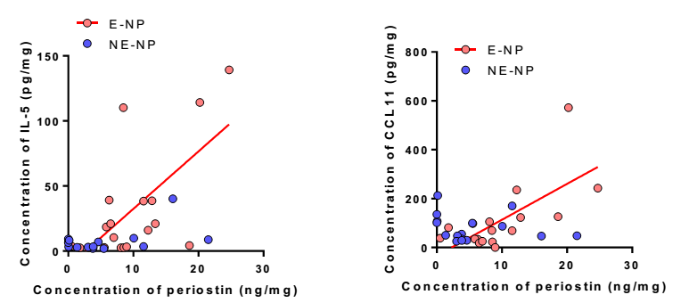
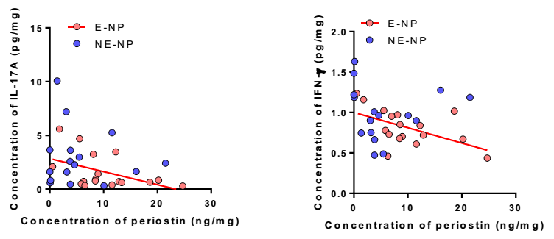
Relationship between periostin and major cytokines
Result

Slide 11
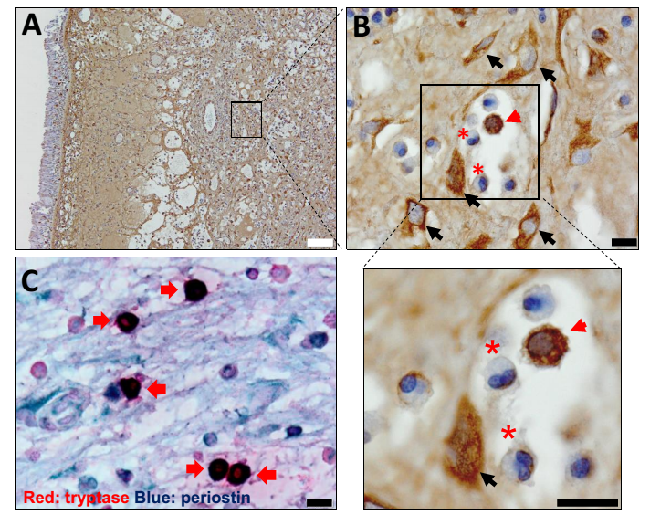
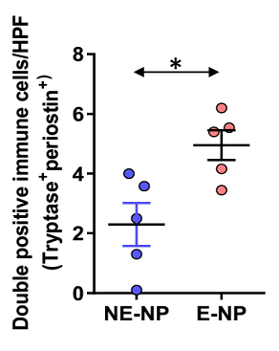
Cellular source of periostin
Result

Slide 12
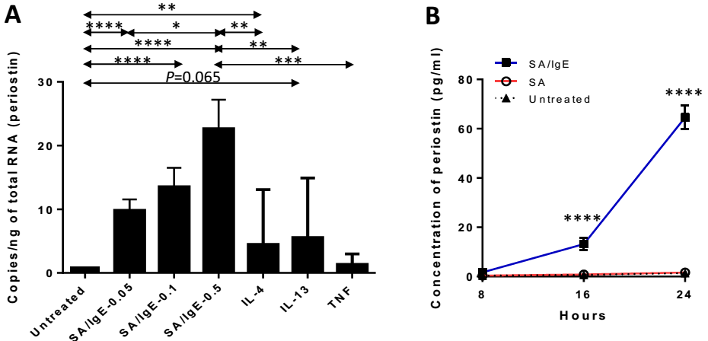
Periostin expression in human mast cell
Result
mRNA
Protein

Slide 13
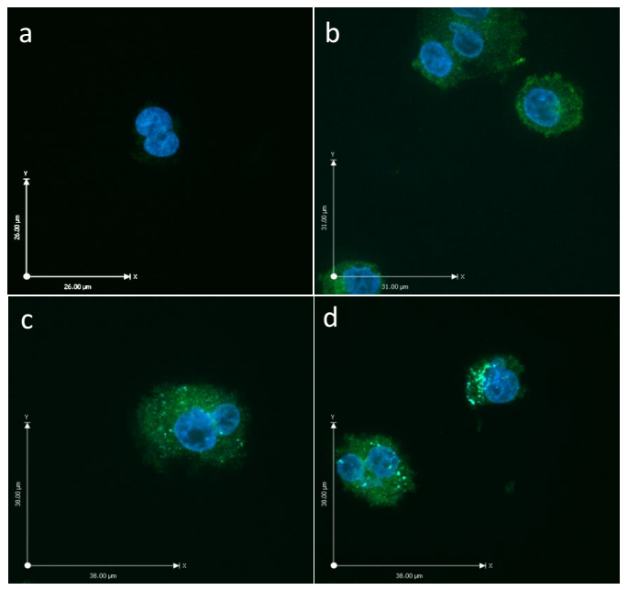
Periostin expression in human mast cell
Result
Rabbit IgG Isotype Control
IgE-biotin/SA-periostin staining
IgE-biotin/SA-periostin/chymase double staining

Slide 14
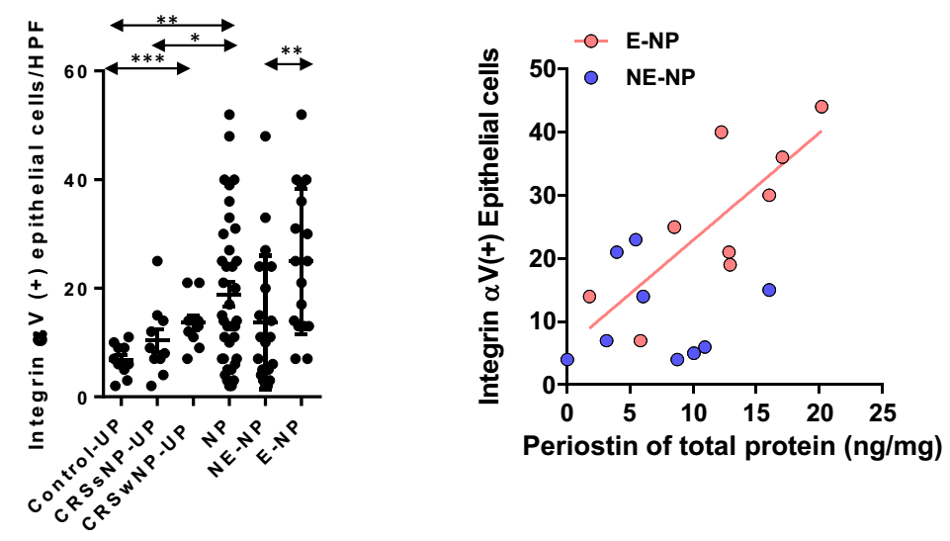
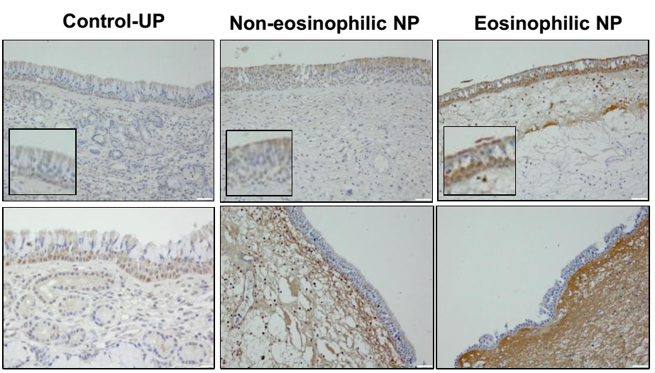
Expression of periostin receptor (integrin aV)
Result
Integrin aV
Control-UP
Non-eosionphilic NP
Eosionphilic NP
Periostin

Slide 15
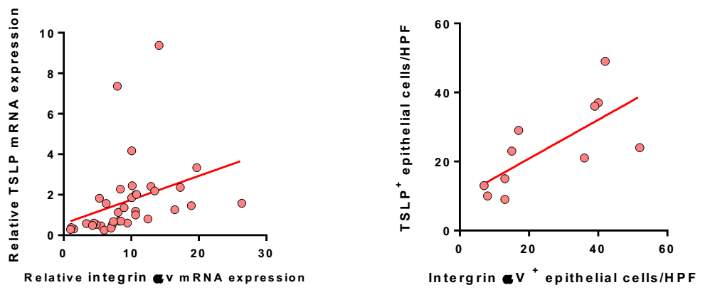
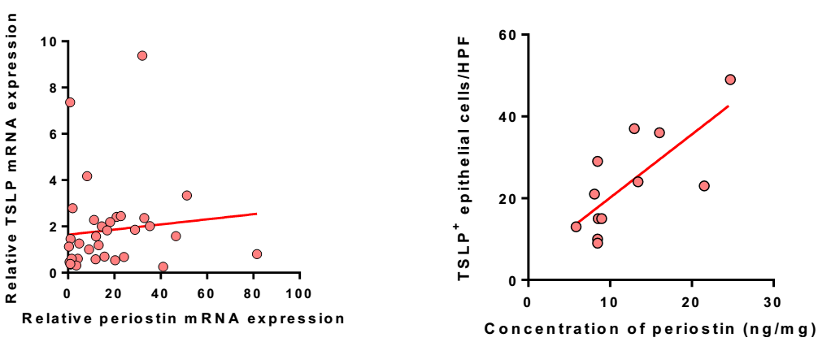
Correlation between periostin/integrin aV and innate Th2 cytokines
Result
TSLP
r=0.703, p<0.001
r=0.792, p=0.005
r=0.313, p=0.072
r=0.742, p=0.018

Slide 16
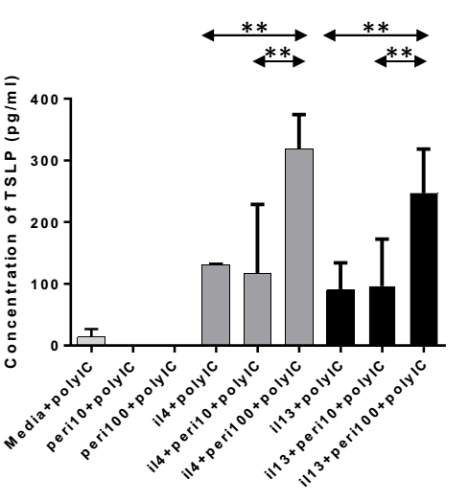
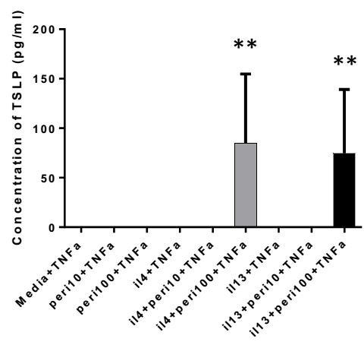
Periostin induced TSLP production in airway epithelium
Result

Slide 17
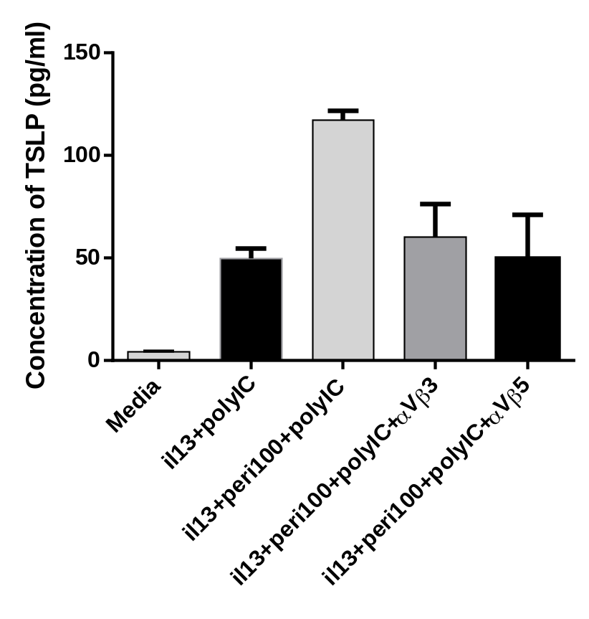
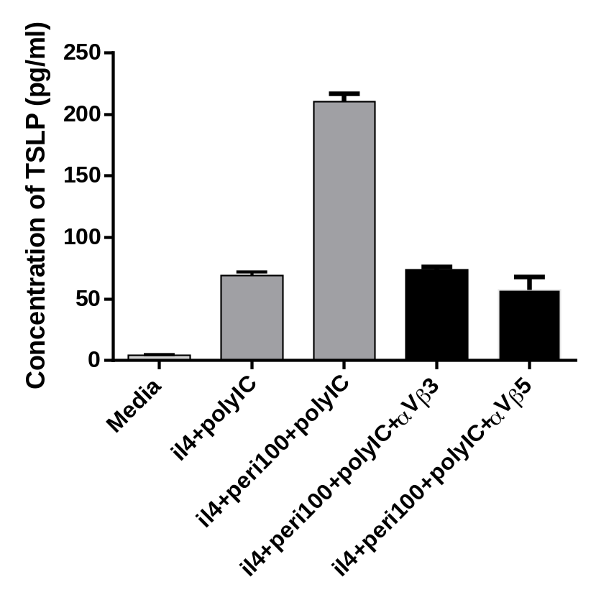
Periostin induced TSLP production in airway epithelium
**
**
**
**
**
**
**
**
**
**
**
**
**
**

Slide 18
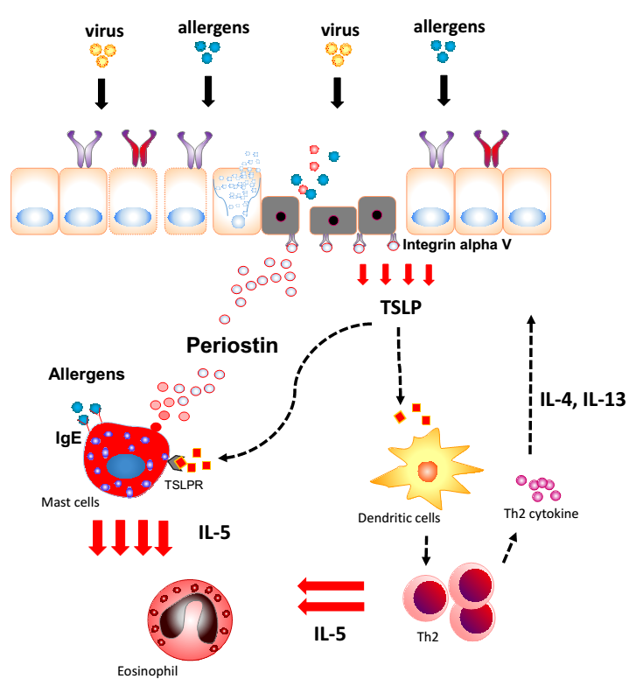
Conclusion

