Slide 1
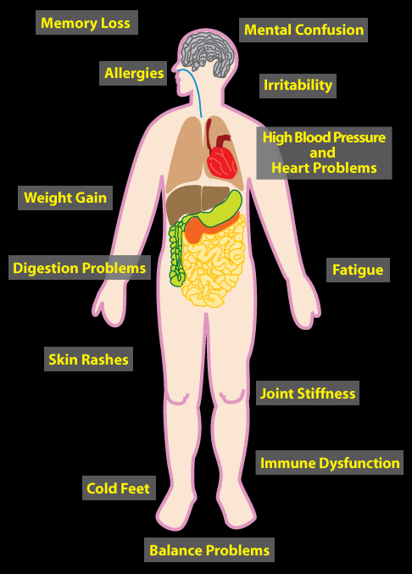
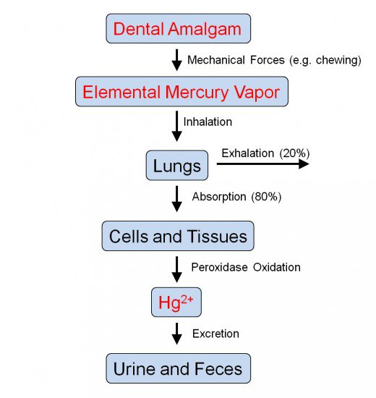
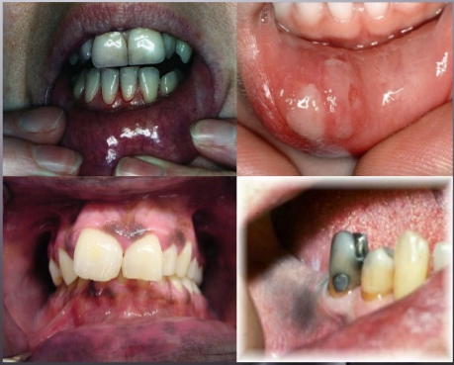
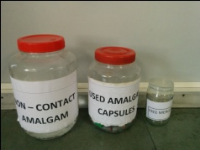
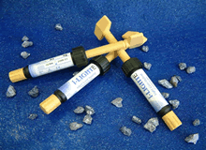
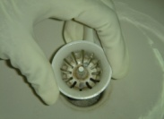
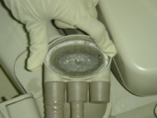
MERCURY TOXICITY IN ORAL HEALTH CARE
ABSORPTION
Inhalation: 60-80%
Dermal 3-15%
GI Tract – Metallic <0.2%
- Inorganic 15%
- Organic 90%
ELEMENTAL MERCURY
Exist in liquid & vapour form.
  Sources: Sphygmomanometers, thermometers, barometers.
Exposure by accidental spillage.
INORGANIC MERCURY
Exist in liquid form.
Mined as sulphide ore.
Sources: Traditional remedies.
Irritating in nature.
ORGANIC MERCURY
Mainly in methyl mercury form & toxic.
Sources: Fungicide, pesticide, vegetables & fruits.
Slow elimination, ½ life of 2 to 3 months
PREVENTION
EFFECTS OF MERCURY TOXICITY
MERCURY FROM DENTAL AMALGAM
EFFECTS ON ORAL CAVITY
Scrap Amalgam: Collect in wide mouth, air tight container.
Amalgam Alternatives like composite, Cermet, Ceramic, GIC cement.
Disposable chair-side Traps & Vacuum Pump Filter (Amalgam Separators) to avoid flushing in water drainage system
Bleeding gums
Alveolar bone loss
Loosening of teeth
Excessive salivation
Foul breath
Metallic taste
Burning sensation, with tingling of lips, face
Tissue pigmentation
Stomatitis
Ulceration in mouth
Dr. Meera Choudhary
Maulana Azad Institute of Dental Sciences, New Delhi, India

