Slide 1

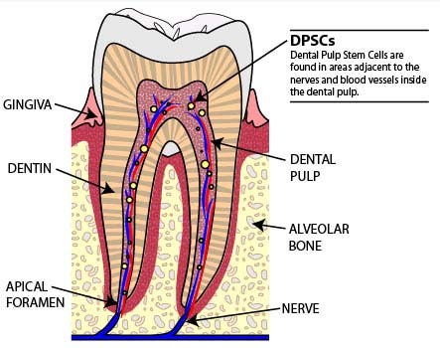
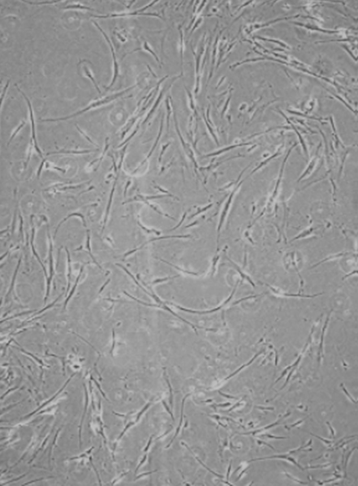
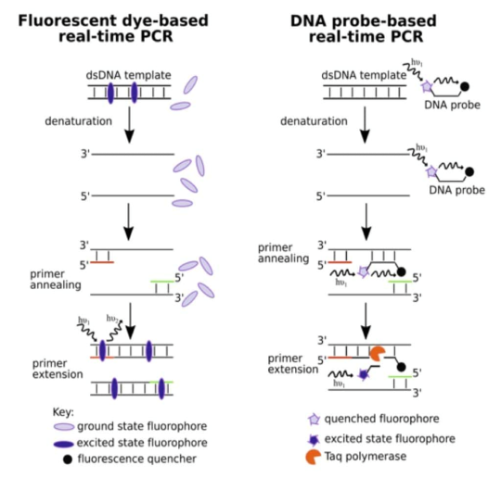
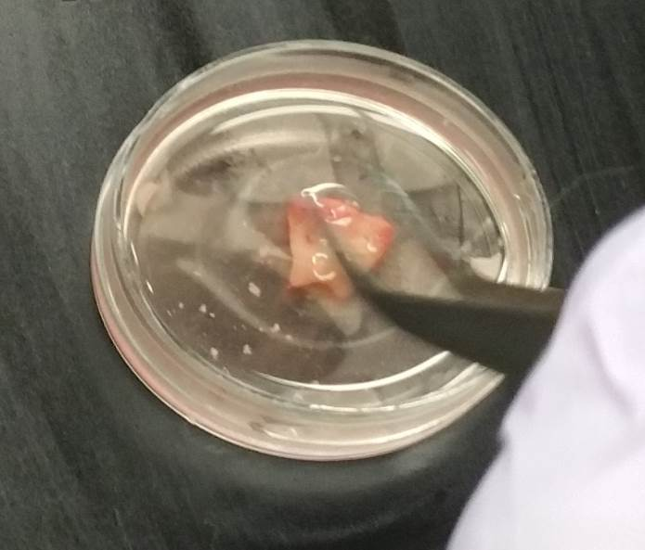
.
Complement C5a Promotes Odontogenic Dental Pulp Stem Cell Differentiation
Amer Marachli¹, Raghuvaran Narayanan², Yessenia Valverde¹, Fanny Chmilewsky¹, Satish Alapati², Seung Chung¹
¹ Department of Oral Biology, ²Department of Endodontics, University of Illinois at Chicago College of Dentistry, Chicago, Illinois 60612
Introduction
Process
Gene Expression
Dental pulp stem cells (DPSCs) are multipotent/undifferentiated cells that are found in the soft living tissue within the dental pulp. Given their easy access compared to other stem cells, they have been given much attention in recent regenerative medicine. Odontoblasts are dentin-making cells in the pulp and have a significant role in dentin-pulp repair in injured teeth. Our team demonstrated for the first time that the complement system, a major component of innate immunity and inflammation, is activated at the injured site of human carious teeth and plays an important role in dental nerve regeneration. We extend this observation in DPSC differentiation. The role of complement fragment C5a in the differentiation of DPSCs is unknown.
Objective: To investigate the role of C5a in odontogenic differentiation of dental pulp stem cells.
Hypothesis: C5a has a positive affect on odontogenic differentiation of DPSC.
Tooth Composition
DPSCs 21 days from isolation passages 3/4
Figure 1
Real Time PCR
Conclusion
Methods
Pulp extraction and DPSC
C5a plays a positive role in odontogenic differentiation of DPSCs. As seen in figure 1, the important odontogenic differentiation gene markers, BMP1, ON, RUNX2, DSPP, have all increased relative to the control. Our results demonstrate that C5a constitutes a positive regulator of the odontogenic DPSC differentiation and identified the C5a as a key initial signal to control odontogenic DPSC differentiation.
Cell Culture: Human dental pulp cells were prepared from healthy molars at the 2/3 root formation stage by the explant outgrowth method. The dental pulp cells were cultured at 37 degrees Celsius and 5% CO2 in regular media and osteogenic media. This was done under hypoxic conditions and normoxia conditions. 100 micromolars of concentration of the C5a antagonist. Osteogenic media composed of 20% FBS, 1% Anti Anti, 1% L-Glutamine, 100 mg/ml Abscorbic acid, 10 mM BGP, 100 nM dex, and alpha MEM Regular media composed of 20% FBS, 1% Anti Anti, 1% L-Glutamine, and alpha MEM. Dental Pulp stem cells were treated with C5a antagonist for 72 hours in regular media (regular growth media), and then swapped with osteogenic media for 21 days.
Quantitative PCR Analysis: Using Trizol-Phenol- Chloroform RNA isolation protocol, we isolated the mRNA. Using Nanodrop instrument, we quantified the isolated mRNA. Reverse Transcribed mRNA into cDNA by using the Thermo Scientific Maxima First Strand CDNA Synthesis kit with dsDNase We ran real time PCR with our cDNA to probe for the expression of our gene of interest.
Gene Expression
Genes MS | Normoxia Expression with C5AR blocking | p-value | stdev | Genes | Hypoxia Expression with C5AR blocking | p-value | stdev
P38 | 0.911030377 | 0.00434705365811 | 0.02758411661787 | P38 | 0.642502308 | 0.00017236296354 | 0.03066008460551
NFKB | 0.475670449 | 0.00000862202357 | 0.01415298354971 | NFKB | 0.974402076 | 0.00242384309115 | 0.15047586649189
BMP1 | 0.647072929 | 0.00000966963899 | 0.01163281693552 | BMP1 | 0.964387683 | 0.00021482507083 | 0.06606176590901
FGF | 0.758098348 | 0.00177914675398 | 0.05090024322067 | FGF | 0.741601191 | 0.00290672965567 | 0.06322527327038
ON | 0.473786405 | 0.00023598674799 | 0.04098545857914 | ON | 0.727448053 | 0.01800824422716 | 0.12545006205946
DSPP | 0.729187499 | 0.00066559141230 | 0.03925458141149 | DSPP | 2.247260633 | 0.00430457649713 | 0.29462450994025
RUNX2 | 0.671887114 | 0.00083963831139 | 0.04956694423832 | RUNX2 | 0.972238252 | 0.00016496188713 | 0.05881949734388
OSX | 1.049617089 | 0.07539712476914 | 0.50350775607758 | OSX | 0.763807216 | 0.03426457709687 | 0.39275537895411
IL6 | 0.438098693 | 0.00001800941810 | 0.01874180940920 | IL6 | 1.052669606 | 0.00242513677020 | 0.14849406462028
IL6-R | 0.368064296 | 0.00017937829634 | 0.04104764453744 | IL6-R | 0.773183401 | 0.00041424811696 | 0.09350982735048
DMP1 | 0.485216844 | 0.00287731579814 | 0.10201345800520 | DMP1 | 1.687696007 | 0.00190250271286 | 0.20604705238636
Table 1
References
Alejandro Victoria-Escandell, José Santiago Ibañez-Cabellos, Sergio Bañuls-Sánchez de Cutanda, et al., “Cellular Responses in Human Dental Pulp Stem Cells Treated with Three Endodontic Materials,” Stem Cells International, vol. 2017, Article ID 8920356, 14 pages, 2017. doi:10.1155/2017/8920356
He, Xinyao, et al. “IFN-Y regulates himan dental pulp stem cells behavior via NF-kB and MAPK signaling. Scientific reports,7, (2017) : 40681
“Inflammation and Regeneration in the Dentin-Pulp Complex: A Double-Edge Sword”. Inflammation and Regeneration in the Dentin-Pulp Complex: A Double-edged Sword- ScienceDirect. N.p., n.d. Web. 14 July 2017.
Acknowledgments
This project was sponsored by internal grant from Department of Oral Biology, University of Illinois at Chicago

