Slide 1


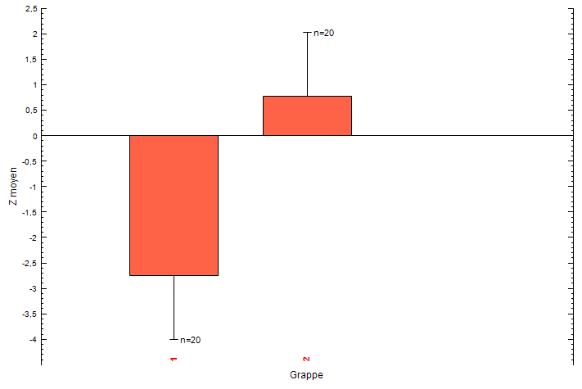
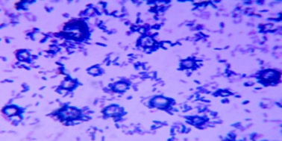
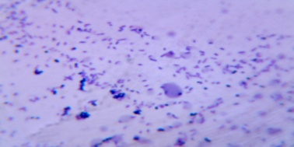
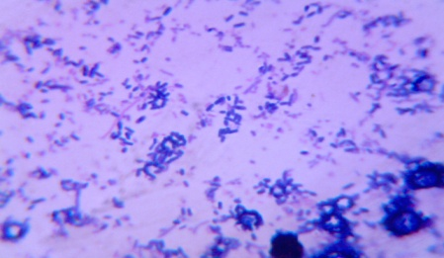
Characterisation of the impact of renutrition milk on Clinical profil and intestinal flora of malnourish children
A. BELGHARBI¹, A. TIR TOUIL¹ and B.MEDDAH ¹
¹Bioconversion Laboratory, Engineering Microbiological and safety Health, University of Mascara, Algeria, 29000
1.Introduction
Recently, many studies concentrate on the relationship between malnutrition, intestinal flora and clinical nutrition . However, the composition of this flora is influenced by several factors such as the age, the environment, and nutrition [1]. This observation motivated us to evaluate the impact of the introduction of the milk of renutrition on the composition of this flora.
2.Material and Methods
Direct Population
It is about a comparative study case – witnesses, composed of two groups of 20 children aged between 2 to 36 months residing in the area of Mascara each one, one made up malnourish children, the other of healthy ones ( fig 1).This study was carried out while following the methods and methodologies of the clinical trials [3]. Clinical data were gathered with a questionaire data established according to the methodology of clinical studies. However, having seen the impossibility to access into the intestinal flora, the fecal flora was targeted since it reflects the one which is upstream of the rectum [4].
Inclusion and Exclusion criteria
Simple Unpredictable simpling
40 children kept for study
3. Results and Discussion
Control group(CG)
Trial group (CG)
A/ Evaluation of nutritional state of our groups
Clinical examination
Characterzation of intestinal Flora
Fig.1: Methodology adapted of this study
C/ Results of the characterization of the intestinal microflora
C.1/ Microscopic examination
CG
A
B
TG
Fig.2: Results of the nutritional sate ( weight/age)
B/ Monitoring of the nutritional state of the malnourish children after administratiuon of renutrition milk
C
Fig.4: Visualusation of the diversity of the intestinal microbiota after Gram coloration of smear of saddles (X1000): A:CG/B;TG at D0/C:TG at D 30
C.2/quantitative sharing of intestinal microflora in TG
Fig.3: Variation of the weight benefit in the both groups according to period of administation with renutrition milk
References:
1/UNICEF, 2011. Protocole de prise en charge de la malnutrition aigue au Benin : Ministere de la santé, République de Benin.
2/Saunders J., Smith T. and Stroud M., 2015. Malnutrition and undernutrition: Medicine, 43(2), 112‑118.
3/Kabat A. M., Srinivasan N.andMaloy K. J., 2014. Modulation of immune development and function by intestinal microbiota. Trends in Immunology, 35(11), 507‑517.
4/Lagier J.-C., Million M., Hugon P., Armougom F.andRaoult D., 2012. Human Gut Microbiota: Repertoire and Variations: Frontiers in Cellular and Infection Microbiology, 2.
7th annual Congress on Clinical Microbiology. September 25-26,2017.Chicago, Illinois, USA.

