Slide 1


31st World Congress on
Nursing and Healthcare
November 14-15, 2025 Barcelona, Spain
Theme: “The Digital Revolution in Nursing: Adapting to a New Era”
Contact us:
MAIL: : nursingcareconference@eurosessions.com
URL: https://nursingsummit.nursingconference.com/
WORLD NURSING SUMMIT 2025

Slide 2


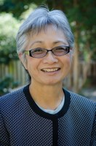
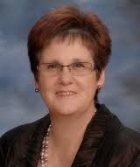


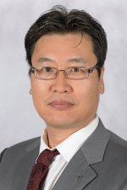
B2B
Meetings
2
Days Of Scientific
Exchange
15+
Scientific Sessions
80+
International Expert
Faculty Members
20+
Exhibitors
INVITATION
Dear Colleagues,
Conference Series LLC LTD is delighted to welcome you for the Prestigious “31st World Congress on Nursing and Healthcare ” focusing on determination of various approaches in the field of Nursing and Healthcare and we are confident that you will enjoy the Scientific Program of this upcoming Conference. We look forward to see you..
With Regards
WORLD NURSING SUMMIT 2025
Operating Committee, Conference Series llc LTD
Editorial Board Members of Supporting Journals
Olivia Catolico, PhD Division of Nursing, Dominican University of California, USA | Linda J Patrick , PhD University of Windsor, Canada | Alan Cooper, PhD Adelphi University College of Nursing and Public Health, USA | Aparna A Labroo, PhD Division of Management, Northwestern University, USA | Sangchoon Jeon, PhD Research Scientist Yale School of Nursing Yale University, USA
https://forensicchemistry.conferenceseries.com/registration.php

Slide 3


PROGRAM ANNOUNCEMENT
VENUE & ACCOMMODATION
November 14-15, 2025 Barcelona, Spain
Abstract Submission Opens: January 25, 2025
Registration Opens: February 02, 2025
Early Bird Registration: March 13, 2025
Mid Date Registration: June 13, 2025
On Spot Registration: Nov 13, 2025
EXHIBITION AND SPONSORSHIP
An Exhibition will be held concurrently with the Conference. Thanks to exhibitors from all over the world, attendees will have a complete overview of new findings in the field of Nursing and Healthcare.
https://nursingsummit.nursingconference.com/

