Slide 1


TENTATIVE PROGRAM
17th World Congress on
Virology, Emerging Diseases & Vaccines
February 23-24, 2022|Vienna, Austria
Theme:
Protection against viruses and emerging disease
VIROLOGTY 2022
MAIL: virologycongress@meetingsnexpo.com
URL: https://virology.infectiousconferences.com/

Slide 2
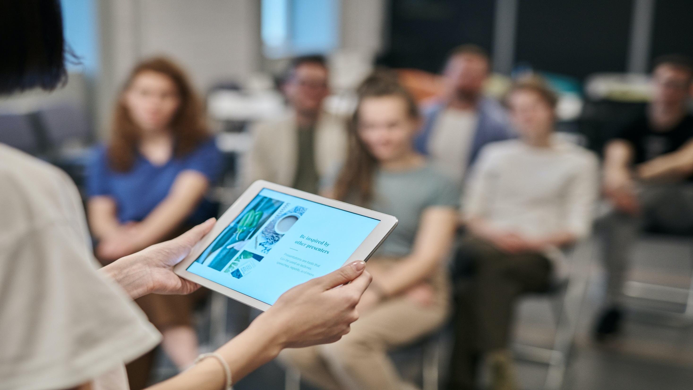

DAY 1
WEDNESDAY,23rd FEBRUARY
08:30-09:00 | Registrations
09:00-09:30 | Introduction
09:00-09:30 | COFFEE BREAK
09:50-11:50 Meeting Hall 01 | KEYNOTE LECTURES
09:00-09:30 | Introduction
09:00-09:30 | MEETING Hall 02
11:50-13:10 | MEETING Hall 01 | MEETING Hall 02
 | General Virology and Basic Science Viral Pathogenesis, Virulence and Latency Viruses and Diseases | Therapeutic Approaches and Targets for Viral Infections Viral Immunology Global Epidemiology of HIV/AIDS, STDs, & STIs
03:10-13:15 | GROUP PHOTO
13:15-14:00 | LUNCH BREAK
11:50-13:10 | MEETING Hall 01 | MEETING Hall 02
 | Bacterial Virology Diagnostic Virology & Molecular Analysis New Innovations in Viral Infections | Organ specific Cancer and Tumor virology Respiratory and Emerging/Re-emerging Viruses Coronaviruses COVID-19
16:00-16:20 | COFFEE BREAK

Slide 3
DAY 2
THURSDAY, 24th FEBRUARY
08:30-09:00 | Registrations
09:00-09:30 | Introduction
09:00-09:30 | COFFEE BREAK
09:50-11:50 Meeting Hall 01 | KEYNOTE LECTURES
09:00-09:30 | Introduction
09:00-09:30 | MEETING Hall 02
11:50-13:10 | MEETING Hall 01 | MEETING Hall 02
 | Human Vaccines - Infectious & Non Infectious Diseases Vaccine Research & Development | Next-Generation Vaccine Delivery Technologies Vaccine Adjuvants
03:10-13:15 | GROUP PHOTO
13:15-14:00 | LUNCH BREAK
11:50-13:10 | MEETING Hall 01 | MEETING Hall 02
 | Human Preventive & Therapeutic Vaccines Vaccines Safety & Efficancy | Vaccines Business Development Current Focus in Virology Research
16:00-16:20 | COFFEE BREAK

Slide 4

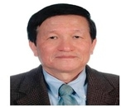
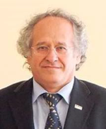
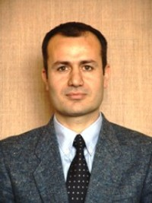
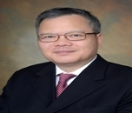

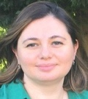

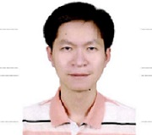
EDITORIAL BOARD MEMBERS
Ting-Chao Chou
PD Science LLC
USA
Huseyin Yilmaz
University of Istanbul
Turkey
Nuri Turan
University of Istanbul
Turkey
De-chu Christopher Tang
Founder of VaxDome LLC and Vaxin Inc
USA
Nahla Mohamed
Princess Nourah Bint Abdurrahman University
Saudi Arabia
Sabiha Imran
Manav Rachna International University
India
Aysun Yilmaz
University of Istanbul
Turkey
Bor-Tau Hung
Chang Gung University College of Medicine,Kaohsiung
Taiwan

Slide 5
PAST AFFILIATIONS
Ting-Chao Chou PD Science LLC USA | Huseyin Yilmaz University of Istanbul Turkey | Nuri Turan University of Istanbul Turkey | De-chu Christopher Tang Founder of VaxDome LLC and Vaxin Inc | Nahla Mohamed Princess Nourah Bint Abdurrahman University Saudi Arabia
Sabiha Imran Manav Rachna International University India | Aysun Yilmaz University of Istanbul Turkey | Bor-Tau Hung Chang Gung University College of Medicine,Kaohsiung Taiwan | Jabbar Gardy University of Leeds UK | Daniel Davoodian Univeristy of Southern Queensland Australia
Thomas Foust National Renewable Energy Laboratory USA | Zhang Tianjiao China University of Petroleum China | Tarek M. Aboul –Fotouh The British University Egypt | Donghyeon Kim Chonbuk National University South Korea | Rafid Abbas University of Leeds UK
Ezeddine Hamida Petroleum Training and Qualifying Institute Libya | Feng Yuelin China University of Petroleum China | Yan Haijun Research Institute of Petroleum Exploration & Development China | Gianfranco Manes The Midra Consortium Italy | Walaa Fathy Heriot Watt University UK

Slide 6
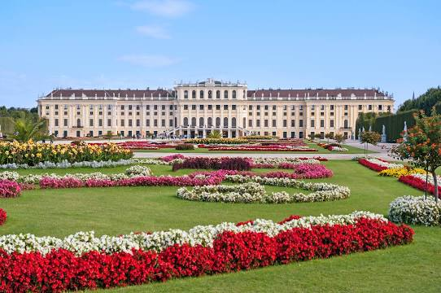
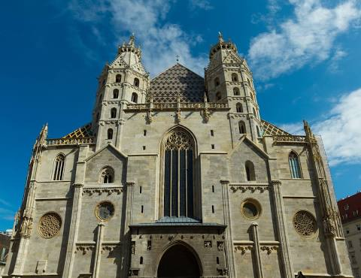
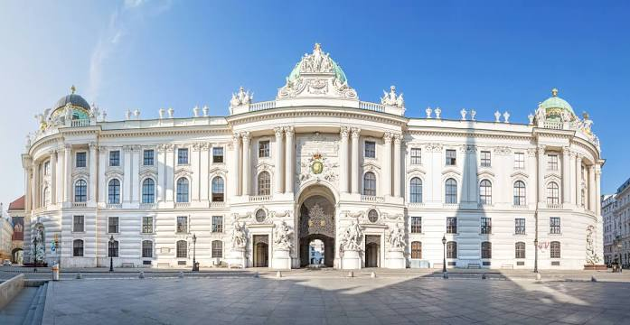
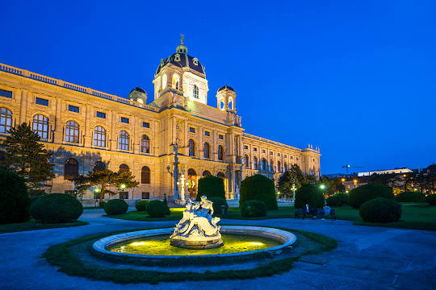
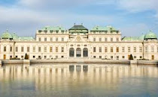
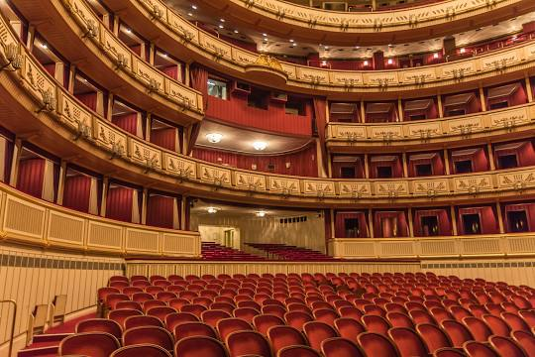
CITY ATTRACTIONS
Schönbrunn Palace
St. Stephen's Cathedral
The Hofburg
\
Belvedere Palace
Vienna State Opera
Kunsthistorisches Museum Wien

