Slide 1



17th World Congress on
Virology, Emerging Diseases & Vaccines
February 23-24, 2022|Vienna, Austria
Theme:
Protection against viruises and emerging disease
VIROLOGY 2022
MAIL:virologycongress@meetingsnexpo.com
URL:https://virology.infectiousconferences.com/

Slide 2
REGISTRATION & TIMINGS
December 09, 2021 (8:00AM to 6:00PM)
December 09, 2021 (8:00AM to 6:00PM)
GROUP PHOTO TIME
10:45 AM - 10:50 AM; DECEMBER 09, 2021
VIROLOGY 2022
Dubai, UAE
Please try your best to attend the Conference. If you could not attend, please let us know :virologycongress@meetingsnexpo.com
https://virology.infectiousconferences.com/

Slide 3
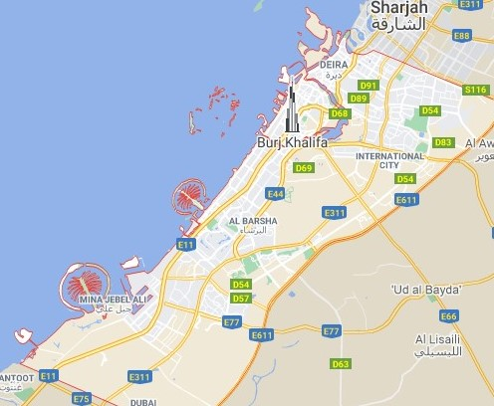
VENUE
Vienna, Austria
SPEAKERS’ PPT
VIROLOGY 2022
You may submit your presentation to any of our onsite organizers on the day of your talk. If your presentation is not compatible with our laptops, then you may use your own laptop.
To Register Online, Please visit
https://virology.infectiousconferences.com/

