Slide 1


TENTATIVE PROGRAM
3rd International Conference on
Animal Biotechnology and Veterinary Medicine
November 27-28, 2023 | Kualalumpur, Malaysia
Theme:
Innovation, Sustainability in Veterinary and Livestock
VETERINARY HEALTH CONFERENCE 2023
MAIL: veterinaryhealth@euroconferences.net
URL: https://veterinaryhealth.conferenceseries.com/

Slide 2


DAY 1
MONDAY, 27, November
08:30-09:00 | Registrations
09:00-09:30 | Introduction
09:00-09:30 | COFFEE BREAK
09:50-11:50 Meeting Hall 01 | KEYNOTE LECTURES
09:00-09:30 | Introduction
09:00-09:30 | MEETING Hall 02
11:50-13:10 | MEETING Hall 01 | MEETING Hall 02
 | Veterinary Epidemiology, Veterinary Vaccines, Veterinary Nursing | Veterinary Medicine, Veterinary Microbiology and Microbial Diseases, Veterinary Surgery & Radiology
13:10-13:15 | GROUP PHOTO
13:15-14:00 | LUNCH BREAK
11:50-13:10 | MEETING Hall 01 | MEETING Hall 02
 | Animal Biotechnology, Animal Cloning & Transgenic animals | Animal Ecology & Physiology, Animal Models & Testing, Animal Nutrition
16:00-16:20 | COFFEE BREAK

Slide 3
DAY 2
TUESDAY, November 28
08:30-09:00 | Registrations
09:00-09:30 | Introduction
09:00-09:30 | COFFEE BREAK
09:50-11:50 Meeting Hall 01 | KEYNOTE LECTURES
09:00-09:30 | Introduction
09:00-09:30 | MEETING Hall 02
11:50-13:10 | MEETING Hall 01 | MEETING Hall 02
 | Dairy Farming, Meat Science and Technology, Aquaculture | Veterinary Forensics, Poultry Production, Emergency Animal treatments
13:10-13:15 | GROUP PHOTO
13:15-14:00 | LUNCH BREAK
11:50-13:10 | MEETING Hall 01 | MEETING Hall 02
 | Veterinary Toxicology, Animal Cloning & Transgenic animals | Livestock Production, Preventive Pet Healthcare & Club
16:00-16:20 | COFFEE BREAK

Slide 4

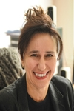




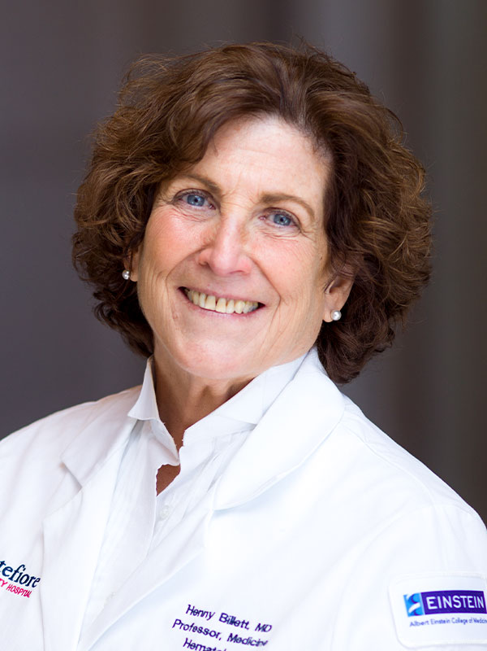
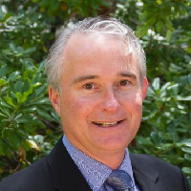
EDITORIAL BOARD MEMBERS
Dr. Nisreen Ezz El-Dien Mahmoud
Cairo University, Egypt
Egypt
Marina Pavlak
University of Zagreb
Croatia
Dr Jonathan F Pycock
University of London
UK
Srebrenka Nejedli
University of Zagreb,
Croatia
Shweta Gera
Montefiore Medical Center at Albert Einstein College of Medicine, Bronx, New York
Darius M Moshfeghi
Stanford University School of Medicine, USA
Kungl Krisztina
University of Veterinary Medicine
Hungary
Erol Guclu Gulanber
G&G Academia
Turkey

Slide 5
PAST AFFILIATIONS
Ramesh C. Gupta Murray State University, USA USA | Francois- Xavier Frapaise Principle FX Frapaise Pharma Consulting France | Olivier Sparagano UK | Andras Guttman Professor University of Pannonia Hungary | Fiona M Greer Director SGS Life Sciences Swaziland
Amelie Mc Fadyen University of Quebec in Montreal Canada | Estanislao Nistal- Villán, University of Navarra Spain | Peter Kalinka Chairman at Longmore 60 Biotech Inc. Longmore 60 Biotech Inc. United States USA | Julia Hilliard Georgia State University USA | Eckard Wimmer Stony Brook University USA
Kurt R Karst Director Hyman, Phelps & McNamara USA | Aysun Yilmaz University of Istanbul Turke | Mark Enright Manchester Metropolitan University UK | Nelly Adel Chair, Pharmacy Practice Touro College of Pharmacy USA | Michael W. Washabaugh Washabaugh MedImmune USA

Slide 6
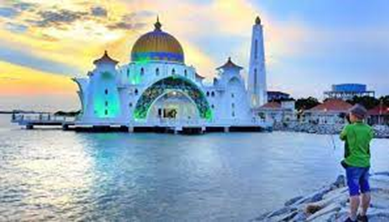

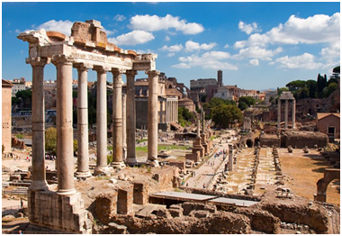



CITY ATTRACTIONS
Langkawi Island
Perhentian Island
Penang
Kinabatangan
Melaka
Alor Setar

