Slide 1


TENTATIVE PROGRAM
18th World Congress on
Vascular Dementia and Neurodegenerative Diseases
July 03-04, 2023 Paris, France
Theme:
Recommended Global Vascular Dementia and Neuroscience Conference
vasculardementianeuro2023
MAIL: dementia@globalannualsummit.com
URLhttps://vasculardementia.neuroconferences.com
/

Slide 2
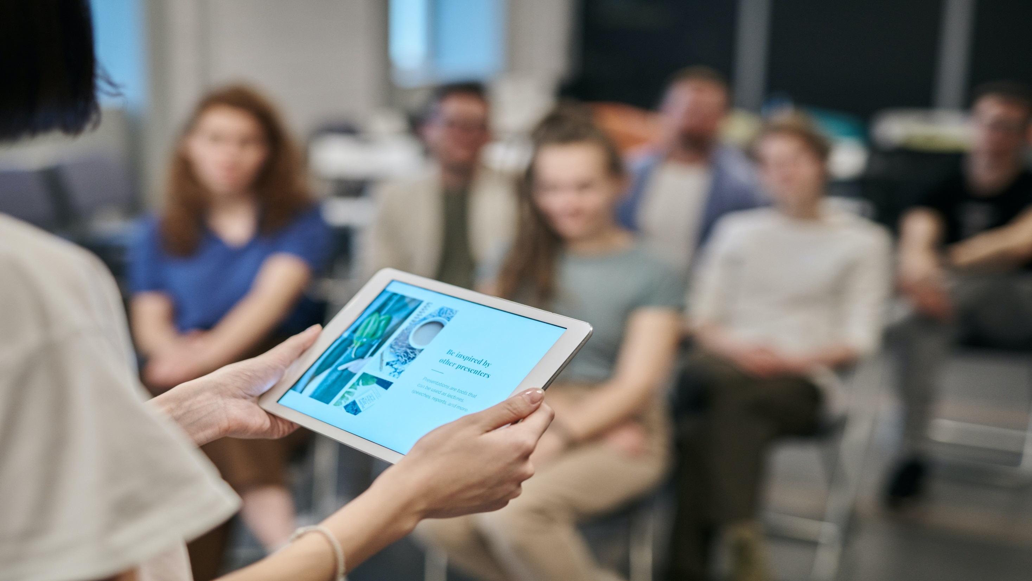

DAY 1
MONDAY, 3rd July
08:30-09:00 | Registrations
09:00-09:30 | Introduction
09:00-09:30 | COFFEE BREAK
09:50-11:50 Meeting Hall 01 | KEYNOTE LECTURES
09:00-09:30 | Introduction
09:00-09:30 | MEETING Hall 02
11:50-13:10 | MEETING Hall 01 | MEETING Hall 02
 | Alzheimer's Disease Vascular Dementia Dementia Nursing | Recent Advancement in Treating Dementia Neurological Disorders
03:10-13:15 | GROUP PHOTO
13:15-14:00 | LUNCH BREAK
11:50-13:10 | MEETING Hall 01 | MEETING Hall 02
 | Stroke Rehabilitation and Brain Haemorrhage Brain Tumor and Neuro oncology Neuropsychiatry | Anxiety & Depression Treatment for Dementia Bioinformatics Approach for Dementia
16:00-16:20 | COFFEE BREAK

Slide 3
DAY 2
TUESDAY, 25th October
08:30-09:00 | Registrations
09:00-09:30 | Introduction
09:00-09:30 | COFFEE BREAK
09:50-11:50 Meeting Hall 01 | KEYNOTE LECTURES
09:00-09:30 | Introduction
09:00-09:30 | MEETING Hall 02
11:50-13:10 | MEETING Hall 01 | MEETING Hall 02
 | Neurological Disorders Neuropsychiatry Anxiety & Depression | Treatment for Dementia Bioinformatics Approach for Dementia Neurodegenerative Diseases
03:10-13:15 | GROUP PHOTO
13:15-14:00 | LUNCH BREAK
11:50-13:10 | MEETING Hall 01 | MEETING Hall 02
 | Neurology and Neurosurgery Alzheimer’s Clinical Trials and Studies | Diagnostic Alzheimer Molecular Genetics and Biology of Dementia
16:00-16:20 | COFFEE BREAK

Slide 4

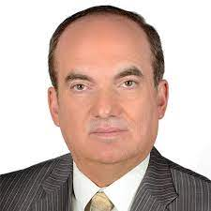
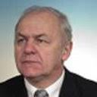
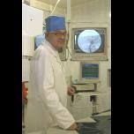
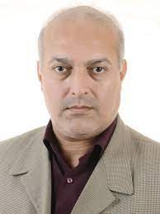
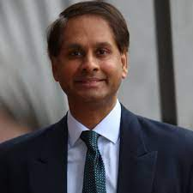
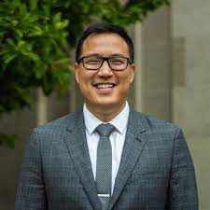
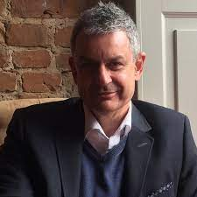
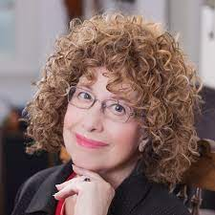
EDITORIAL BOARD MEMBERS
Samer Ellahham
Cardiovascular Consultant
Cleveland Clinic
Abu Dhabi
Jerzy Leszek
Professor
Medical University in Wroclaw
Poland
Professor
Clinic of Cardiovascular Diseases named after Most Holy John Tobo
Moscow, Russia
Professor
Pacific Albion University
U.S.A
Raymond Chang
DEPARTMENT CHAIR
College of Allied Health Sciences Department of Interdisciplinary Health Sciences
Augusta, Georgia
Professor
Columbia University, USA
USA
Dr. Ian James Martins
Senior Researcher
Edith Cowan University,Australia
Australia
Professor
Southern Federal University
Russia

Slide 5
PAST AFFILIATIONS
Michael Fossel President of Telocyte, author of "Cells, Aging, and Human Disease" (Oxford University Press, 2004) & "The Telomerase Revolution" (2015)​, and "Reversing Human Aging" (1996). USA | Daniel Alkon President/Chief Scientific Officer, synaptogenix USA | Shireen-Qureshi Vice president, Saudi Stroke Association, Saudi Arabia
Dionisio-Figueiredo Hospital de Urgencia Otavio Lage Brazil | Galina-Mindlin Mount Sinai USA | James-Gratwicke The National Hospital for Neurology and Neurosurgery, UK
Amal-Al-Hashmi Vice President Oman Medical Association Oman | Ad-Verheul Centre De Hartenberg, Netherlands | Alessandro-Morelli University of Genova, Italy
Christianto-B-Lumenta University of Munich Germany | James-C-Pace New York University , USA | David-Rowell Queensland Brain Institute, Australia

Slide 6

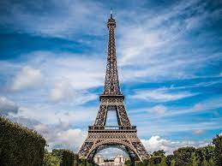
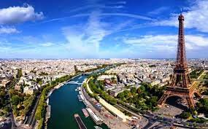
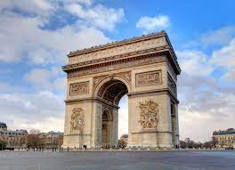
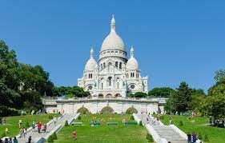
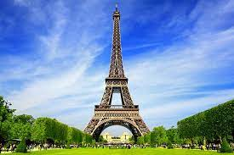
CITY ATTRACTIONS

