Slide 1
18th World Congress on
Vascular Dementia and Neurodegenerative Diseases
Cell Tissue Science 2023
July 03-04, 2023 Paris, France
Theme:
Recommended Global Vascular Dementia and Neuroscience Conference
.
Contact us:
MAIL: dementia@globalannualsummit.com
URL: https://vasculardementia.neuroconferences.com/

Slide 2

B2B
Meetings
I N V I T A T I O N
2
Days Of Scientific
Exchange
Dear Colleagues,
Conference Series LLC LTD is delighted to welcome you for the Prestigious “14th International Conference on Nephrology & Therapeutics.” focusing on determination of various approaches in the field of Nephrology and We are confident that you will enjoy the Scientific Program of this upcoming Conference. We look forward to see you.
With Regards
vasculardementianeuro2023
Operating Committee, Conference Series LLC LTD
15+
Scientific Sessions
Editorial Board Members of Supporting Journals
Samer Ellahham Cardiovascular Consultant Cleveland Clinic Abu Dhabi |  | Dr. Ian James Martins Senior Researcher Edith Cowan University,Australia Australia |  | Ivan V Maksimovich Clinic of Cardiovascular Diseases Moscow, Russia
Randa M.Mostafa, | Gerald Schatten |  |  | Shahrzad Bazargan-Hejazi,
Chairman of Basic Medical | University of Pittsburgh, USA | Assistant Professor, Indiana | Elizabeth Midlarsky Professor Columbia University, USA USA | University of California, Los
Sciences Department, College |  | University Southeast, USA |  | Angeles (UCLA), USA Charles
of Medicine, Sharjah |  |  |  | Drew University of Medicine
University, UAE |  |  |  | and Science (CDU), USA
Jerzy Leszek
Professor
Medical University in Wroclaw
Poland
Raymond Chang
College of Allied Health Sciences Department of Interdisciplinary Health Scienc
Augusta, Georgia
80+
International Expert
Faculty Members
20+
Exhibitors
C.P Abdolrasoul Aleezaadeh
Professor
Pacific Albion University
U.S.A
Sam Vaknin
Professor
Southern Federal University
Russia
Peter Norrie
Professor
Australian National University
Australia
https://tissuesciencecongress.conferenceseries.com/

Slide 3

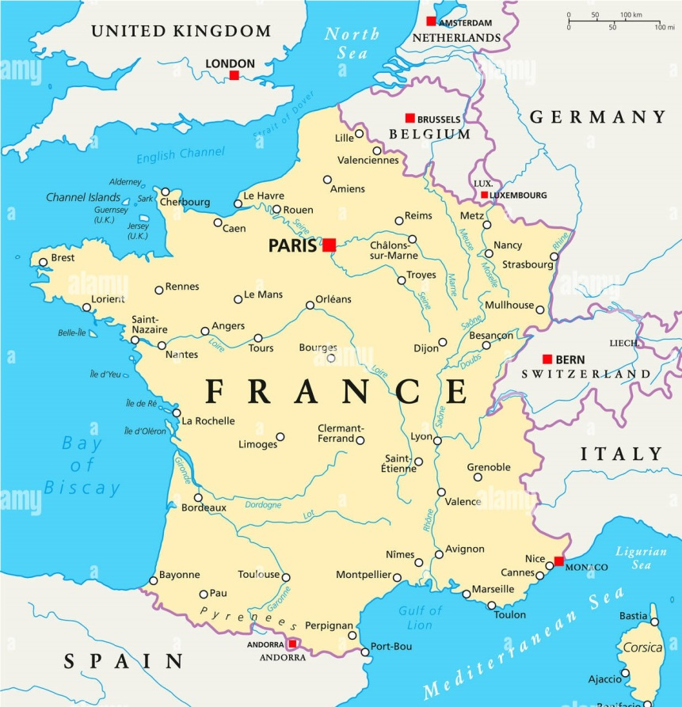
P R O G R A M A N N O U N C E M E N T
V E N U E & A C C O M M O D A T I O N Paris, France
Abstract Submission Opens: December 30, 2022
Registration Opens: January 30 , 2022
Early Bird Registration: January 30, 2023
Mid Date Registration: March 23, 2023
On Spot Registration: July 03, 2023
E X H I B I T I O N A N D S P O N S O R S H I P
An Exhibition will be held concurrently with the Conference. Thanks to exhibitors from all over the world, attendees will have a complete overview of new findings in the field of Chemistry.
https://vasculardementia.neuroconferences.com/

