Slide 1


Vascular Dementia and Neurodegenerative Diseases
vasculardementianeuro2023
₁₈th
World C o n f e r e n c e o n
July 03-04, 2023 Paris, France
Theme:
Recommended Global Vascular Dementia and Neuroscience Conference
MAIL: dementia@globalannualsummit.com
URL:https://vasculardementia.neuroconferences.com/

Slide 2
Vasculardementianeuro 2023
R E G I S T R A T I O N & T I M I N G S
July 03, 2 0 2 3 ( 8 : 0 0 A M t o 6 : 0 0 P M )
May 04, 2 0 2 3 ( 8 : 0 0 A M t o 6 : 0 0 P M )
G R O U P P H O T O T I M E
1 0 : 4 5 A M - 1 0 : 5 0 A M ; July 24 , 2023
v3
PARIS, FRANCE
Please try your best to attend the Conference. If you could not attend, please
let us know https://vasculardementia.neuroconferences.com
,
https://vasculardementia.neuroconferences.com/

Slide 3
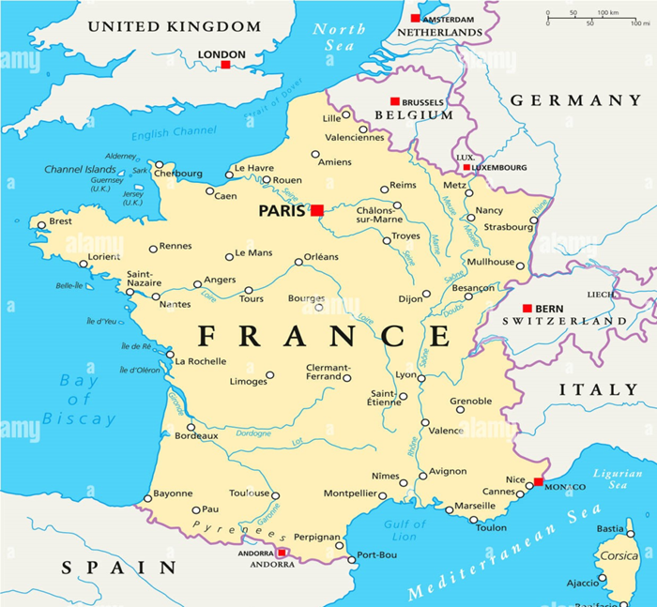
Vasculardementianeuro 2023
V E N U E
PARIS
France
S P E A K E R S ’ P P T
You may submit your presentation to any of our onsite organizers on the day of your talk. If your presentation is not compatible with our laptops, then you may use your own laptop.
To Register Online, Please visit
https://vasculardementia.neuroconferences.com/registration.php

