Slide 1


37th Conference On Preventive Oncology and Diagnostic Cancer
Preventive Oncology-2024
November 19-20, 2024 Paris, France
Theme :Advancing Cancer Prevention and Early Detection: Innovations and Best Practices
MAIL: preventiveoncology@eventqueries.com
URL: https://preventiveoncology.conferenceseries.com/

Slide 2

Preventive Oncology-2024
R E G I S T R A T I O N & T I M I N G S
September, 19 2024 ( 9: 0 0 A M t o 6 : 0 0 P M )
September 20 , 2 0 2 4 ( 9 : 0 0 A M t o 6 : 0 0 P M )
G R O U P P H O T O T I M E
1 0 : 4 5 A M - 1 0 : 5 0 A M ; September 19, 2024
Paris, France
Please try your best to attend the Conference. If you could not attend, please let us know at preventiveoncology@eventqueries.com
https://preventiveoncology.conferenceseries.com/

Slide 3

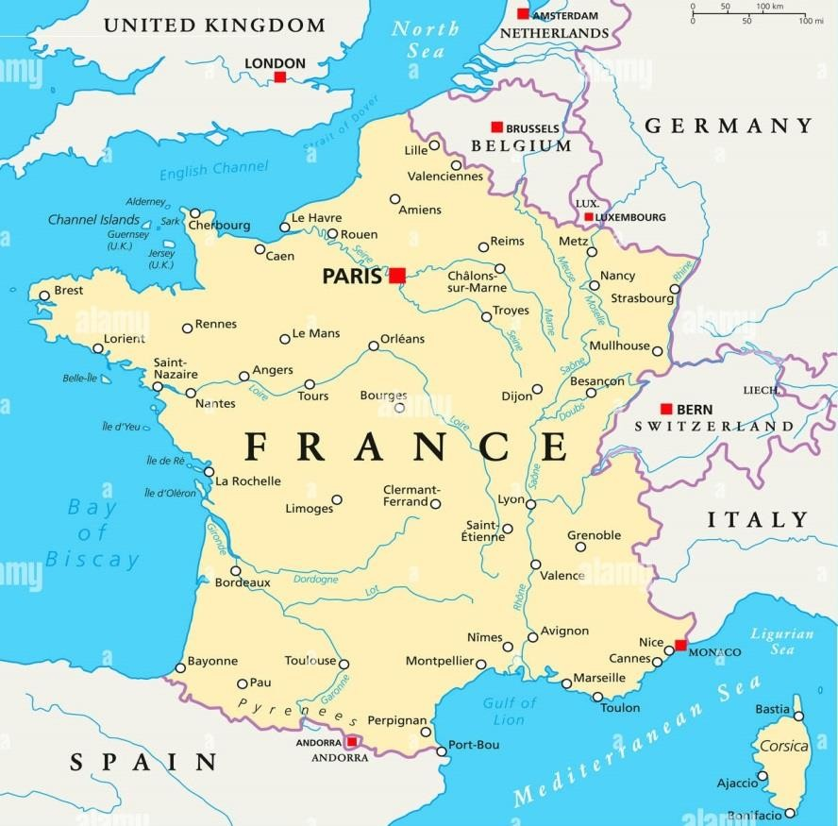
Preventive Oncology-2024
V E N U E
Paris, France
S P E A K E R S ’ P P T
You may submit your presentation to any of our onsite organizers on the day of your talk. If your presentation is not compatible with our laptops, then you may use your own laptop.
To Register Online, Please visit preventiveoncology@eventqueries.com

