Slide 1








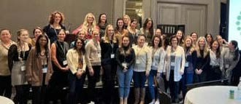


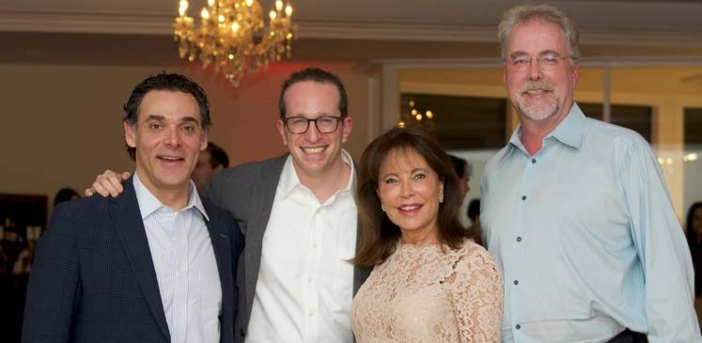


11th Global Meeting on
Plastic, Aesthetic and Reconstructive
April 07-08,2025|London,UK
Theme:
“Advancing Precision: The Future of
Plastic and Reconstructive Surgery”
MAIL: plasticsurgery@medicalscienceconference.com
URL : https://plasticsurgery.insightconferences.com/

Slide 2


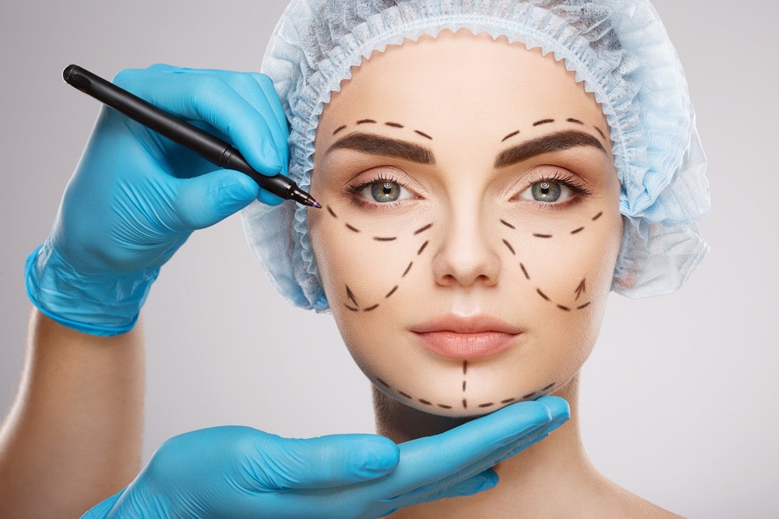
I N V I T A T I O N
DearAttendees,
Conference Series LLC LTD welcomes you to attend the 11th Global Meeting on Plastic, Aesthetic and Reconstructive
Surgery which is going to be held on April 07-08, 2025 at London, UK.
We cordially invite all the participants who are interested in sharing their knowledge and research in the arena of PLASTIC SURGERY CONFERENCE 2025 anticipates more than 100+ participants around the globe with thought provoking keynote lectures, oral and poster presentations. The attending delegates include editorial board members of related open access journals. This is an excellent opportunity for the delegates from universities, institutes, and industries to interact with the world class scientists. The intending participants can confirm their participation by registering for the conference along with your colleagues. Avail the delegate early bird offer. The main theme of the conference is “Advancing Precision:The Future of Plastic and Reconstructive Surgery". As the premier event, we have developed a program with your interests in mind.
We have not only increased the number of opportunities for you to network with colleagues from across the world but also introduced more focused sessions that will feature cutting edge presentations, special panel discussions, and livelier interaction with industry leaders and experts. Life is full of give and take. Make it count in your professional life. Attend the PLASTIC SURGERY CONFERENCE 2025 to network with your peers, exchange expertise and experiences, and arm yourself with the latest information to take your department to the next level. We look forward to personally welcoming you to Plastic Surgery Conference.
Sincerely,
Organizing Committee
PLASTIC SURGERY CONFERENCE 2025
https://plasticsurgery.insightconferences.com/

Slide 3
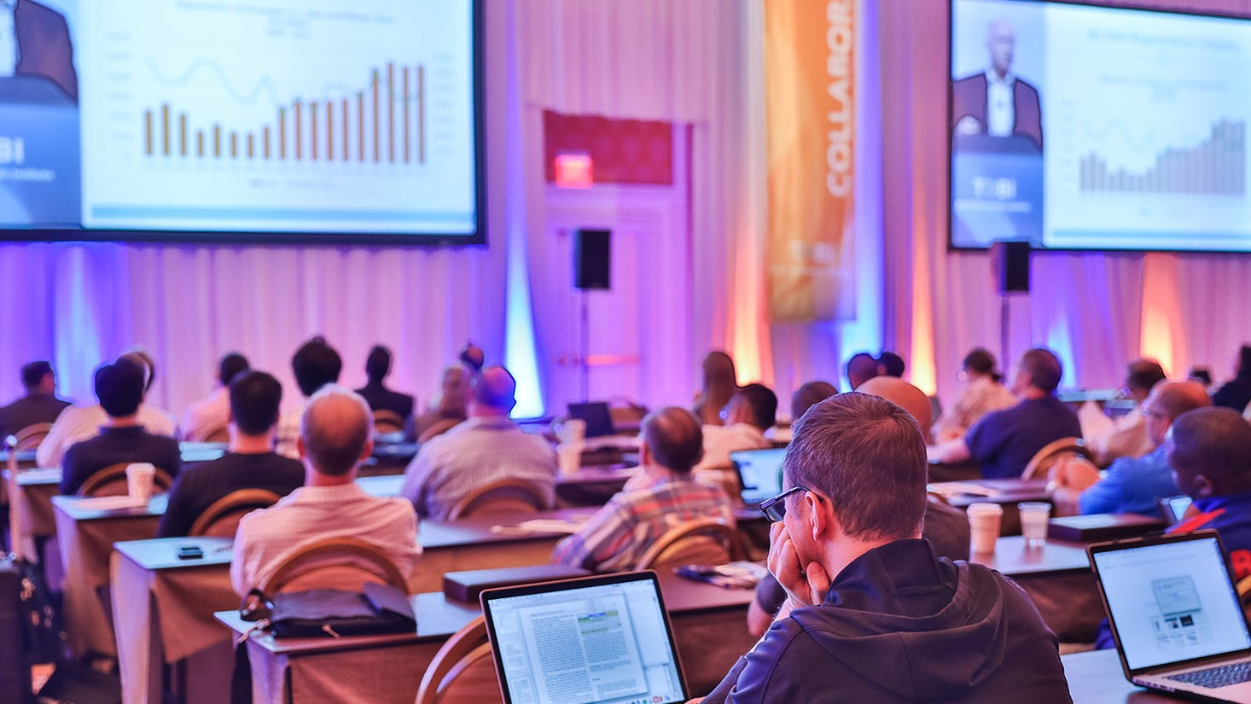


A B O U T U S
O u r I n t e r n a t i o n a l O p e n A c c e s s J o u r n a l s
S a l i e n t F e a t u r e s
700+ Leading-edge Peer Reviewed Open Access Journals
21 Day Rapid Review Process
50000+ Editorial Board Team, 35000+ Reviewers team
30 Million Readers and High Visibility
1000+ Scientific Associations Collaborations
100000+ Facebook Likes
Publication immediately after acceptance
Quality and Quick editorial, review processing
O u r I n t e r n a t i o n a l S c i e n t i f i c C o n f e r e n c e s
More than 3000 Conferences happening across the globe
Conferences organized in Medical, Pharma, Engineering, Science, Technology and Business.
CME/CPD Accredited Conferences fostering professional and Personal development
Continuum of education through organized scientific program
Renowned speakers and scientists representing from 40 countries
Highly Interactive sessions and Panel Discussions
B2B Meetings offers perfect platform for Global Networking
Easy to Submit and Review Systems
High Quality and Fast Publishing Guaranteed
Unbiased, quality-oriented, and transparent reviews
Truly impartial recognition of the best papers
Feedback on the impact of every article
Enhanced feature: Audio version of published paper
Digital articles to share and explore
Sharing option: Social networking enabled
Authors, reviewers and editors are provided with scientific credits
User friendly/feasible website articles translations across more than 50 world
languages
Robust on-line publicity for all the speakers and organizing committee members
Career Guidance Workshops for students and early career researchers
Accepted Abstracts will be published in various indexed journals
Accepted abstracts will be labeled with a Digital Object Identification Number
(DOI) provided by Cross Ref
Creation of speakers and abstracts pages in Google
Opportunity to publish full Manu Scripts in our Open Access Journals Special
Special Issues : All accepted abstracts will be published in respective UK: Conference Series LLC Ltd Journals Each abstract will be provided with digital Object Identifier by
https://plasticsurgery.insightconferences.com/

Slide 4

Conference Series LLC Ltd is overwhelmed to announce the commencement of 11th Global Meeting on Plastic, Aesthetic and Reconstructive Surgery which is going to be held on April 07-08,2025 at London, UK. The conference highlights the theme “Advancing Precision: The Future of Plastic and Reconstructive Surgery” This conference provides a global forum for Academics, Deans, Academic Experts, Industrialists,, Doctors, Young Scientists, Students, Delegates and talented understudy groups from universities and research laboratories to share the most recent advancements in the fields of Plastic Surgery to participate at Plastic Surgery Conference 2025.
PLASTIC SURGERY CONFERENCE 2025 S A L I E N T F E A T U R E S
C O N F E R E N C E
Meet academia and industry visionaries to get inspired
Expand your knowledge and find solutions to problems
Knowledge, benchmarking and Networking offered at one place
Forge connections and for global networking
Highly organized and structured scientific programs
Poster presentations and world class exhibitions
Meet with new vendors and suppliers
H O W C O N F E R E N C E S E R I E S C O N F E R E N C E S D I F F E R S F R O M O T H E R S ?
3000+ Conferences across the globe in 30+ countries all through the year
Over 25 million+ visitors and 20000+ unique visitors per conference
Participation by Stalwarts from various international societies
Internationally renowned speakers and scientists representation
Career guidance for early career researchers and students
Interesting scientific deliberations and discussions
Perfect platform for global networking
A B O U T
G O A L S
The conference program emphasizes evidence-based practice, educational innovation, practical application, and peer to peer networking and collaboration. The goal of the conference is to provide a transformative professional development experience.
Bringing together the world’s scientific experts to catalyze and advance scientific knowledge about Plastic Surgery measures present the most recent
research findings, and promote and enhance scientific collaborations around the world.
Bringing together community leaders, scientists, and policy leaders to promote and enhance programmatic collaborations to more effectively address regional, national and local responses to elderly population around the world and overcome barriers that limit access to care and services.
https://plasticsurgery.insightconferences.com/

Slide 5


G O A L S
After participating in this meeting, attendees should be able to
Discuss emerging issues in the field of Plastic Surgery
Discuss and apply recent research findings related to Plastic Surgery
Reflect on the place of critical distance in Plastic Surgery
C O N F E R E N C E
W H O S H O U L D A T T E N D
Plastic Surgery, Conferences are exclusively designed for is exclusively designed for our point is to the corporate network and to make a stage for the trading of data on innovative advancements, new logical modernization and the viability of different administrative projects towards PLASTIC SURGERY-2025. This meeting likewise centers around a wide assortment of momentum look into on sanitation and wellbeing that have both useful and pernicious impacts on the security and nature of nourishments, and Plastic Surgery are along these lines a worry of general wellbeing.
A B O U T H O S T I N G O R G A N I Z A T I O N
Conference Series is the world’s leading specialist in organizing Academic, Scientific and Business conferences, meetings, symposiums and exhibitions in different verticals and horizontals like Medical, Pharma, Engineering, Science, Technology and Business to promote scientific research. Every year we host more than 3000+ global events inclusive of 1000+ Conferences 1000+ Symposiums 1000+ Workshops in USA, Europe, Middle East and Asia with the generous support and cooperation from our 30000 + Editorial Board Members, 1000+ Scientific Societies. All the conference proceedings are published in the special issues of our 700+ Open Access International Journals with the DOI provided by
PA R T I C I PA T I O N O P T I O N S
A B O U T
Speaker (special session): 45-50 minutes (more than 1 can present)
Speaker (symposium): more than 45 minutes (more than 1 can present)
Delegate(only registration): will have access to all the sessions with all the
benefits of registration
Poster presenter: can present a poster and enjoy the benefits of delegate
Remote attendance: can participate via video presentation or e-poster presentation
Exhibitor: can exhibit his/her company’s products by booking exhibitor booths of different sizes
Media partner
Sponsor
Collaborator
For more details about each mode, kindly contact:
plasticsurgery@medicalscienceconference.com
https://plasticsurgery.insightconferences.com/

Slide 6



PA R T I C I PA T I O N B E N E F I T S
Attend Keynote Presentation by world’s most eminent researchers
Access to all the sessions
Get OCM certificate
Get worldwide acknowledgment to your profile and Research
Get your abstracts published with unique DOI in International
Journals
Get up to 50% discounts for publishing your entire article in our
open access International Journals
Get Handbooks and conference kits
Get an access to the network with eminent personalities from
worldwide
A B S T R A C T S U B M I S S I O N
https://plasticsurgery.insightconferences.com/abstract-submission.php
F O R M O R E I N F O R M A T I O N
https://plasticsurgery.insightconferences.com/
Track 1: Aesthetic Face
Track 2: Aesthetic Surgery
Track 3: Breast Reconstruction
Track 4: Challenges in Blepharoplasty
Track 5: Craniofacial/Peds
Track 6: Forehead,Facial and Eyelid Rejuvenation
Track 7: Female Genital Surgery
Track 8: Gender Affirmation
Track 9: General Reconstruction
Track 10: Head,Skin and Cosmetic Dentistry
Track 11: Hand and Upper Extremities
Track 12: Non-Surgical Aesthetic Procedures
Track 13: New Science in Anti-Aging
Track 14: Skincare Focus: Acne, Scar and
Pigmentary Disorder
Track 15: Plastic Surgery
Track 16:Phalloplasty
Track 17:Practice Management
Track 18:Peri-Oral Rejuvenation
Track 19:Reconstructive Surgery
Track 20: Regenerative Aesthetics Technologies
E
C
I O N S
N
E
R
F E
S S
C O N
S E
M A J O R
T
B O U
A

Slide 7










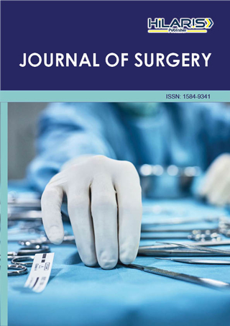
S U P P O R T I N G
J O U R N A L S
Journal 1:- Journal of Aging Science
https://www.walshmedicalmedia.com/aging-science.html
Journal 2:- Journal of Surgery
https://www.hilarispublisher.com/surgery.html

Slide 8



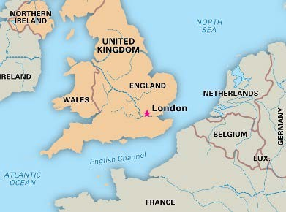
V E N U E & A C C O M O D A T I O N
V E N U E & A C C O M M O D AT I O N
London, UK
C O N T A C T U S
Romania Winged
Conference Managing Editor | Plastic Surgery Conference 2025 Email: plasticsurgery@medicalscienceconference.com WhatsApp: +44-7915641825
General Queries: +32 (800) 753-58

Slide 9



A C A D E M I C
Only Registration: $ 899
Package A (Registration + 2 nights Accommodation): $ 1499
Package B (Registration + 3 nights Accommodation): $ 1699
Package C (Registration + Manuscript Publication): $ 1199
B U S I N E S S
Only Registration: $ 850
Package A (Registration + 2 nights Accommodation): $ 1499
Package B (Registration + 3 nights Accommodation): $ 1599
R E G I S T R A T I O N S
S T U D E N T
Only Registration: $499
Student Delegate: $ 399
E-poster: $ 99
Virtual Registration: $ 450
I M P O R T A N T D A T E S
Abstract submission opens: September 01, 2024
Early Bird Registration: September 28, 2024
Registration Opens: September 01, 2024
On Spot Registration : April 07-08, 2025 | London, UK
https://plasticsurgery.insightconferences.com/

