Slide 1


Applied Physics and Materials Science
October 27-28, 2025 London, UK
PHYSICS CONFERENCE 2025
5th International Conference on
Theme:
"Innovations at the Interface: Uniting Physics and Materials for Sustainability’
MAIL : contact@speakermeeting.com
URL:https://physics.physicsmeeting.com/

Slide 2
R E G I S T R AT I O N & T I M I N G S
PHYSICS CONFERENCE 2025
October 27,2025 (09:00AM – 06:00PM) October 28,2025 (09:00AM – 06:00PM)
June 27, 2 0 2 4 ( 9 : 0 0 AM t o 6 : 0 0 PM )
June 28, 2 0 2 4 ( 9 : 0 0 AM t o 6 : 0 0 PM )
G R O U P P H O T O T I M E
1 0 : 4 5 AM - 1 0 : 5 0 AM ; October 28,2025
London, UK
Please try your best to attend the Conference. If you could not attend, please let us know
https://physics.physicsmeeting.com/
contact@speakermeeting.com
https://physics.physicsmeeting.com/ /

Slide 3





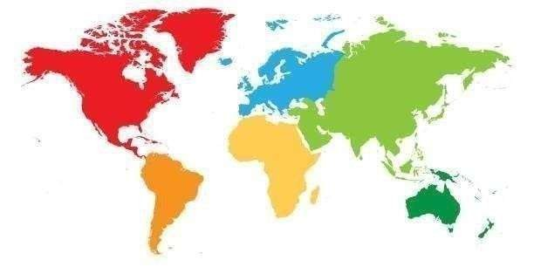
London, UK
PHYSICS CONFERENCE 2025
VENUE
SPEAKER‘S PPT
You may submit your presentation to any of our onsite organizers on the day of your talk. If your presentation is not compatible with our laptops, then you may use your own laptop.
To RegisterOnline, Please visit
https://physics.physicsmeeting.com/

