Slide 1











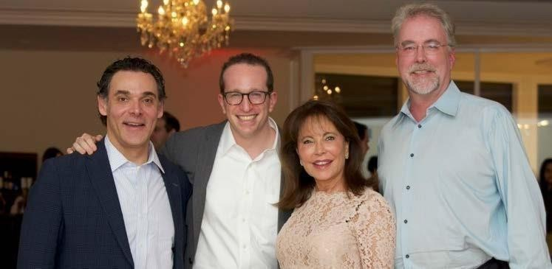


Applied Physics and Materials Science
5th International Conference on
5th International Conference on
October 27-28, 2025 London, UK
Theme:, Innovations at the Interface: Uniting Physics and Materials for Sustainability
”
"
Contactus :
MAIL: contact@speakermeeting.com
URL: https://physics.physicsmeeting.com/

Slide 2





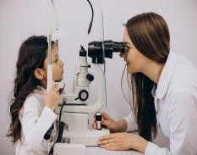
I N V I T A T I O N
DearAttendees,
Conference Series LLC LTD welcomes you to 5th International Conference on Applied Physics and Materials Science
October 27-28, 2025 London, UK
We cordially invite all the participants who are interested in sharing their knowledge and research in the area of PHYSICS CONFERENCE 2025 anticipates more than 100+ participants around the globe with thought provoking keynote lectures, oral and poster presentations. The attending delegates include editorial board members of related open access journals. This is an excellent opportunity for the delegates from universities, institutes, and industries to interact with the world class scientists. The intending participants can confirm their participation by registering for the conference along with your colleagues. Avail the delegate early bird offer. The main theme of the conference is "Innovations at the Interface: Uniting Physics and Materials for Sustainability."As the premier event, we have developed a program with your interests in mind.
We have not only increased the number of opportunities for you to network with colleagues from across the world but also introduced more focused sessions that will feature cutting edge presentations, special panel discussions, and livelier interaction with industry leaders and experts. Life is full of give and take. Make it count in your professional life. Attend the PHYSICS CONFERENCE 2025 to network with your peers, exchange expertise and experiences, and arm yourself with the latest information to take your department to the next level. We look forward to personally welcoming you to Spine Conference.
Sincerely,
Organizing Committee
PHYSICS CONFERENCE 2025
https://physics.physicsmeeting.com/

Slide 3
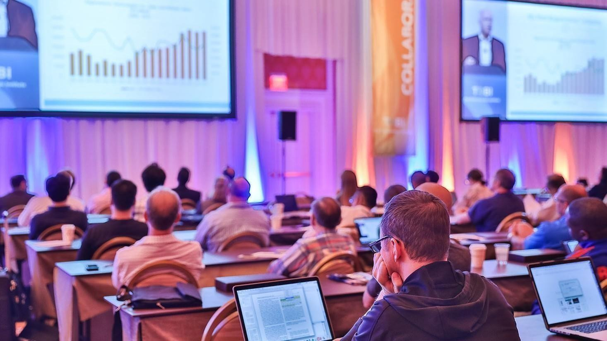


A B O U T U S
O u r I n t e r n a t i o n a l O p e n Ac c e s s J o u r n a l s
S a l i e n t F e a t u r e s
700+Leading-edge Peer Reviewed OpenAccess Journals
21 Day RapidReview Process
50000+EditorialBoard Team, 35000+Reviewers
30 MillionReaders and High Visibility
1000+Scientific Associations Collaborations
100000+ FacebookLikes
Publicationimmediately after acceptance
Qualityand Quick editorial,review processing
Easyto Submitand Review Systems
High Quality and Fast Publishing Guaranteed
Unbiased,quality-oriented, and transparent reviews
Trulyimpartial recognitionof the bestpapers
Feedbackon the impact of every article
Enhanced feature: Audio versionofpublishedpaper
Digitalarticles to share and explore
Sharing option:Social networking enabled
Authors, reviewers and editorsare providedwith scientific credits
User friendly/feasible website articles translations across more than 50 world
languages
Robuston-line publicityfor all the speakers and organizing committee members
Career Guidance Workshopsfor students and early career researchers
Accepted Abstracts will bepublishedinvariousindexed journals
Accepted abstractswill be labeled with a Digital Object Identification Number
(DOI) providedby CrossRef
Creation of speakers and abstracts pages in Google
Opportunityto publishfull Manu Scriptsin our Open Access JournalsSpecial
team
O u r I n t e r n a t i o n a l S c i e n t i f i c C o n f e r e n c e s
Morethan 3000Conferences happeningacrossthe globe
Conferences organized inMedical, Pharma, Engineering, Science, Technology and Business.
CME/CPDAccredited Conferences fostering professional and Personal development
Continuum of educationthrough organized scientific program
Renowned speakers and scientists representing from 40 countries
Highly Interactive sessions and Panel Discussions
B2B Meetings offers perfect platformfor GlobalNetworking
SpecialIssues: All acceptedabstracts will be published in respective UK:Conference Series LLCLtd Journals Eachabstract will be provided with digital ObjectIdentifier by
https://physics.physicsmeeting.com/

Slide 4

Conference Series LLC Ltd is overwhelmed to announce the commencement of 5th International Conference on Applied Physics and Materials Science October 27-28, 2025 London, UK The conference highlights the theme "Innovations at the Interface: Uniting Physics and Materials for Sustainability. This conference provides a global forum for Academics, Deans, Academic Experts, Industrialists,, Doctors, Young Scientists, Students, Delegates and talented understudy groups from universities and research laboratories to share the most recent advancements in the fields of Physics to participate in Physics conference 2025
C O N F E R E N C E
SPINE CONFERENCE 2025 S A L I E N T F E A T U R E S
Meet academia and industryvisionaries toget inspired
Expand your knowledge and find solutionstoproblems
Knowledge, benchmarking and Networking offered at oneplace
Forge connections and for globalnetworking
Highlyorganized and structured scientific programs
Posterpresentationsand world class exhibitions
Meetwith new vendorsand suppliers
H O W C O N F E R E N C E S E R I E S C O N F E R E N C E S D I F F E R S F R O M O T H E R S ?
3000+ Conferences across the globe in 30+ countries all through the year
Over 25 million+ visitorsand 20000+uniquevisitorsper conference
Participationby Stalwarts from various international societies
Internationallyrenowned speakers and scientists representation
Career guidance for early career researchers and students
Interesting scientific deliberationsand discussions
Perfect platformfor global networking
A B O U T
GO A L S
The conference program emphasizes evidence-based practice, educational innovation, practicalapplication, and peer to peer networking and collaboration.The
goal of the conference is to providea transformative professionaldevelopment experience.
Bringing together the world’s scientific experts to catalyze and advance scientific knowledge about Spine measures present the most recent research findings, and promote and enhance scientific collaborations around the world.
Bringingtogether community leaders, scientists, and policy leaders to promote and enhance programmatic collaborationsto more effectively address regional, national and local responsesto elderly population around the world and overcome barriers hat limit access to care and services.
https://physics.physicsmeeting.com/

Slide 5


G OAL S
After participating in this meeting, attendees should be able to
Discuss emerging issues in thefieldof Spine
Discuss and apply recent research findings related to Spine
WHO S H O U LD AT T E N D
Physics , Conferences are exclusively designed for is exclusively designed for our point is to the corporate network and to make a stage for the trading of data on innovative advancements, new logical modernization and the viability of different administrative projects towards Physics conference - 2025. This meeting likewise centers around a wide assortment of momentum look into on sanitation and wellbeing that have both useful and pernicious impacts on the security and nature of nourishments, and Spine are alongthese lines a worry of general wellbeing.
AB O U T H O S T I N G O R GAN I ZAT I O N
Conference Series is the world’s leading specialist in organizing Academic, Scientific and Business conferences, meetings, symposiums and exhibitions in different verticals and horizontals like Medical, Pharma, Engineering, Science, Technology and Business to promote scientific research. Every year we host more than 3000+ global events inclusive of 1000+ Conferences 1000+ Symposiums 1000+ Workshops in USA, Europe, Middle East and Asia with the generous support and cooperation from our 30000 + Editorial Board Members, 1000+ Scientific Societies. All the conference proceedings are published in the special issues of our 700+ Open Access InternationalJournals with the DOI provided by
PART I C I PAT I O N O PT I O N S
C O N F E R E N C E
A B O U T
Speaker (special session):45-50 minutes (more than 1 can present)
Speaker (symposium): more than 45 minutes (more than 1 can present)
Delegate(onlyregistration): will have access to all the sessionswith all the
benefits of registration
Poster presenter: can present a poster and enjoythe benefits of delegate
Remote attendance: can participate via video presentation or e-poster
presentation
Exhibitor: can exhibit his/her company’s productsby booking exhibitor boothsofdifferent sizes
Media partner
Sponsor
Collaborator
Formore detailsabouteach mode, kindly contact:
https://diabeticnutrition.conferenceseries.com/
https://diabeticnutrition.conferenceseries.com/

Slide 6



PART I C I PAT I O N B E N E FI T S
Track 1:Computational Materials Science
Track 2:Innovation, Commercialization, and Technology Transfer
Track 3:Mechanical Behavior of Materials
Track 4:Ceramics, Polymers, and Hybrid Materials
Track 5:Magnetic Materials and Superconductivity
Track 6:Crystallography and Structural Analysis
Track 7:Biomaterials and Biomedical Engineering
Track 8:Electronic Materials and Semiconductor Physics
Track 9:Thin Films and Surface Engineering
Track 10:Applied Physics in Emerging Technologies
Track 11:Energy Materials and Storage Systems
Track 12:Sustainable and Green Materials
Track 13:Smart Materials and Intelligent Systems
Track 14:Photonics and Optical Materials
Track 15:Quantum Materials and Technologies
Track 16:Condensed Matter and Solid-State Physics
Track 17:Nanotechnology and Nanomaterials
Track 18:Advanced Materials and Functional Composites
Track 1:Computational Materials Science
Track 2:Innovation, Commercialization, and Technology Transfer
Track 3:Mechanical Behavior of Materials
Track 4:Ceramics, Polymers, and Hybrid Materials
Track 5:Magnetic Materials and Superconductivity
Track 6:Crystallography and Structural Analysis
Track 7:Biomaterials and Biomedical Engineering
Track 8:Electronic Materials and Semiconductor Physics
Track 9:Thin Films and Surface Engineering
Track 10:Applied Physics in Emerging Technologies
Track 11:Energy Materials and Storage Systems
Track 12:Sustainable and Green Materials
Track 13:Smart Materials and Intelligent Systems
Track 14:Photonics and Optical Materials
Track 15:Quantum Materials and Technologies
Attend Keynote Presentation by world’s most eminent
researchers
Access toall the sessions
Get OCM certificate
Getworldwide acknowledgment toyour profileand Research
Get your abstracts published with unique DOI in International
Journals
Get up to 50% discounts for publishing your entire article in our
openaccess International Journals
GetHandbooksand conference kits
Get an access to the network with eminent personalities from
worldwide
AB S T RAC T S U B M I S S I O N
https://diabeticnutrition.conferenceseries.com/abstract-submission.php
E
C
I O N S
E N
R
F E
S S
C O N
S E
M A J O R
T
B O U
FO R M O R E I N F O R MAT I O Nhttps://diabeticnutrition.conferenceseries.com/
A

Slide 7












S U P P O R T I N G J O U R N A L S
Journal 1:-Journal of Physical Chemistry & Biophysics
https://www.longdom.org/physical-chemistry-biophysics/archive.html
Journal 2: Fluid Mechanics: Open Access
https://www.hilarispublisher.com/fluid-mechanics/editorial-board.html
Journal 3:- Journal of Lasers, Optics & Photonics
https://www.hilarispublisher.com/lasers-optics-photonics.html

Slide 8

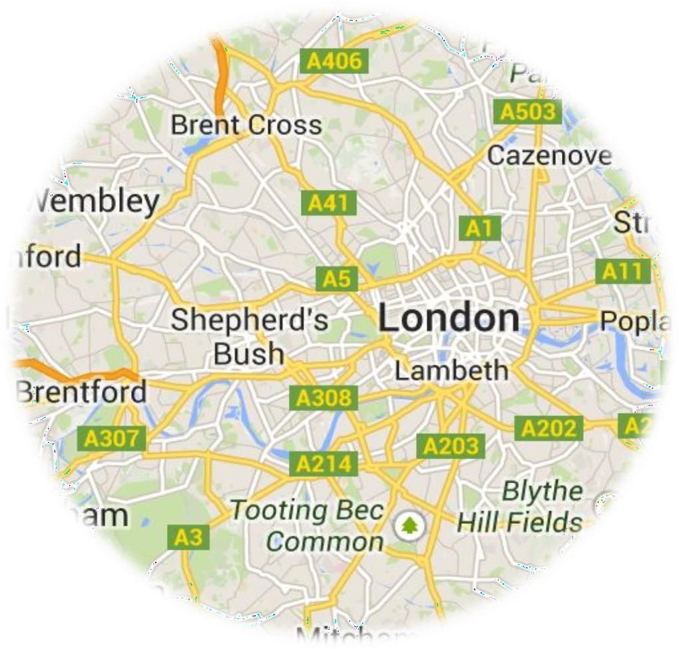
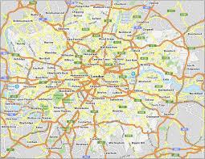
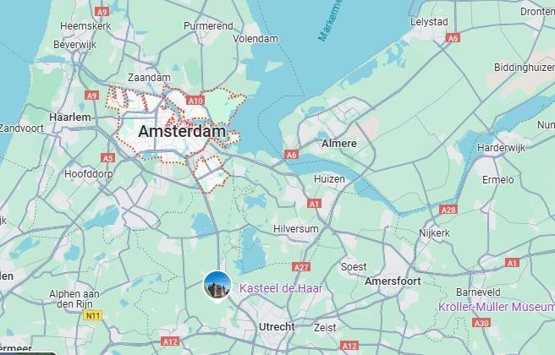
V E N U E
& A C C O M O D A T I O N
V E N U E & AC C O M M O D AT I O N
London, UK
C O N TAC T U S
Conference Managing Editor| Physics Conference 2025
Email: contact@speakermeeting.com
WhatsApp: + +443308221359
General Queries: + +443308221359

Slide 9



Only Registration: $ 899
Package A (Registration + 2 nights Accommodation): $ 1499
Package B (Registration + 3 nights Accommodation): $ 1699
Package C (Registration+ Manuscript Publication): $ 1199
A C A D E M I C
Only Registration: $ 850
Package A (Registration+ 2 nights Accommodation): $ 1499
Package B (Registration+ 3 nights Accommodation): $ 1599
R E G I S T R A T I O N S
B U S I N E S S
Only Registration: $499
Student Delegate: $ 399
E-poster: $ 99
VirtualRegistration: $ 450
S T U D E N T
I M P O R T A N T D A T E S
Abstract submission opens: January 10, 2025
Early Bird Registration: February 28, 2025
Registration Opens: January 10, 2025
On Spot Registration: October 23-24, 2025 ( London, UK)
https://spine-disorders.neurologyconference.com/

