Slide 1
5th International Conference on
PHYSICS CONFERENCE 2025
Applied Physics and Materials Science
October 27-28, 2025 London, UK
Theme: Innovations at the Interface: Uniting Physics and Materials for Sustainability
.”
Contact us:
MAIL: contact@speakermeeting.com
U R L ::https://physics.physicsmeeting.com/ /

Slide 2
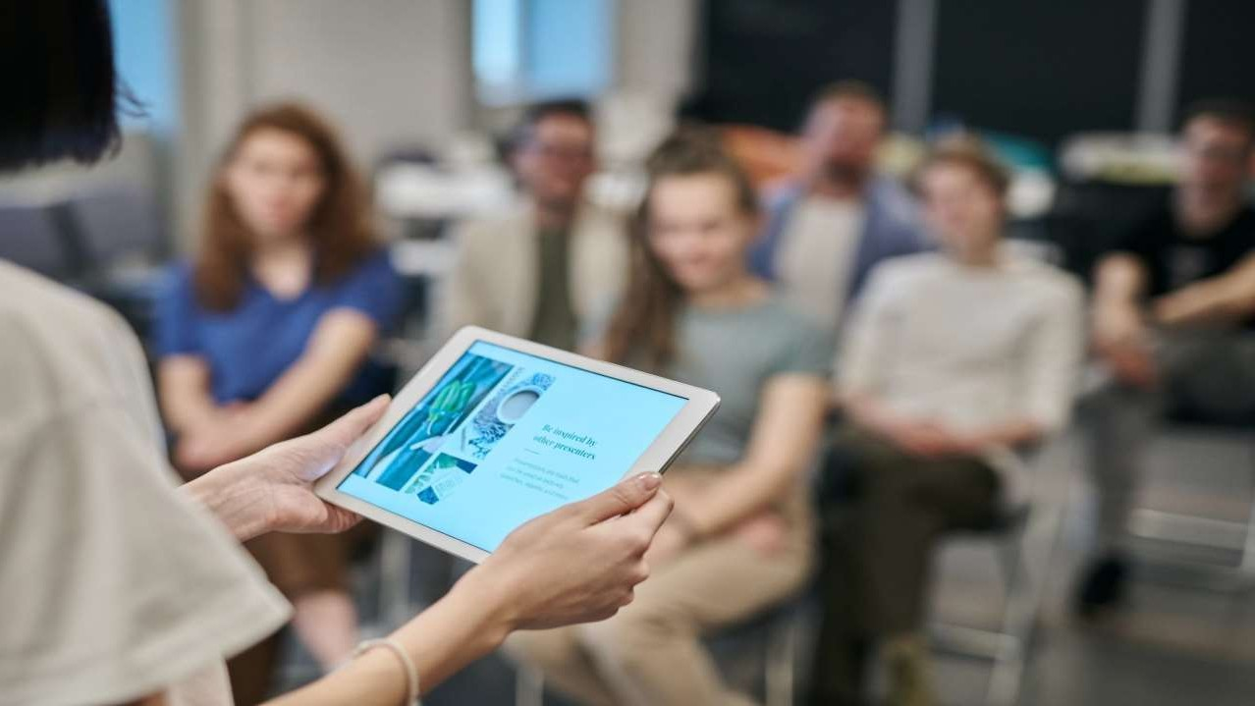
I N V I T A T I O N
B2B
Meetings
2
Days Of Scientific Exchange
15+
Scientific Sessions
80+
International Expert
Faculty Members
20+
Exhibitors
Dear Colleagues,
Conference Series is delighted to welcome you for the 5th International Conference on Applied Physics and Materials Science October 27-28, 2025 London, UK, focusing on determination of various approaches in the field of on Neurology and we are confident that you will enjoy the Scientific Program of this upcoming Conference.
We look forward to see you..
Editorial Board Members of Supporting Journals
Athanasios K. Petridis Department of Neurosurgery University of Schleswig Holstein, Germany | Kenneth M Heilman University of Florida College of Medicine and GRECC-VAMC, The James E. Rooks Jr. Distinguished Professor of Neurology, Gainesville, USA | Hiroshi Nakanishi PhD Professor & Vice Dean, Department of Aging Science and Pharmacology Kyushu University, Faculty of Dental Sciences, Japan | Alessandro Landi MD, Department of Neurology and Psychiatry University di Roma, Italy | Suresh Kumar Jetti PHD, Postdoctoral Fellow & Research Scientist Pondicherry University,
Dr. Bern S. Schmidt Department of fundamental neuroscience University of Lausanne, Switzerland | Dr. Manoj P. Dandekar Postdoctoral Research Fellow McGovern Medical School, Division of Cardiovascular Medicine The University of Texas Health Science Center at Houston Department of Internal Medicine, USA
https://physics.physicsmeeting.com/

Slide 3

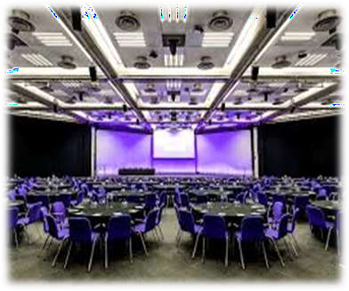

P R O G R A M A N N O U N C E M E N T
V E N U E & A C C O M M O D AT I O N
October 27-28, 2025 London, UK
Abstract Submission Opens: May 10, 2025
Registration Opens: Early Bird Registration: Normal Registration: On Spot Registration:
Jane 18, 2025
Jun 18, 2025
Aug 28, 2025
Oct 27 ,2025
E X H I B I T I O N A N D S P O N S O R S H I P
An Exhibition will be held concurrently with the Conference. Thanks to exhibitors from all over the world, attendees will have a complete overview of new findings in the field of Spine.
https://physics.physicsmeeting.com/

