Slide 1



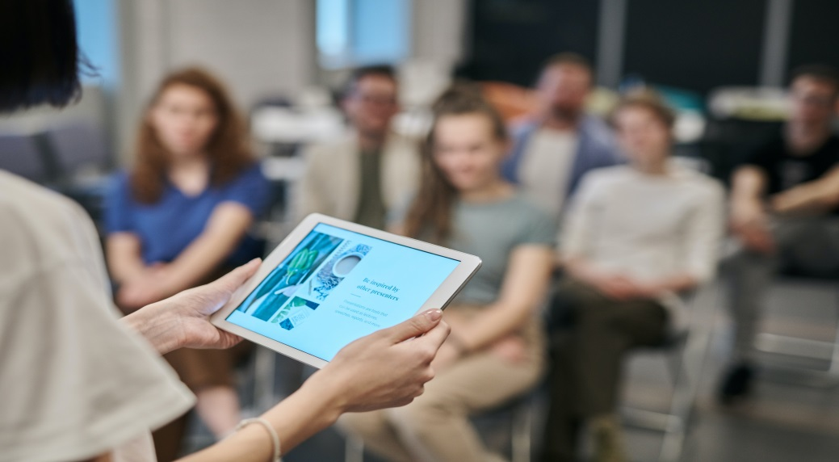

10th International Conference and Expo on
Physiotherapies, Physical Rehabilitation and Sports Medicine
August 8-9, 2024
London, UK
Theme- Fusion of Science and Practice: Redefining Physiotherapies and Sports Medicine
MAIL: sportsmedicinecongress@medicalscienceconference.com
URL: https://physicaltherapycongress.insightconferences.com/

Slide 2

INVITATION
Dear Attendees,
Conference Series cordially invites you to join the 10th International Conference and Expo on
Physiotherapies, Physical Rehabilitation and Sports Medicine which will take place August 8-9, 2024 London, UK. All participants who are interested in sharing their experience and research in the field Physiotherapy, Physical Rehabilitation and Sports Medicine are kindly invited to attend. More than 200+ people from all around the world are expected to attend in 2024, with thought-provoking keynote talks, oral and poster presentations. Members of the editorial boards of associated open access publications are among the delegates in attendance. Delegates from universities, institutes, and corporations will have the opportunity to connect with world-class scientists. Intentional attendees can ensure their attendance by registering for the conference with their colleagues. Take advantage of the early bird delegate deal "Fusion of Science and Practice: Redefining Physiotherapies and Sports Medicine“ is the conference's principal focus. As the premier event, we've created a program that caters to your specific needs.
We've added more focused sessions with cutting-edge presentations, special panel discussions, and livelier interaction with industry leaders and experts, not to mention increased the amount of possibilities for you to network with colleagues from across the world. Life is full of give-and-take situations. In your working life, make it count. Physical Therapy 2024 to network with your peers, share your skills and experiences, and have access to the most up-to-date information to help your department advance. We look forward to meeting you in person at Conference this August.
Sincerely,
Organizing Committee
Physical Therapy 2024
https://physicaltherapycongress.insightconferences.com/

Slide 3



ABOUT US
Our International Open Access Journals
Salient Features
700+ Leading-edge Peer Reviewed Open Access Journals
21 Day Rapid Review Process
50000+ Editorial Board Team, 35000+ Reviewers team
30 Million Readers and High Visibility
1000+ Scientific Associations Collaborations
100000+ Facebook Likes
Publication immediately after acceptance
Quality and Quick editorial, review processing
Easy to Submit and Review Systems
High Quality and Fast Publishing Guaranteed
Unbiased, quality-oriented, and transparent reviews
Truly impartial recognition of the best papers
Feedback on the impact of every article
Enhanced feature: Audio version of published paper
Digital articles to share and explore
Sharing option: Social networking enabled
Authors, reviewers and editors are provided with scientific credits
User friendly/feasible website articles translations across more than 50 world languages
Robust on-line publicity for all the speakers and organizing committee members
Career Guidance Workshops for students and early career researchers
Accepted Abstracts will be published in various indexed journals
Accepted abstracts will be labeled with a Digital Object Identification Number (DOI) provided by Cross Ref
Creation of speakers and abstracts pages in Google
Opportunity to publish full Manu Scripts in our Open Access Journals Special
Our International Scientific Conferences
More than 3000 Conferences happening across the globe
Conferences organized in Medical, Pharma, Engineering, Science, Technology and Business.
CME/CPD Accredited Conferences fostering professional and Personal development
Continuum of education through organized scientific program
Renowned speakers and scientists representing from 40 countries
Highly Interactive sessions and Panel Discussions
B2B Meetings offers perfect platform for Global Networking
Special Issues : All accepted abstracts will be
published in respective UK: Conference Series LLC Ltd Journals
Each abstract will be provided with digital Object Identifier by
https://physicaltherapycongress.insightconferences.com/

Slide 4

Physical Therapy 2024 , The main objective is to bring all the leading academic scientists, researchers and research scholars together to exchange and share their experiences and research results about all the aspects of Physical Therapy It also provides the premier interdisciplinary forum for researchers, practitioners and educators to present and discuss the most recent innovations, trends, and concerns, practical challenges encountered and the solutions adopted in the field of Physical Therapy. This unique opportunity that we extend to our speakers and attendees is not being offered by any other conference organizers. Through this the abstracts and research profiles of our speakers and organizing committee members getting global visibility which is an additional feature that you would be receiving in addition to networking opportunities before, during and after the conference.
PHYSICAL THERAPY 2024
SALIENT FEATURES
Meet academia and industry visionaries to get inspired
Expand your knowledge and find solutions to problems
Knowledge, benchmarking and Networking offered at one place
Forge connections and for global networking
Highly organized and structured scientific programs
Poster presentations and world class exhibitions
Meet with new vendors and suppliers
ABOUT CONFERENCE
HOW CONFERENCE SERIES CONFERENCES DIFFERS FROM OTHERS?
3000+ Conferences across the globe in 30+ countries all through the year
Over 25 million+ visitors and 20000+ unique visitors per conference
Participation by Stalwarts from various international societies
Internationally renowned speakers and scientists representation
Career guidance for early career researchers and students
Interesting scientific deliberations and discussions
Perfect platform for global networking
GOALS
The conference program emphasizes evidence-based practice, educational innovation, practical application, and peer to peer networking and collaboration. The goal of the conference is to provide a transformative professional development experience.
Bringing together the world’s scientific experts to catalyze and advance scientific knowledge about food safety and regulatory measures present the most recent research findings, and promote and enhance scientific collaborations around the world.
Bringing together community leaders, scientists, and policy leaders to promote and enhance programmatic collaborations to more effectively address regional, national and local responses to elderly population around the world and overcome barriers that limit access to care and services.
https://physicaltherapycongress.insightconferences.com/

Slide 5

GOALS
After participating in this meeting, attendees should be able to
Discuss emerging issues in the field of food safety
Discuss and apply recent research findings related to food safety
Reflect on the place of critical distance in food safety
WHO SHOULD ATTEND
Our point is to the corporate network and to make a stage for the trading of data on innovative advancements the 2nd International Conference on Neonatology, new logical modernization and the viability of different administrative projects towards PHYSICAL THERAPY 2024. This meeting likewise centers around a wide assortment of momentum look into on sanitation and wellbeing that have both useful and pernicious impacts on the security and nature of nourishments, and are along these lines a worry of general wellbeing.
ABOUT HOSTING ORGANIZATION
ABOUT CONFERENCE
Conference Series is the world’s leading specialist in organizing Academic, Scientific and Business conferences, meetings, symposiums and exhibitions in different verticals and horizontals like Medical, Pharma, Engineering, Science, Technology and Business to promote scientific research. Every year we host more than 3000+ global events inclusive of 1000+ Conferences 1000+ Symposiums 1000+ Workshops in USA, Europe, Middle East and Asia with the generous support and cooperation from our 30000 + Editorial Board Members, 1000+ Scientific Societies. All the conference proceedings are published in the special issues of our 700+ Open Access International Journals with the DOI provided by
PARTICIPATION OPTIONS
Speaker (special session): 45-50 minutes (more than 1 can present)
Speaker (symposium): more than 45 minutes (more than 1 can present)
Delegate(only registration): will have access to all the sessions with all the benefits of registration
Poster presenter: can present a poster and enjoy the benefits of delegate
Remote attendance: can participate via video presentation or e-poster presentation
Exhibitor: can exhibit his/her company’s products by booking exhibitor booths of different sizes
Media partner
Sponsor
Collaborator
For more details about each mode, kindly contact:: +44-7362049945
https://physicaltherapycongress.insightconferences.com//

Slide 6
PARTICIPATION BENEFITS
Attend Keynote Presentation by world’s most eminent researchers
Access to all the sessions
Get OCM certificate
Get worldwide acknowledgment to your profile and Research
Get your abstracts published with unique DOI in International Journals
Get up to 50% discounts for publishing your entire article in our open access International Journals
Get Handbooks and conference kits
Get an access to the network with eminent personalities from worldwide
Musculoskeletal Rehabilitation
Neurological Rehabilitation
Cardiopulmonary Physiotherapy
Sports Injury Management
Pediatric Physiotherapy
Geriatric Rehabilitation
Orthopedic Sports Medicine
Exercise Physiology
Pain Management
Sports Performance Enhancement
Rehabilitation Technology
Occupational Rehabilitation
Clinical Education and Training
Public Health and Rehabilitation
Interdisciplinary Collaboration in Rehabilitation
ABOUT CONFERENCE
MAJOR SESSIONS
ABSTRACT SUBMISSION
https://physicaltherapycongress.insightconferences.com/abstract-submission.php
FOR MORE INFORMATION
https://physicaltherapycongress.insightconferences.com/

Slide 7



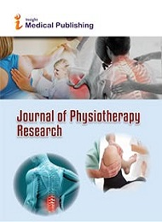

SUPPORTING JOURNALS
Journal 1: Journal of Physiotherapy Research
https://www.imedpub.com/journal-physiotherapy-research/
Journal 2: Journal of Physical Therapy & Sports Medicine
https://www.alliedacademies.org/journal-physical-therapy-sports-medicine/
Journal 3: British Journal of Sports Medicine
https://bjsm.bmj.com/
Right Click > Fill > Picture > Select journal pic from PC
Right Click > Fill > Picture > Select journal pic from PC
Right Click > Fill > Picture > Select journal pic from PC
https://physicaltherapycongress.insightconferences.com/

Slide 8
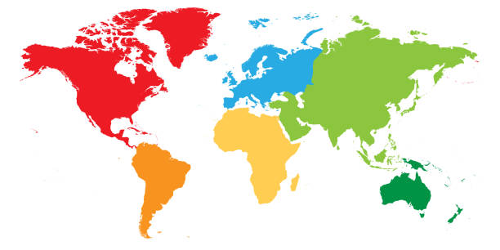
VENUE
VENUE
London,UK
CONTACT US
Program Manager | PHYSICAL THERAPY 2024
Conference Series
E-MAIL: sportsmedicinecongress@medicalscienceconference.com
Web: https://physicaltherapycongress.insightconferences.com/
WhatsApp no. +44 -7362049945

Slide 9
Only Registration: $999
Speaker: $ 899
ACADEMIC
BUSINESS
Only Registration: $ 1099
Speaker : $999
Poster presentation: $ 499
Delegate: $ 599
Young Researchers Forum : $799
REGISTRATIONS
STUDENT
IMPORTANT DATES
Abstract submission opens: September 25, 2024
Early Bird Registration: August 30, 2022
Normal registration: September30,2023
Registration Opens: June 01, 2022
On Spo+++++++t Registration: August 25, 2024
https://physicaltherapycongress.insightconferences.com//

