Slide 1


PEDIATRICS -2024
32nd World Congress on
Clinical Pediatrics
June 13-14, 2024| Rome, Italy
Theme:
"Advancing Pediatric Care: Innovations and Insights”
MAIL: pediatriccongress@globalconferencemeet.com
URL:https://clinicalpediatric.pediatricsconferences.com/
WhatsApp No: +44-7362055154

Slide 2
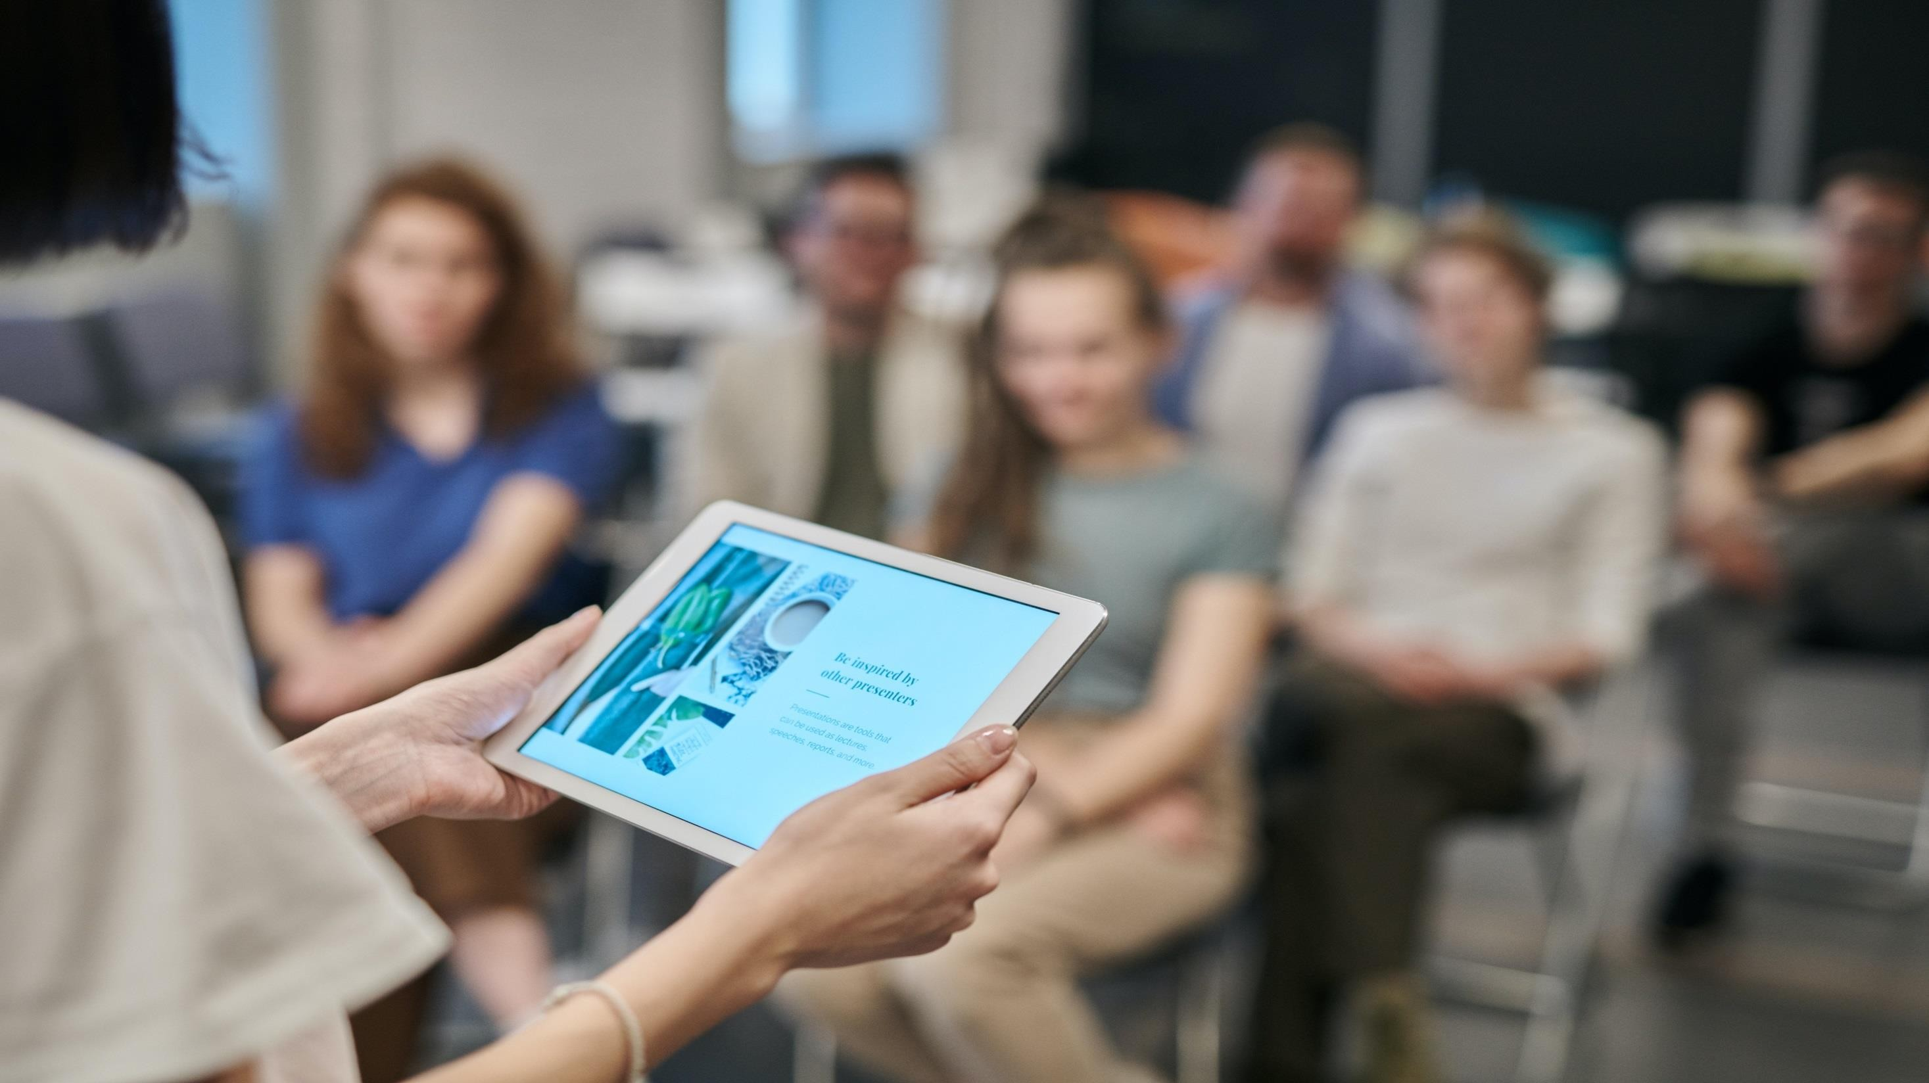

I N V I T A T I O N
Dear Attendees,
Conference Series LLC LTD welcomes you to attend the 32nd World Congress on Clinical Pediatrics. which is going to be held on June 13-14, 2024 in Rome, Italy. We cordially invite all the participants who are interested in sharing their knowledge and research in the arena of PEDIATRICS -2024 anticipates more than 100 participants around the globe with thought provoking keynote lectures, oral and poster presentations. The attending delegates include editorial board members of related open access journals. This is an excellent opportunity for the delegates from universities, institutes, and industries to interact with the world class scientists. The intending participants can confirm their participation by registering for the conference along with your colleagues. Avail the delegate early bird offer. The main theme of the conference is “Advancing Pediatric Care: Innovations and Insights” As the premier event, we have developed a program with your interests in mind.
We have not only increased the number of opportunities for you to network with colleagues from across the world but also introduced more focused sessions that will feature cutting edge presentations, special panel discussions, and livelier interaction with industry leaders and experts. Life is full of give and take. Make it count in your professional life. Attend the PEDIATRICS -2024 to network with your peers, exchange expertise and experiences, and arm yourself with the latest information to take your department to the next level. We look forward to personally welcoming you to Conference this June .
Sincerely,
Organizing Committee
PEDIATRICS -2024
https://clinicalpediatric.pediatricsconferences.com/

Slide 3


A B O U T U S
O u r I n t e r n a t i o n a l O p e n A c c e s s J o u r n a l s
700+ Leading-edge Peer Reviewed Open Access Journals
21 Day Rapid Review Process
50000+ Editorial Board Team, 35000+ Reviewers team
30 Million Readers and High Visibility
1000+ Scientific Associations Collaborations
100000+ Facebook Likes
Publication immediately after acceptance
Quality and Quick editorial, review processing
O u r I n t e r n a t i o n a l S c i e n t i f i c C o n f e r e n c e s
More than 3000 Conferences happening across the globe
Conferences organized in Medical, Pharma, Engineering, Science, Technology and Business.
CME/CPD Accredited Conferences fostering professional and Personal development
Continuum of education through organized scientific program
Renowned speakers and scientists representing from 40 countries
Highly Interactive sessions and Panel Discussions
B2B Meetings offers perfect platform for Global Networking
S a l i e n t F e a t u r e s
Easy to Submit and Review Systems
High Quality and Fast Publishing Guaranteed
Unbiased, quality-oriented, and transparent reviews
Truly impartial recognition of the best papers
Feedback on the impact of every article
Enhanced feature: Audio version of published paper
Digital articles to share and explore
Sharing option: Social networking enabled
Authors, reviewers and editors are provided with scientific credits
User friendly/feasible website articles translations across more than 50 world languages
Robust on-line publicity for all the speakers and organizing committee members
Career Guidance Workshops for students and early career researchers
Accepted Abstracts will be published in various indexed journals
Accepted abstracts will be labeled with a Digital Object Identification Number (DOI) provided by Cross Ref
Creation of speakers and abstracts pages in Google
Opportunity to publish full Manu Scripts in our Open Access Journals Special
Special Issues : All accepted abstracts will be published in respective UK: Conference Series Journals
Each abstract will be provided with digital Object Identifier by
https://clinicalpediatric.pediatricsconferences.com/

Slide 4
Clinical pharmacology 2023, The main objective is to bring all the leading academic scientists, researchers and research scholars together to exchange and share their experiences and research results about all the aspects of Clinical pharmacology. It also provides the premier interdisciplinary forum for researchers, practitioners and educators to present and discuss the most recent innovations, trends, and concerns, practical challenges encountered and the solutions adopted in the field of Clinical pharmacology . The conference program will cover a wide variety of topics relevant to the Clinical pharmacology , including: Clinical pharmacology , various technologies in Clinical pharmacology . This unique opportunity that we extend to our speakers and attendees is not being offered by any other conference organizers. Through this the abstracts and research profiles of our speakers and organizing committee members getting global visibility which is an additional feature that you would be receiving in addition to networking opportunities before, during and after the conference.
C A R D I O C A R E 2 0 2 3 S A L I E N T F E A T U R E S
C O N F E R E N C E
Meet academia and industry visionaries to get inspired
Expand your knowledge and find solutions to problems
Knowledge, benchmarking and Networking offered at one place
Forge connections and for global networking
Highly organized and structured scientific programs
Poster presentations and world class exhibitions
Meet with new vendors and suppliers
H O W C O N F E R E N C E S E R I E S C O N F E R E N C E S D I F F E R S F R O M O T H E R S ?
3000+ Conferences across the globe in 30+ countries all through the year
Over 25 million+ visitors and 20000+ unique visitors per conference
Participation by Stalwarts from various international societies
Internationally renowned speakers and scientists representation
Career guidance for early career researchers and students
Interesting scientific deliberations and discussions
Perfect platform for global networking
A B O U T
G O A L S
The conference program emphasizes evidence-based practice, educational innovation, practical application, and peer to peer networking and collaboration. The goal of the conference is to provide a transformative professional development experience.
Bringing together the world’s scientific experts to catalyze and advance scientific knowledge about food safety and regulatory measures present the most recent research findings, and promote and enhance scientific collaborations around the world.
Bringing together community leaders, scientists, and policy leaders to promote and enhance programmatic collaborations to more effectively address regional, national and local responses to elderly population around the world and overcome barriers that limit access to care and services.
https://clinicalpediatric.pediatricsconferences.com/

Slide 5

G O A L S
After participating in this meeting, attendees should be able to
Discuss emerging issues in the field of food safety
Discuss and apply recent research findings related to food safety
Reflect on the place of critical distance in food safety
C O N F E R E N C E
W H O S H O U L D A T T E N D
11th international Conference, Conferences are exclusively designed for is exclusively designed for Our point is to the corporate network and to make a stage for the trading of data on innovative advancements, new logical modernization and the viability of different administrative projects towards 11th international Conference on Food Safety 2024. The use of Molecular Approaches in all parts of the cutting edge Nursing Science and Health field. This meeting likewise centers around a wide assortment of momentum look into on sanitation and wellbeing that have both useful and pernicious impacts on the security and nature of nourishments, and are along these lines a worry of general wellbeing.
A B O U T H O S T I N G O R G A N I Z A T I O N
Conference Series is the world’s leading specialist in organizing Academic, Scientific and Business conferences, meetings, symposiums and exhibitions in different verticals and horizontals like Medical, Pharma, Engineering, Science, Technology and Business to promote scientific research. Every year we host more than 3000+ global events inclusive of 1000+ Conferences 1000+ Symposiums 1000+ Workshops in USA, Europe, Middle East and Asia with the generous support and cooperation from our 30000 + Editorial Board Members, 1000+ Scientific Societies. All the conference proceedings are published in the special issues of our 700+ Open Access International Journals with the DOI provided by
P A R T I C I P A T I O N O P T I O N S
A B O U T
Speaker (special session): 45-50 minutes (more than 1 can present)
Speaker (symposium): more than 45 minutes (more than 1 can present)
Delegate(only registration): will have access to all the sessions with all the benefits of registration
Poster presenter: can present a poster and enjoy the benefits of delegate
Remote attendance: can participate via video presentation or e-poster
presentation
Exhibitor: can exhibit his/her company’s products by booking exhibitor booths of different sizes
Media partner
Sponsor
Collaborator
For more details about each mode, kindly contact:
pediatriccongress@globalconferencemeet.com
https://clinicalpediatric.pediatricsconferences.com/

Slide 6
P A R T I C I P A T I O N B E N E F I T S
by world’s most eminent
Pediatric Advanced Life Support
Future of Pediatric Healthcare
Precision Medicine in Pediatrics
Pediatric Radiology
Pediatrics
Pediatric Surgery
Pediatric Immunization
Clinical Pediatrics
Advances in Pediatric Medicine
Child and Adolescent Obesity
Pediatric Gastroenterology
Neonatology and Perinatology
Pediatric Oncology & Hematology
Pediatric Allergy and Asthma
Pediatric Neurology
Pediatric Cardiology
Pediatric Orthodontics
Pediatric Nephrology
Pediatric Endocrinology
Pediatric General Pediatrics/Emergency Medicine
Attend Keynote Presentation
researchers
Access to all the sessions
Get OCM certificate
Get worldwide acknowledgment to your profile and Research
Get your abstracts published with unique DOI in International Journals
Get up to 50% discounts for publishing your entire article in our open access International Journals
Get Handbooks and conference kits
Get an access to the network with eminent personalities from worldwide
E
C
I O N S
N
E
R
F E
S S
O N
S E
A B S T R A C T S U B M I S S I O N
C
https://clinicalpediatric.pediatricsconferences.com/abstract-submission.php
M A J O R
T
F O R M O R E I N F O R M A T I O N
O U
pediatriccongress@globalconferencemeet.com/
B
A
https://clinicalpediatric.pediatricsconferences.com/

Slide 7



S U P P O R T I N G J O U R N A L S
Journal of Child and Adolescent Behavior
URL: https://www.omicsonline.org/child-and-adolescent-behavior.php
Journal of Paediatric Medicine & Surgery
URL: https://www.omicsonline.org/paediatric-medicine-surgery.php
Journal of Novel Physiotherapies
URL: https://www.omicsonline.org/novel-physiotherapies.php
https://clinicalpediatric.pediatricsconferences.com/

Slide 8

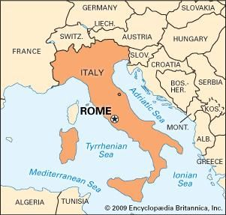
V E N U E & A C C O M M O D A T I O N
Rome, Italy
A C C O M O D A T I O N
A N D
C O N T A C T U S
Ellyse Brindle
Program Manager | PEDIATRICS -2024
UK: Conference Series LLC Ltd
Email: pediatriccongress@globalconferencemeet.com
W: https://clinicalpediatric.pediatricsconferences.com/
WhatsApp No. +44-7362055154
V E N U E
https://clinicalpediatric.pediatricsconferences.com/

Slide 9
Only Registration: € 789
Package A (Registration + 2 nights Accommodation): € 1129
Package B (Registration + 3 nights Accommodation): € 1379
A C A D E M I C
R E G I S T R A T I O N S
Only Registration: $ 849
Package A (Registration + 2 nights Accommodation): € 1229
Package B (Registration + 3 nights Accommodation): € 1479
B U S I N E S S
Student Oral: € 245
YRF: € 489
Student Delegate: € 199
E-poster: € 99
S T U D E N T
I M P O R T A N T D A T E S
Abstract submission opens: July 01, 2023
Early Bird Registration: Aug 30, 2023
Registration Opens: July 01, 2023
On Spot Registration: June 13, 2024
https://clinicalpediatric.pediatricsconferences.com/

