Slide 1


Ophthalmology and
Optometry
Skin Care-2023
5th World congress on
March 14-15, 2024 |London, UK
Theme:
"Vision for Tomorrow: Advancing Ophthalmology in the Modern Era”
MAIL: ophthameets@meetingsnexpo.com
URL:https://ophthalmology.ophthalmologyconferences.com/

Slide 2
R E G I S T R A T I O N & T I M I N G S
Ophthalmology 2024
March 14, 2 0 2 4 ( 9 : 0 0 A M t o 6 : 0 0 P M )
March 15, 2 0 2 4 ( 9 : 0 0 A M t o 6 : 0 0 P M )
G R O U P P H O T O T I M E
1 0 : 4 5 A M - 1 0 : 5 0 A M ; March 15 , 2024
London, UK
Please try your best to attend the Conference. If you could not attend, please
let us know https://ophthalmology.ophthalmologyconferences.com/, ophthameets@meetingsnexpo.com
https://ophthalmology.ophthalmologyconferences.com/

Slide 3

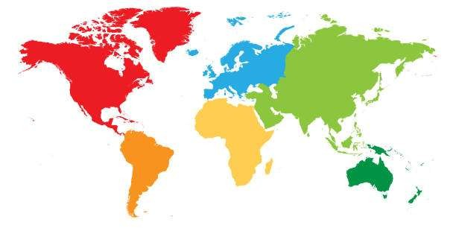
Skin Care-2023
V E N U E
London
UK
S P E A K E R S ’ P P T
You may submit your presentation to any of our onsite organizers on the day of your talk. If your presentation is not compatible with our laptops, then you may use your own laptop.
To Register Online, Please visit
https://ophthalmology.ophthalmologyconferences.com/registration.php

