Slide 1


conferenceseries.com
conferenceseries.com
Oculoplastic Surgery 2018
Tentative Program
International Conference on
Clinical Ophthalmology and OculoplasticSurgery 2018
Theme: Advances in Clinical Ophthalmology
May 24-25, 2018 Osaka, Japan
Seating is Limited Register Today!
Conference Secretariat
Conference Series
47 Churchfield Road, London, W3 6AY, UK
Phone: +44 800 098 8455
Fax: + 44 203 004 1517
Email: oculoplasty@annualcongress.net oculoplasty@conferencesworld.org

Slide 2
conferenceseries.com
conferenceseries.com
Oculoplastic Surgery 2018
Conference Highlights
Clinical Ophthalmology
Oculoplastic Surgery
Pediatric Ophthalmology
Cataract and Refractive Surgery
Retina and Retinal Surgery
Glaucoma: Visual field loss
Uveitis
Strabismus
External Eye Diseases
Ophthalmic Pathology
Ophthalmic Pharmacology
Ophthalmic Oncology
Ophthalmology Surgery
Optometry and Contact Lens
Orbital Disorders and Surgery
Ocular Imaging
Ophthalmic Research and Drug Delivery
Vision Rehabilitation
** Speaker Slots are Available **

Slide 3
conferenceseries.com
conferenceseries.com
Oculoplastic Surgery 2018
Tentative Program
Day 1 May 24, 2018
08:00-08:30 Registrations
Conference Hall
Opening Ceremony
conferenceseries.com
08:30-09:00
Keynote Forum
Title: Non-Surgical Techniques For Facial Rejuvenation And Contouring 09:00-09:40 Dr. Christopher B. Chambers, University of Washington, USA Title: Anterior Approach White Line Advancement: A Hybrid Technique For Ptosis Correction 09:40-10:20 Dr. Suresh Sagili, Royal Shrewsbury Hospital, UK
Group Photo / Networking and Refreshments Break: 10:20-10:40
Sessions: Clinical Ophthalmology | Oculoplastic Surgery| Pediatric Ophthalmology
Session Introduction
Session Chair: Dr. Christopher B. Chambers, University of Washington, USA
Session Co-chair: Dr. Suresh Sagili, Royal Shrewsbury Hospital, UK
10:40-11:00
Title: Incision-Less Solution For Punctal Stenosis Induced Epiphora- Is It Really Effective? Dr. Ayelet Priel, Goldschleger Eye Institute, Shebe Medical Center, Israel
Title: Antibiotic Prescription For Infective Conjunctivitis In General Practice Dr. Chandni Nigam, Imperial College London, UK
Title: Sphingosine-1-Phosphate Mediates Inflammation And Fibrosis In Orbital Fibroblasts of Graves’
Orbitopathy
Dr. Jin Sook Yoon, Yonsei University , South Korea
Title: Lower Eyelid Cadaveric Anatomical Dissection Techniques
Dr. Melike Ozgun Gedar, Bahcesehir University School of Medicine, Turkey
*Speaker Slot Available*
*Speaker Slot Available*
11:00-11:20
11:20-11:40
11:40-12:00
12:00-12:20
12:20-12:40
Lunch Break 12:40-13:40
Sessions:
Cataract and Refractive Surgery | Retina and Retinal Surgery | Glaucoma: Visual Field Loss
Session Introduction
Session Chair: Dr. Jianmin Ma, Beijing Tongren Eye Center, China
Session Co-chair: Dr. Melike Ozgun Gedar, Bahcesehir University School of Medicine, Turkey
13:40-14:00
Title: Pathological Evaluation Of Lacrimal Sac In Cases Undergoing Dacryocystorhinostomy For Acquired Nasolacrimal Duct Obstruction
Dr. Pranita Dhakal, Mechi Eye Hospital, Nepal
Title: Comparative Study On Dacryocystorhinostomy (DCR) Surgery With Silicone Tube Intubation And Without Silicone Tube Intubation At Geta Eye Hospital
Dr. Ravi Dhar Bhandari, Geta Eye Hospital, Nepal
14:00-14:20

Slide 4
conferenceseries.com
conferenceseries.com
Oculoplastic Surgery 2018
14:20-14:40
Title: Corneal Collagen Cross Linking As An Effective Aid To Medical Therapy In Refractory Corneal Ulcer Dr. Abhiyan Kumar, Pattnaik Laser Eye Institute, India
Title: Current Understanding Of Posterior Corneal Astigmatism Dr. Ruchika Kedia, Wavikar Eye Institute, India
*Speaker Slot Available*
*Speaker Slot Available*
14:40-15:00
15:00-15:20
15:20-15:40
Networking and Refreshments Break: 16:00-16:20
16:00-16:20
Title: A Retrospective Review Of Orbital Mycoses In An Adult Subtropical Population Over Three Decades Dr. Allister Lee, University Of Queensland, Australia
Title: Refractive Changes Among Nepalese Youths Working In South Korea Under Employment Permit System
Dr. Gokarna Dhakal, Civil Service Hospital, Nepal
Title: Expanding The Micropthalmic Orbit
Dr. Christopher B. Chambers, University Of Washington, USA
Title: Lower Eyelid Retractor (White-Line) Advancement To Correct Tarsal Ectropion Dr. Suresh Sagili, Royal Shrewsbury Hospital, UK
*Speaker Slot Available*
*Speaker Slot Available*
16:20-16:40
16:40-17:00
17:00-17:20
17:20-17:40
17:40-18:00
Panel Discussion
Day 2 May 25, 2018 Keynote Forum
Title: Combined Treatment Of Exudative Age-Related Macular Degeneration 09:00-09:40 Dr. Bilalov Erkin Nazimovich, Tashkent Medical Academy, Uzbekistan Title: Guidelines For Management Of Ocular Surface Squamous Neoplasia 09:40-10:20 Dr. Anita Panda, AIIMS, India
Networking and Refreshments Break: 10:20-10:40
Sessions: Ophthalmology Surgery | External Eye Diseases | Neuro-Ophthalmology
Session Introduction
Session Chair: Dr. Christopher B. Chambers, University of Washington, USA
Session Co-chair: Dr. Melike Ozgun Gedar, Bahcesehir University School of Medicine, Turkey
10:40-11:00
Title: Effectiveness of External Dacryocystorhinostomy With Small Skin Incision Dr. Mohammad Idris, Lady Reading Hospital, Pakistan
Title: Epibulbar Dermoid
Dr. Abhiyan Kumar, Pattnaik Laser Eye Institute, India
Title: Lncrnas In Genetic Basis of Glaucoma
Dr. Cisse Yacouba, Southern Medical University, China
Title: Effectiveness of The Modified Method of Surgical Treatment of Terminal Glaucoma
Dr. Fazilat Bhakhridinova, Tashkent Medical Academy, Uzbekistan
Title: The Efficacy of Improved Method of Surgical Treatment of Persistently Recurrent Pterygium
Dr. Kumri Narzikulova, Tashkent Medical Academy, Uzbekistan
11:00-11:20
11:20-11:40
11:40-12:00
12:00-12:20

Slide 5
conferenceseries.com
conferenceseries.com
Oculoplastic Surgery 2018
12:20-12:40
12:40-13:00
13:00-13:20
*Speaker Slot Available*
*Speaker Slot Available*
*Speaker Slot Available*
Lunch Break: 13:20-14:20
Keynote Forum
Title: Correlation Between Optic Nerve Involvement And Chronic Obstructive Pulmonary Disease 14:20-15:00 Dr. Mohammad Yazdchi, Tabriz University, Iran Title: Experimental Study Of The Effectiveness Of Eye Medicinal Films In Viral Eye Lesions 15:00-15:40 Dr. Bilalov Erkin Nazimovich, Tashkent Medical Academy, Uzbekistan
Networking and Refreshments Break: 15:40-16:00
Sessions: Ophthalmic Pharmacology | Orbital Disorders And Surgery
Session Introduction
Session Chair: Dr. Mohammad Yazdchi, Tabriz University, Iran
Session Co-chair: Dr. Bilalov Erkin Nazimovich, Tashkent Medical Academy, Uzbekistan
16:00-16:20
Title: The Study Of Surgical Design And Prevention And Treatment Of Operative Complications Of Ocular Tumors And Orbital Diseases
Dr. Jianmin Ma, Beijing Tongren Eye Center, China
Title: PACK- CXL In Infectious Keratitis Dr. Anita Panda, AIIMS, India
Title: Out Come Of Phaco Surgeries In Patients With Pseudoexfoliation Dr. Nisar Ahmed Khan, Indus Medical College, Pakistan
*Speaker Slot Available*
*Speaker Slot Available*
*Exhibitor Promotion Slot Available*
16:20-16:40
16:40-17:00
17:00-17:20
17:20-17:40
17:40-18:00
Networking & Closing Ceremony

Slide 6
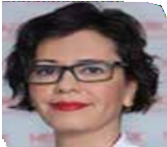
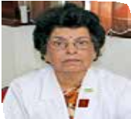
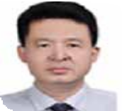
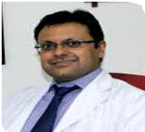
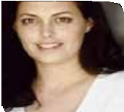
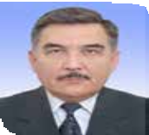
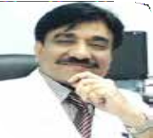
conferenceseries.com
conferenceseries.com
Oculoplastic Surgery 2018
Organizing Commitee Members
 | Melike Ozgun Gedar Bahcesehir University Turkey |  |  | Anita Panda AIIMS, India
 | Jianmin Ma Beijing Tongren Eye Center, China |  |  | Abhiyan Kumar Pattnaik Laser Eye Institute India
 | Ayelet Priel Chaim Sheba Medical Center, Israel |  |  | Bilalov Erkin Nazimovich Tashkent Medical Academy Uzbekistan
 | Nisar Ahmed Khan Indus Medical College Pakistan

Slide 7
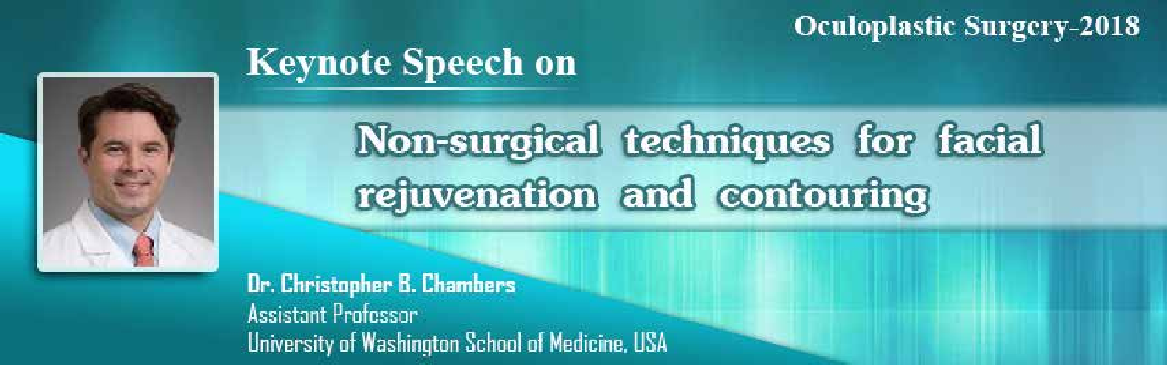
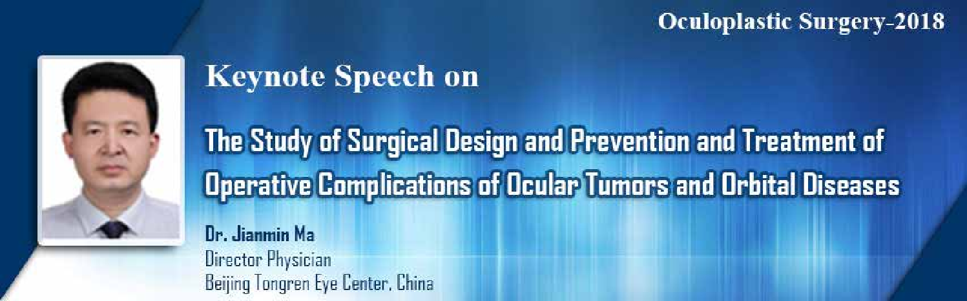
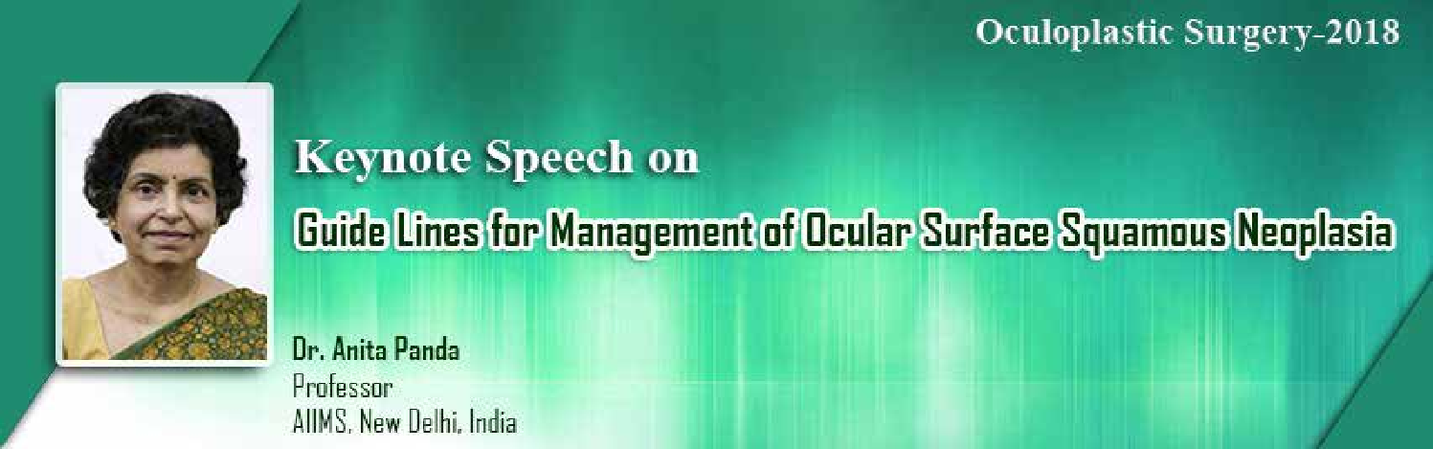
conferenceseries.com
conferenceseries.com
Oculoplastic Surgery 2018

Slide 8

conferenceseries.com
conferenceseries.com
Oculoplastic Surgery 2018
Poster Guidelines
The poster exhibition will be located on the exhibition area of the congress centre. The area will be clearly signposted from the registration area.
Technical Instructions:
Posters must be prepared in Portrait style.
Please DO NOT prepare a landscape poster
The dimensions should be 100 cm high by 70 cm wide
Posters should be attached to the boards with stickers, which you will be supplied to the organizers.
Poster session schedule Posters will be displayed and presented in session.
Please plan to be at your poster and available to answer questions from delegates at the time of your assigned poster session. Posters will be displayed according to the POSTER numbers given by the organizers and will be grouped by sub topic.
Young Researchers Forum
The Young Researchers Forum offers young researchers the possibility to meet and discuss research topics and methodologies, share and develop ideas, learn from each other and gain knowledge from senior researchers.
Young Researcher Sessions are organized to provide a unique platform for Young Researchers/Investigators for presenting latest research projects with an in-depth analysis. Young Investigators (e.g. Post-Graduate students, Post-doctoral fellows, Trainees, Junior faculty) are the focus of this event. Participants should be below the age of 33 years. All submissions must be in English.
The prize winning papers will be considered for publication in the international journals once the paper is subjected to standard review procedures.
For further information please contact: oculoplasty@annualcongress.net, oculoplasty@conferencesworld.org

Slide 9

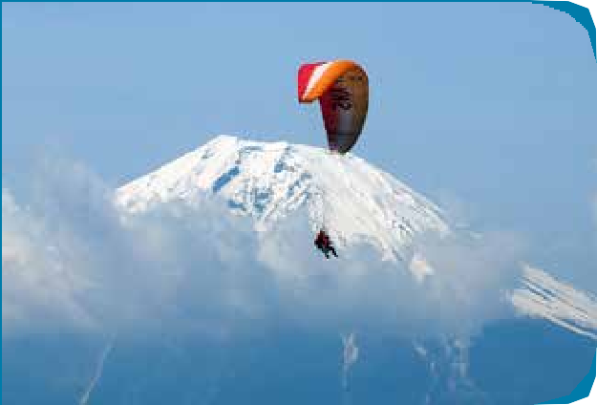


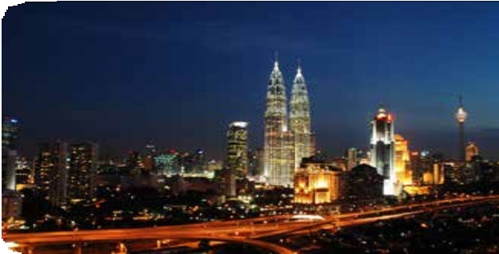
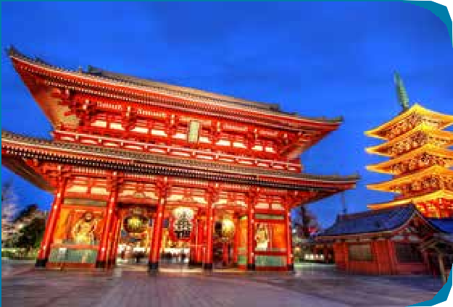
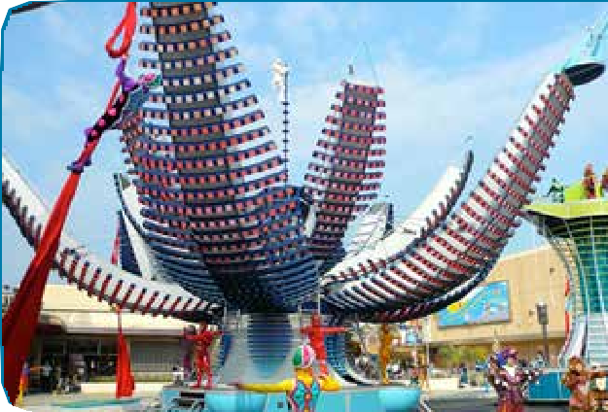

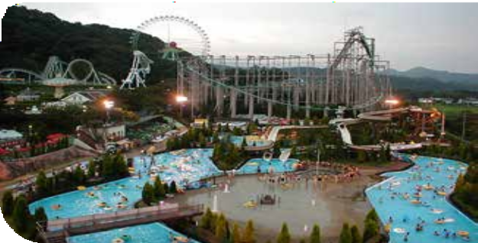






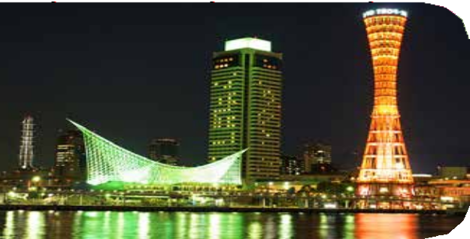

Plan your Trip to Osaka
conferenceseries.com
conferenceseries.com Oculoplastic Surgery 2018
https://oculoplastic.ophthalmologyconferences.com/

Slide 10
About Osaka
Osaka is the most populous city in the Japan which is developed very rapidly and become the attraction for all kinds of investments. It is the tourist hub and known for the luxury and comfort and thus it makes the perfect destination for Clinical Ophthalmology and OculoplasticSurgery 2018
A booming population, growing prevalence of lifestyle diseases and mandatory health insurance policies are fuelling the growth of private sector firms in the Japan’s healthcare industry.
Japan’s private hospitals were valued at $1.75 billion in 2013 but are expected to reach $3.23 billion by 2020, according to a new report by research firm Colliers International.
The report revealed that population growth, prevalence of lifestyle diseases, introduction of compulsory health insurance along with the emirate’s push to become a medical tourism hub are expected to drive the growth of the private sector in Japan’s healthcare industry.
Osaka is the second largest metropolitan area in Japan and serves a major economic hub. Historically a merchant city, Osaka has also been known as the “Nation’s Kitchen”. With a population of 2.5 million, Osaka is Japan’s third largest and second most important city. It has been the economic powerhouse of the Kansai region for many centuries. The city’s west side has the main port as well as a tourist destina- tion with attractions such as Kyocera Dome, Universal Studios Japan, Osaka aquarium, Minami, Osaka castle, Umeda sky building and the Tempozan Harbour Village. Osaka is known for its food, both in Japan and abroad. Author Michael Booth and food critic François Simon of Le Figaro have both suggested that Osaka is the food capital of the world. Osaka’s culinary prevalence is the result of a location that has pro- vided access to high quality ingredients, a high population of merchants, and close proximity to the ocean and waterway trade.
Contact Details
https://oculoplastic.ophthalmologyconferences.com/
Submit your abstract online at:
https://oculoplastic.ophthalmologyconferences.com/abstract-submission.php
Register online:
https://oculoplastic.ophthalmologyconferences.com/registration.php

