Slide 1
TENTATIVE
FOOD SAFETY CONFERENCE 2023
PROGRAM
24th I n t e r n a t i o n a l C o n f e r e n c e o n
Nursing care and Health
MAY 29-30, 2023 ROME, ITLAY
Theme:
Examining New Developments, Research, and the Best Nursing Practices
.
MAIL: nursingcareconference@eurosessions.com
URL: https://nursingcare.global-summit.com/

Slide 2
₂₉ th
D A Y 1
MONDAY,
May
08:30-09:00 | Registrations
09:00-09:30 | Introduction
09:00-09:30 | COFFEE BREAK
09:50-11:50 Meeting Hall 01 | KEYNOTE LECTURES
09:00-09:30 | Introduction
09:00-09:30 | MEETING Hall 02
11:50-13:10 | MEETING Hall 01 | MEETING Hall 02
 | Ayurveda Nursing Nursing Education and Research | Nursing Practice Nursing education in the future
03:10-13:15 | GROUP PHOTO
13:15-14:00 | LUNCH BREAK
11:50-13:10 | MEETING Hall 01 | MEETING Hall 02
 | Nurses' part in the COVID-19 pandemic Patient Safety & Health care | Surgical Nursing Critical Care Nursing Orthopaedic Nurse
16:00-16:20 | COFFEE BREAK

Slide 3
D A Y 2
Tuesday ,
₃₀ th
May
08:30-09:00 | Registrations
09:00-09:30 | Introduction
09:00-09:30 | COFFEE BREAK
09:50-11:50 Meeting Hall 01 | KEYNOTE LECTURES
09:00-09:30 | Introduction
09:00-09:30 | MEETING Hall 02
11:50-13:10 | MEETING Hall 01 | MEETING Hall 02
 | Clinical Nursing Dental Nurse Healthcare and Maternal Child Health | Neonatal Nursing Pediatric nursing Neonatal Nursing
03:10-13:15 | GROUP PHOTO
13:15-14:00 | LUNCH BREAK
11:50-13:10 | MEETING Hall 01 | MEETING Hall 02
 | Euro Nursing Gerontological Nursing Cardiac Nursing | Tele nursing and travel Healthcare and Maternal Child Health
16:00-16:20 | COFFEE BREAK

Slide 4
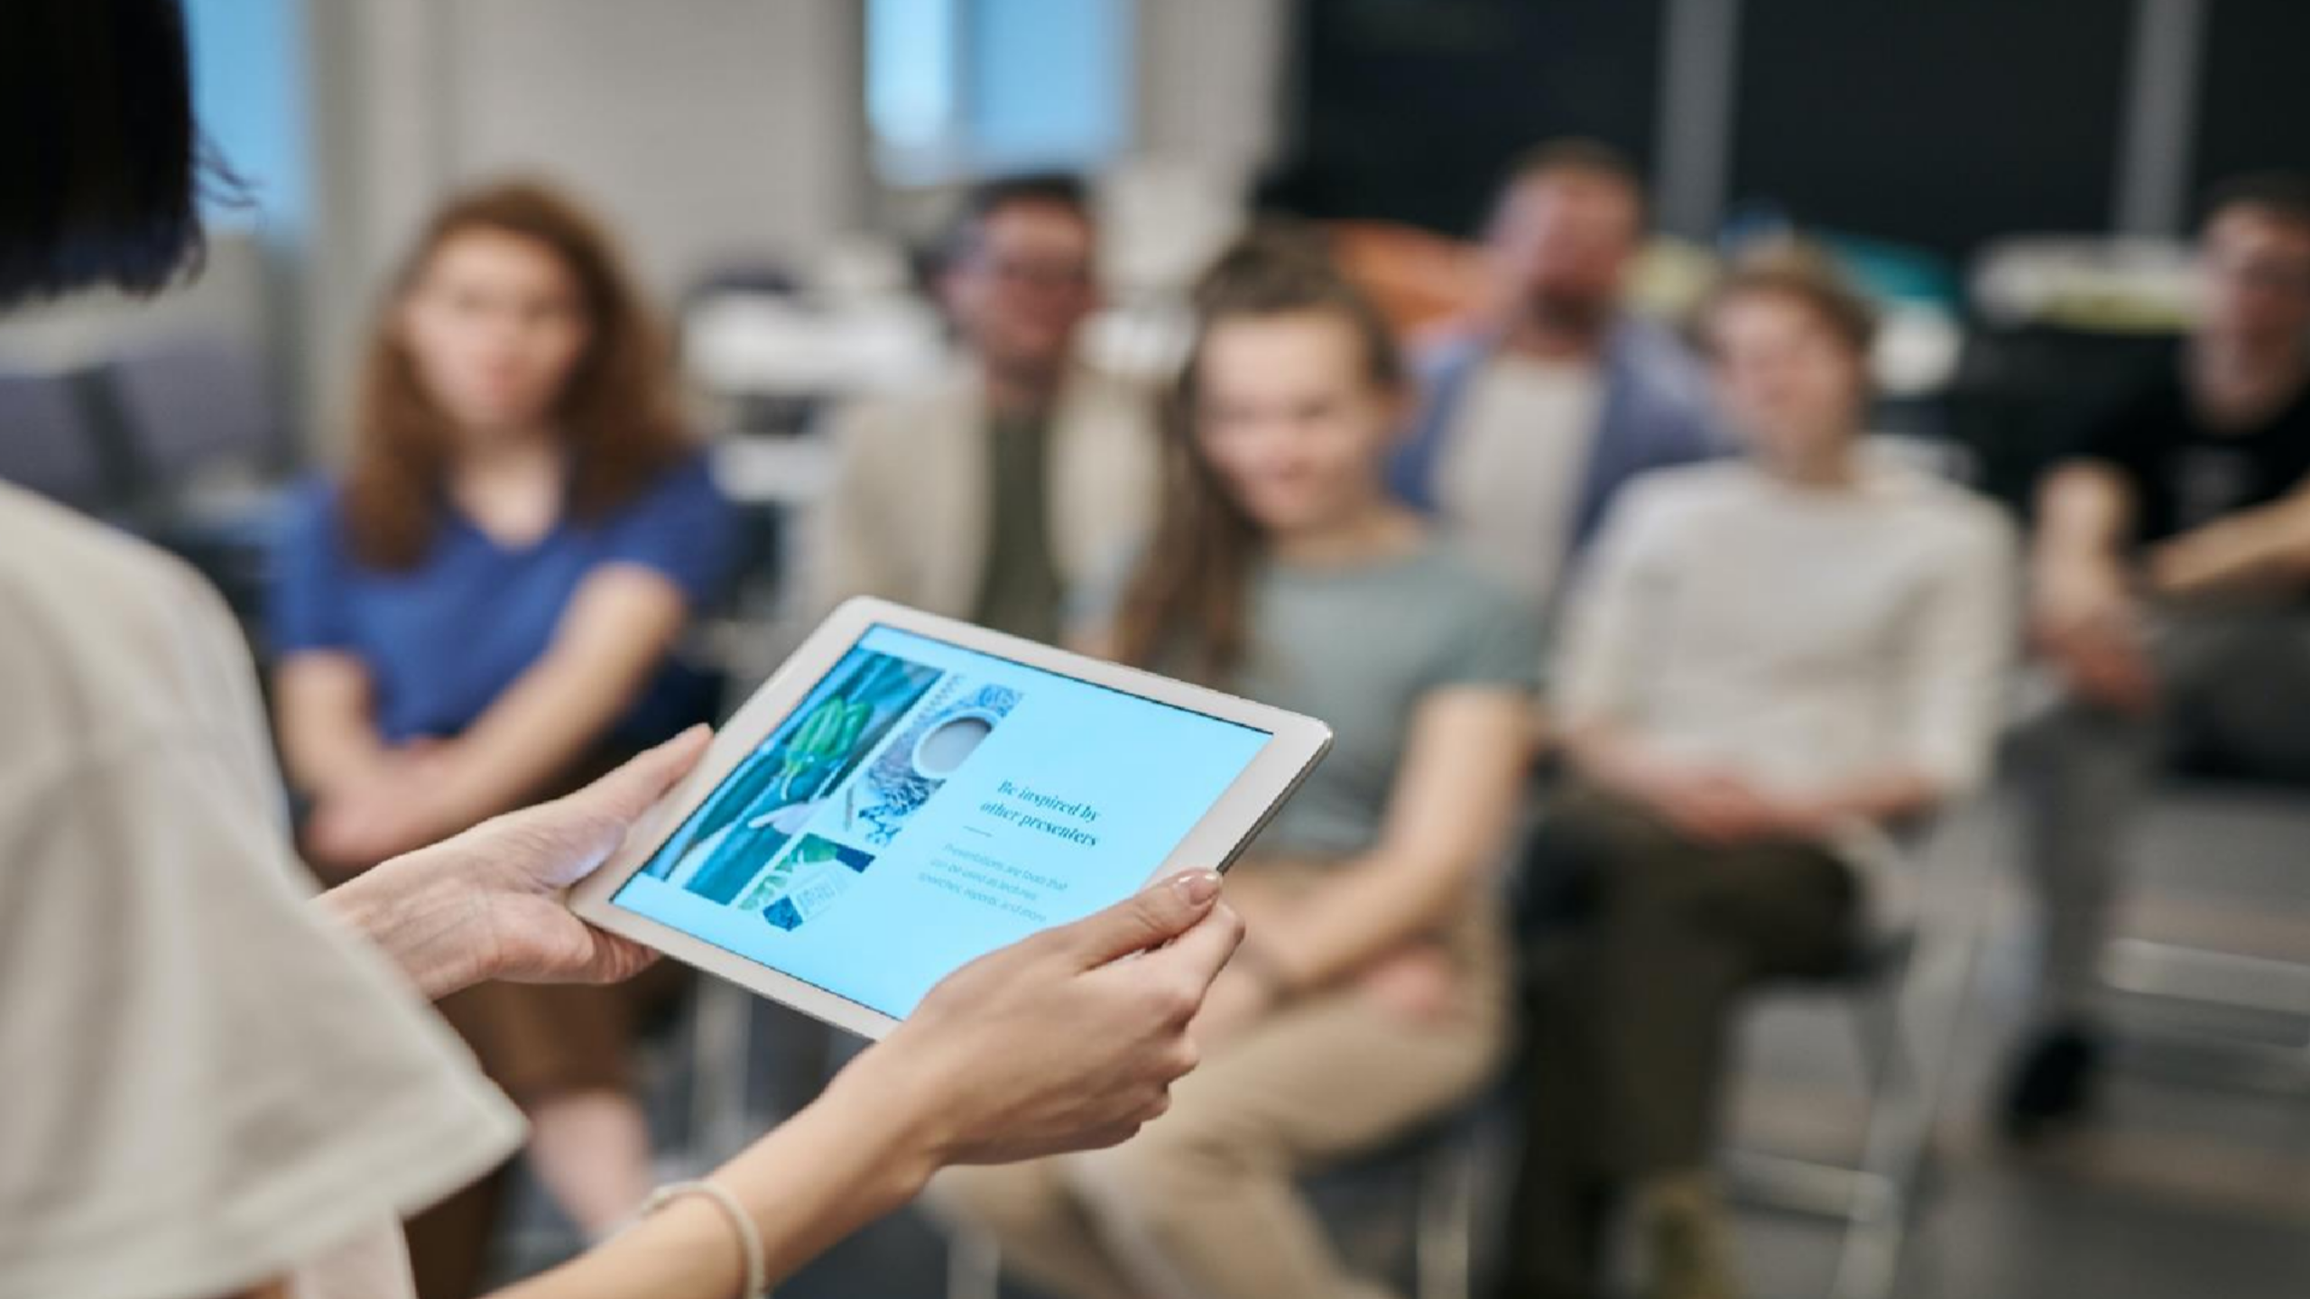

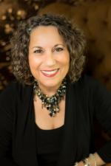
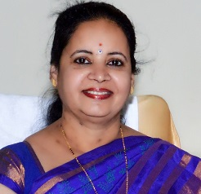
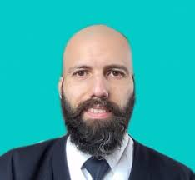
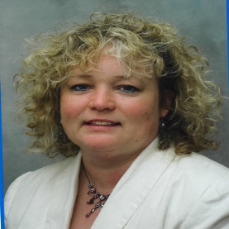
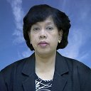
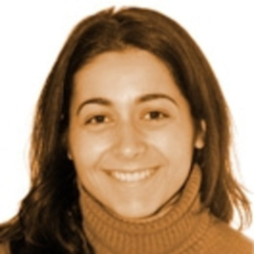
E D I T O R I A L B O A R D M E M B E R S
Raúl Hormazábal-Salgado
The University of Talca Chile
Sharadha Ramesh
Symbiosis International University India
Ilene Gottlieb
Healing From The Heart, Inc. USA
Elsa Vitale
University of Bari Italy
Susan J Kitching
Northern Area Armed Forces Hospital, Saudi Arabia
S.Setyowati
University Indonesia

Slide 5
P A S T
A F F I L I A T I O N S
Hector Magno
UC Berkeley as a National Science Foundation, UK
Arne Rehnsfeldt
Western Norway University of Applied Sciences, Norway
Maria-Teresa Parisotto
Fresenius Medical Care USA
Jean Du Plessis
Fiona Stanley Hospital, Australia
Meng-Yan Tang
Sichuan University, China
Hank Drummond
Cross Country Healthcare USA
Lonnie Wederski
Northern Arizona University USA
Monette Mabolo
Moses Cone Memorial Hospital USA

Slide 6
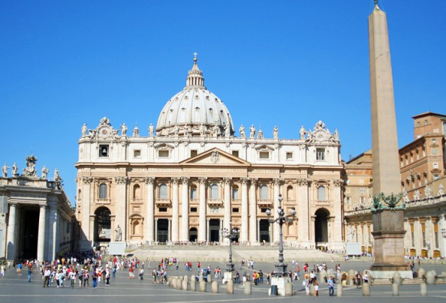
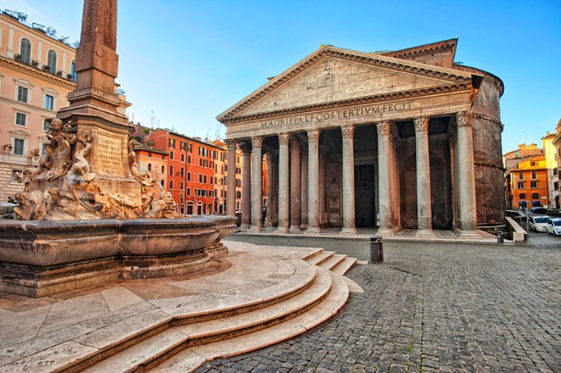
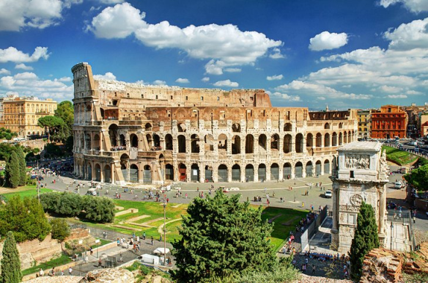
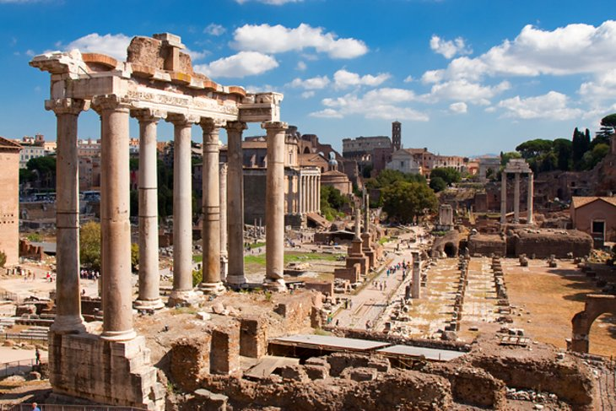
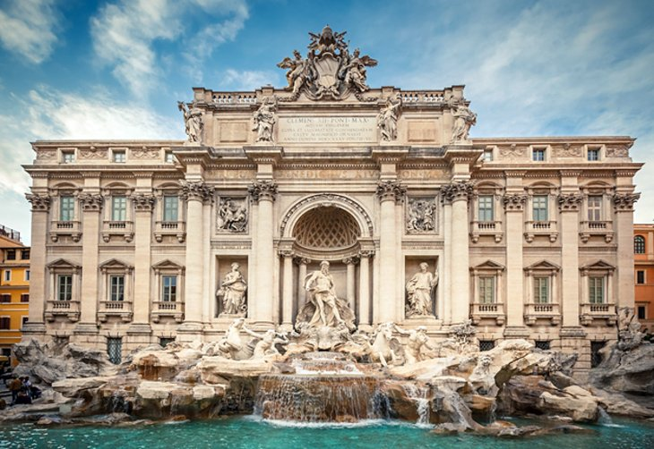
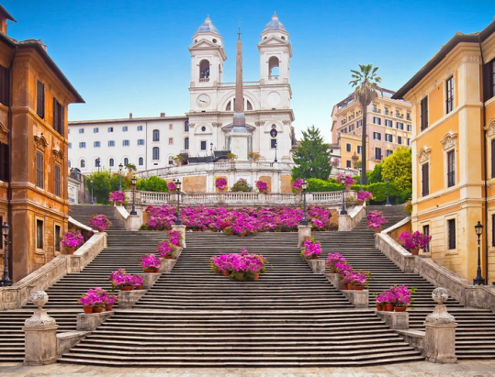
C I T Y
A T T R A C T I O N S
The Colosseum and the Arch of Constantine
Vatican City
The Pantheon
Roman Forum
Trevi Fountain
Centro Storico & the Spanish Steps

