Slide 1
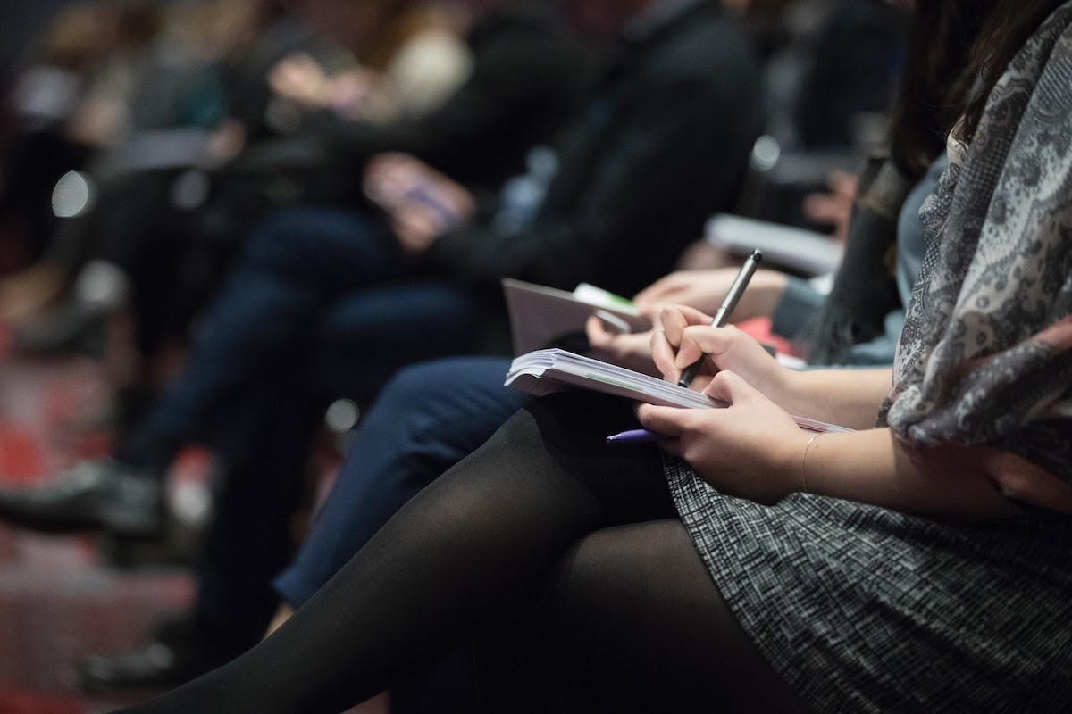

TENTATIVE PROGRAM
16th International Conference on
Neurology and Neuromuscular Disorders
January 25-26, 2024 London, UK
Theme:
"New model to diagnose neurological and neuromuscular disorders"
NEUROLOGY 2024
MAIL: neuromuscular@speakermeeting.com
URL:https://neuromuscular.neuroconferences.com/

Slide 2
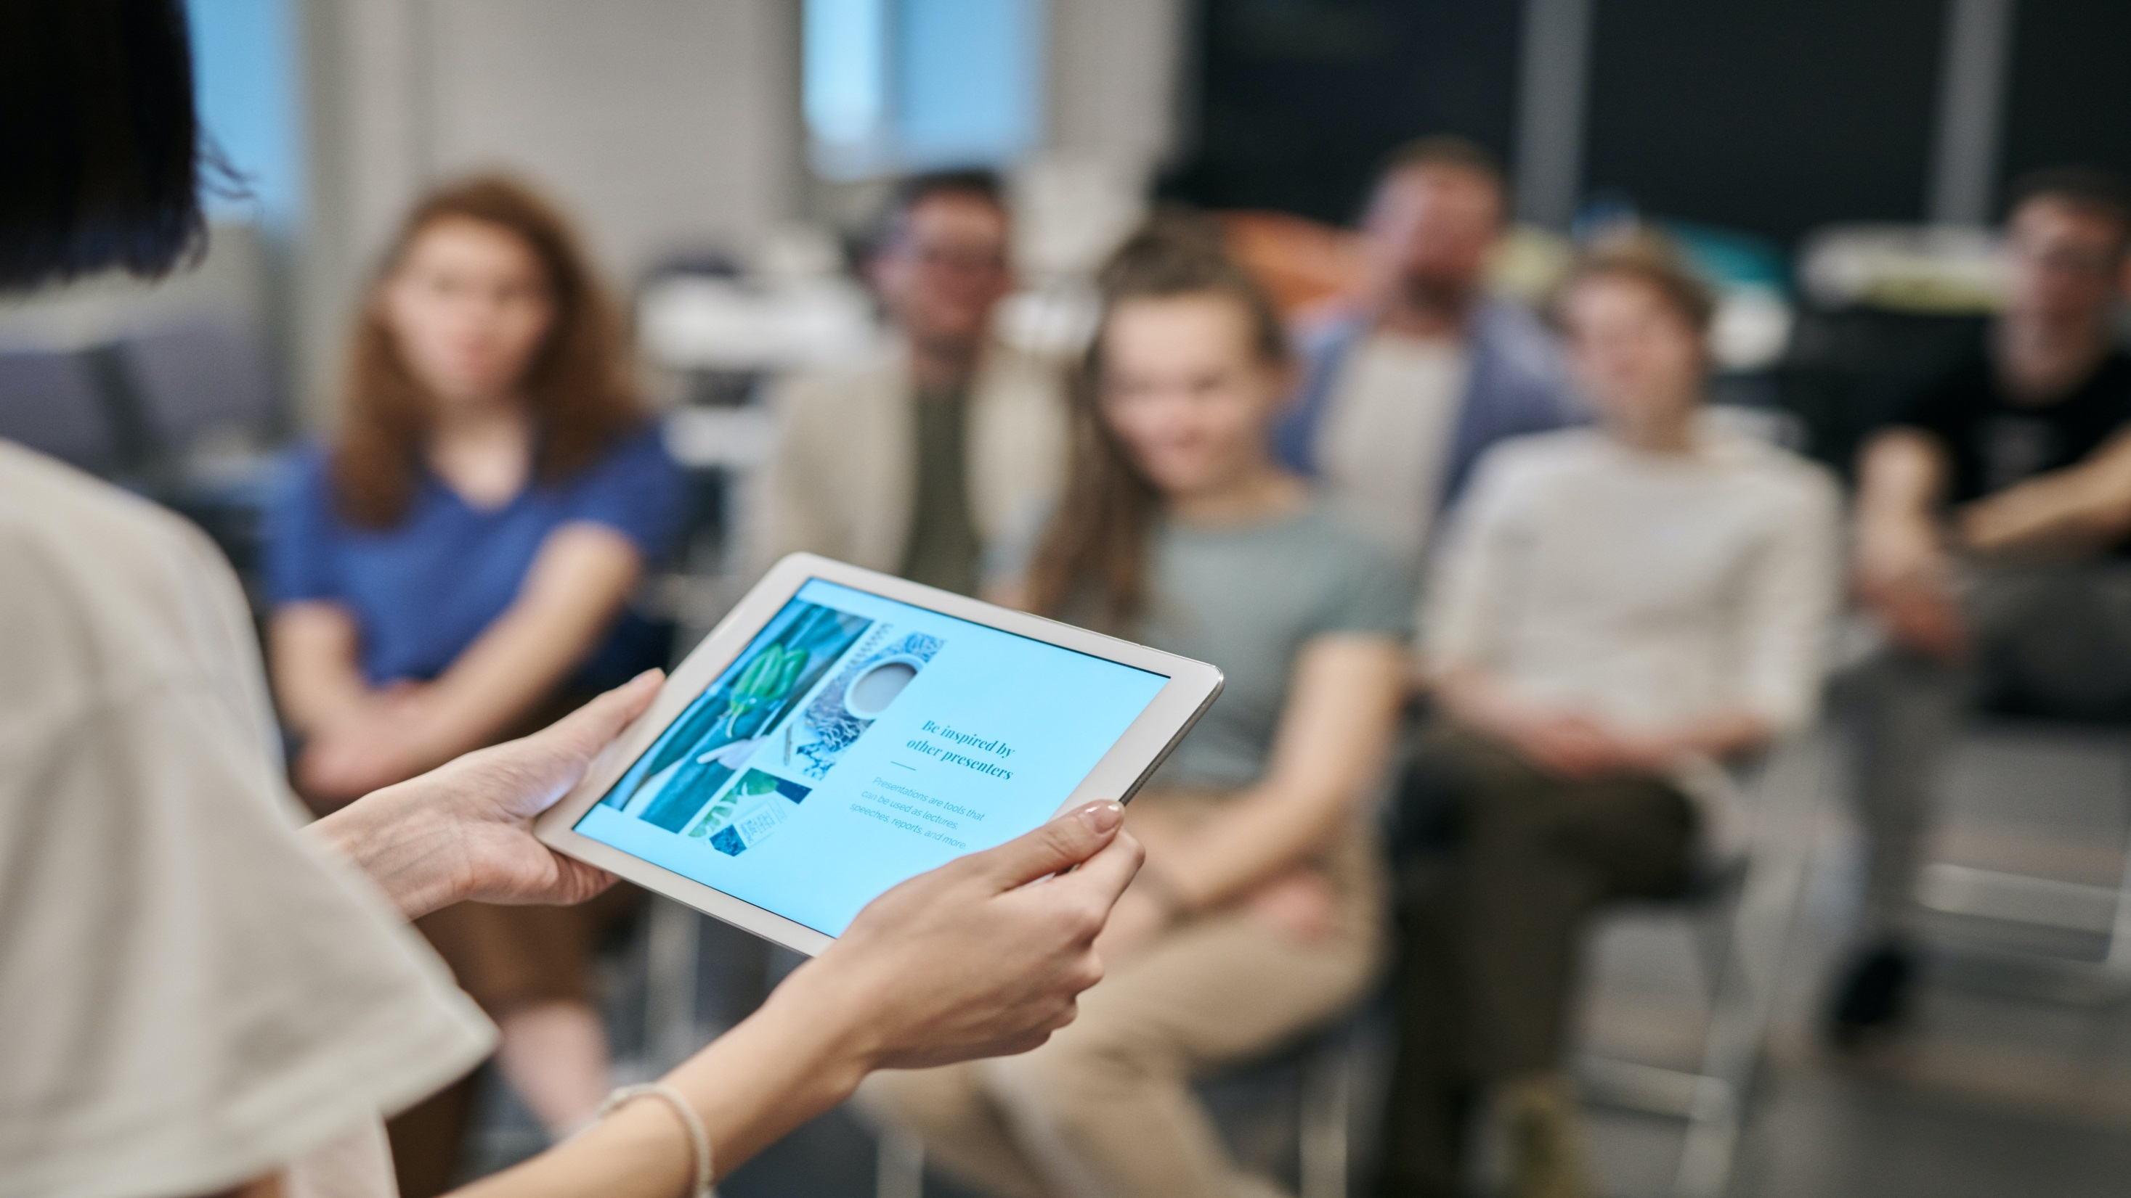

DAY 1
THURSDAY, 25th JANUARY
08:30-09:00 | Registrations
09:00-09:30 | Introduction
09:00-09:30 | COFFEE BREAK
09:50-11:50 Meeting Hall 01 | KEYNOTE LECTURES
09:00-09:30 | Introduction
09:00-09:30 | MEETING Hall 02
11:50-13:10 | MEETING Hall 01 | MEETING Hall 02
 | Pediatric Neurology Psychosomatic Disorders Neurology | Neuromuscular Disorders Neurosurgery Neurological manifestation in covid-19
03:10-13:15 | GROUP PHOTO
13:15-14:00 | LUNCH BREAK
11:50-13:10 | MEETING Hall 01 | MEETING Hall 02
 | Neurological diseases in COVID 19 Psychiatry and Psychology Spine and Spinal Disorders | Neurological infections Paediatric Neuromuscular disorder Muscular Dystrophy
16:00-16:20 | COFFEE BREAK

Slide 3
DAY 2
FRIDAY 26^{th,}January
08:30-09:00 | Registrations
09:00-09:30 | Introduction
09:00-09:30 | COFFEE BREAK
09:50-11:50 Meeting Hall 01 | KEYNOTE LECTURES
09:00-09:30 | Introduction
09:00-09:30 | MEETING Hall 02
11:50-13:10 | MEETING Hall 01 | MEETING Hall 02
 | Autoimmune Neuromuscular disorder Neuropsychology and Neurorehabilitation | Brain Tumour and Neuro-oncology Neuroradiology
13:10-13:15 | GROUP PHOTO
13:15-14:00 | LUNCH BREAK
11:50-13:10 | MEETING Hall 01 | MEETING Hall 02
 | Neuro Therapeutics, Diagnostics and Case Studies Nursing and Neuroscience | Neuromuscular respiratory Neuropharmacology
16:00-16:20 | COFFEE BREAK

Slide 4






Tetsumori Yamashima
Professor
Graduate School of Medical Science Kanazawa University
Japan
Do
EDITORIAL BOARD MEMBERS
Shen Yong
Professor
Roskamp Institute Srasota
Florida, USA
Aleksandar Videnovic
Associate Professor, Northwestern University,
USA
Dott Federico Bilotta
Clinical Anesthesiology
Albert Einstein College of Medicine, USA
Shashi Kant Tiwari
Professor
University of California, San Diego (UCSD)
USA
Eef Hogervorst
Professor
Loughborough University United Kingdom

Slide 5
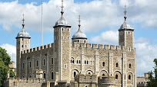
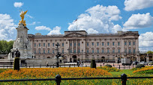
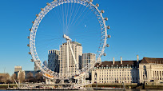
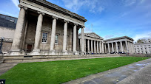
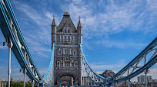
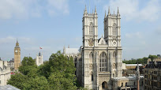
CITY ATTRACTIONS
Tower of London
Buckingham Palace
London Eye
The British Museum
Tower Bridge
Westminster Abbey

