Slide 1

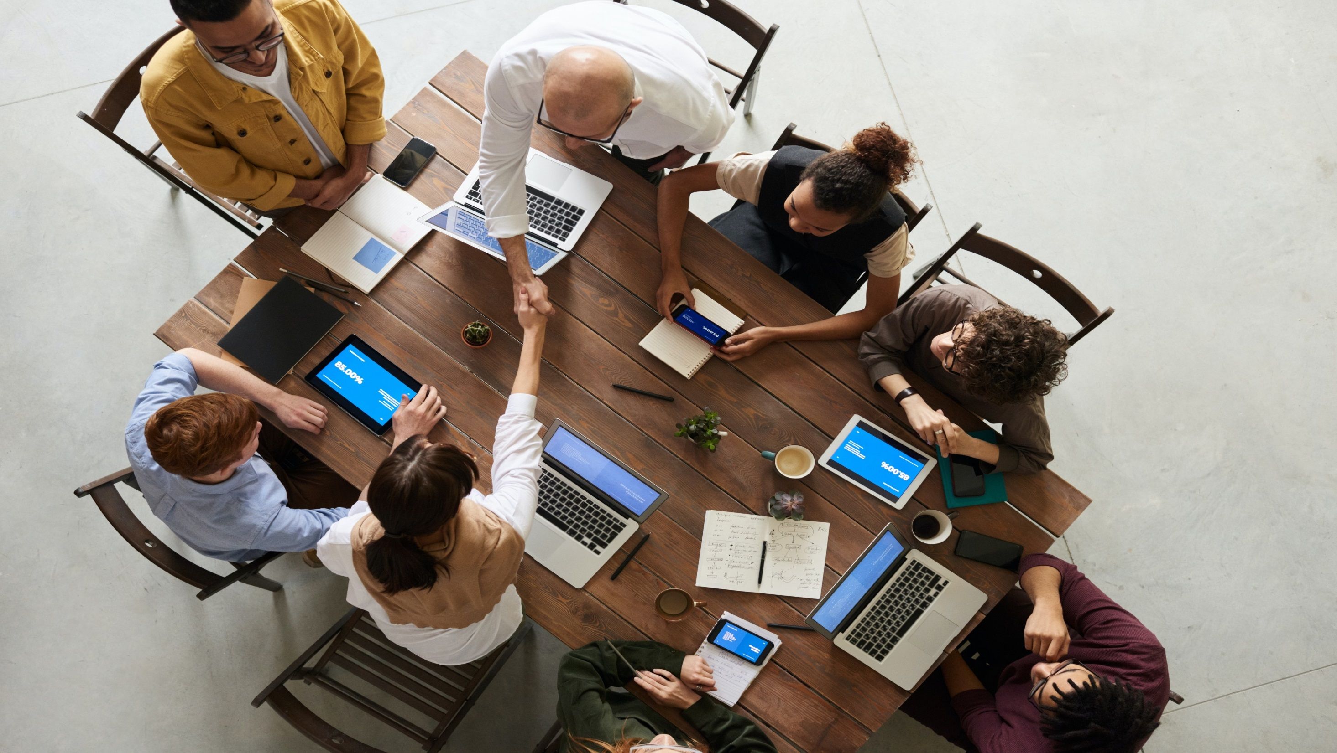
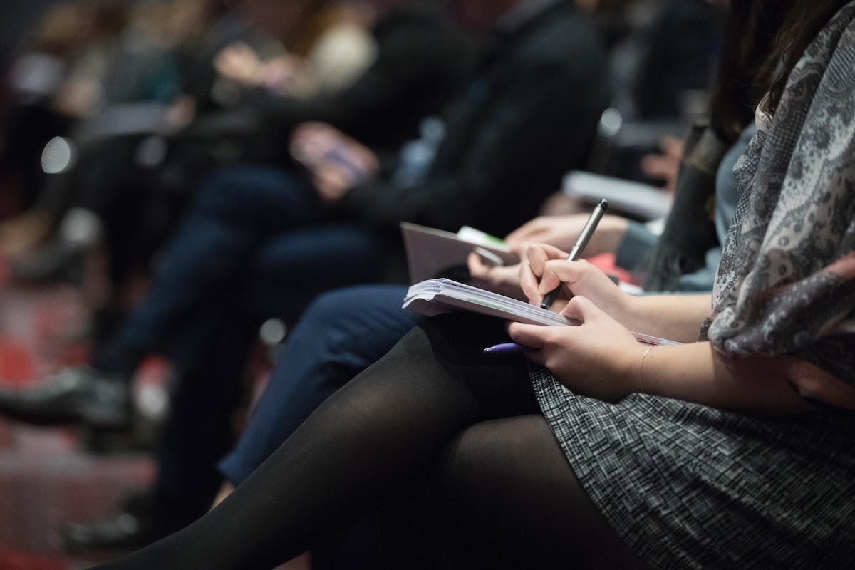
16th International Conference on
Neurology and Neuromuscular Disorders
January 25-26, 2024 London, UK
Theme:
"New model to diagnose neurological and neuromuscular disorders"
NEUROLOGY 2024
MAIL: : neuromuscular@speakermeeting.com
URL: https://neuromuscular.neuroconferences.com/

Slide 2
REGISTRATION & TIMINGS
August 09, 2023 (8:00AM to 6:00PM)
August 10, 2023 (8:00AM to 6:00PM)
GROUP PHOTO TIME
10:45 AM - 10:50 AM; August 09, 2023
NEUROLOGY 2024
Barcelona, Spain
Please try your best to attend the Conference. If you could not attend, please let us know at neuromuscular@speakermeeting.com
https://virology.infectiousconferences.com/

Slide 3
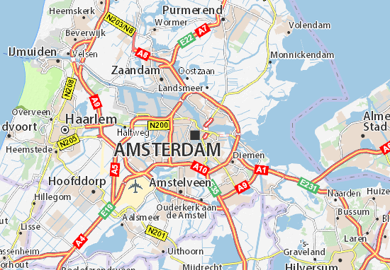
London, UK
VENUE
London, UK
NEUROLOGY 2024
SPEAKERS’ PPT
You may submit your presentation to any of our onsite organizers on the day of your talk. If your presentation is not compatible with our laptops, then you may use your own laptop.
To Register Online, Please visit
https://neuromuscular.neuroconferences.com/

