Slide 1


16th International Conference on
Neurology and Neuromuscular Disorders
January 25-26, 2024 London, UK
Theme:
"New model to diagnose neurological and neuromuscular disorders"
NEUROLOGY 2024
MAIL: neuromuscular@speakermeeting.com
URL: https://neuromuscular.neuroconferences.com/

Slide 2
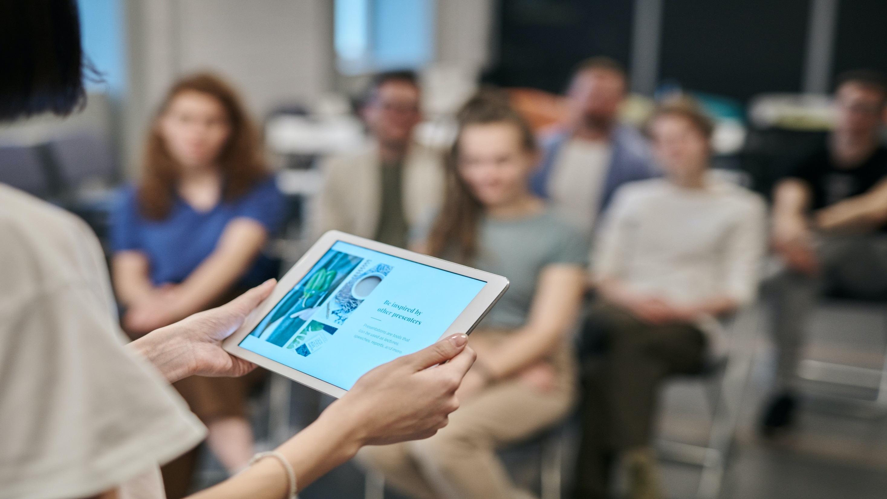

INVITATION
Dear Attendees,
Conference Series LLC LTD welcomes you to attend the 16th International Conference on Neurology and Neuromuscular Disorder which is going to be held on January 25-26, 2024 London, UK We cordially invite all the participants who are interested in sharing their knowledge and research in the area of Neurology. anticipates more than 100 participants around the globe with thought provoking keynote lectures, oral and poster presentations. The attending delegates include editorial board members of related open access journals. This is an excellent opportunity for the delegates from universities, institutes, and industries to interact with the world class scientists. The intending participants can confirm their participation by registering for the conference along with your colleagues. Avail the delegate early bird offer. The main theme of the conference is "New model to diagnose neurological and neuromuscular disorders "As the premier event, we have developed a program with your interests in mind.
We have not only increased the number of opportunities for you to network with colleagues from across the world but also introduced more focused sessions that will feature cutting edge presentations, special panel discussions, and livelier interaction with industry leaders and experts. Life is full of give and take. Make it count in your professional life. Attend Neurology 2024 to network with your peers, exchange expertise and experiences, and arm yourself with the latest information to take your department to the next level. We look forward to personally welcoming you to Conference this January.
Sincerely,
Organizing Committee
Neurology 2024.
https://neuromuscular.neuroconferences.com/

Slide 3


ABOUT US
Our International Open Access Journals
Salient Features
700+ Leading-edge Peer Reviewed Open Access Journals
21 Day Rapid Review Process
50000+ Editorial Board Team, 35000+ Reviewers team
30 Million Readers and High Visibility
1000+ Scientific Associations Collaborations
100000+ Facebook Likes
Publication immediately after acceptance
Quality and Quick editorial, review processing
Easy to Submit and Review Systems
High Quality and Fast Publishing Guaranteed
Unbiased, quality-oriented, and transparent reviews
Truly impartial recognition of the best papers
Feedback on the impact of every article
Enhanced feature: Audio version of published paper
Digital articles to share and explore
Sharing option: Social networking enabled
Authors, reviewers and editors are provided with scientific credits
User friendly/feasible website articles translations across more than 50 world languages
Robust on-line publicity for all the speakers and organizing committee members
Career Guidance Workshops for students and early career researchers
Accepted Abstracts will be published in various indexed journals
Accepted abstracts will be labeled with a Digital Object Identification Number (DOI) provided by Cross Ref
Creation of speakers and abstracts pages in Google
Opportunity to publish full Manu Scripts in our Open Access Journals Special
Our International Scientific Conferences
More than 3000 Conferences happening across the globe
Conferences organized in Medical, Pharma, Engineering, Science, Technology and Business.
CME/CPD Accredited Conferences fostering professional and Personal development
Continuum of education through organized scientific program
Renowned speakers and scientists representing from 40 countries
Highly Interactive sessions and Panel Discussions
B2B Meetings offers perfect platform for Global Networking
Special Issues : All accepted abstracts will be
published in respective UK: Conference Series LLC Ltd Journals
Each abstract will be provided with digital Object Identifier by
https://neuromuscular.neuroconferences.com/

Slide 4

Neurology 2023 , The main objective is to bring all the leading academic scientists, researchers and research scholars together to exchange and share their experiences and research results about all the aspects of Neurology. It also provides the premier interdisciplinary forum for researchers, practitioners and educators to present and discuss the most recent innovations, trends, and concerns, practical challenges encountered and the solutions adopted in the field of Virology. The conference program will cover a wide variety of topics relevant to the Neurology, adsorption and partition Neurology and so on. This unique opportunity that we extend to our speakers and attendees is not being offered by any other conference organizers. Through this the abstracts and research profiles of our speakers and organizing committee members getting global visibility which is an additional feature that you would be receiving in addition to networking opportunities before, during and after the conference.
NEUROLOGY 2024 SALIENT FEATURES
Meet academia and industry visionaries to get inspired
Expand your knowledge and find solutions to problems
Knowledge, benchmarking and Networking offered at one place
Forge connections and for global networking
Highly organized and structured scientific programs
Poster presentations and world class exhibitions
Meet with new vendors and suppliers
ABOUT CONFERENCE
HOW CONFERENCE SERIES CONFERENCES DIFFERS FROM OTHERS?
3000+ Conferences across the globe in 30+ countries all through the year
Over 25 million+ visitors and 20000+ unique visitors per conference
Participation by Stalwarts from various international societies
Internationally renowned speakers and scientists representation
Career guidance for early career researchers and students
Interesting scientific deliberations and discussions
Perfect platform for global networking
GOALS
The conference program emphasizes evidence-based practice, educational innovation, practical application, and peer to peer networking and collaboration. The goal of the conference is to provide a transformative professional development experience.
Bringing together the world’s scientific experts to catalyze and advance scientific knowledge about food safety and regulatory measures present the most recent research findings, and promote and enhance scientific collaborations around the world.
Bringing together community leaders, scientists, and policy leaders to promote and enhance programmatic collaborations to more effectively address regional, national and local responses to elderly population around the world and overcome barriers that limit access to care and services.
https://neuromuscular.neuroconferences.com/

Slide 5

GOALS
After participating in this meeting, attendees should be able to
Discuss emerging issues in the field of mass spectroscopy
Discuss and apply recent research findings related to chromatography
Reflect on the place of critical distance in chromatography
WHO SHOULD ATTEND
16th International Conference on Neurology and Neuromuscular Disorders, Conferences are exclusively designed for is exclusively designed for Our point is to the corporate network and to make a stage for the trading of data on innovative advancements, new logical modernization and the viability of different administrative projects towards Neurology 2024. likewise centers around a wide assortment of momentum look into on sanitation and wellbeing that have both useful and pernicious impacts on the security and nature of nourishments, and are along these lines a worry of general wellbeing.
ABOUT HOSTING ORGANIZATION
ABOUT CONFERENCE
Conference Series is the world’s leading specialist in organizing Academic, Scientific and Business conferences, meetings, symposiums and exhibitions in different verticals and horizontals like Medical, Pharma, Engineering, Science, Technology and Business to promote scientific research. Every year we host more than 3000+ global events inclusive of 1000+ Conferences 1000+ Symposiums 1000+ Workshops in USA, Europe, Middle East and Asia with the generous support and cooperation from our 30000 + Editorial Board Members, 1000+ Scientific Societies. All the conference proceedings are published in the special issues of our 700+ Open Access International Journals with the DOI provided by
PARTICIPATION OPTIONS
Speaker (special session): 45-50 minutes (more than 1 can present)
Speaker (symposium): more than 45 minutes (more than 1 can present)
Delegate(only registration): will have access to all the sessions with all the benefits of registration
Poster presenter: can present a poster and enjoy the benefits of delegate
Remote attendance: can participate via video presentation or e-poster presentation
Exhibitor: can exhibit his/her company’s products by booking exhibitor booths of different sizes
Media partner
Sponsor
Collaborator
For more details about each mode, kindly contact: mailto:massspectrometrycongress@globalannualsummit.com
https://neuromuscular.neuroconferences.com/

Slide 6
PARTICIPATION BENEFITS
paediatric Neurology
Psychosomatic Disorders
Neurology
Neuromuscular Disorders
Neurosurgery
Neurological manifestation in covid-19
Neurological diseases in COVID 19
Psychiatry and Psychology
Spine and Spinal Disorders
Neurological infections
Paediatric Neuromuscular disorder
Muscular Dystrophy
Autoimmune Neuromuscular disorder
Neuropsychology and Neuro rehabilitation
Neuroplasticity
Brain Tumour and Neuro-oncology
Neuroradiology
Neuromuscular respiratory
Neuro Therapeutics, Diagnostics and Case Studies
Nursing and Neuroscience
Neuropharmacology
Attend Keynote Presentation by world’s most eminent researchers
Access to all the sessions
Get OCM certificate
Get worldwide acknowledgment to your profile and Research
Get your abstracts published with unique DOI in International Journals
Get up to 50% discounts for publishing your entire article in our open access International Journals
Get Handbooks and conference kits
Get an access to the network with eminent personalities from worldwide
ABOUT CONFERENCE
MAJOR SESSIONS
ABSTRACT SUBMISSION
https://neuromuscular.neuroconferences.com/abstract-submission.php
https://neuromuscular.neuroconferences.com/

Slide 7
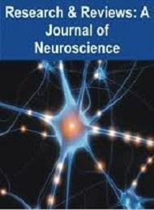
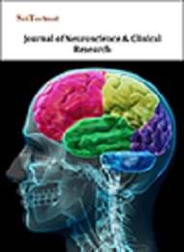
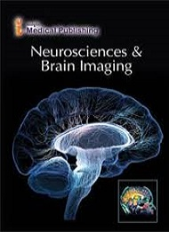
SUPPORTING JOURNALS
Research & Reviews:Neuroscience
URL:https://www.rroij.com/neuroscience.php
Journal of Neuroscience & Clinical Research
URL:https://www.scitechnol.com/journal-of-neuroscience-and-clinical-research.php
Neurosciences & Brain Imaging
URL:https://www.primescholars.com/neurosciences-brain-imaging.html
https://neuromuscular.neuroconferences.com/

Slide 8
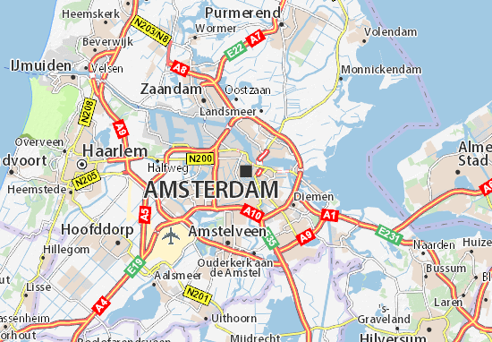
VENUE & ACCOMMODATION
London, UK
VENUE AND ACCOMODATION
CONTACT US
Charlie Sterling
Program Manager | Neurology 2024
UK: Conference Series LLC Ltd
E: neuromuscular@speakermeeting.com
W:https://neuromuscular.neuroconferences.com/registration.php
WhatsApp no. +44-7360516157
https://neuromuscular.neuroconferences.com/

Slide 9
Only Registration: $ 699
Package A (Registration + 2 nights Accommodation): $ 1199
Package B (Registration + 3 nights Accommodation): $ 1349
ACADEMIC
Only Registration: $ 799
Package A (Registration + 2 nights Accommodation): $ 1299
Package B (Registration + 3 nights Accommodation): $ 1349
BUSINESS
Student Oral: $ 249
Student Poster: $ 349 ($249 + $100) for Poster
Student Delegate: $ 199
E-poster: $ 99
REGISTRATIONS
STUDENT
IMPORTANT DATES
Abstract submission opens: Sep 1, 2023
Registration Opens: Sep 1,2023
Early Bird Registration: Sep 30, 2023
Mid Date Registration: Oct 30, 2023
On Spot Registration: Jan 25, 2024
https://neuromuscular.neuroconferences.com/

