Slide 1




41th GLOBAL NANOTECHNOLOGY CONGRESS
April 11 – 12 , 2024 Amsterdam, Netherlands
Theme: Endless possibilities with nanotechnology conference.
VIROLOGY 2023
MAIL: : easypharma29@gmail.com
URL: : https://nanotechnology.nanotechconferences.org

Slide 2
REGISTRATION & TIMINGS
April 11, 2024 (8:00AM to 6:00PM)
April 12, 2024 (8:00AM to 6:00PM)
GROUP PHOTO TIME
10:45 AM - 10:50 AM;April 11, 2024
NANOTECHNOLOGY 2024
Amsterdam , Netherland
Please try your best to attend the Conference. If you could not attend, please let us know at virologycongress@meetingsnexpo.com
: https://nanotechnology.nanotechconferences.org /

Slide 3
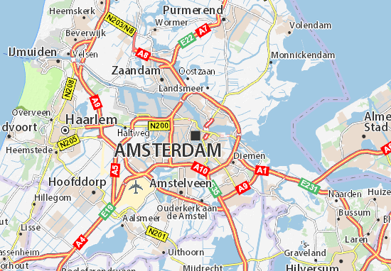
VENUE
Amsterdam, Netherlands
NANOTECHNOLOGY 2024
SPEAKERS’ PPT
You may submit your presentation to any of our onsite organizers on the day of your talk. If your presentation is not compatible with our laptops, then you may use your own laptop.
To Register Online, Please visit
: https://nanotechnology.nanotechconferences.org

