Slide 1
5th International Conference on
Infectious Diseases: Control and Prevention
Webinar, May 24, 2021
Anionic polymers and photoactive coatings to prevent pathogen transmission via fomites
Frank Scholle
Associate Professor

Slide 2
The Unmet Need for Antimicrobial Materials
Photoactive compounds
Explain challenges in diagnosing Urinary Tract Infection (UTI) in older adults
Clostridioides difficile infection
Faecal microbial transplantation (FMT)
Saprochaete clavata

Slide 3
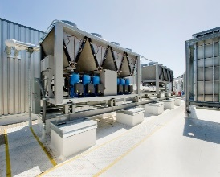

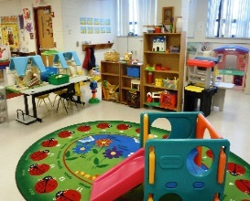
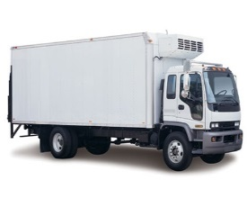
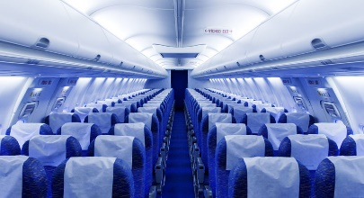
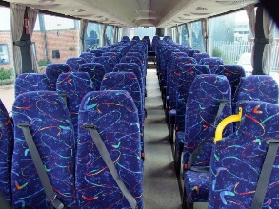
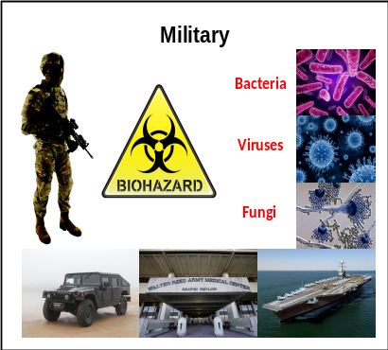
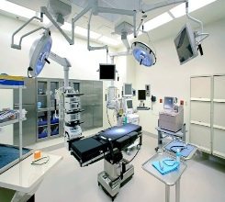
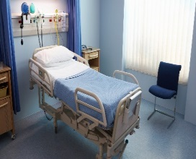



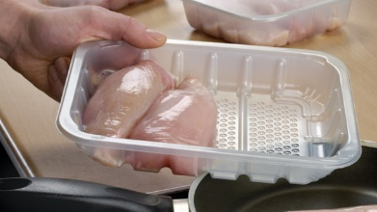
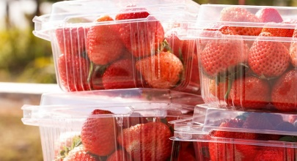

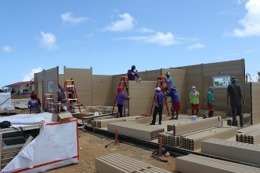
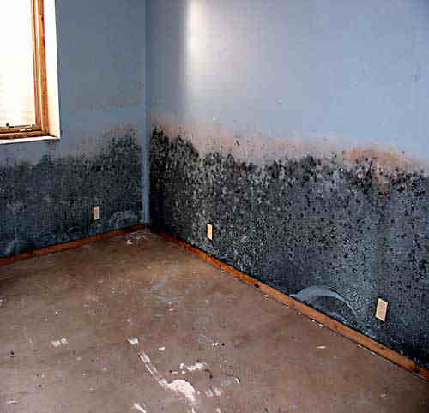
Markets for Antimicrobial Coatings & Additives
Indoor air/HVAC
Transportation
Medical
Textiles (odor control)
Food & Beverages
Building & Construction

Slide 4
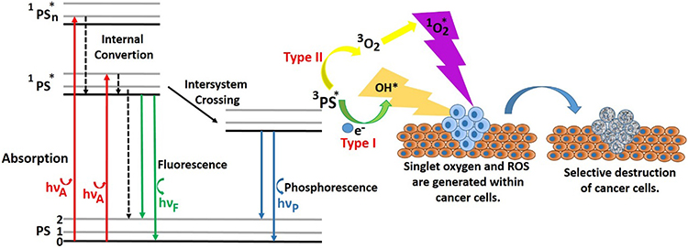
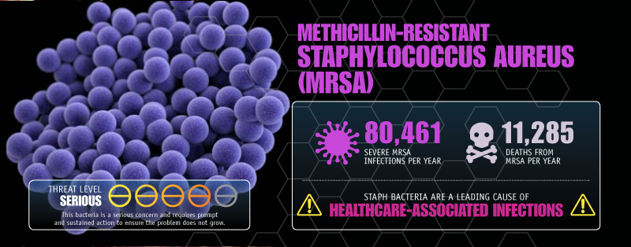
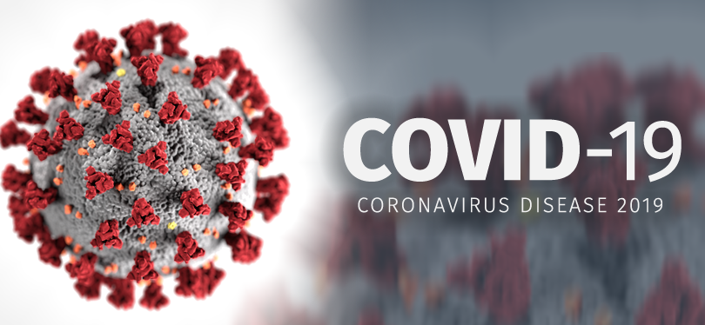
Photoactive compounds
Photosensitizers: Methylene Blue, Rose Bengal, Cucurmin, Porphyrins and many more

Slide 5
Virus Inactivation
Temperature
Humidity
pH
Detergents
Oxidation
Metal ions
Radiation
Damage to particle
Damage to genome

Slide 6
Diagnosis Resulting in an Antibiotic Order

Slide 7
Pattern of Antibiotic Use: Location of Initiation
Location of Initiation | Number | %
Geri-Psych (GPU) | 57 | 49.6
Emergency Department (ED) | 22 | 19.1
¹GPU + ED | 8 | 6.9
²Other | 28 | 24.3
1 GPU + ED= Two different antibiotics started in each location
2 Includes other units, PCPs, other hospitals, LTC

Slide 8
Classes of Antibiotics Used in Urinary tract Infection & Respiratory Tract Infections

Slide 9
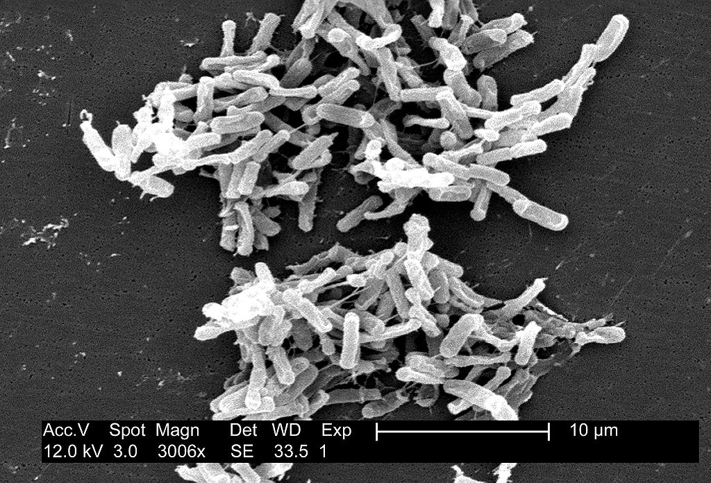
Clostridioides difficle
Obtained from the CDC Public Health Image Library. Image credit: CDC/ Lois S. Wiggs (PHIL #6260), 2004.
Sporulating Gram positive anaerogic rod
Part of large intestine flora of 5% adults and up to 70% of infants

Slide 10
FMT failure
Recurrence of CDI despite the successful FMT procedure
5 to 20% of all patients experiences recurrences in 2 months following FMT
Mechanisms of FMT failure are poorly understood
Study to identify risk factors of FMT failure
Hypothesis: advancing age and comorbid status of patients contributes to the declining success rate
Study patients: Patient with CDI which experienced recurrence after standard therapy by vancomycin
Procedure: FMT of fresh stool from a healthy donor by retention enema
Follow up for 12 weeks

Slide 11
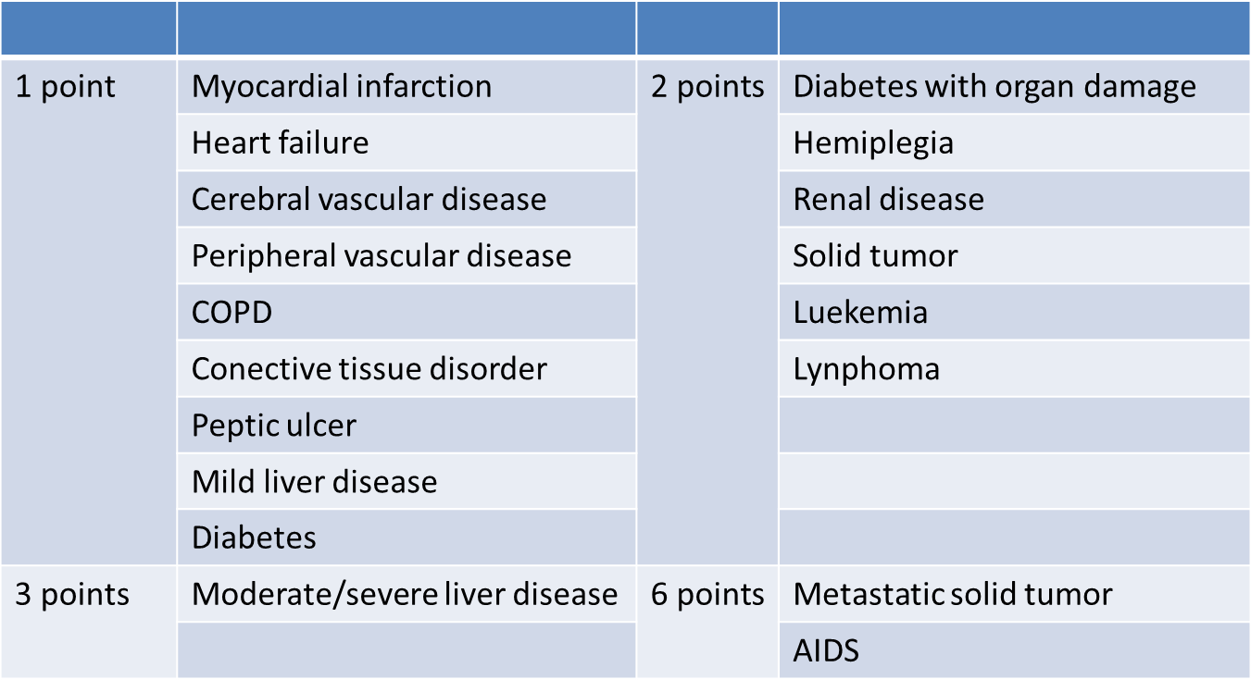
Charlson Comorbidity Index (ChCI)
Age: for each decade after 40, 1 point is added

Slide 12
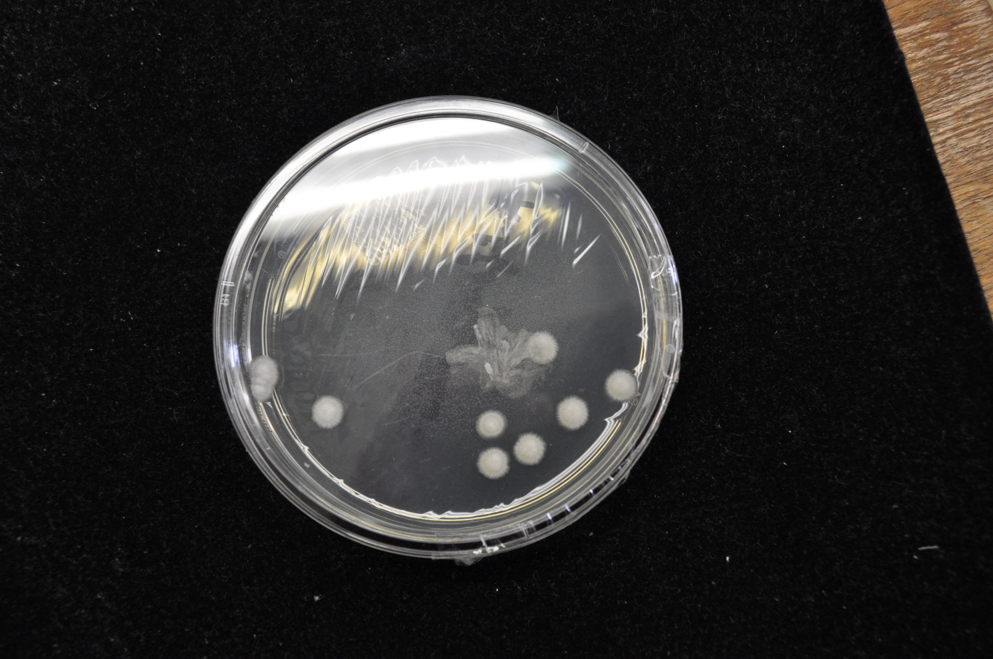
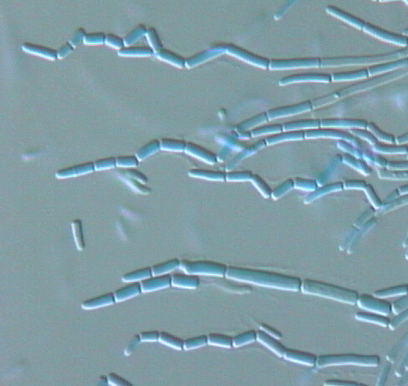
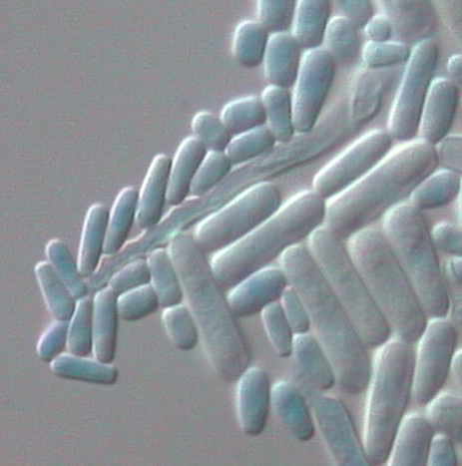
Saprochaete clavata
Ascomycetous yeast-like, Saccharomycetales, Dipodascaceae (1986¹)
Synonyms : Geotrichum clavatum, Magnusiomyces clavatus²
Hyaline hyphae disarticulated in arthroconida
Elongate blastoconidia
¹ de Hoog et al., 1986,Studies in Mycology,² de Hoog et al., 2018, JCM

Slide 13
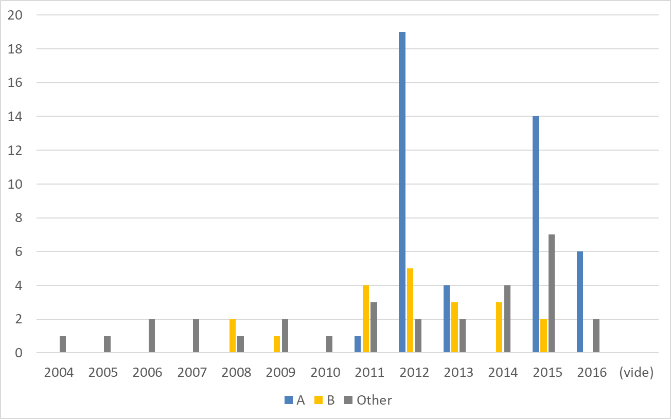
Retro and prospective monitoring of clades A and B
no clade B in Europe and 1 clade A in Belgium in 2016 => Geographic specificity?
French isolates
    Clade B: 3 before outbreak, 2 during and 11 after.
    Clade A: 1 before; 24 after with a new cluster in 1 hospital.

Slide 14
Pandemics
SARS
770
MERS 850
Ebola 11000
COVID-19
?
Smallpox
56 million
Spanish flu
40-50 million
HIV
35 million

Slide 15
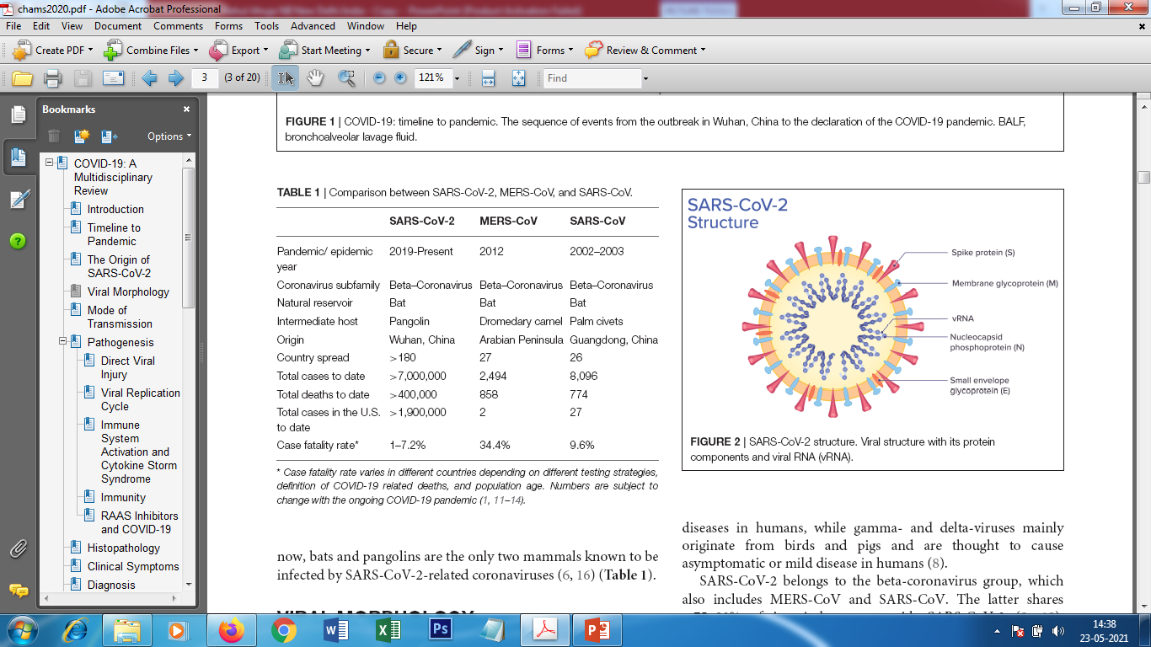
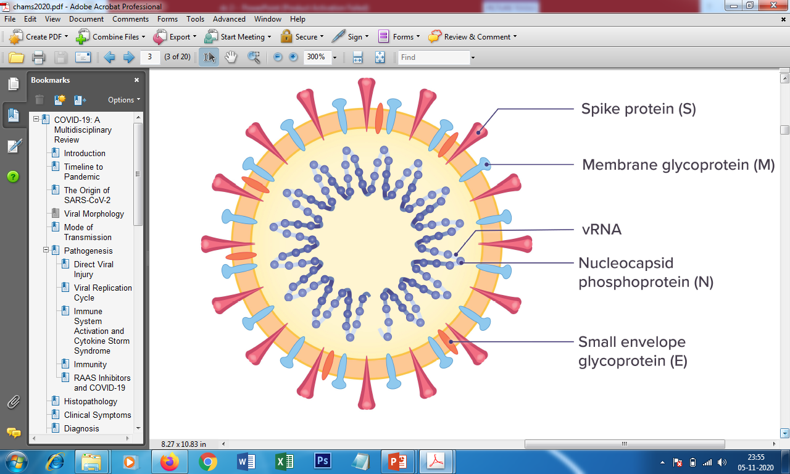
The Current Pandemic: COVID-19
Previous Epidemics
SARS-CoV-2 structure

