Slide 1
5th International Conference on
Infectious Diseases: Control and Prevention
Webinar, May 24, 2021
Anionic polymers and photoactive coatings to prevent pathogen transmission via fomites
Frank Scholle
Associate Professor

Slide 2
Outline
The Unmet Need for Antimicrobial Materials
Photoactive compounds
Explain challenges in diagnosing Urinary Tract Infection (UTI) in older adults
Clostridioides difficile infection
Faecal microbial transplantation (FMT)
Saprochaete clavata
Leishmmaniasis

Slide 3
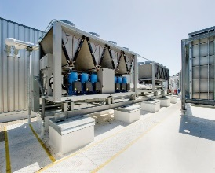

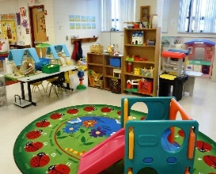
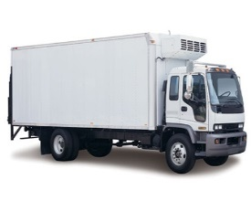
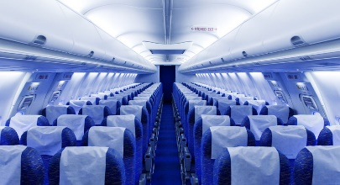
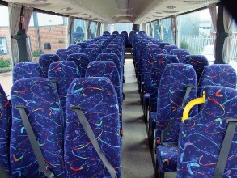
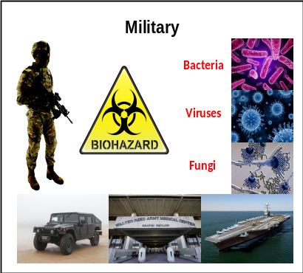
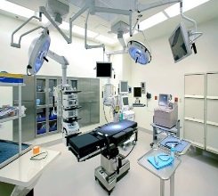
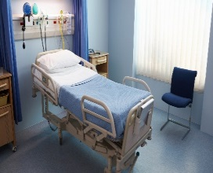



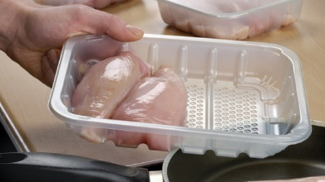
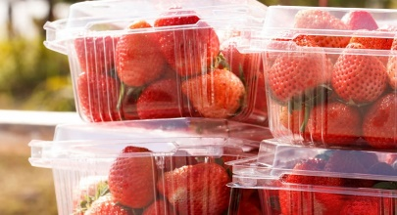

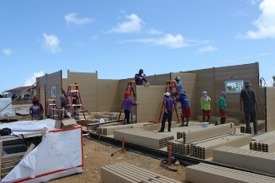
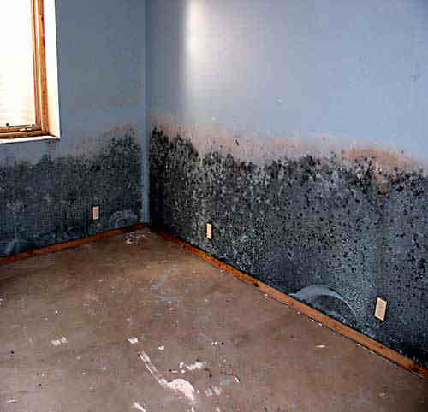
Markets for Antimicrobial Coatings & Additives
Indoor air/HVAC
Transportation
Medical
Textiles (odor control)
Food & Beverages
Building & Construction

Slide 4
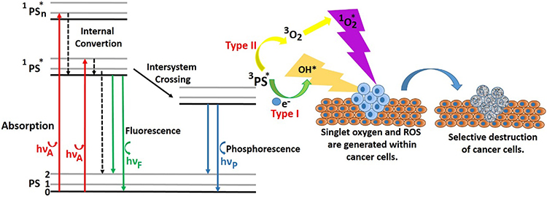
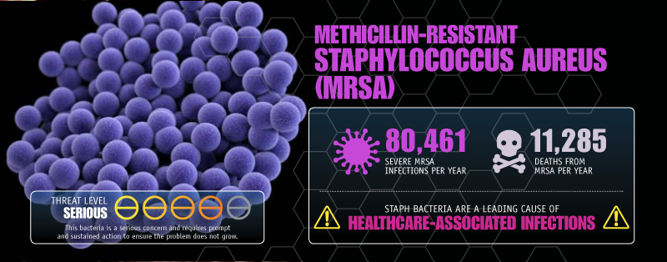
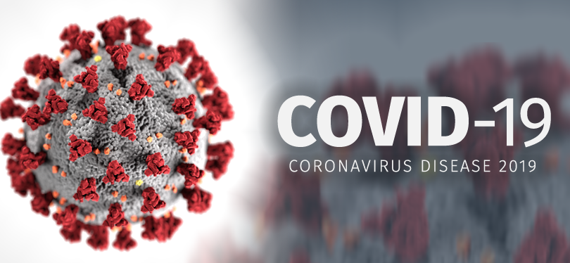
Photoactive compounds
Photosensitizers: Methylene Blue, Rose Bengal, Cucurmin, Porphyrins and many more

Slide 5
Virus Inactivation
Temperature
Humidity
pH
Detergents
Oxidation
Metal ions
Radiation
Damage to particle
Damage to genome

Slide 6
Diagnosis Resulting in an Antibiotic Order

Slide 7
Pattern of Antibiotic Use: Location of Initiation
Location of Initiation | Number | %
Geri-Psych (GPU) | 57 | 49.6
Emergency Department (ED) | 22 | 19.1
¹GPU + ED | 8 | 6.9
²Other | 28 | 24.3
1 GPU + ED= Two different antibiotics started in each location
2 Includes other units, PCPs, other hospitals, LTC

Slide 8
Classes of Antibiotics Used in Urinary tract Infection & Respiratory Tract Infections

Slide 9
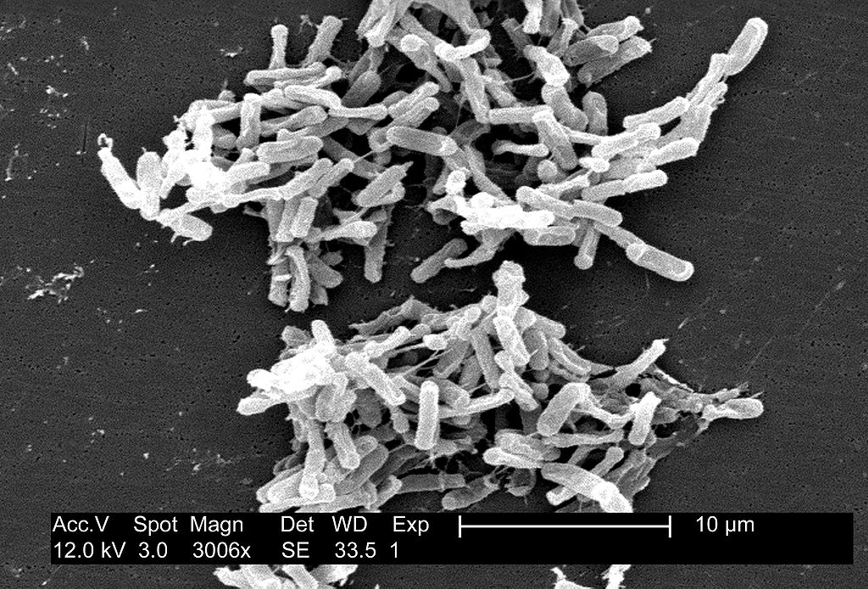
Clostridioides difficle
Obtained from the CDC Public Health Image Library. Image credit: CDC/ Lois S. Wiggs (PHIL #6260), 2004.
Sporulating Gram positive anaerogic rod
Part of large intestine flora of 5% adults and up to 70% of infants

Slide 10
FMT failure
Recurrence of CDI despite the successful FMT procedure
5 to 20% of all patients experiences recurrences in 2 months following FMT
Mechanisms of FMT failure are poorly understood
Study to identify risk factors of FMT failure
Hypothesis: advancing age and comorbid status of patients contributes to the declining success rate
Study patients: Patient with CDI which experienced recurrence after standard therapy by vancomycin
Procedure: FMT of fresh stool from a healthy donor by retention enema
Follow up for 12 weeks

Slide 11
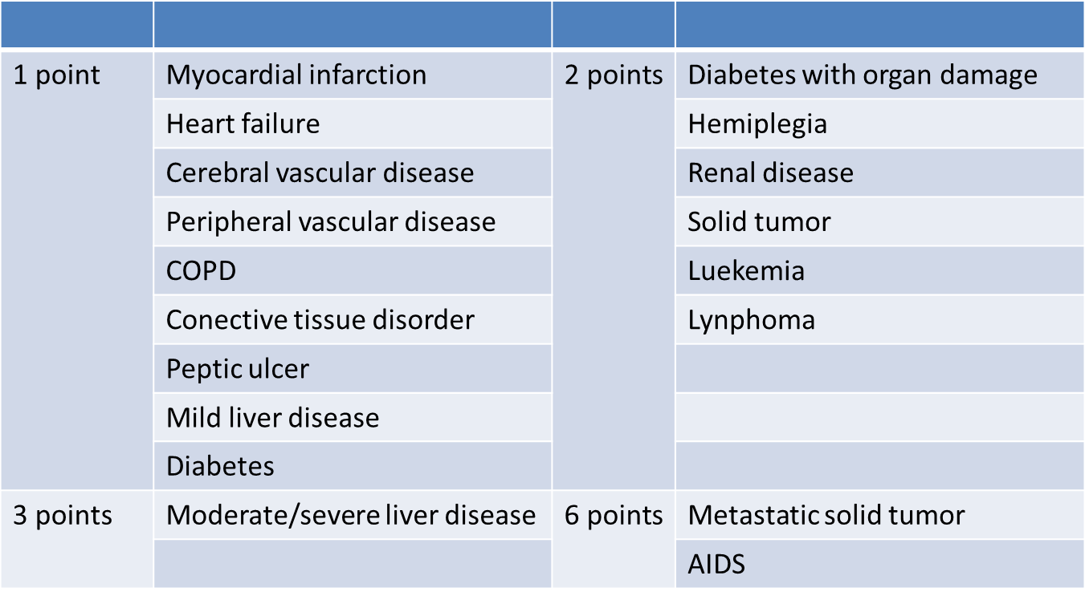
Charlson Comorbidity Index (ChCI)
Age: for each decade after 40, 1 point is added

Slide 12
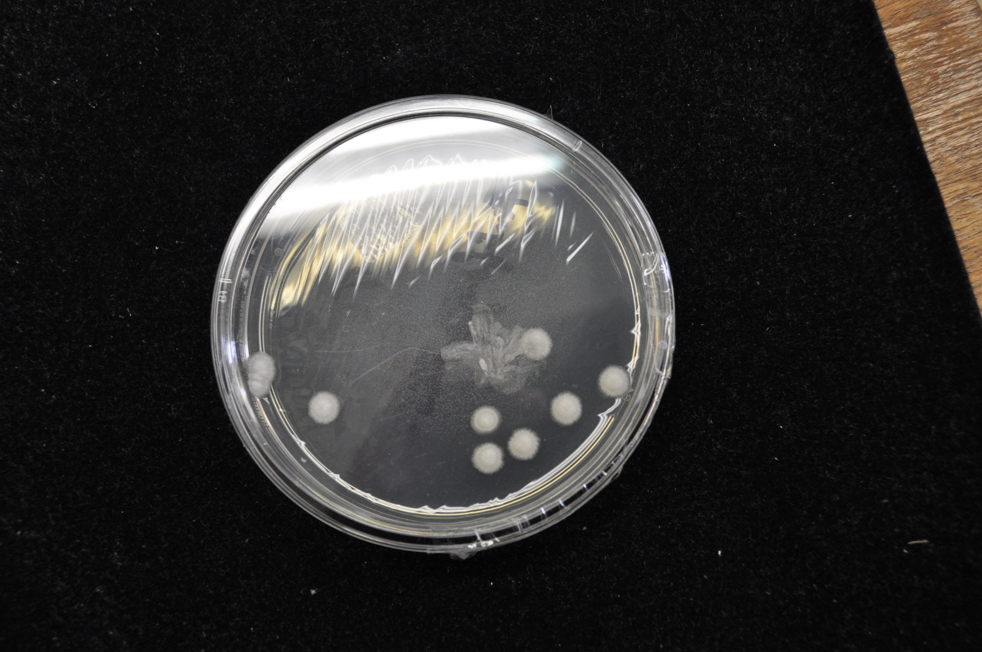
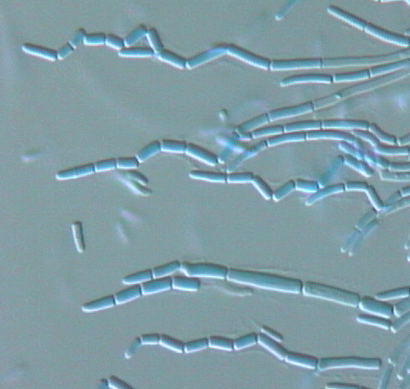
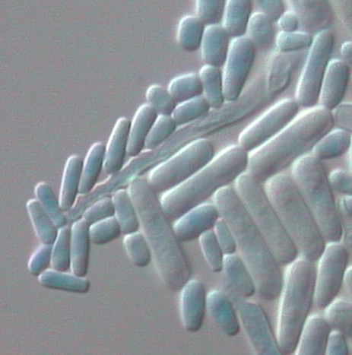
Saprochaete clavata
Ascomycetous yeast-like, Saccharomycetales, Dipodascaceae (1986¹)
Synonyms : Geotrichum clavatum, Magnusiomyces clavatus²
Hyaline hyphae disarticulated in arthroconida
Elongate blastoconidia
¹ de Hoog et al., 1986,Studies in Mycology,² de Hoog et al., 2018, JCM

Slide 13
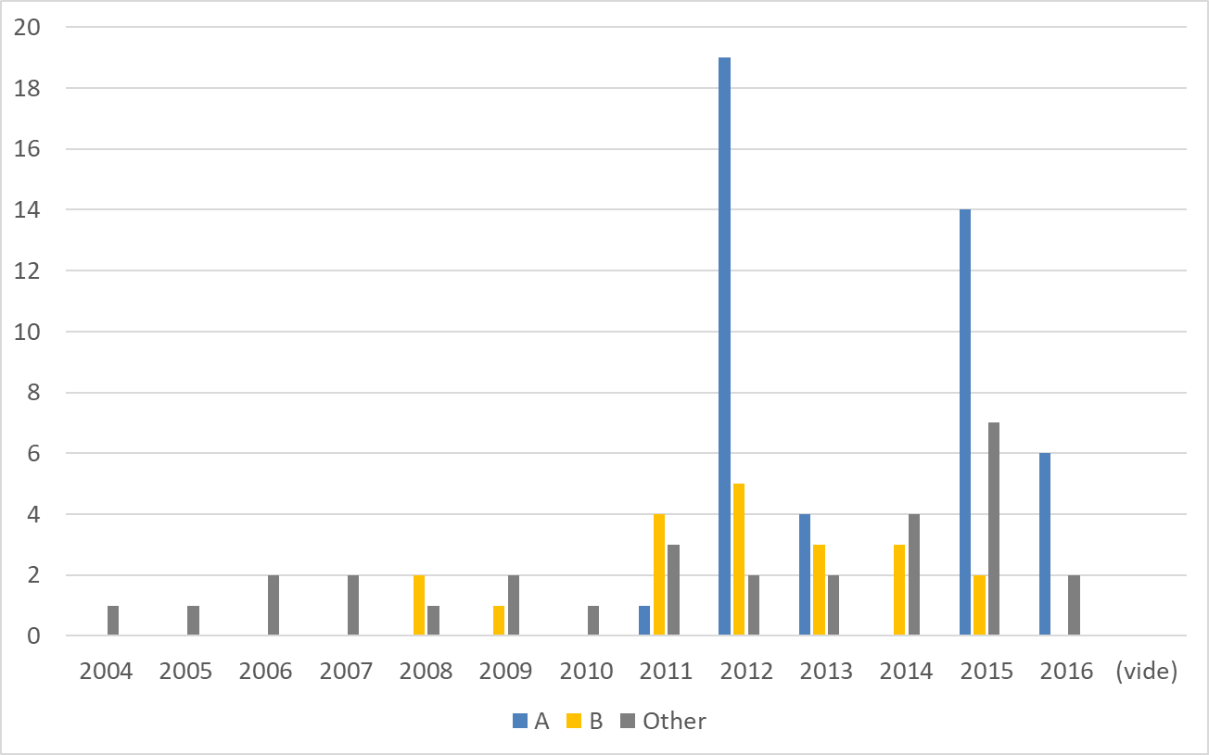
Retro and prospective monitoring of clades A and B
no clade B in Europe and 1 clade A in Belgium in 2016 => Geographic specificity?
French isolates
    Clade B: 3 before outbreak, 2 during and 11 after.
    Clade A: 1 before; 24 after with a new cluster in 1 hospital.

Slide 14
Pandemics
SARS
770
MERS 850
Ebola 11000
COVID-19
?
Smallpox
56 million
Spanish flu
40-50 million
HIV
35 million

Slide 15
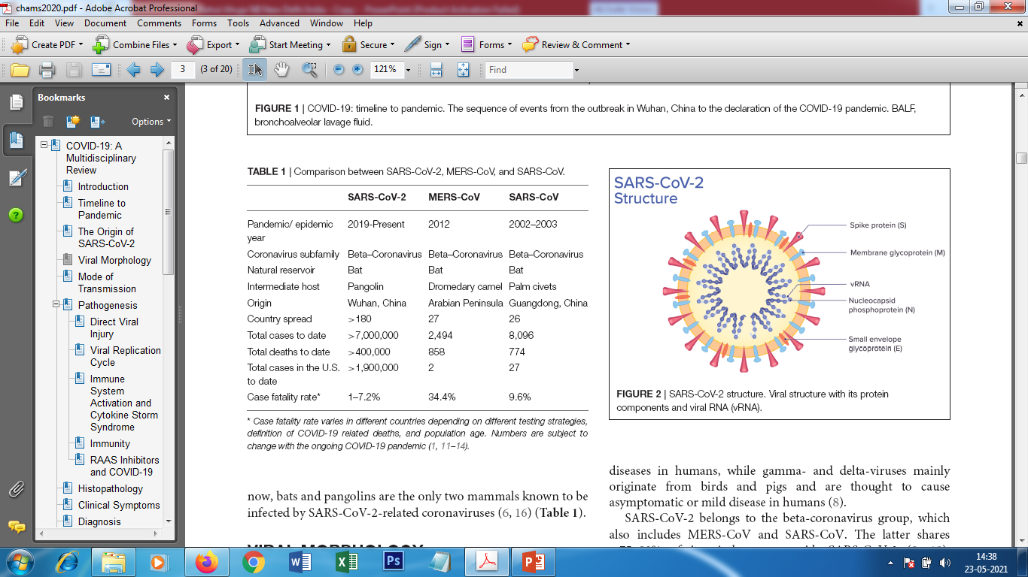
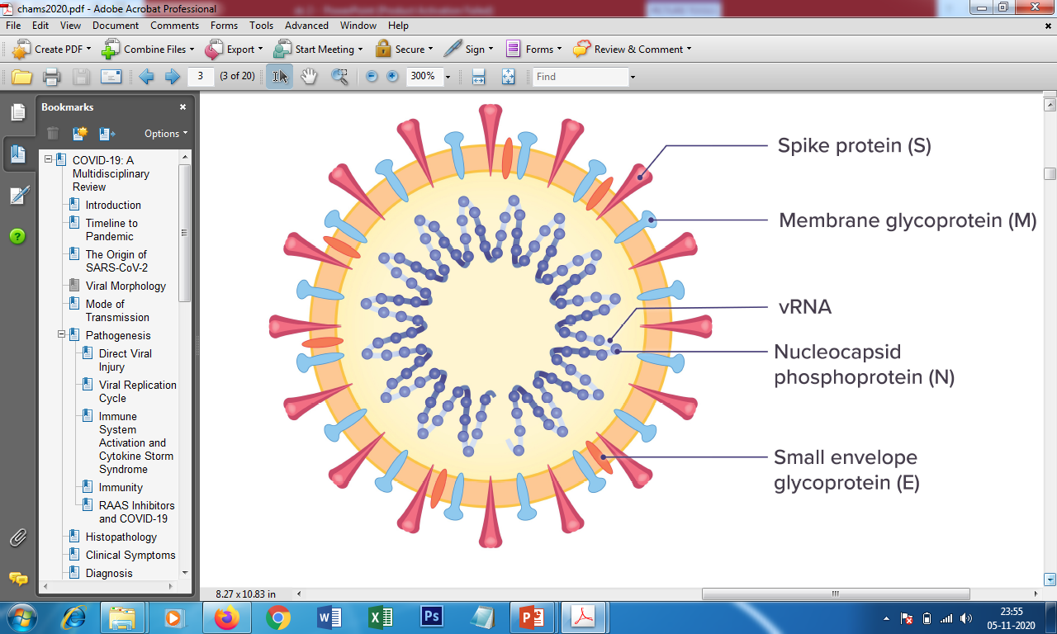
The Current Pandemic: COVID-19
Previous Epidemics
SARS-CoV-2 structure

Slide 16
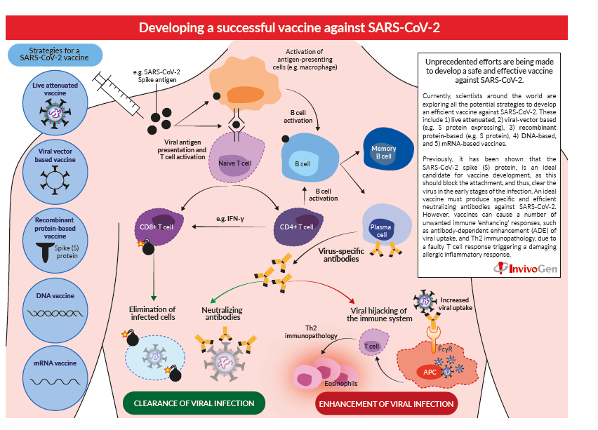

Slide 17
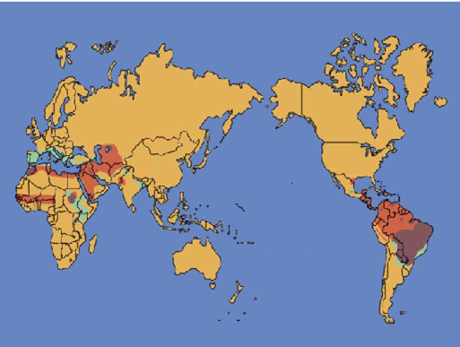
Leishmmaniasis
Leishmaniasis is one of the most neglected health problems in tropical and subtropical regions.
Affect the poorest people
W
O
R
> 12 Million people infected in 102 countries
> 350 Million people are risk
L
Annually, 0.1 million deaths
D

Slide 18
Gender-wise Distribution of CL Infection
Season-Wise Distribution of CL
The highest cases of cl were observed during more temperature months, i.e. summer 47.79% (271/567) (June-September) followed by spring 20.46% (116/567) (March to May), autumn 28.92% (164/567) (october to november) and winter 2.81% (16/567) (December-February
Highest infection rate was observed in males (63.84%) than females (36.16%).

Slide 19
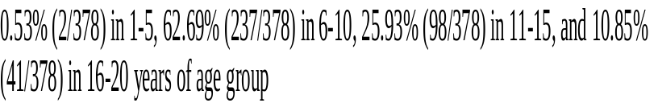
Age-wise Distribution of CL Infection
Distribution of most affected ages 1-20
The most affected age group of CL patients were 1-20 years i.e. 66.67% (378/567) while 23.63% (134/567) was observed in 21-40 years old followed by 9.70% (55/567) in 41-60 years old.

Slide 20
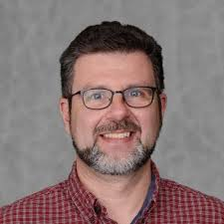
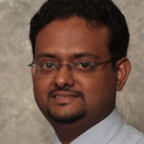
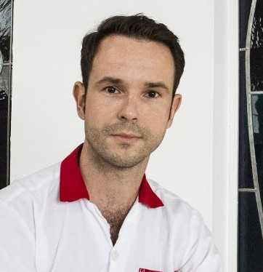
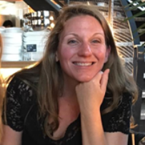
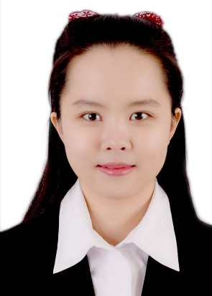
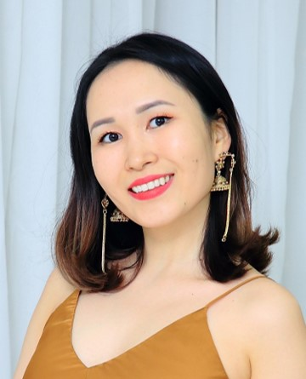
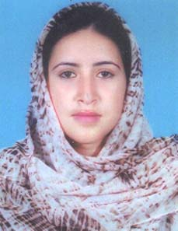
Speakers at Infection Control 2021
Frank Scholle
Rajdip Barman
Peter Sabaka
Marie Desnos-Ollivier
Jiaying Zhu
Saikal Shamkeeva
Nargis Shaheen

Slide 21







Universities

Slide 22
See You Next Year in Person!
At Infection Control 2022

