Slide 1


Theme: Functional Energy Materials for Sustainable Future
Tentative Schedule
Conference Secretariat
2360 Corporate Circle, Suite 400,
Henderson, NV 89074-7722, USA
Tel: +1-888-843-816
Fax: +1-650-618-1417
Email: energymaterials@materialsconferences.org
Website: http://energymaterials.conferenceseries.com

Slide 2









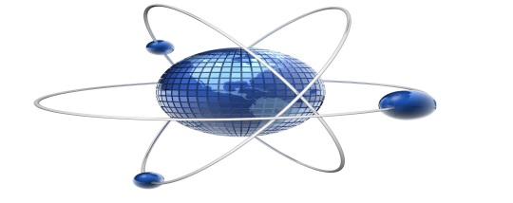
Past Organizing Committee Members
Carlo Montemagno
University of Alberta
Canada
Matthew E Edwards
A A M U
USA
Ramesh K Agarwal
Washington University
USA
Jun Ding
N Univ. of Singapore
Singapore
Samuel Frimpong
M U S T
United States
Past Supporters & Media Partners

Slide 3
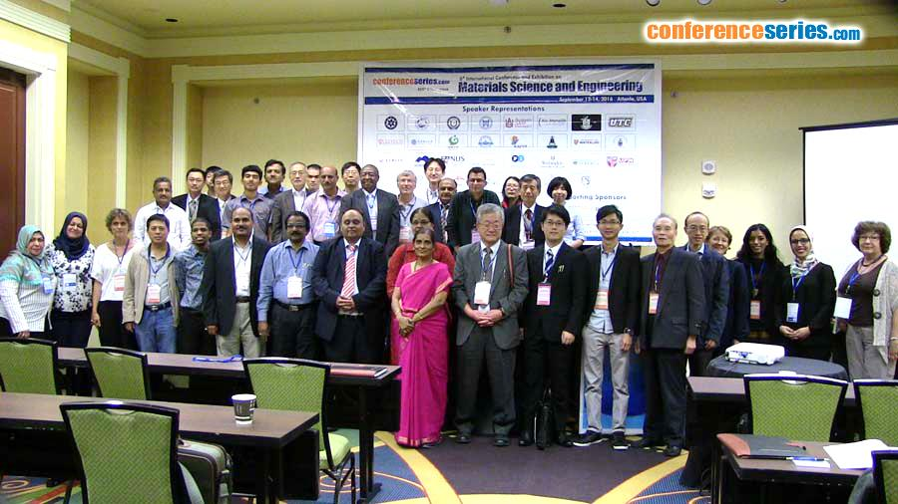
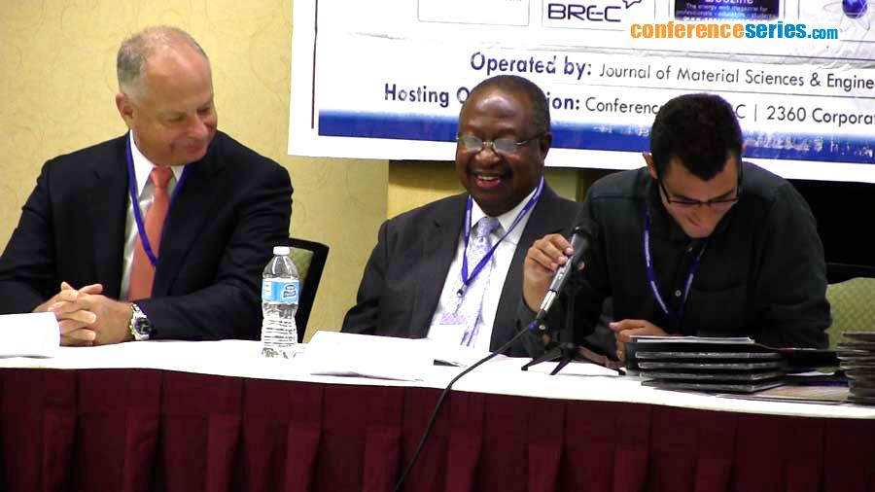
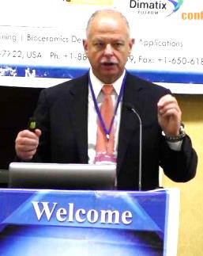
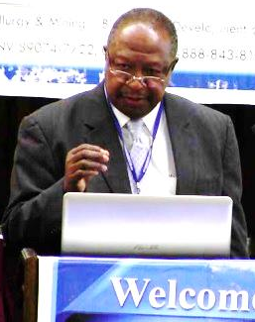
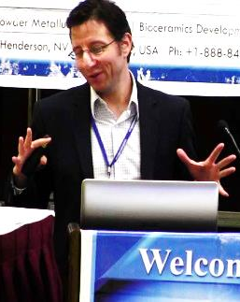
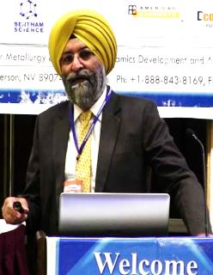
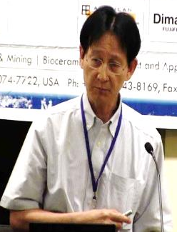
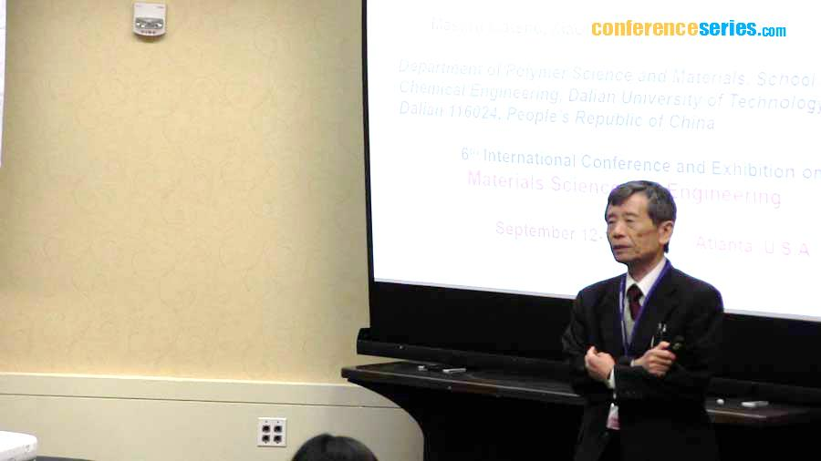
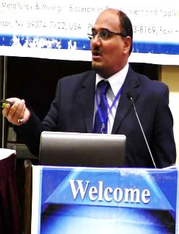
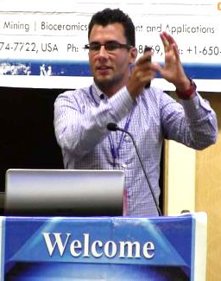
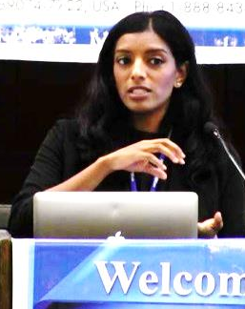
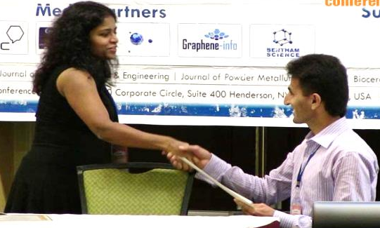
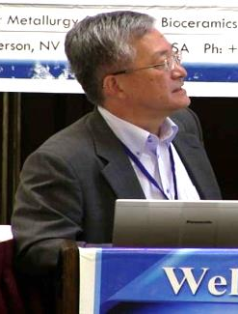
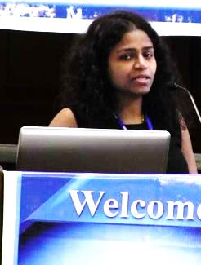
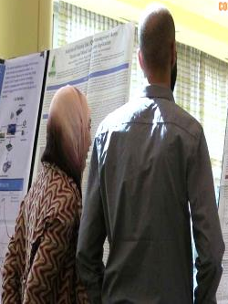
Gallery of Materials Science 2016
For more details, please visit: Past Report | Gallery

Slide 4




Testimonials of Materials Science 2016
The Materials Science Conference was very nice this year, and I plan to attend and participate in the 2017 Conference in Las Vegas.
-Matthew E Edwards, Alabama A&M University, USA
The scientific matters of the speakers were very good in relation to the technology and the quality of most of speakers are good
-Masaru Matsuo, Dalian University of Technology, China
The conference is doing well. The quality of the papers and the international participation is on the rise. The venue and other organizational aspects have been good; thanks to your efforts. I have been participating regularly since the first conference and would continue to do so in years to come.
-Ramesh Agarwal, Washington University in St. Louis, USA
The conference was extremely well-organized and an excellent professional development opportunity in terms of exposure and professional contacts.
-Soubantika Palchoudhury, University of Tennessee, USA

Slide 5
Program at a Glance
Day 1 (Dec 06, 2017)
Reception/Registration |  | 08.00-09.00
Keynote/ Plenary Talks | Time | General Session
 | 09.00-09.15 | Inaugural Address
 | 09.15-10.45 | Keynote/Plenary Talk
Panel Discussions/Group Photo
Coffee/Tea Break 10.45-11.00 (Networking)
11.00-13.00 | Sessions
Lunch Break 13.00-13.30
13.30-15.30 | Sessions
Coffee/Tea Break 15.30-15.45 (Networking)
15.45-17.30 | Sessions
Closing and Memento Presentation to OCM
Day 2 (Dec 07, 2017)
Reception/Registration |  | 08.00-09.00
Keynote/ Plenary Talks | Time | General Session
 | 09.00-10.00 | Keynote/Plenary Talk 1
 | 10.15-10.45 | Keynote/Plenary Talk 2
Panel Discussions
Coffee/Tea Break 10.00-10.15 (Networking)
10.15-13.00 | Sessions
Lunch Break 13.00-13.30
13.30-15.30 | Sessions
Coffee/Tea Break 15.30-15.45 (Networking)
15.45-17.30 | Poster Presentations
Closing and Award Ceremony

Slide 6
Conference Highlights
Functional Energy Materials
Materials for Solar Energy
Nanotechnology and Energy Materials
Superconducting Materials
Energy Storage Materials
Energy Harvesting Materials
Materials for Smart Homes
Materials for Energy Saving and Sustainability
Applications of Functional Energy Materials in Various Fields
Useful Links
Brochure & Contact Details
Call for Abstracts
Abstracts Submission
Registration
E-mail

Slide 7
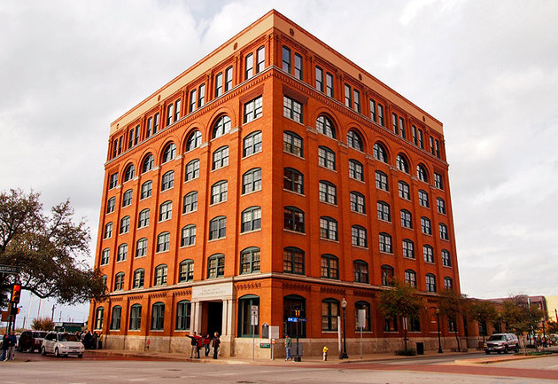
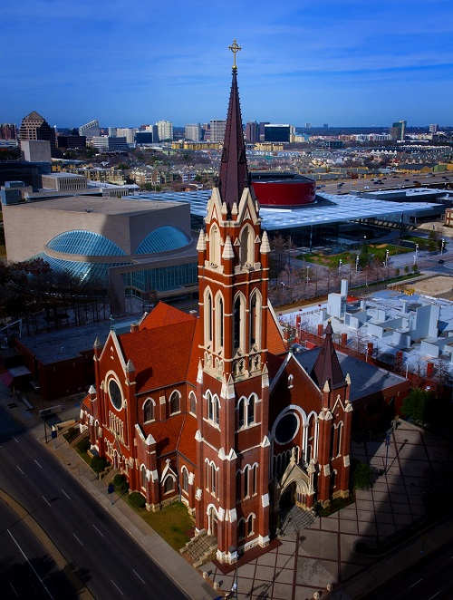
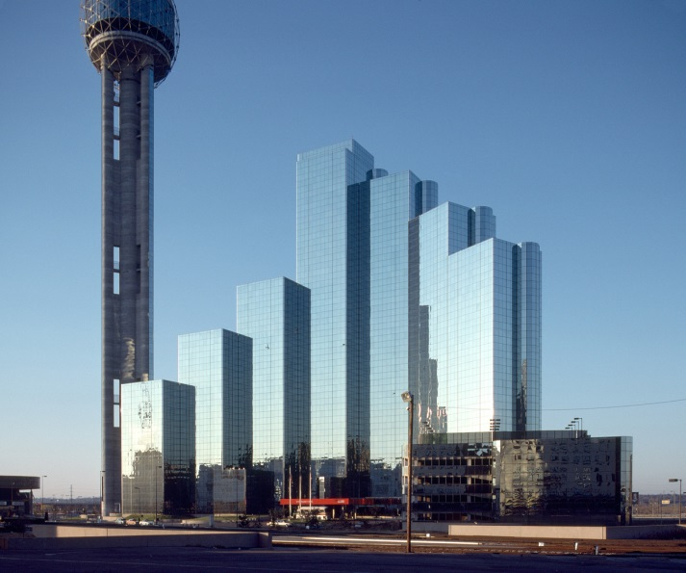
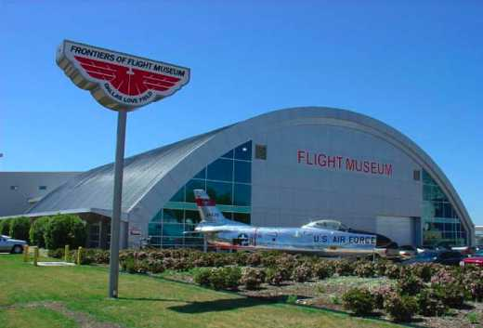
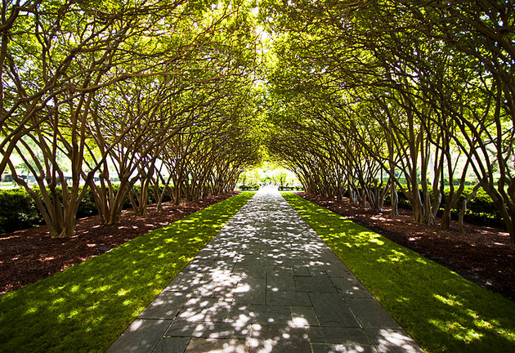
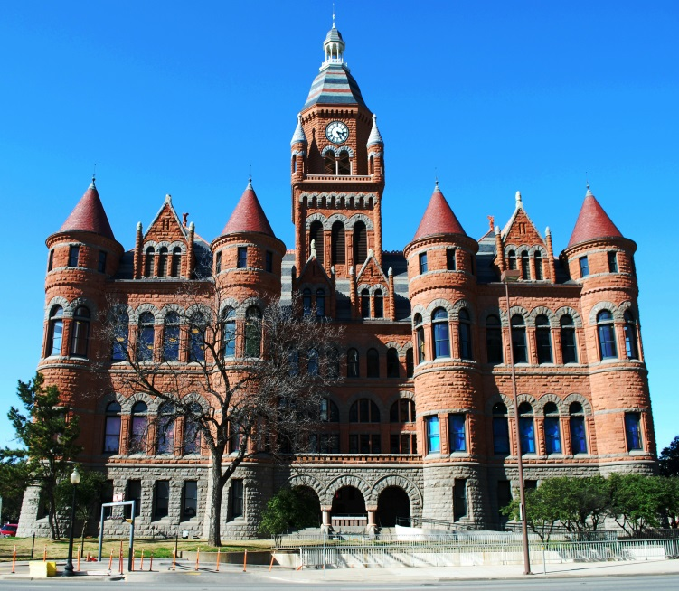
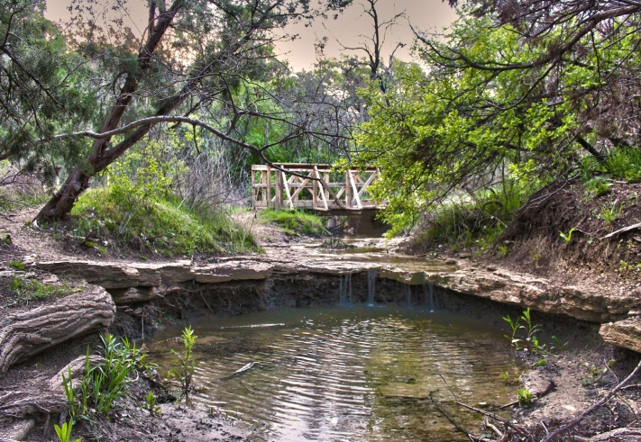
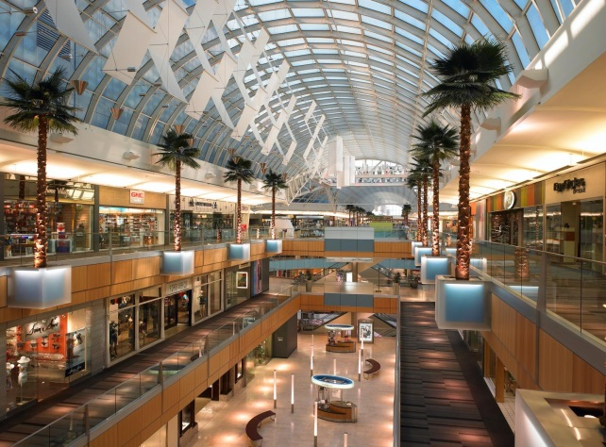
Tourist Attractions of Dallas, Texas

