Slide 1


TENTATIVE PROGRAM
14th International Conference on
DRUG DELIVERY SUMMIT
November 1-2, 2021 | Rome, Italy
Theme: Advancement in the Technologies used in Drug Delivery
DRUG DELIVERY 2021
MAIL: stonealiza343@yahoo.com
URL: https://drugdelivery.pharmaceuticalconferences.com/

Slide 2
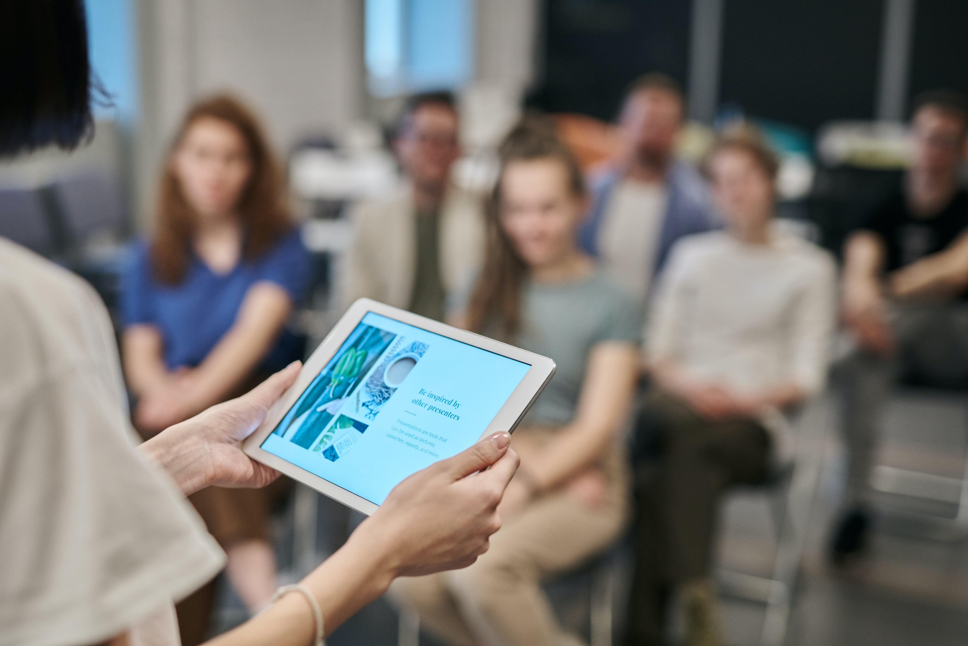

DAY 1
^{MONDAY NOVEMBER,1,2021}
08:30-09:00 | Registrations
09:00-09:30 | Introduction
09:00-09:30 | COFFEE BREAK
09:50-11:50 Meeting Hall 01 | KEYNOTE LECTURES
09:00-09:30 | Introduction
09:00-09:30 | MEETING Hall 02
11:50-13:10 | MEETING Hall 01 | MEETING Hall 02
 | Drug repurposing to treat Viruses: COVID-19 Advanced Drug Delivery Systems Drug Targeting and Design | Drug Delivery Technologies Nanotechnology for better Drug Deliverability Novel Drug Delivery
03:10-13:15 | GROUP PHOTO
13:15-14:00 | LUNCH BREAK
11:50-13:10 | MEETING Hall 01 | MEETING Hall 02
 | Drug Discovery and Development Cellular Targeting and Intracellular Delivery Anti-Cancer Drug Delivery Agents | Vaccine Drug Delivery Systems Peptides and Protein Drug Delivery Therapeutic Drug Carrier Systems
16:00-16:20 | COFFEE BREAK

Slide 3
DAY 2
TUESDAY, November,2,2021
08:30-09:00 | Registrations
09:00-09:30 | Introduction
09:00-09:30 | COFFEE BREAK
09:50-11:50 Meeting Hall 01 | KEYNOTE LECTURES
09:00-09:30 | Introduction
09:00-09:30 | MEETING Hall 02
11:50-13:10 | MEETING Hall 01 | MEETING Hall 02
 | Routes of Drug Administration Pharmaceutical Formulation Technologies Drug Delivery through Blood-Brain Barrier (BBB) | Controlled Released Technologies Transdermal and Intradermal Drug Delivery Systems Biopharmaceutics and Biologic Drugs
03:10-13:15 | GROUP PHOTO
13:15-14:00 | LUNCH BREAK
11:50-13:10 | MEETING Hall 01 | MEETING Hall 02
 | Medical Devices for Drug Delivery | RNA Therapeutics
16:00-16:20 | COFFEE BREAK

Slide 4
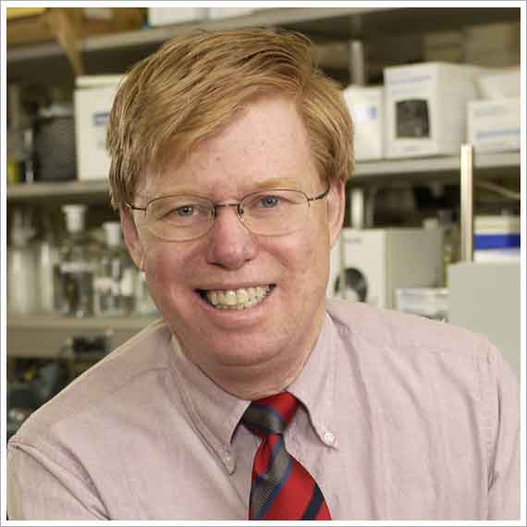
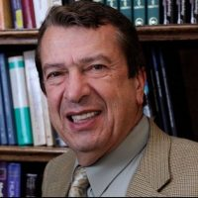
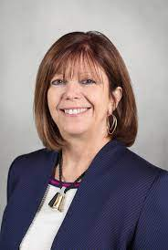
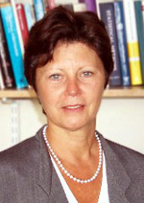
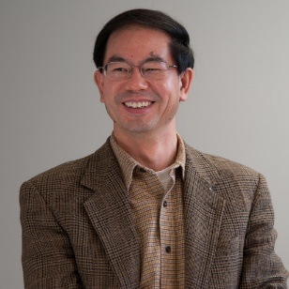
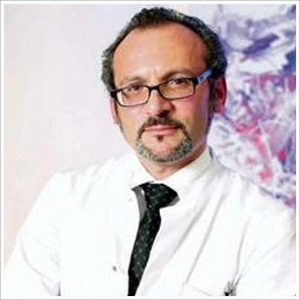
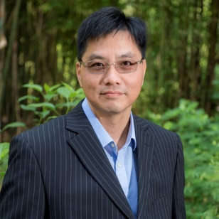
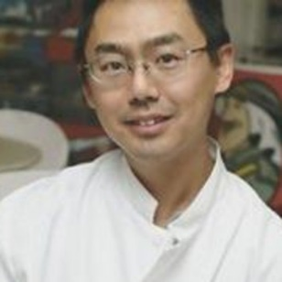
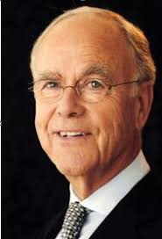
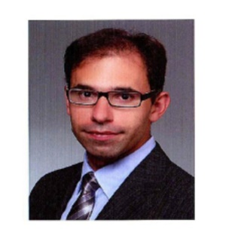
Editorial Board Members
Moses Rodriguez
College of Medicine
Mayo Clinic, USA
Michel Baudry
Western University of Health Scienc-
es, USA
Irene Litvan
University of California San Diego,
USA
Lucia M. Vaina
Boston University, USA
Han-Xiang Deng
Northwestern University, USA
Pasquale Calabrese
University of Basel, Switzerland
Tang Wai Kwong
Chinese University of Hong Kong,
Hong Kong, China
Liu Yawu
University of Eastern Finland
Klaus Rüdiger Helmut von Wild Westphalian-Wilhelm’s-University, Germany
Athanasios K Petridis
University of Schleswig Holstein,
Germany

Slide 5
PAST AFFILIATES
Hans Von Holst
Karolinska University Hospital, Swe- den
Jacqueline A. Hinds
Society of Emotional Intelligence, UK
Taheri Saeid
Byrd Alzheimer’s Institute, USA
Despoina Drivakou
AUTH, School of Medicine, Greece
Anne L Foundas
Brain Institute of Louisiana, USA
David Truswell
Dementia Alliance for Culture and Ethnicity (DACE), UK
Ellie Robinson-Carter
Sensory Trust, UK
Yunfei Yang
Peterborough City Hospital, UK
Shu G. Chen
Case Western Reserve University, School of Medicine, USA
Debanjan Pan
Saltlake Mindset, India
Olessia Gorkovenko
UNISA, South Africa
Brian Norris
Living Memories C.I.C., United King- dom
Morejoy Saineti
LANH Professional LLP, UK
Alberto de bellis
Maria Rosaria Maglione Foundation o.n.l.u.s, Italy
Marija Litvinenko
Riga Stradinš university, Latvia
Nancy D. Broz
Rowan University, USA
Kyaien O. Conner
University of South Florida, USA
Edward Chan
WellLab, Malaysia

Slide 6

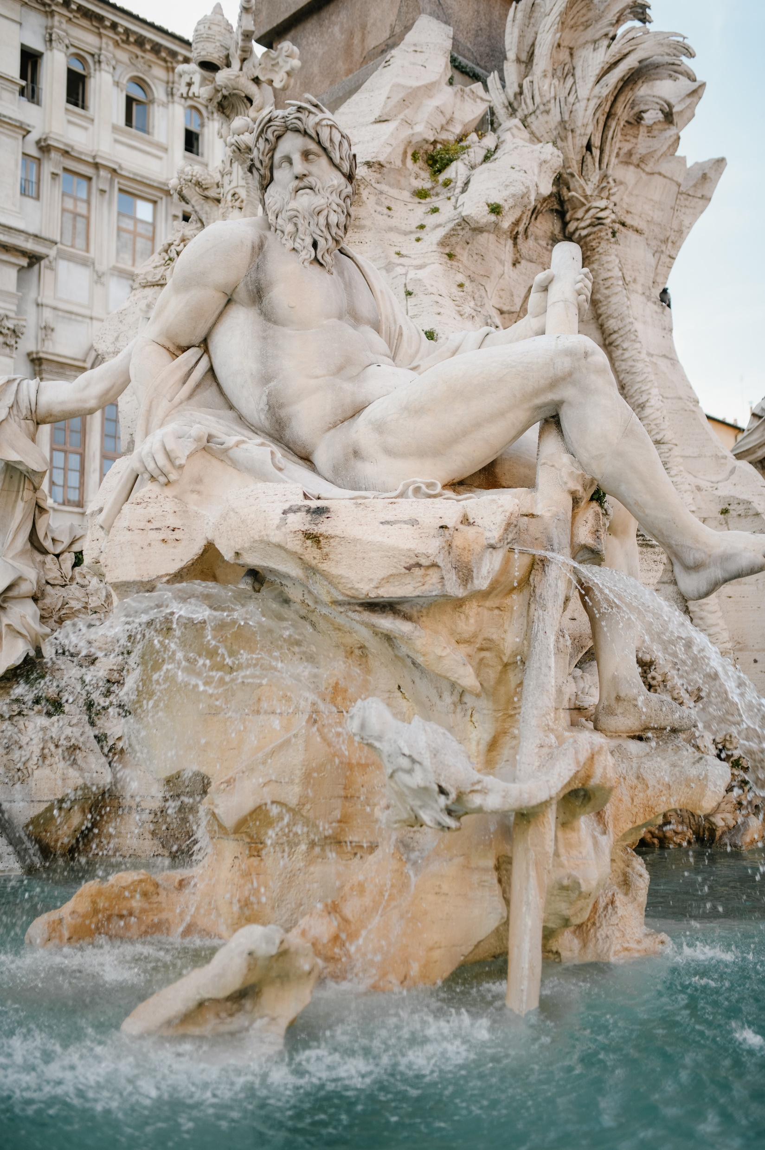

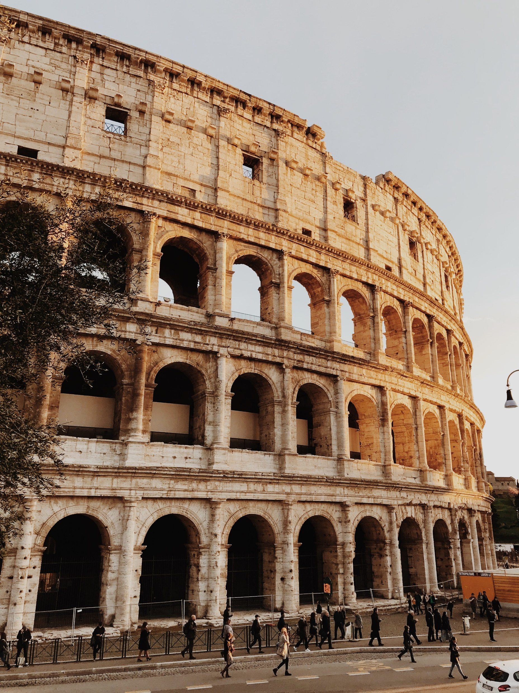
Rome,ItalyAttraction

