Slide 1
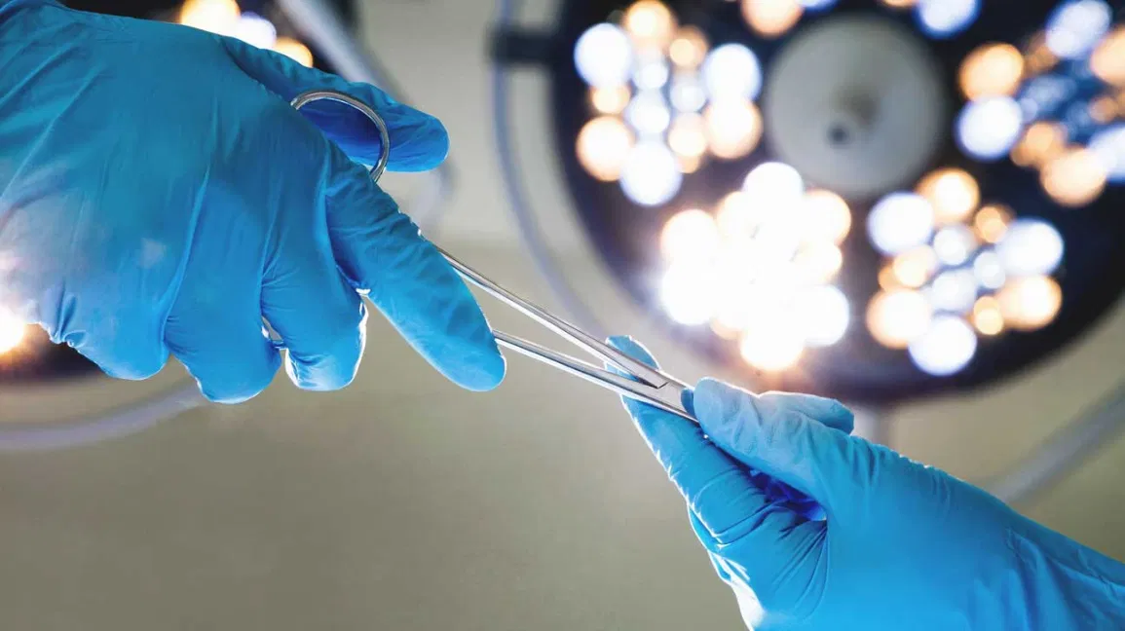

32nd International Conference on
Clinical Diabetes, Diabetic Medication & Treatment
December 04-05, 2023| Paris, France
Theme:
Current Trends & Advances for a Better Healthcare System
DIABETES MEDICARE 2023
MAIL: Diabetesmedicare@sciencesummits.com
URL: https://diabeticmedications.conferenceseries.com/

Slide 2
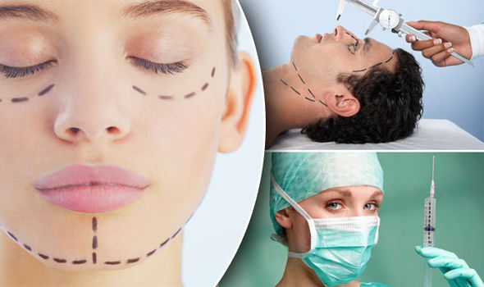

INVITATION
Dear Attendees,
Conference Series LLC LTD welcomes you to attend the 32nd International Conference on Clinical Diabetes, Diabetic Medication & Treatment which is going to be held on December 04-05, 2023 in Paris, France. We cordially invite all the participants who are interested in sharing their knowledge and research in the arena of Surgery anticipates more than 100 participants around the globe with thought provoking keynote lectures, oral and poster presentations. The attending delegates include editorial board members of related open access journals. This is an excellent opportunity for the delegates from universities, institutes, and industries to interact with the world class scientists. The intending participants can confirm their participation by registering for the conference along with your colleagues. Avail the delegate early bird offer. The main theme of the conference is “Current Trends & Advances for a Better Healthcare System”. As the premier event, we have developed a program with your interests in mind.
We have not only increased the number of opportunities for you to network with colleagues from across the world but also introduced more focused sessions that will feature cutting edge presentations, special panel discussions, and livelier interaction with industry leaders and experts. Life is full of give and take. Make it count in your professional life. Attend the DIABETES MEDICARE 2023 to network with your peers, exchange expertise and experiences, and arm yourself with the latest information to take your department to the next level. We look forward to personally welcoming you to Conference this December.
Sincerely,
Organizing Committee
DIABETES MEDICARE 2023
https://diabeticmedications.conferenceseries.com//

Slide 3


ABOUT US
Our International Open Access Journals
Salient Features
700+ Leading-edge Peer Reviewed Open Access Journals
21 Day Rapid Review Process
50000+ Editorial Board Team, 35000+ Reviewers team
30 Million Readers and High Visibility
1000+ Scientific Associations Collaborations
100000+ Facebook Likes
Publication immediately after acceptance
Quality and Quick editorial, review processing
Easy to Submit and Review Systems
High Quality and Fast Publishing Guaranteed
Unbiased, quality-oriented, and transparent reviews
Truly impartial recognition of the best papers
Feedback on the impact of every article
Enhanced feature: Audio version of published paper
Digital articles to share and explore
Sharing option: Social networking enabled
Authors, reviewers and editors are provided with scientific credits
User friendly/feasible website articles translations across more than 50 world languages
Robust on-line publicity for all the speakers and organizing committee members
Career Guidance Workshops for students and early career researchers
Accepted Abstracts will be published in various indexed journals
Accepted abstracts will be labeled with a Digital Object Identification Number (DOI) provided by Cross Ref
Creation of speakers and abstracts pages in Google
Opportunity to publish full Manu Scripts in our Open Access Journals Special
Our International Scientific Conferences
More than 3000 Conferences happening across the globe
Conferences organized in Medical, Pharma, Engineering, Science, Technology and Business.
CME/CPD Accredited Conferences fostering professional and Personal development
Continuum of education through organized scientific program
Renowned speakers and scientists representing from 40 countries
Highly Interactive sessions and Panel Discussions
B2B Meetings offers perfect platform for Global Networking
Special Issues : All accepted abstracts will be
published in respective UK: Conference Series LLC Ltd Journals
Each abstract will be provided with digital Object Identifier by
https://diabeticmedications.conferenceseries.com//

Slide 4

Euro Surgery 2022, The main objective is to bring all the leading academic scientists, researchers and research scholars together to exchange and share their experiences and research results about all the aspects of Surgery. It also provides the premier interdisciplinary forum for researchers, practitioners and educators to present and discuss the most recent innovations, trends, and concerns, practical challenges encountered and the solutions adopted in the field of Surgery. The conference program will cover a wide variety of topics relevant to the General Surgery, Cardiac Surgery , Vascular Surgery, Plastic & Aesthetic Surgery, Endoscopic surgery, Otorhinolaryngology Surgery and so on. This unique opportunity that we extend to our speakers and attendees is not being offered by any other conference organizers. Through this the abstracts and research profiles of our speakers and organizing committee members getting global visibility which is an additional feature that you would be receiving in addition to networking opportunities before, during and after the conference.
FOOD SAFETY 2021 SALIENT FEATURES
Meet academia and industry visionaries to get inspired
Expand your knowledge and find solutions to problems
Knowledge, benchmarking and Networking offered at one place
Forge connections and for global networking
Highly organized and structured scientific programs
Poster presentations and world class exhibitions
Meet with new vendors and suppliers
ABOUT CONFERENCE
HOW CONFERENCE SERIES CONFERENCES DIFFERS FROM OTHERS?
3000+ Conferences across the globe in 30+ countries all through the year
Over 25 million+ visitors and 20000+ unique visitors per conference
Participation by Stalwarts from various international societies
Internationally renowned speakers and scientists representation
Career guidance for early career researchers and students
Interesting scientific deliberations and discussions
Perfect platform for global networking
GOALS
The conference program emphasizes evidence-based practice, educational innovation, practical application, and peer to peer networking and collaboration. The goal of the conference is to provide a transformative professional development experience.
Bringing together the world’s scientific experts to catalyze and advance scientific knowledge about food safety and regulatory measures present the most recent research findings, and promote and enhance scientific collaborations around the world.
Bringing together community leaders, scientists, and policy leaders to promote and enhance programmatic collaborations to more effectively address regional, national and local responses to elderly population around the world and overcome barriers that limit access to care and services.
https://diabeticmedications.conferenceseries.com/

Slide 5


GOALS
After participating in this meeting, attendees should be able to
Discuss emerging issues in the field of food safety
Discuss and apply recent research findings related to food safety
Reflect on the place of critical distance in food safety
WHO SHOULD ATTEND
32nd International Conference on Clinical Diabetes, Diabetic Medication & Treatment, Conferences are exclusively designed for is exclusively designed for Our point is to the corporate network and to make a stage for the trading of data on innovative advancements, new logical modernization and the viability of different administrative projects towards DIABETES MEDICARE 2023. The use of Molecular Approaches in all parts of the cutting edge Surgery and prevention field. This meeting likewise centers around a wide assortment of momentum look into on sanitation and wellbeing that have both useful and pernicious impacts on the security and nature of nourishments, and are along these lines a worry of general wellbeing.
ABOUT HOSTING ORGANIZATION
ABOUT CONFERENCE
Conference Series is the world’s leading specialist in organizing Academic, Scientific and Business conferences, meetings, symposiums and exhibitions in different verticals and horizontals like Medical, Pharma, Engineering, Science, Technology and Business to promote scientific research. Every year we host more than 3000+ global events inclusive of 1000+ Conferences 1000+ Symposiums 1000+ Workshops in USA, Europe, Middle East and Asia with the generous support and cooperation from our 30000 + Editorial Board Members, 1000+ Scientific Societies. All the conference proceedings are published in the special issues of our 700+ Open Access International Journals with the DOI provided by
PARTICIPATION OPTIONS
Speaker (special session): 45-50 minutes (more than 1 can present)
Speaker (symposium): more than 45 minutes (more than 1 can present)
Delegate(only registration): will have access to all the sessions with all the benefits of registration
Poster presenter: can present a poster and enjoy the benefits of delegate
Remote attendance: can participate via video presentation or e-poster presentation
Exhibitor: can exhibit his/her company’s products by booking exhibitor booths of different sizes
Media partner
Sponsor
Collaborator
For more details about each mode, kindly contact: Diabetesmedicare@sciencesummits.com
https://diabeticmedications.conferenceseries.com/

Slide 6

PARTICIPATION BENEFITS
Advanced technologies for the treatment of diabetes
Diabetes and Endocrinology
Cardiovascular risk in Type 2 Diabetes
Stem Cell treatment in Diabetes
Treatment and Diagnosis of Endocrine Diseases
Insulin Medication
Diabetes Advanced Technologies
Thyroid Disorders in Children, Teens and Adolescents
Diabetes and Obesity
Diabetes Ophthalmology
Reproductive Endocrinology
Endocrine Glands and Hormones
Gestational Diabetes
Diabetes and Periodontitis
Ketogenic Diet for Diabetes
Diabetic Disorders and Treatment
Global Market for Diabetes and its Research
Diabetes Research in Clinical Practice
Natural therapy for Diabetes
COVID-19 Impacts People with Diabetes
Attend Keynote Presentation by world’s most eminent researchers
Access to all the sessions
Get OCM certificate
Get worldwide acknowledgment to your profile and Research
Get your abstracts published with unique DOI in International Journals
Get up to 50% discounts for publishing your entire article in our open access International Journals
Get Handbooks and conference kits
Get an access to the network with eminent personalities from worldwide
ABOUT CONFERENCE
MAJOR SESSIONS
ABSTRACT SUBMISSION
https://diabeticmedications.conferenceseries.com/abstract-submission.php
FOR MORE INFORMATION
https://diabeticmedications.conferenceseries.com//
https://diabeticmedications.conferenceseries.com/

Slide 7




SUPPORTING JOURNALS
Journal of Obesity & Weight Loss Therapy
URL: https://www.omicsonline.org/obesity-weight-loss-therapy.php
Journal of Community Medicine & Health Education
URL: https://www.omicsonline.org/community-medicine-health-education.php
Cosmetology & Oro Facial Surgery
URL: https://www.omicsonline.org/cosmetology-orofacial-surgery.php
https://diabeticmedications.conferenceseries.com/

Slide 8
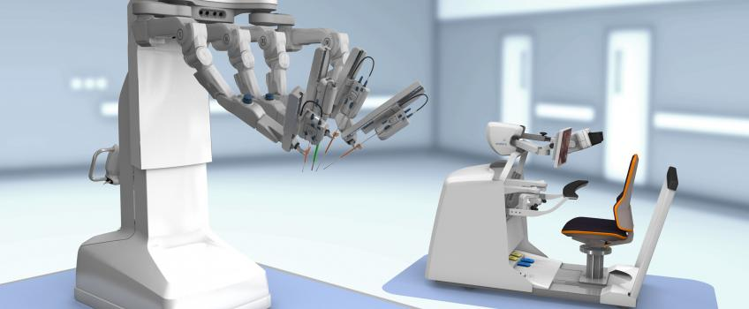
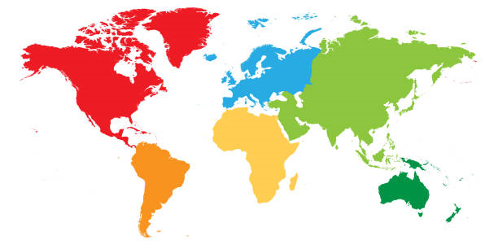
VENUE & ACCOMMODATION
LONDON
UK
VENUE AND ACCOMODATION
CONTACT US
OHANNA DAVIES
Program Manager | Euro Surgery 2022
UK: Conference Series LLC Ltd
E: eurosurgery@lifescienceconferences.org
W: https://euro.surgeryconferences.com/
WhatsApp no. +44-7897073589
https://diabeticmedications.conferenceseries.com/

Slide 9
Only Registration: $ 799
Package A (Registration + 2 nights Accommodation): $ 1149
Package B (Registration + 3 nights Accommodation): $ 1399
ACADEMIC
Only Registration: $ 899
Package A (Registration + 2 nights Accommodation): $ 1249
Package B (Registration + 3 nights Accommodation): $ 1499
BUSINESS
Student Oral: $ 499
Student Poster: $ 599 ($499 + $100) for Poster
Student Delegate: $ 349
E-poster: € 99
REGISTRATIONS
STUDENT
IMPORTANT DATES
Abstract submission opens: May 01, 2023
Early Bird Registration: May 30, 2023
Registration Opens: May 01, 2023
On Spot Registration: December 04, 2023
https://diabeticmedications.conferenceseries.com/

