Slide 1
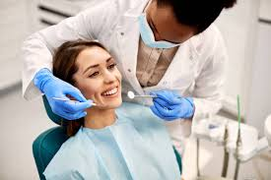
Dental Surgery and Medicine
DENTAL SURGERY 2025
41th International Conference on
March 24-25, 2025 London, UK
Theme:
“Future Smiles: Innovations in Dental Surgery and Medicine”
MAIL: dentalsurgeons@euroconferences.net
URL: https://dentalsurgeons.conferenceseries.com/

Slide 2

DENTAL SURGERY 2025
R E G I S T R A T I O N & T I M I N G S
March 24 , 2 0 2 5 ( 8 : 0 0 A M t o 6 : 0 0 P M )
March 25 , 2 0 2 5 ( 8 : 0 0 A M t o 6 : 0 0 P M )
G R O U P P H O T O T I M E
1 0 : 4 5 A M - 1 0 : 5 0 A M ; M a r c h 24 , 2 0 2 5
L o n d o n, UK
Please try your best to attend the Conference. If you could not attend, please let us know dentalsurgeons@euroconferences.net
/

Slide 3
DENTAL SURGERY 2025
V E N U E
London, UK
S P E A K E R S ’ P P T
You may submit your presentation to any of our onsite organizers on the day of your talk. If your presentation is not compatible with our laptops, then you may use your own laptop.
To Register Online, Please visit https://dentalsurgeons.conferenceseries.com/

