Slide 1


TENTATIVE PROGRAM
24th World Congress on
Analytical and Bioanalytical Chemistry
March 07-08, 2022 | London, UK
Theme:
Shopping The Future with Emerging Research in Analytical Chemistry
ANLYTICAL CHEMISTRY 2022
MAIL: analyticalchemistry@globalannualsummit.com
URL: https://analytika.pharmaceuticalconferences.com/

Slide 2
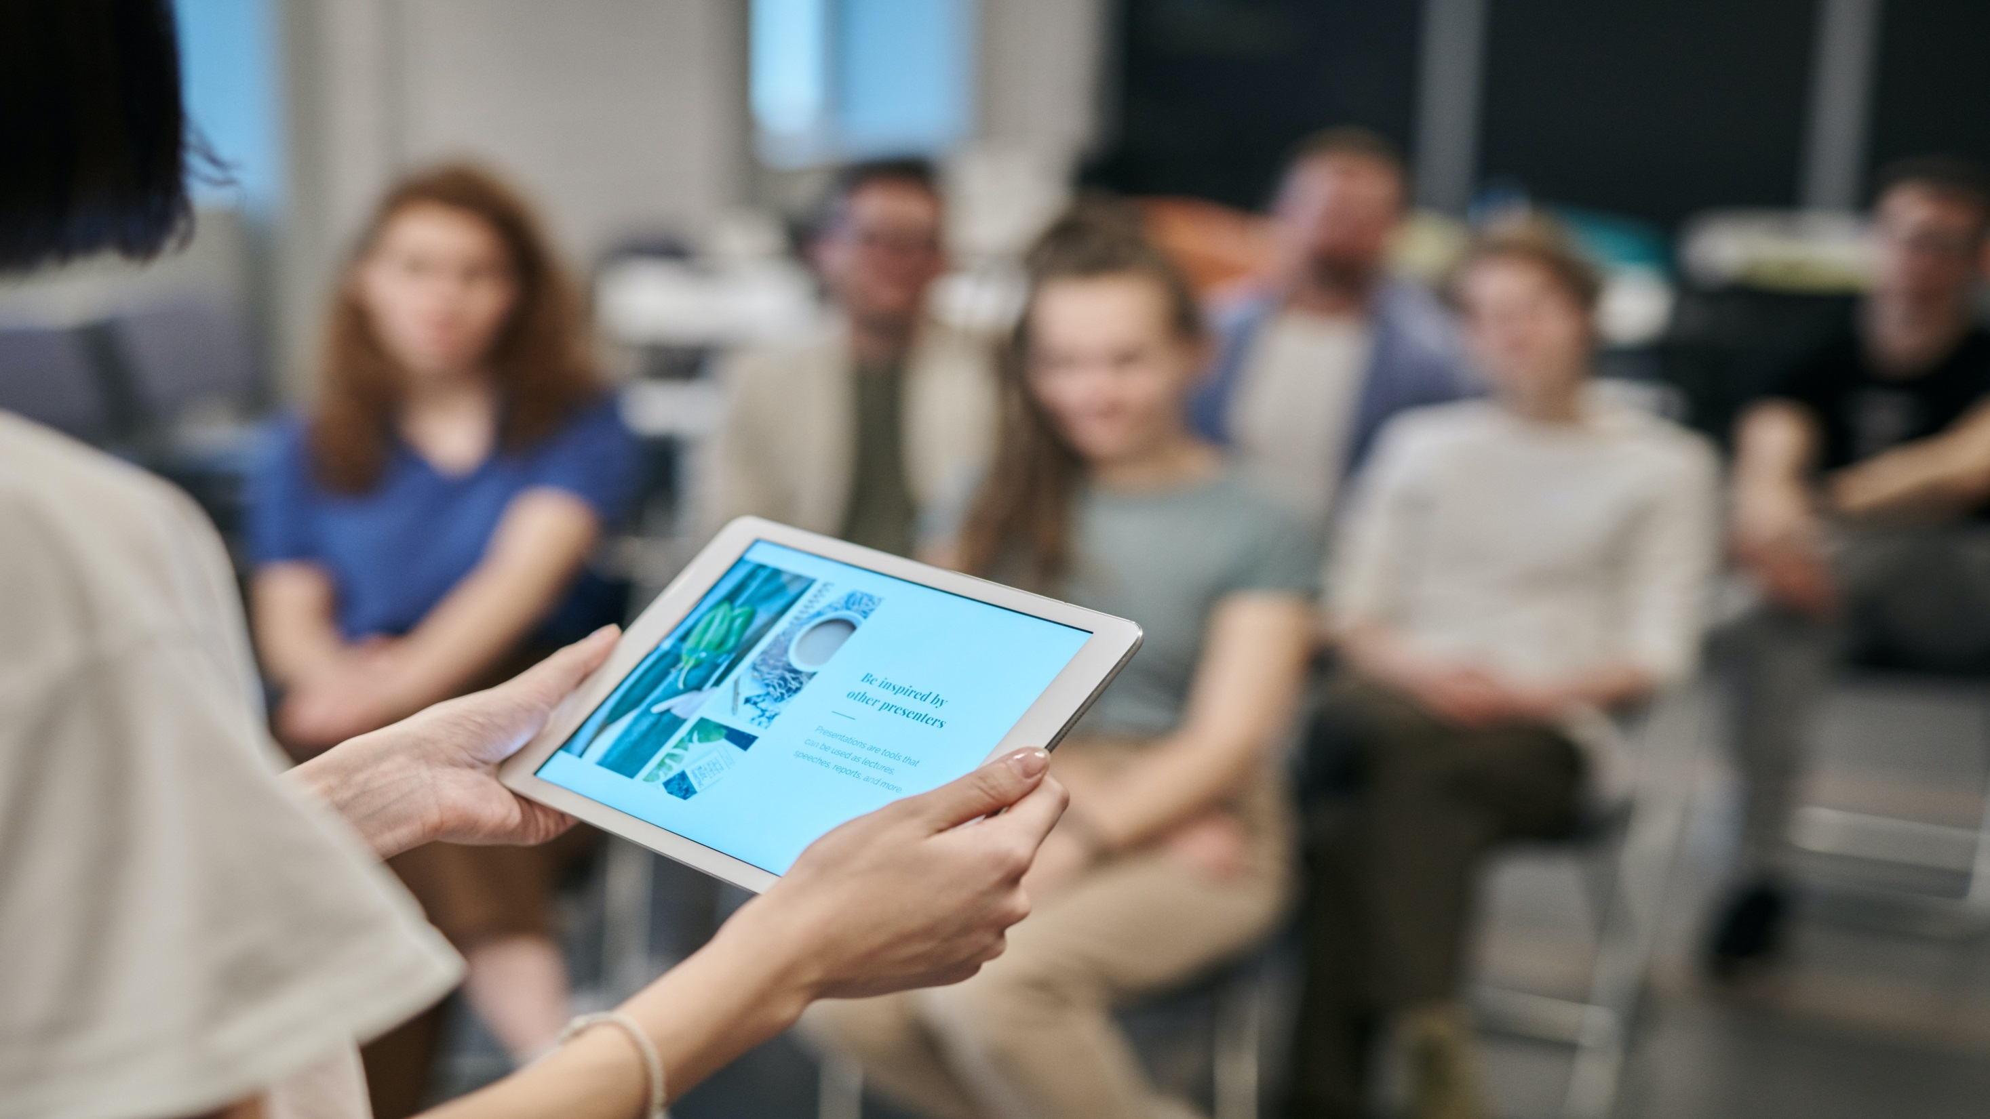

DAY 1
MONDAY, 7th March
08:30-09:00 | Registrations
09:00-09:30 | Introduction
09:00-09:30 | COFFEE BREAK
09:50-11:50 Meeting Hall 01 | KEYNOTE LECTURES
09:00-09:30 | Introduction
09:00-09:30 | MEETING Hall 02
11:50-13:10 | MEETING Hall 01 | MEETING Hall 02
 | Analytical Chemistry and Methodology Bioanalytical Methodology Polymer Science and Material Science | Biopolymers and Biomaterials Chromatography Electrophoresis
03:10-13:15 | GROUP PHOTO
13:15-14:00 | LUNCH BREAK
11:50-13:10 | MEETING Hall 01 | MEETING Hall 02
 | Spectroscopy Mass Spectrometry | Nuclear Magnetic Resonance Spectroscopy Environmental Analytical Chemistry
16:00-16:20 | COFFEE BREAK

Slide 3
DAY 2
TUESDAY, 8th March
08:30-09:00 | Registrations
09:00-09:30 | Introduction
09:00-09:30 | COFFEE BREAK
09:50-11:50 Meeting Hall 01 | KEYNOTE LECTURES
09:00-09:30 | Introduction
09:00-09:30 | MEETING Hall 02
11:50-13:10 | MEETING Hall 01 | MEETING Hall 02
 | Thermal Analysis and Glycemic Advances in Separation Techniques | Pharmaceutical Analytics Applications of Analytical and Bioanalytical Methods
13:10-13:15 | GROUP PHOTO
13:15-14:00 | LUNCH BREAK
11:50-13:10 | MEETING Hall 01 | MEETING Hall 02
 | New Instrumentation and Equipment Regulatory Issues and Biosafety Challenges in Bio analysis | Scope for Analytical Chemist Biopolymers and Biomaterials
16:00-16:20 | COFFEE BREAK

Slide 4
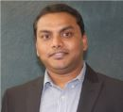











EDITORIAL BOARD MEMBERS
Vivek Agrahari
University of Missouri-Kansas city
USA
Offie P Soldin
Oncology and Physiology
Georgetown University
USA
Devrishi Goswami
Research Associate
The SCRIPPS Research Institute
USA
Nagireddy Putluri
Associate Professor
Baylor College of Medicine
USA
George Perry
Department of Biology
University of Texas at San Antonio
USA
H. Thomas Karnes
University School of Pharmacy
USA
Zaleski JM
Indiana university
USA
Naser L. Rezk
University of North Carolina
USA
Ji-Xin Cheng
Weldon School of Biomedical Engineering
Purdue University
USA
Ivan Gitsov
Forestry
State University of New York
USA
Eugenia Kharlampieva
Department of Chemistry
University of Alabama at Birmingham
USA
Sabine Hildebrandt
Scientific Officer
U.S Food and Drug Administartion
USA

Slide 5
PAST AFFILIATIONS
Gagik Torosyan Professor, Department of Environmental Engineering, National polytechnic University of Armenia, Armenia. | Praveen Kumar Research Fellow, Department of Pharmacokinetics Core, University of Michigan, USA | Theodoros Chatzimitakos Professor, Department of chemistry, Student dormitories of University of Ioannina, Ioannina, Greece. | Ricardo Gobato Professor, Department of Biophysics and Molecular Modeling Genesis, NRE Londrina, PR, Brasil. | Sub Reddy Professor, Department of Biomedical and Molecular Sciences, University of Surrey, UK.
Tomonori Ohba Associate Professor, Chiba University, Chiba, Japan | Alexandre Cestari Instituto Federal de Educação, Ciência e Tecnologia de São Paulo - IFSP | MICHAEL ANJELLO JOTHI RAJAN PROJECTS CO-ORDINATOR, FIST, DST, GOI, NEW DELHI | Alireza Heidari Faculty of Chemistry, California South University (CSU), Irvine, California, USA | Andreas Hirsch Institut fur Organische Chemie Universitat Erlangen-Nurnberg Henkestrasse, 42 91054 Erlangen GERMANY
Bernd Giese Department of Chemistry, University of Basel, St. Johanns Ring 19, CH-4056 Basel, SWITZERLAND | Bernd Strehmel Kodak Polychrome Graphics GmbH, Research and Developement, An der Bahn 80, D-37520 Osterode, GERMANY | Dieter Vollhardt Max-Planck Institute of Colloids and Interfaces, D-14424 Potsdam, GERMANY | Luisa Schenetti Dipartimento di Chimica, via Campi 183, 41100 Modena, ITALY | Rangaswamy Dept. of Studies in Chemistry, Mansagangotri, Mysore - 570 006, Karnataka, INDIA

Slide 6
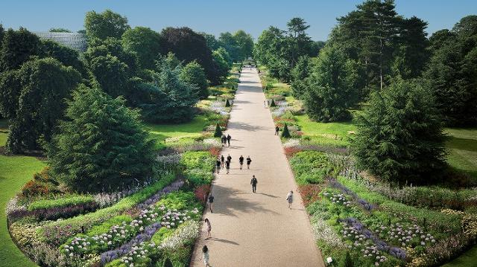
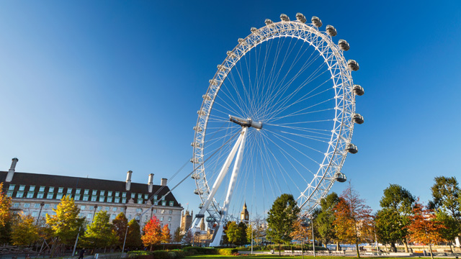
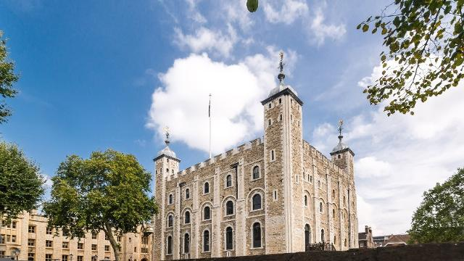
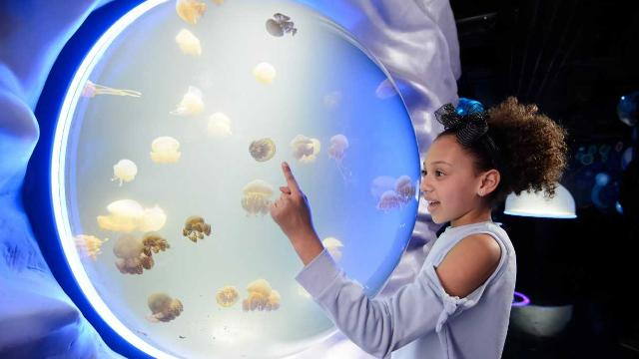
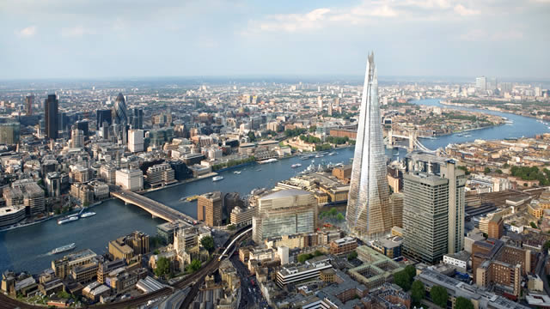
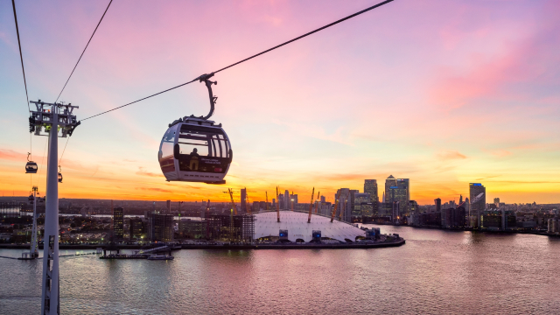
CITY ATTRACTIONS
Kew Gardens.
The London Eye.
Tower of London.
SEA LIFE London Aquarium.
The View From The Shard.
Emirates Air Line cable car.

