Slide 1



24th World Congress on
Analytical and Bioanalytical Chemistry
March 07-08, 2022 | London, UK
Theme:
Shopping The Future with Emerging Research in Analytical Chemistry
ANLYTICAL CHEMISTRY 2022
MAIL: analyticalchemistry@globalannualsummit.com
URL: https://analytika.pharmaceuticalconferences.com/

Slide 2
REGISTRATION & TIMINGS
March 07, 2022(8:00AM to 6:00PM)
March 08, 2022(8:00AM to 6:00PM)
GROUP PHOTO TIME
ANLYTICAL CHEMISTRY 2022
10:45 AM - 10:50 AM; March 08, 2022
BARCELONA, SPAIN
Please try your best to attend the Conference. If you could not attend, please let us know analyticalchemistry@globalannualsummit.com
https://analytika.pharmaceuticalconferences.com/

Slide 3
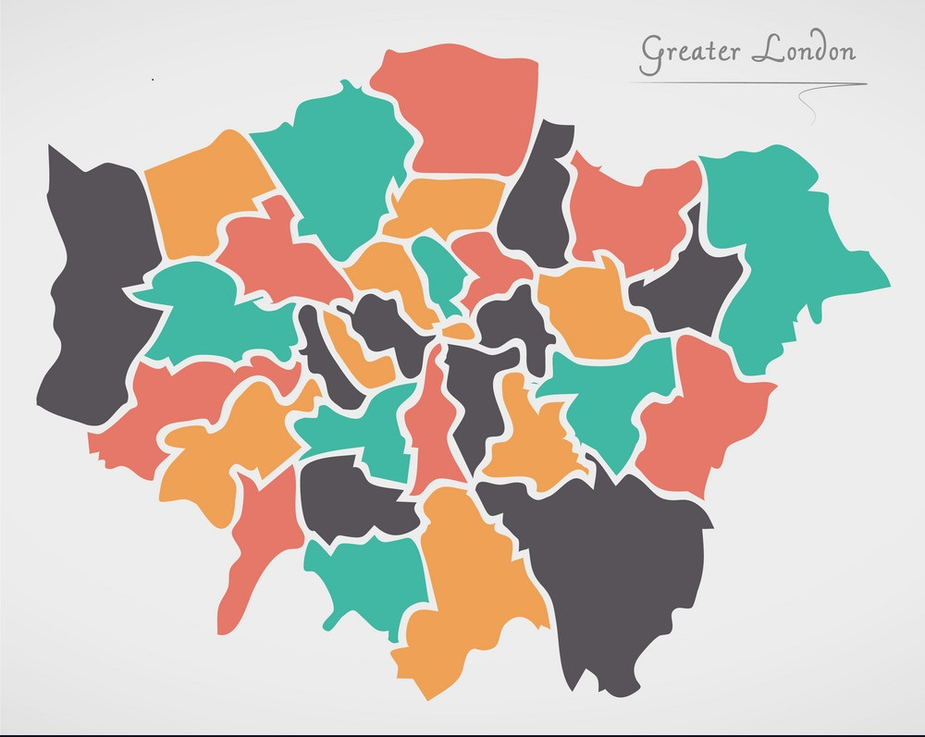
VENUE
London, UK
ANLYTICAL CHEMISTRY 2022
SPEAKERS’ PPT
You may submit your presentation to any of our onsite organizers on the day of your talk. If your presentation is not compatible with our laptops, then you may use your own laptop.
To Register Online, Please visit
https://analytika.pharmaceuticalconferences.com/

