Slide 1
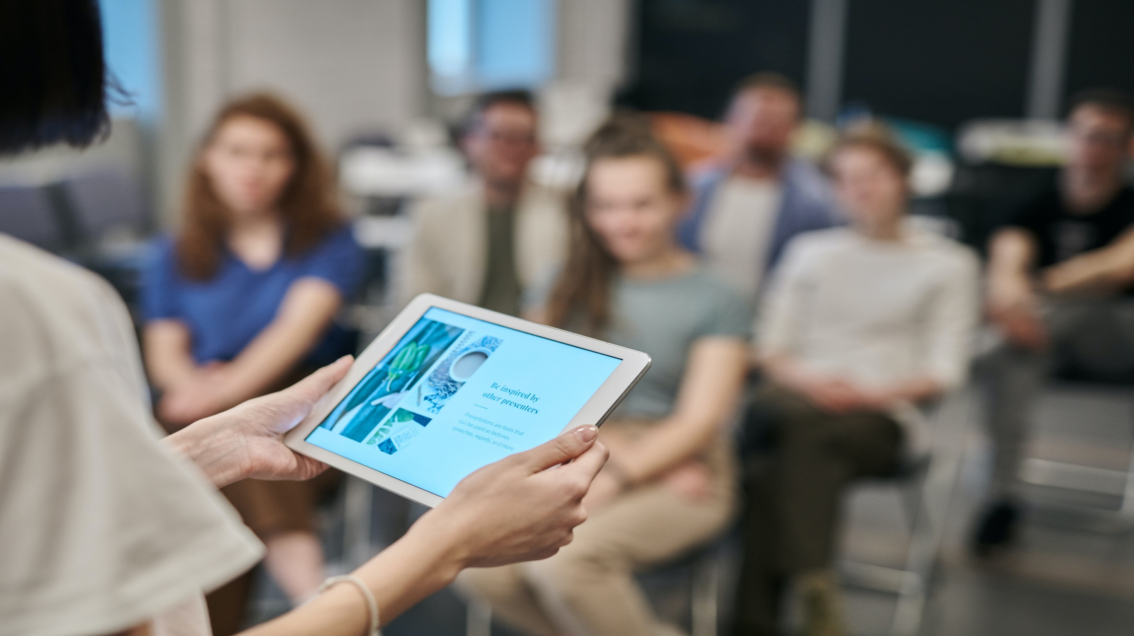

24th World Congress on
Analytical and Bioanalytical Chemistry
March 07-08, 2022 | London, UK
Theme:
Shopping The Future with Emerging Research in Analytical Chemistry
Contact us:
MAIL: analyticalchemistry@globalannualsummit.com
URL: https://analytika.pharmaceuticalconferences.com/
ANLYTICAL CHEMISTRY 2022

Slide 2


B2B
Meetings
2
Days Of Scientific
Exchange
15+
Scientific Sessions
80+
International Expert
Faculty Members
20+
Exhibitors
INVITATION
Dear Colleagues,
Conference Series LLC LTD is delighted to welcome you for the Prestigious “8th International Conference on Herbal and Traditional Plant Medicines” focusing on determination of various approaches in the field of Herbalism and we are confident that you will enjoy the Scientific Program of this upcoming Conference. We look forward to see you.
With Regards
World Cardiology 2021
Operating Committee, Conference Series llc LTD
Editorial Board Members of Supporting Journals
Neha Chawla Research specialist at Carnegie Mellon University, USA. | Muhammad Ovais University of Chinese Academy of Sciences, China. | Anju Goyal Institute of Pharmaceutical Sciences, India. | Suleyman Aydin Firat University, Turkey. | Dayue Darrel Duan Professor University of Nevada USA
Rahul A Hajare National AIDS Research Institute, India. | Gagik Torosyan National polytechnic University of Armenia, Armenia. | Praveen Kumar University of Michigan, USA | Theodoros Chatzimitakos University of Ioannina, Ioannina, Greece. | Ricardo Gobato NRE Londrina, PR, Brasil.
https://analytika.pharmaceuticalconferences.com/

Slide 3

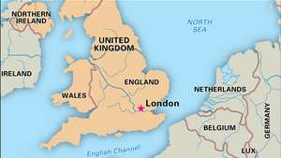
PROGRAM ANNOUNCEMENT
VENUE & ACCOMMODATION
London, UK
Abstract Submission Opens: 20 August 2021
Registration Opens: 20 August 2021
Early Bird Registration: 30 December 2021
Mid Date Registration: 20 January 2021
On Spot Registration: 08 March, 2022
EXHIBITION AND SPONSORSHIP
An Exhibition will be held concurrently with the Conference. Thanks to exhibitors from all over the world, attendees will have a complete overview of new findings in the field of food safety.
https://analytika.pharmaceuticalconferences.com/

