Slide 1
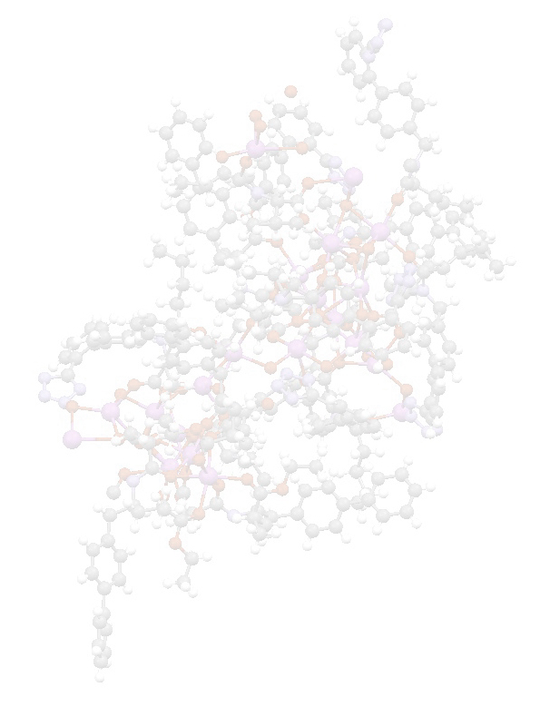

Perplex Polymorphic Behavior of Active Pharmaceutical Ingredients
Peter Karpinski, Ph.D., D.Sc.
Consultant/Expert Witness/Trainer
New Jersey, USA. peterhkarpinski@gmail.com
Formerly, of Novartis Pharmaceuticals Corp., USA
5th International Conference and Exhibition
on Pharmaceutics & Novel Drug Delivery Systems
March 16-18, 2015, Dubai, UAE

Slide 2
Presentation Flow
Significance of polymorphism
‘Well-behaved’ API forms
‘All the rest’
Polymorphs behaving badly: Case study examples
Conclusions

Slide 3
POLYMORPHISM and POLYMORPHS
Definitions
Polymorphism is defined as a property of substance to exist in more than one crystal structure.
The various polymorphic forms – polymorphs – of a crystal have different crystal lattices and thereby different physical and chemical properties, such as: density, hardness, solubility, m.p., etc.

Slide 4
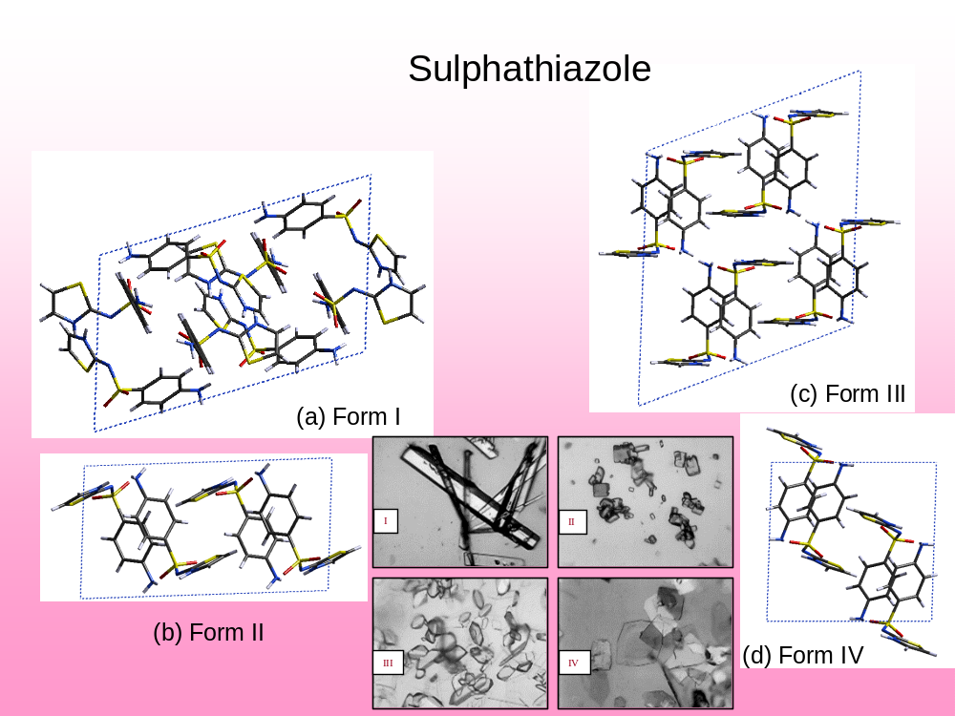
Polymorphs - Definition

Slide 5
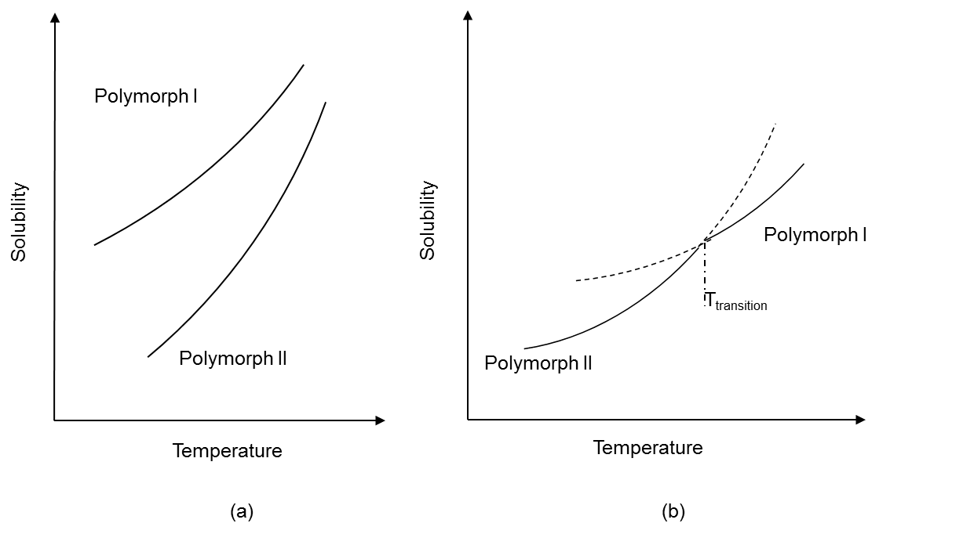
Monotropic and Enantiotropic Systems
For the monotropic system, there is a transition point above the melting points of both polymorphs. The two polymorphs cannot be converted from one another without undergoing a phase transition. The highest melting form is always the more stable form at a given pressure.
For the enantiotropic system, each polymorph has a definite temperature range of stability.
monotropy
enantiotropy

Slide 6
Significance of polymorphism
Early detection of polymorphic and solvatomorphic forms during preformulation activities, and selection of the most stable form is of paramount importance for rapid and smooth API development process
Mistakes are costly and unacceptable

Slide 7
‘Desired’ API Forms
Ideal API form
  Monomorphic
  Stable
  Anhydrous
  Solvate-free
  Nonhygroscopic
  Good solubility and dissolution profile
  High-melting
  Free of amorphous component
  Easy to manufacture
  Compact morphology

Slide 8
‘Well-behaved’ Polymorphs
Still Good
  Stable one of the monotropically-related pair
  Less-soluble of the enantiotropically-related pair, below the transition temperature
  Not “the most thermodynamically-stable” yet shelf-stable
  Hydrate that does not dehydrate below 60 ºC

Slide 9
‘All the Rest’
Common problems
  Multiple forms
  Elevated hygroscopicity
  Low m.p.
  Amorphous component
  Solvate component
  Minor form(s) present (mixtures)
  Hydrate that dehydrates below 60 ºC
  Needle/plate morphology

Slide 10
‘All the Rest’
Tough and/or unusual situations
  Forms difficult to discriminate amongst
  Forms difficult to detect
  ‘Disappearing’ polymorphs
  New/stable form unexpectedly discovered
  Isostructural forms of same and different molecules
  Same form but inconsistent properties for different batches
  Unexpected solvent effect

Slide 11
Case study examples
Time factor
  Holiday factor
  Weekend factor
Geography factor
Tool factor
Camouflage factor
Surprise factor
  Unexpectedly appearing polymorph
  ‘Disappearing’ polymorph
Hit and miss factor
Alchemy factor

Slide 12
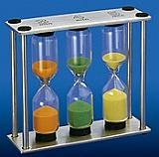
CASE STUDY 1: Creeping Polymorph Conversion (Time Factor)
Situation:
An API1 candidate has several forms.
The highest melting Form A was selected and manufactured.

Slide 13
CASE STUDY 1: Creeping Polymorph Conversion (Time Factor)
Problems:
  Upon storage (freezer, sealed bags) Form A converts slowly to Form B
  Form B cannot be isolated directly using the current process

Slide 14
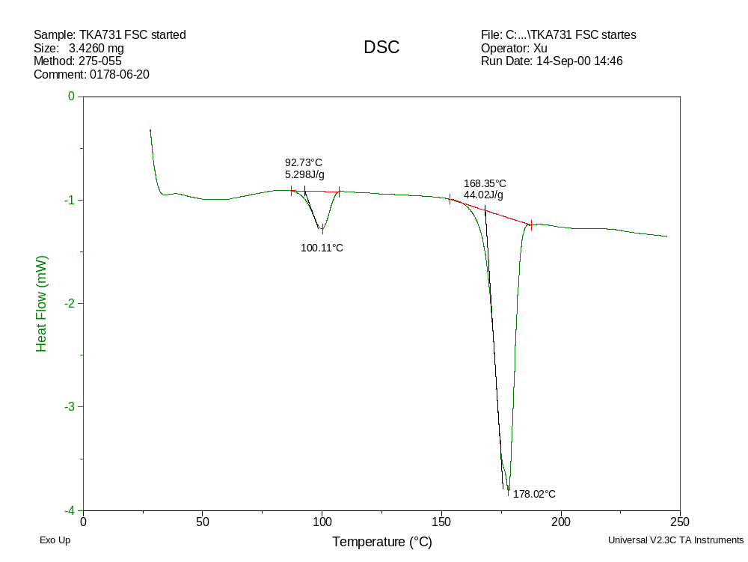
CASE STUDY 1: Creeping Polymorph Conversion (Time Factor)
DSC Thermogram for Form B (10 K/min)

Slide 15
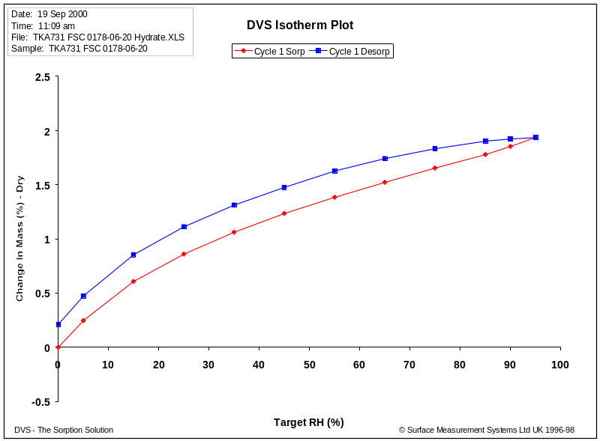
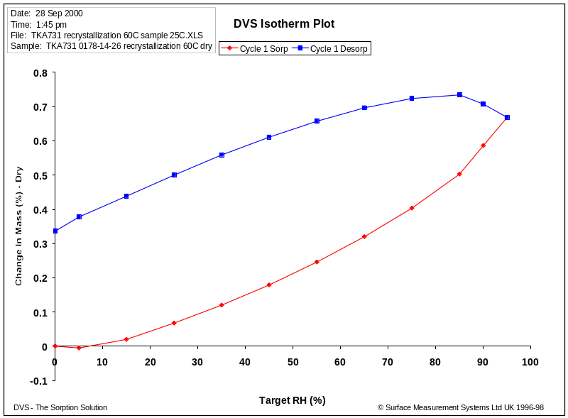
CASE STUDY 1: Creeping Polymorph Conversion (Time Factor)
Polymorph B
Polymorph A

Slide 16
CASE STUDY 1: Creeping Polymorph Conversion (Time Factor)
Polymorphic conversion:
  Form A Form B
moisture, r.t., 3 weeks
T>36ºC, hours

Slide 17
CASE STUDY 1: Creeping Polymorph Conversion (Time Factor)
Solutions (proposed):
  Formulation-dependent
    Do nothing (if API is dissolved in the formulation process)
  Continue efforts to produce Form B directly
    (drawback: for T > 36 ºC, conversion to Form A is unavoidable)
  Search for other stable form
  Develop amorphous form (known to be stable)

Slide 18

CASE STUDY 2: Unexpected Polymorphic Transformation (Holiday Surprise Factor)
Situation:
Single crystal of an API2 candidate was grown.
The structure could not be solved by X-ray crystallography (Dec. 20, 2002)
  A verbatim quote from e-mail from crystallographer:
  “(…) crystals out of either vial are clearly uniaxial with a big square face that is isotropic. (…) The closest I can get to a cell is that they are tetragonal (…)

Slide 19
CASE STUDY 2: Unexpected Polymorphic Transformation (Holiday Surprise Factor)
Problem (January 8, 2003):
  A verbatim quote from e-mail from crystallographer:
  “(…) crystals out of either vial are clearly uniaxial with a big square face that is isotropic. (…) The closest I can get to a cell is that they are tetragonal (…) When I came back from break (…) I found (…) they were biaxial and the large face extinguished under cross polars. I mounted one and collected data. When I solved the structure, (…) I assumed I had just grabbed the wrong sample. However, I have now duplicated the transformation from tetragonal to orthorhombic where I am sure of the sample. Interestingly this occurs even under paratone oil (…). Obviously something is going on. (…)”

Slide 20

CASE STUDY 3: Unexpected Appearance of New Form (Weekend Factor)
Situation:
An API3 candidate has advanced to Phase II
11 polymorphs were identified for API3
Two enantiotropically related forms A and B are considered as frontrunners

Slide 21
CASE STUDY 3: Unexpected Appearance of New Form (Weekend Factor)
Problem:
  As a part of evaluation of Lasentec’s FBRM probe, a crystallization experiment – that in its usual timeframe consistently produced Form A – was set up on Friday to run over the weekend
  A transformation of Form A to a new Form “L” was ‘caught’ while reviewing CSD statistics

Slide 22
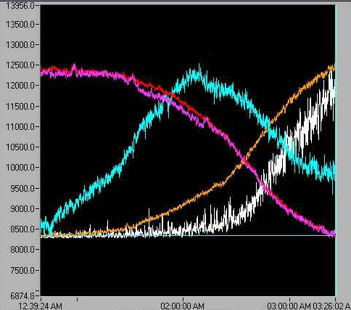
CASE STUDY 3: Unexpected Appearance of New Form (Weekend Factor)
Course of CSD Profile Measured by FBRM Probe

Slide 23
CASE STUDY 3: Unexpected Appearance of New Form (Weekend Factor)
Lessons Learned:
  Form L appeared to be thermodynamically most stable and was recommended for development
  All subsequent polymorph pre-screening protocols were supplemented with equilibration experiments with process solvent(s), running for one week (before, a typical equilibration experiment had been run for 24 h)

Slide 24
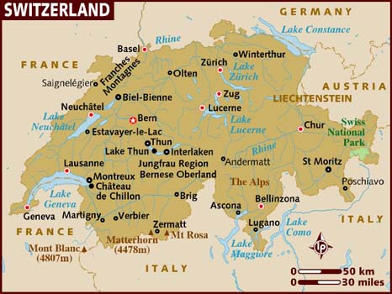
CASE STUDY 4: ‘Disappearing’ Polymorphs (Geography Factor)
Situation:
Our Swiss counterpart sent us an API4 candidate for polymorph screening and selection
Two forms were already isolated and characterized by the Swiss lab

Slide 25
CASE STUDY 4: ‘Disappearing’ Polymorphs (Geography Factor)
Problem:
Two new forms were discovered but one of the two original forms isolated by the Swiss colleagues was never found, in spite of repeated efforts (an uneasy international embarrassment)

Slide 26
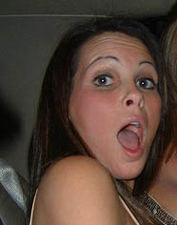
CASE STUDY 5: “Disappearing” Polymorph
(Surprise Factor)
Situation:
4 polymorphs and a hydrate were isolated for API5
Form B was recommended for further development and consistently obtained in all the experiments
Concurrently run formulation activities with Form B were significantly advanced

Slide 27
CASE STUDY 5: “Disappearing” Polymorph
(Surprise Factor)
Situation:
To our enormous surprise, an unknown Form E popped up in a pilot plant, set up to produce Form B
A team to convert E➔B was formed

Slide 28
CASE STUDY 5: “Disappearing” Polymorph
(Surprise Factor)
Findings:
All recrystallization efforts to convert E➔B were futile (seeding with B included)
Small-scale purification by multiple fractional crystallization did eventually lead to Form B

Slide 29
CASE STUDY 5: “Disappearing” Polymorph
(Surprise Factor)
Properties B vs. E:
Solubility at 23°C and pH 1: 0.52 mg/ml vs. 0.51 mg/ml
Slurrying at 37°C and 50°C resulted in E

Slide 30
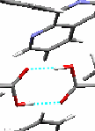
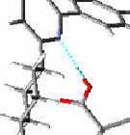
CASE STUDY 5: “Disappearing” Polymorph
(Surprise Factor)
Structures:
B ρ=1.313 g/cm³
E ρ=1.366 g/cm³

Slide 31
CASE STUDY 5: “Disappearing” Polymorph
(Surprise Factor)
Findings:
Both polymorphs B and E are stable
Form B can be obtained from pure solutions
Form E appeared due to the impurities that inhibit the formation of dimers
Form E can be manufactured from pure solutions with seeds of Form E

Slide 32
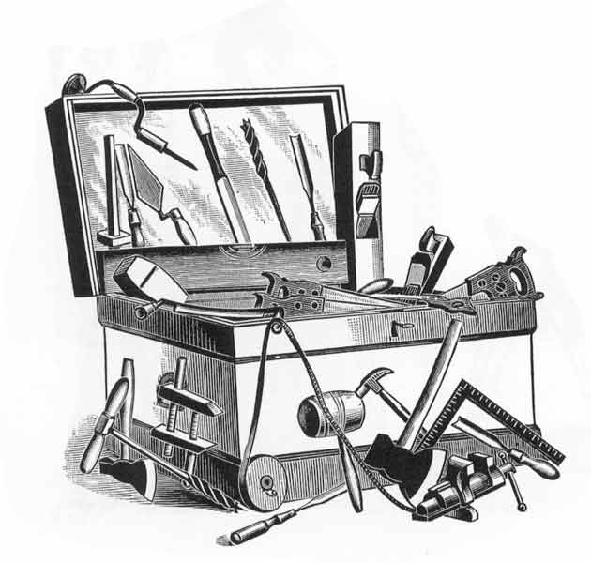
CASE STUDY 6: Polymorphs Analyzed by Vibrational Spectroscopy (Tool Factor)
Situation:
FT-Raman and FT-IR spectroscopies were used as tools to differentiate between polymorphs of APIs

Slide 33
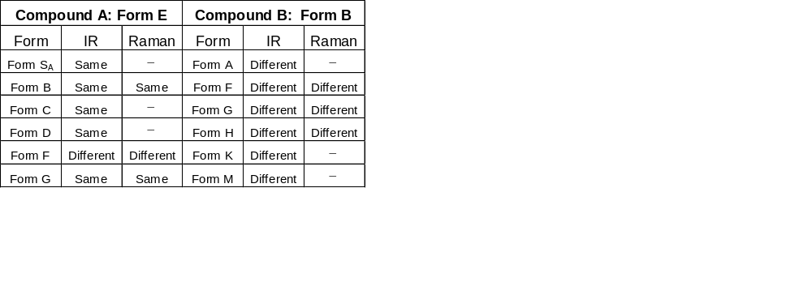
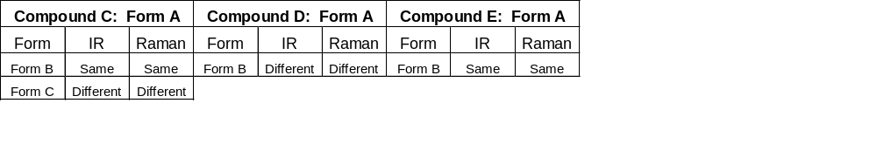
CASE STUDY 6: Polymorphs Analyzed by Vibrational Spectroscopy (Tool Factor)
FT-IR and FT-Raman Spectra for Polymorphs of Various APIs

Slide 34
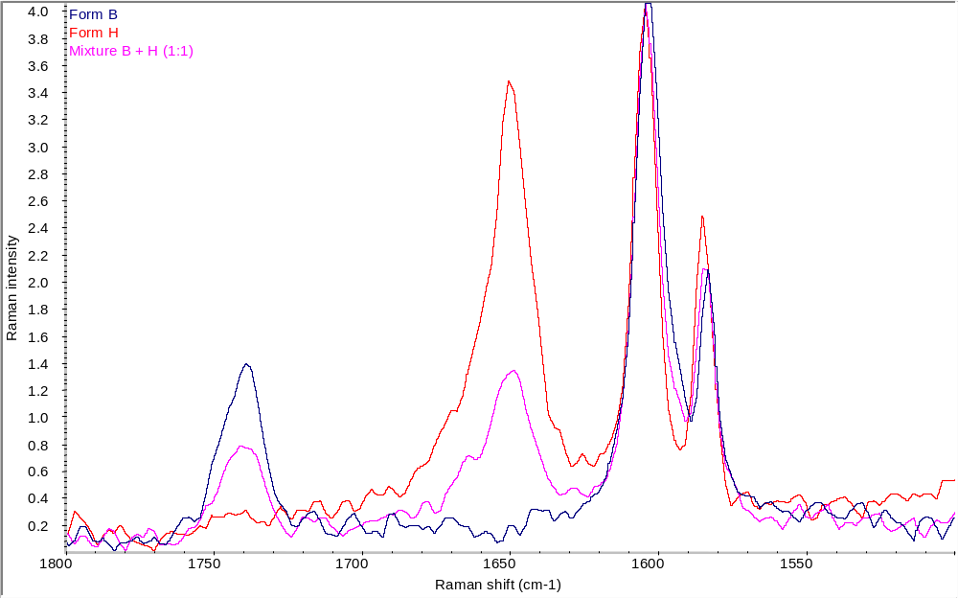
CASE STUDY 6: Polymorphs Analyzed by Vibrational Spectroscopy (Tool Factor)
Success: Quantification of Polymorph Mixture by FT-Raman

Slide 35
CASE STUDY 6: Polymorphs Analyzed by Vibrational Spectroscopy (Tool Factor)
Problem:
For roughly 30%* of cases, vibrational spectroscopy spectra do not facilitate differentiation between various polymorphic forms
  * - own experience and general consensus in discussion at the Crystal Engineering to Crystal Growth: Design and Function Session, 223rd ASC Meeting, Orlando, FL, April 2002

Slide 36
CASE STUDY 6: Polymorphs Analyzed by Vibrational Spectroscopy (Tool Factor)
Solution:
  A single technique is not sufficient - multiple analytical techniques for polymorph detection must be employed

Slide 37
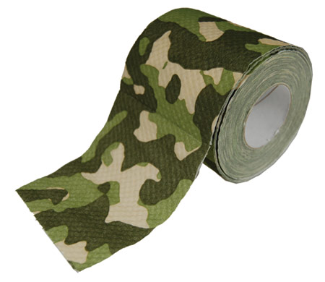
CASE STUDY 7: Isostructural Forms of Different Solvates (Camouflage Factor)
Situation:
Salt feasibility study was run on an API6 free base
XRPD spectra were used to characterize the salts isolated

Slide 38
CASE STUDY 7: Isostructural Forms of Different Solvates (Camouflage Factor)
Problem:
  XRPD patterns of API6 malonate salts after equilibration in different solvents are indistinguishable

Slide 39
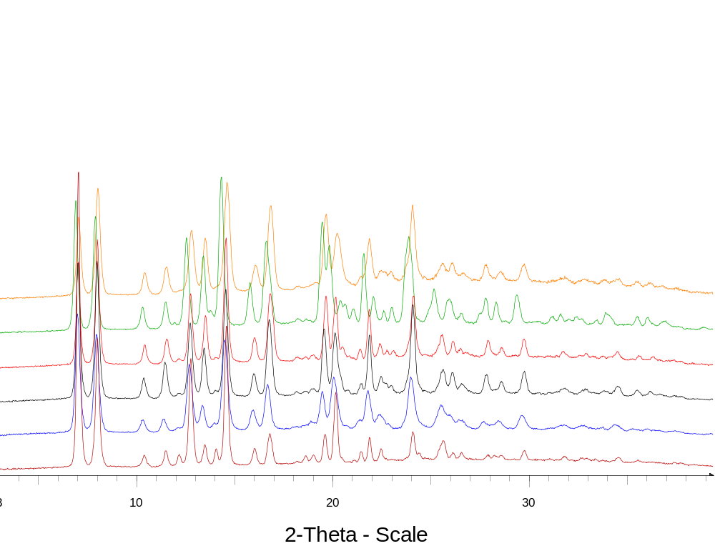
CASE STUDY 7: Isostructural Forms of Different Solvates (Camouflage Factor)
XRPD patterns for solvates of malonate salt
Tetrahydrofuran-
ethyl acetate
tetrahydrofuran
ethyl acetate
acetone
ethanol

Slide 40
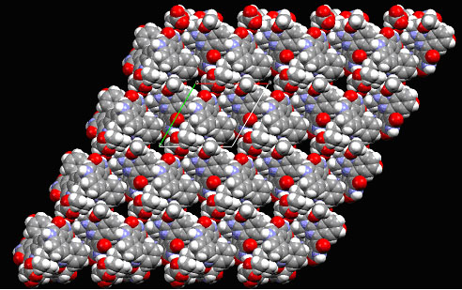
CASE STUDY 7: Isostructural Forms of Different Solvates (Camouflage Factor)
Space filled model of the three-dimensional structure, viewed down the c-axis

Slide 41
CASE STUDY 7: Isostructural Forms of Different Solvates (Camouflage Factor)
Lessons (re)Learned:
  Yes, it’s chemistry that dictates crystal structures
  A single technique is not sufficient - multiple analytical techniques for polymorph detection must be employed

Slide 42

CASE STUDY 8: Same Polymorph - Different Powder Properties (Hit & Miss Factor)
Situation:
Two batches of API7 differ in certain properties although all analyses, down to the level of detection, indicate single form

Slide 43
CASE STUDY 8: Same Polymorph - Different Powder Properties (Hit & Miss Factor)
Problem:
  One batch has a higher moisture content (0.07% vs. 1.2% at 95% RH) and different moisture sorption/desorption isotherms than the reference batch
  Excluded were
  Presence of amorphous component
  Crystal size difference
  Presence of other form (monomorphic compound)

Slide 44
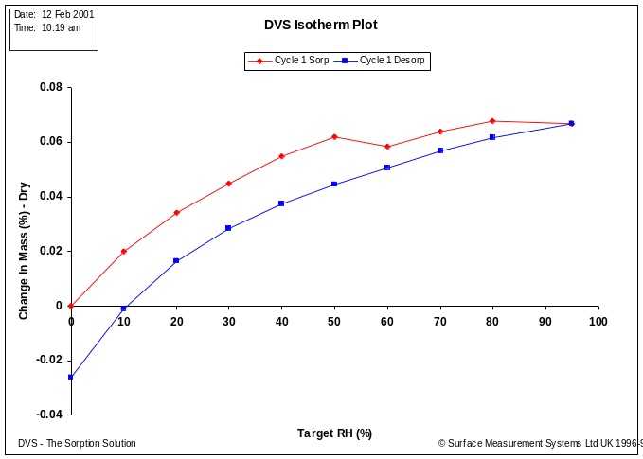
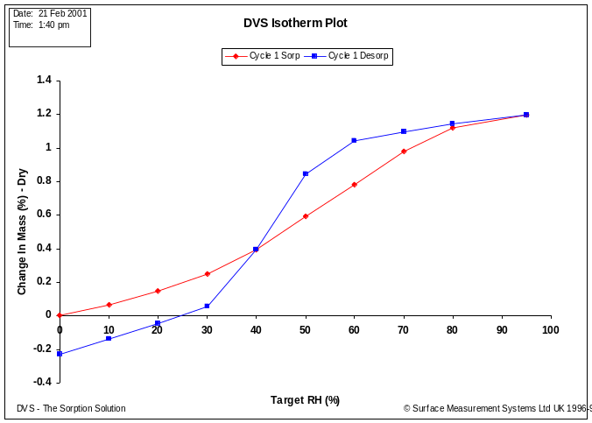
CASE STUDY 8: Same Polymorph - Different Powder Properties (Hit & Miss Factor)
Moisture Sorption-Desorption Isotherms
Batch 1
Batch 2

Slide 45
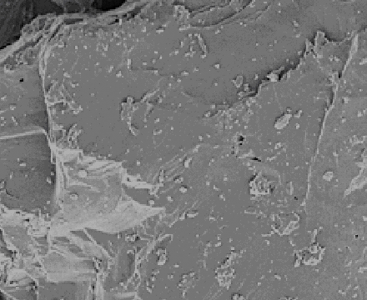
CASE STUDY 8: Same Polymorph - Different Powder Properties (Hit & Miss Factor)
Solution: Porosity of suspected batch

Slide 46
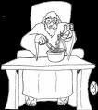
CASE STUDY 9: (Alchemy Factor) Solvent-Mediated Polymorphic Transformations
Situation:
API8 has multiple polymorphs which all seem to be relatively stable.
A choice of the most stable polymorph for development needs to be made.

Slide 47
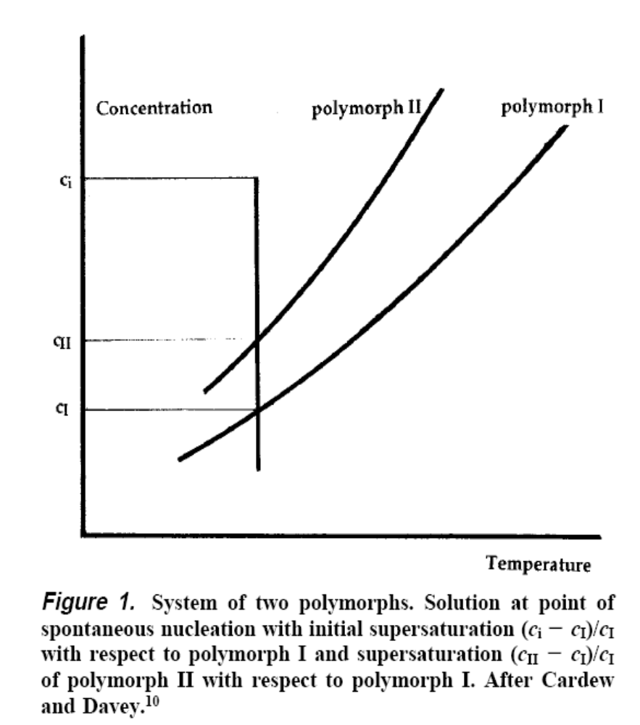
CASE STUDY 9: (Alchemy Factor) Solvent-Mediated Polymorphic Transformations
The ratio of the solubility of two polymorphs in any solvent is a constant at any given temperature, provided the solutions are ideal, as this solubility ratio is a thermodynamic invariant, being a measure only of the relative thermodynamic stability (Gibbs energy) of the polymorphs at that temperature. Therefore, the result of changing the solvent will only be to transform the concentration axis linearly. If the solutions are non-ideal, then the concentration axis will need to be re-scaled in a nonlinear fashion. The temperature axis and the diagram itself will remain precisely the same. The result remains the same for any solvent. The solvent plays no part in the polymorphic outcome other than in determining the numerical values on the ordinate.
Terry Threlfall, Organic Process Research & Development 2000, 4, 384-390

Slide 48
CASE STUDY 9: (Alchemy Factor) Solvent-Mediated Polymorphic Transformations
In competitive slurrying equilibration, mixture of polymorphs is placed in a solvent in which all forms have certain solubility. Eventually, in hours or days, the suspension is composed of a single most thermodynamically stable polymorph.
The result of competitive slurrying equilibration should not depend on a solvent choice, as long as each polymorph of the mixture has a non-zero solubility in a given solvent

Slide 49
CASE STUDY 9: (Alchemy Factor) Solvent-Mediated Polymorphic Transformations
Background:
The first pilot plant batch was produced and designated as Form A.
In about 3 weeks, the XRPD pattern of the material produced has changed to a new pattern (A ➔ B).
In a comprehensive polymorph screening, six new modifications were identified (C, D, E, F, G, and H).
Task:
Determine, which form, out of eight known, should be selected for further development.

Slide 50
CASE STUDY 9: (Alchemy Factor) Solvent-Mediated Polymorphic Transformations
Path Forward:
Produce multigram quantities of the new forms (C to H)
Fully characterize all forms
Determine relative stability of the forms
Select the most stable form, preferably based on competitive slurry equilibration study.

Slide 51
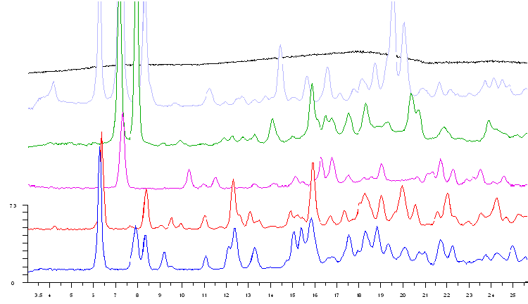
CASE STUDY 9: (Alchemy Factor) Solvent-Mediated Polymorphic Transformations
Amorphous
H
G
C
Lin (Counts)
B
A
2-theta-scale
API8: All forms are anhydrous and not solvates

Slide 52
CASE STUDY 9: (Alchemy Factor) Solvent-Mediated Polymorphic Transformations
Ethanol
Form C
Form H
Acetone
Acetone
Ethanol
Form B
MeCN
Ethanol
Acetone
MeCN
MeCN
Form G
Slurry at ambient temperature, solid filtered and dried in open air
Notes:
Solid sample at the end of transformation is filtered, air dried and checked by XRPD

Slide 53
CASE STUDY 9: (Alchemy Factor) Solvent-Mediated Polymorphic Transformations
B
Ethanol
H
1005.0
1004.9
Peak position (cm⁻¹)
1004.8
1004.7
1004.6
1004.5
1004.4
1004.3
1004.2
1004.1
1004.1
0
0
500
500
1000
1000
1500
1500
2000
2000
2500
2500
3000
3000
3500
3500
4000
4000
Time (mins.)
Time (mins.)
form B to A
form A
form A to H
form H
Notes:
Although failed to identify any solvate intermediate, Raman did reveal the transformation pathway in this case.
Due to the complication of the system, further investigation would be necessary to determine the mechanism of solvent directed transformation. Although intermediate solvates, which dissociate easily at ambient environment are also suspected to be the cause, more proper analytical techniques as well as experiemental design could help to better explain this observation

Slide 54
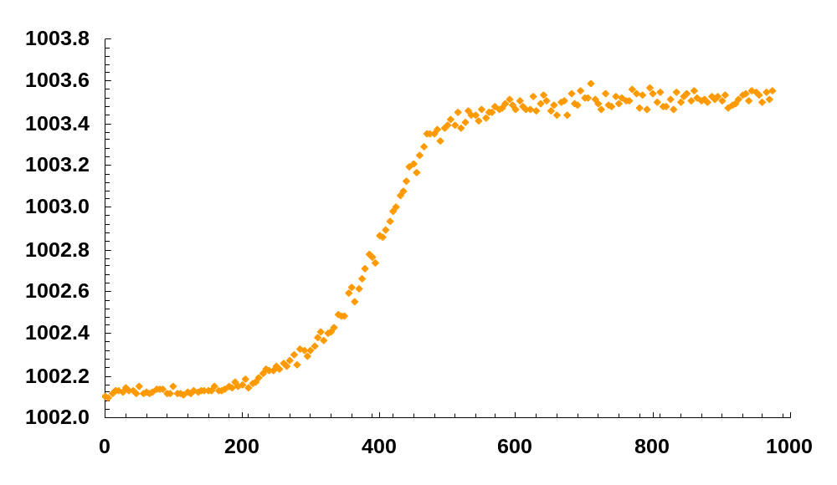
CASE STUDY 9: (Alchemy Factor) Solvent-Mediated Polymorphic Transformations
B
Acetonitrile
G
Form B
Form B + G
Form G
Peak position (cm⁻¹)
Time (mins.)

Slide 55
Conclusions (abbreviated)
Several complementary techniques must be used in polymorph characterization
Only thermodynamically most stable API form should be developed (if possible)
High-Throughput Screening may be considered to speed-up the polymorph discovery stage and make it more complete

Slide 56
Conclusions
In order to avoid late-stage development surprises, only thermodynamically most stable API forms should be developed. Frequently, such forms are discovered after a significant research and development effort, in the post-screening stage. In fact, they are often the last to be discovered (or suddenly appear, as in the (un)famous ritonavir or API2, API3 and API5 case).

Slide 57
Conclusions
Multiple complementary techniques must be used in polymorph detection and characterization which, however, is both capital-intensive and highly labor-intensive as well as time-consuming exercise

Slide 58
Conclusions
With increased demands on the speed and efficiency of drug discovery and development, one may wish to involve the automated and robotic systems for generation of polymorphs in different crystallization environment – followed by their automated characterization by XRPD, Raman spectroscopy, and other techniques

Slide 59
Acknowledgements
  OMICS
  Audience
  Lili Feng, Dimitris Papoutsakis, Beata Sweryda-Krawiec, and Jean Xu, Novartis Pharmaceuticals, USA
  – for experiments and API characterization

