Slide 1
KEYWORDS
MODULE

Slide 2
The purpose of this module is to compose SEO Keyword Content Pages by TL/PC in his/her respective cms portal and after the QC can review the content and he can publish the content.

Slide 3
Example Keyword Dental Medicine
Proposed Keyword URL https://www.lexisconferences.com/meetings-list/dental-medicine

Slide 4
Module Flow :
CTL needs to Provide Keywords to TLs
2. TL needs to add keywords and assign to their PCs
3. PC needs to compose information and send to QC
4. QC has to review and publish content

Slide 5
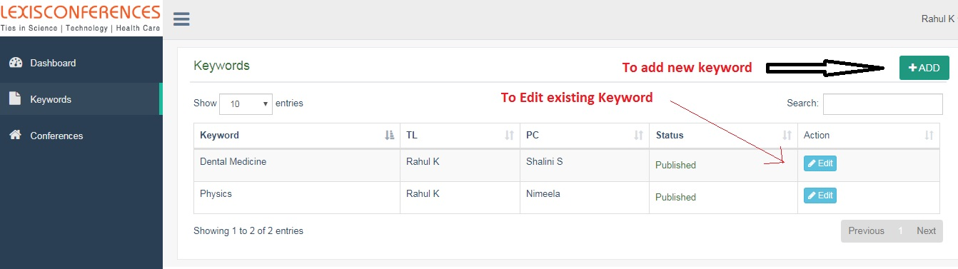
TL Portal
The TL can enter new keywords He/she can compose main content or he/she can simply assign to PCs.
After completion of everything, he has to forward to QC for review.
After forwarded to QC, the TL or PC cannot change the main content, but he/she can update remaining fields.

Slide 6
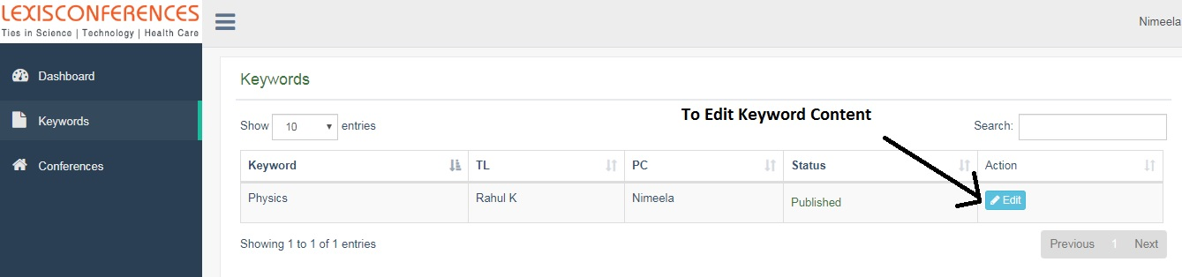
PC Portal
The PC can enter Edit the existing Keywords. And he/she can add related conferences, related journals, can add meta title, meta keywords, meta description. After completion of everything, he/she has to forward to QC for review and publish.
Once he/she forwarded to QC, the PC cannot update main content, but he/she can update remaining fields.

Slide 7
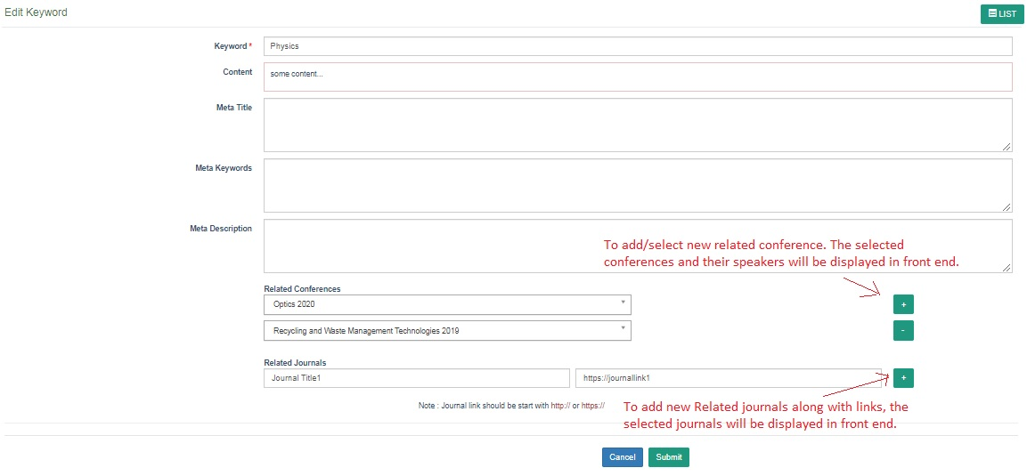
And at the time of composing the content, the TL/PC has to select related conferences like below :

Slide 8
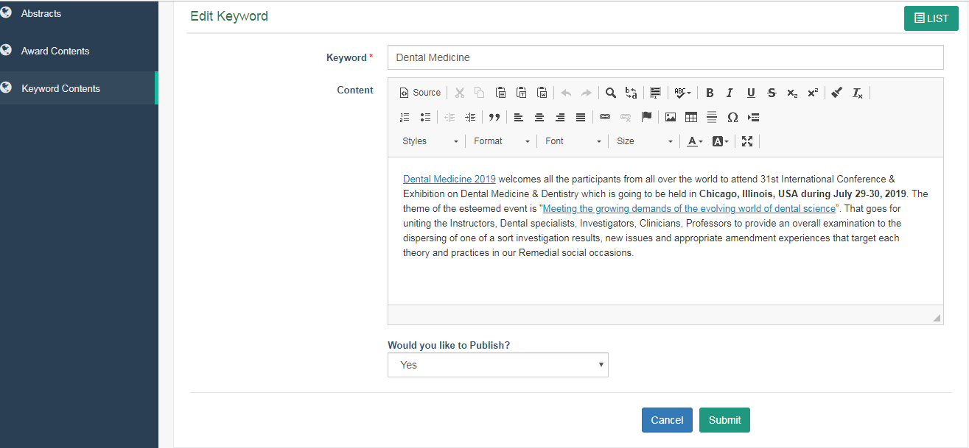
QC Portal
The QC can review the content and he can publish or unpublish the content at any time.

Slide 9
Thank You
Created By
Sureshkumar
Send Queries to
sureshkumar_g@omicsgroup.co.in

