Slide 1
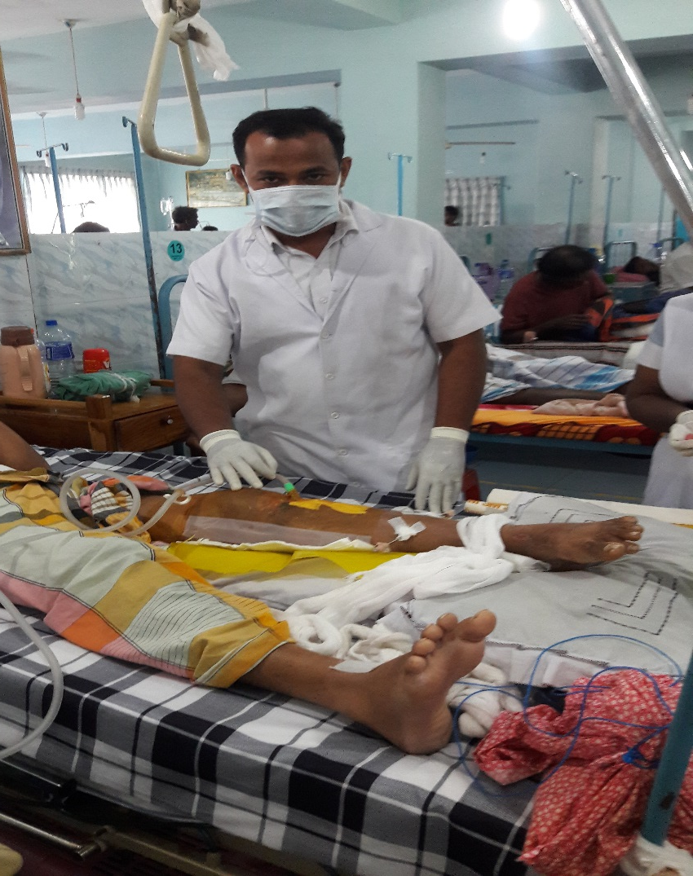
Manual VAC therapy system
M.M.ANVAR AZAM
WOC Nurse
University hospital
Sri lanka

Slide 2
Aim
To provide VAC therapy to the poor patients are not affordable to hire the commercial VAC therapy equipment.
To make easy access to obtain VAC therapy in all surgical units.

Slide 3
Introduction
Currently studies have shown that negative pressure vacuum therapy is effective method for the wound care to promote quick healing.
In Sri Lanka, most patients are not affordable for the commercial negative pressure vacuum therapy.
Its easy to assemble in the unit using the available resources.
Less cost effective
All patient will obtain this treatment without pain ful procedure.

Slide 4
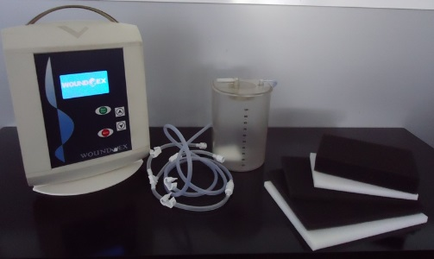
Commercial VAC therapy set

Slide 5
Clinical history
Patient name is Nazik Ahamed, following road traffic accident, he was admitted in Orthopedic unit.
Compound Tibia and fibula plateau fracture.
Open reduction internal fixation was done with the san flap attachment.
Flap Wound was infected as evidence by purulent discharge through the suture line, after five days during the post operative phase.
Suture was removed and opened the wound.

Slide 6
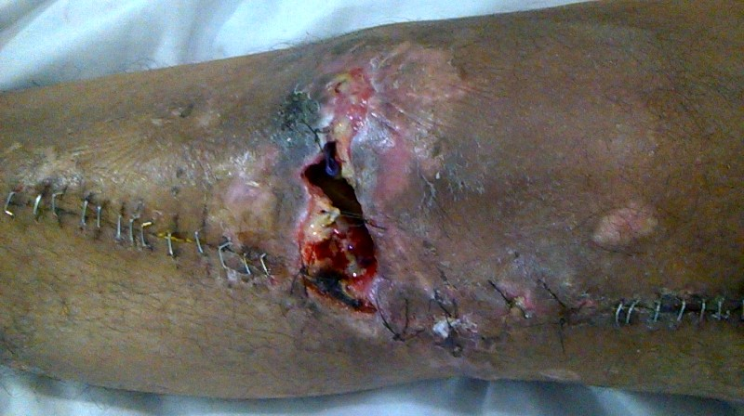
Assessment
Below knee edematous with tension suture.
Bone fragment is exposed.
Purulent discharge with severe pain
Peripheral skin is unhealthy and discolouration

Slide 7
Available Resources in the unit
Sucker machine
IC tube drainage
Needed from out of hospital
Sponge
3M ioban incise drapes
Atraumann Silvar mesh

Slide 8
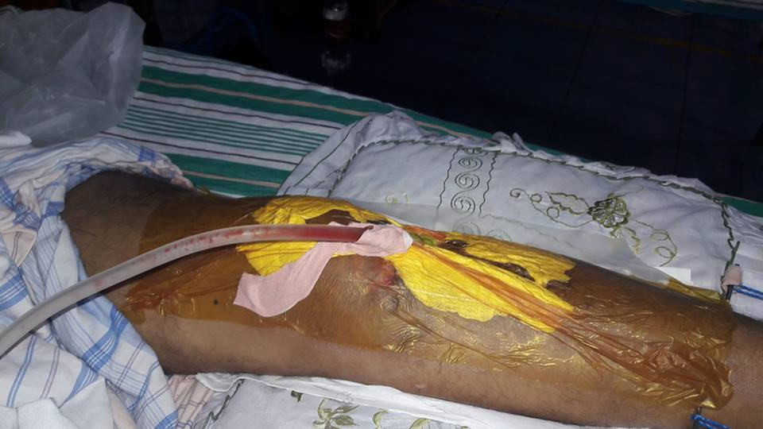
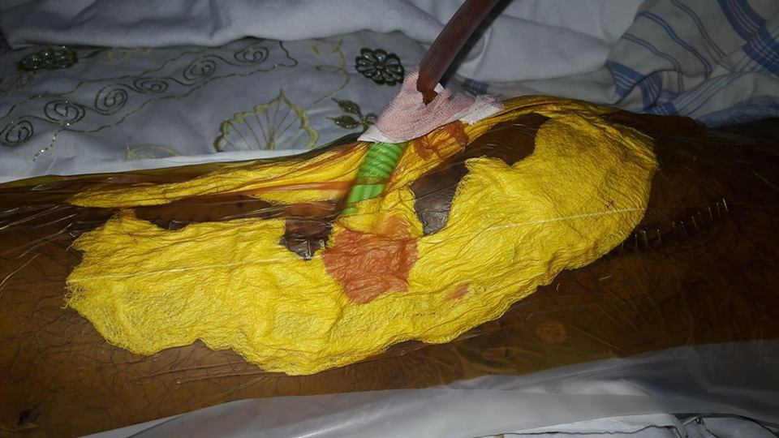
Clinical ground …………………..

Slide 9
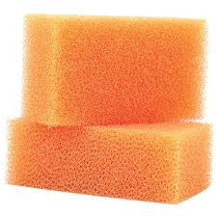
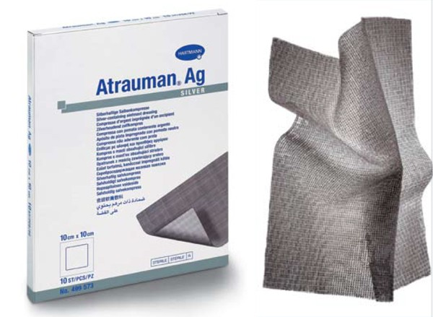
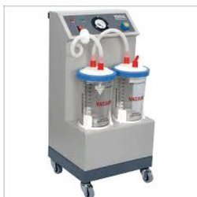
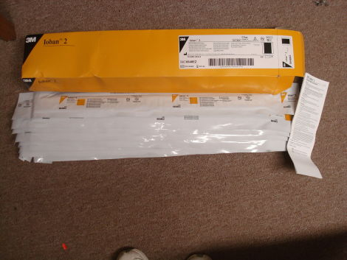
RESOURCES

Slide 10
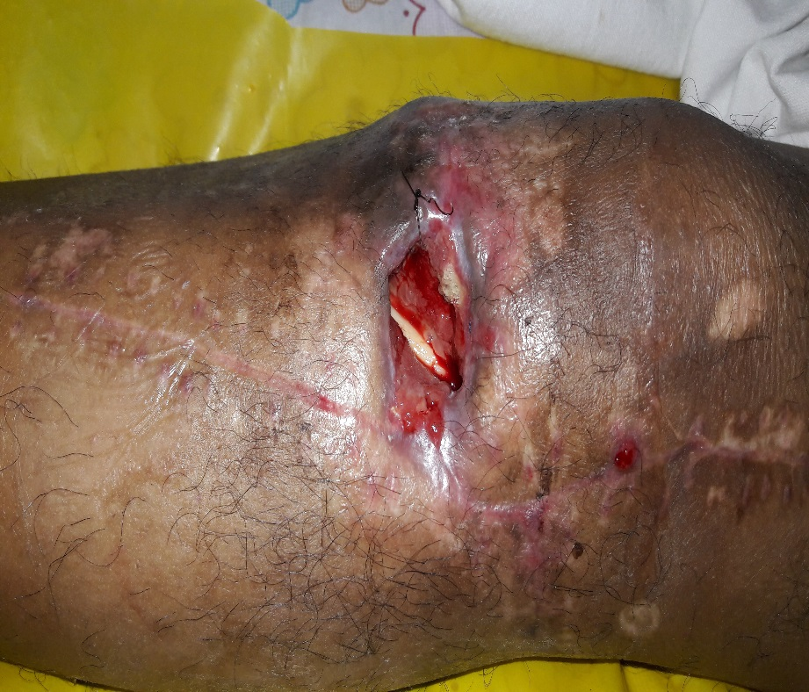
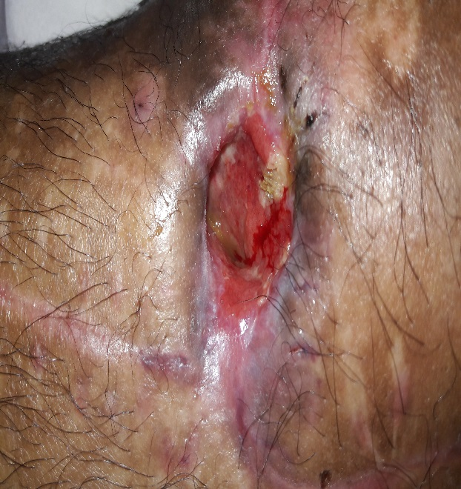
1st week VAC response
MANUAL VAC
2st week VAC response

Slide 11
Method
Wound is cleaned with normal saline and slightly debrided the slough.
Atraumann silver mesh was kept on the wound base.
Sterile sponge was cut according to the size of wound cavity.
Later, cavity was filled with sponge with silver mesh (Atraumaan mesh).
Intercostal drain tube was used to connect with sucker bottle. Guaze was secured with surrounding the wound to absorb the oozing.
Following that, the tube was sealed tightly with ioban adhisive plaster.
Sucker pressure was maintained 20mmgh as a standard negative pressure. Before this process, Both sucker bottle, sponge were autoclaved to maintain the sterility.

Slide 12
Results
Total edematous and purulent oozing were cleared fast.
edematous leg revered to back.
wound appeared fully granulated wound base and it is indicated to do flap surgery.
Patient felt pain free and satisfied with this method.
Microbiological investigation show no growth of organism

Slide 13
Comparative benefit between Manual and commercial VAC
Manual VAC | Commercial VAC
Its less cost effective | Expensive
Easy to assemble the system during the dressing | Its very careful during the dressing
Air leakage can be managed easy with tight seal of small piece of ioban compared with commercial VAC. | very difficult to seal air leakage in commercial equipment. Some time, need to apply again.
Easy handling to the nurses and patients. They adjust the pressure easily in the sucker machine. | Commecial VAC is having digital monitor for the pressure adjustment. Illiterate patients have not much idea to operate the system.
No fear to handle with this system. Because, every resource can be identified by the patients. | Patient is afraid of with Commercial VAC equipment, because mishandling will make system error.

Slide 14
Comparative benefit between Manual and commercial VAC
Manual VAC | Commercial VAC
Whatever size of wound, cost will not be changed. Because of this, There is a chance for wasting of VAC accessories products. Manual VAC is not . | Whatever size of wound ,payment will not be changed.

Slide 15
Conclusion
Basic principal of VAC therapy was applied in this practice.
Its good solution for the clients who are not affordable to hire the commercial VAC therapy.
This method is mostly possible to introduce in the developing countries

